Slide 1
A Systems Engineering outlook
First 3 project life cycle phases:
Pre-phase A: concept studies.
Requires approval for formulation to move to Phase A
2. Phase A: concept and technology development: Mission Definition Review; System Definition Review; System Requirements Review.
Requires approval for implementation to move to Phase B
3. Phase B: Preliminary Design and Technology Completion: Preliminary Design Review

Slide 2
OBC architecture
Processing architecture
Could be centralized to reduce BOM count, complexity and power consumption compared to a distributed architecture.
Software Architecture
A kernel such as FreeRTOS would be suitable as it is thoroughly tested and has been used in space applications.
Software Communication Framework
CubeSat Space Protocol be used for communication between subsystems

Slide 3
Some processor requirements
1. High fault-tolerance
This could be achieved by: ECC, CRC modules, Lock-step architecture.
2. Radiation/ionization tolerance
This could be achieved by selecting a radiation hardened chip or having external shielding to minimize SEU, SEL and ionization effects.
3. Floating point precision
Is necessary since some satellite processes require a lot of floating-point calculations. This requires an FPU(single/double precision) and/or DSP slices.
4. Low current consumption
This makes MCUs with low power modes a good option.

Slide 4
I/O
Protocol | Data link | Signalling rate | Possible application
SpaceWire | LVDS | Up to 400Mbps | Camera payload
CAN | CAN | Up to 1Mbps | Communication
USB | USB | Up to 480Mbps | External storage/ debugging
RS-232 | UART/USART | Up to 1Mbps | EPS
RS-485 | UART/USART | Up to 35Mbps | EPS/ADCS
I2C | 12C | Up to 3.4Mbps | Sensors/ADCS
SPI | SPI | Up to 60Mbps | Camera payload
Table 1: Comparison of possible I/O and their applications

Slide 5
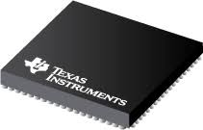
A proposed MCU – TMS570 microcontroller
Features:
Two ARM Cortex- R cores in lock-step for redundancy
4MB flash, 512KB SRAM, 128KB emulated EEPROM, 16-bit EMIF
Max. clock frequency of 300MHz
2 CRC modules
4X UART, 5X SPI, 4X CAN, 2X I2C
FPU with single- and double-point precision
MPU
145 GPIO
Max current consumption 990mA
Unit cost: $26 to $76, depends on package
Flight heritage on NASA Mars helicopter launched in 2020
In stock at Digi-Key, Mouser and TI online store
Fig 1: TMS570 from Texas Instruments

Slide 6
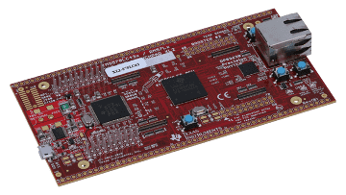
TMS570 Development
Hardware
Development kits for prototyping are available starting from $59.99
Reference designs are provided by TI
Software
CCSTUDIO, and IDE by TI supports the TMS570. It allows for code editing, debugging, code generation and run-time resource estimation.
HAL libraries are available.
FreeRTOS is supported.
Programmer’s manuals, application notes are in plenty.
An existing developer community has been identified with an E2E (engineer to engineer) discussion forum at E2E.TI and Electronics Stack Exchange
Fig 2: TMS570 development kit

Slide 7
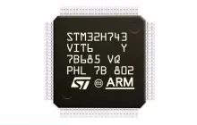
A proposed MCU – STM32H743 microcontroller
Features:
ARM Cortex-M7
2MB flash, 1MB SRAM, 32-bit EMIF
Max. clock frequency of 480MHz
CRC calculation unit
4X UART, 6X SPI, 2X CAN, 4X I2C, 2X USB, HDMI
DP-FPU, and DSP
Memory Protection Unit
168 GPIO
Max current consumption 840mA
Unit cost: $55.9
Flight heritage on 6U M6P CubeSat launched in 2019
In stock at LCSC
Fig 3: STM32H743 from STMicroelectronics

Slide 8
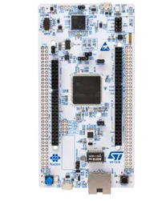
STM32H743 Development
Hardware Development
Development kits for prototyping are available starting from $28.42
Reference designs are provided by ST
Software Development
STM32 CubeIDE by ST supports the STM32H743. It allows for code editing, debugging, code generation and run-time resource estimation.
HAL libraries are available.
FreeRTOS is supported.
Programmer’s manuals, application notes are in plenty.
An existing developer community has been identified with a discussion forum at Community.St and Electronics Stack Exchange.
Fig 4: STM32H755 development kit

