Slide 1
FIREWALL RULE OPTIMIZER
Enhancing Network Security through Intelligent Rule Management
Student: James Gichia (P01/0010/2022) Supervisor: Dr. Elijah Maseno

Slide 2
Introduction
► Firewalls are the critical first line of defense for modern networks.
► Over time, manual management of iptables and nftables configurations leads to bloated, inefficient rulesets.
► Rule redundancy and shadowing degrade system performance and obscure actual security postures.
► This project presents FireOpt: an intelligent web-based system that parses, analyzes, and automatically optimizes Linux firewall rulesets.

Slide 3
Problem Statement
► Network administrators managing Linux firewalls (iptables/nftables) face massive cognitive load when tracking thousands of rules.
► Rule Shadowing: An earlier, broader rule dictates the action for traffic, rendering subsequent specific rules completely unreachable.
► Rule Redundancy: Duplicate rules consume kernel memory and processing cycles with zero added security benefit.
► Conflict Detection: Conflicting statements (e.g., an ACCEPT followed by a DROP for the same subnet) create dangerous security loopholes or false alarms.

Slide 4
Literature Review
► Pioneering Work: Al-Shaer and Hamed (2004) categorized firewall policy anomalies into shadowing, correlation, redundancy, and generalization.
► Commercial Tools: Enterprise suites like FireMon and AlgoSec offer robust analysis but are prohibitively expensive and largely proprietary.
► Open Source Shortcomings: Existing FOSS tools like Firewall Builder are outdated and lack native, deep support for the modern nftables specification.
► The Gap: There is a critical need for a lightweight, modern, open-source rule optimization engine tailored specifically for Linux kernel netfilter deployments.

Slide 5
Methodology
► Iterative SDLC: Development was conducted using an iterative approach allowing rapid prototyping and continuous testing.
► Dialect Normalization: Both iptables-save and nftables syntaxes are parsed into a single, generic FirewallRule object model for uniform processing.
► Anomaly Detection Algorithm: A purely computational engine evaluates subnet overlaps using CIDR arithmetic to detect full inclusion (shadowing) and exact matches (redundancy).
► Optimizer Subsystem: A deterministic filter that safely removes anomaly-flagged rules while strictly preserving the necessary kernel evaluation order.

Slide 6
System Requirements
► Functional:
► - Auto-detection of iptables vs nftables configuration inputs.
► - Real-time JSON API for evaluating rule sets via Python regex lexers.
► - Mathematical guarantee of rule semantic preservation post-optimization.
► Non-Functional:
► - System must execute analysis in < 2.0 seconds for rulesets of 10,000+ lines.
► - Persistent SQLite session tracking without storing sensitive network topologies.
► - React-based SPA interface meeting modern UX guidelines.

Slide 7
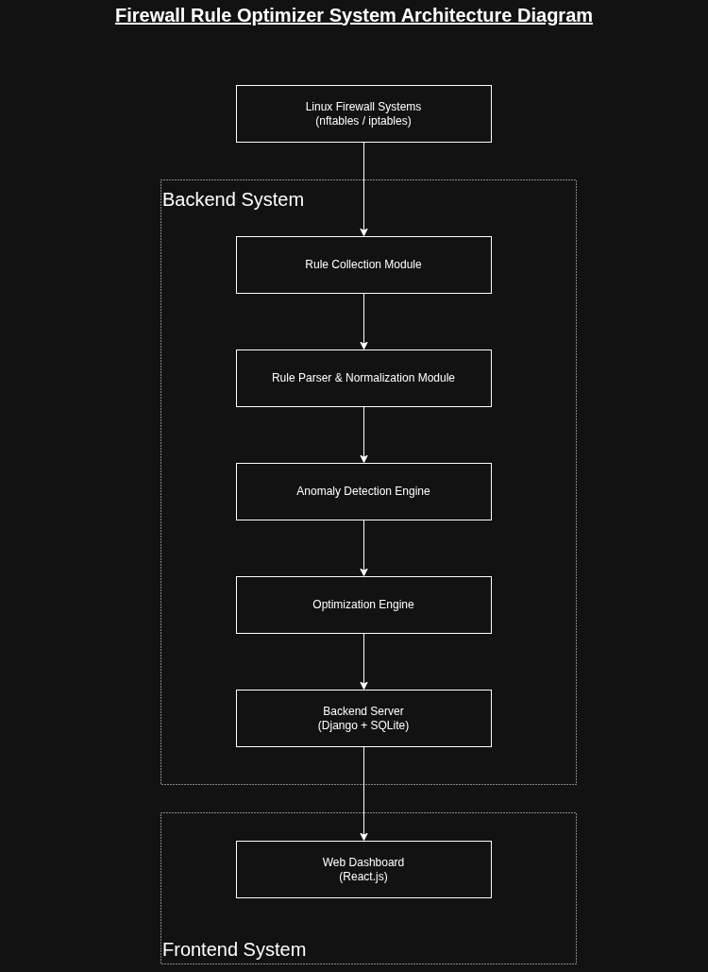
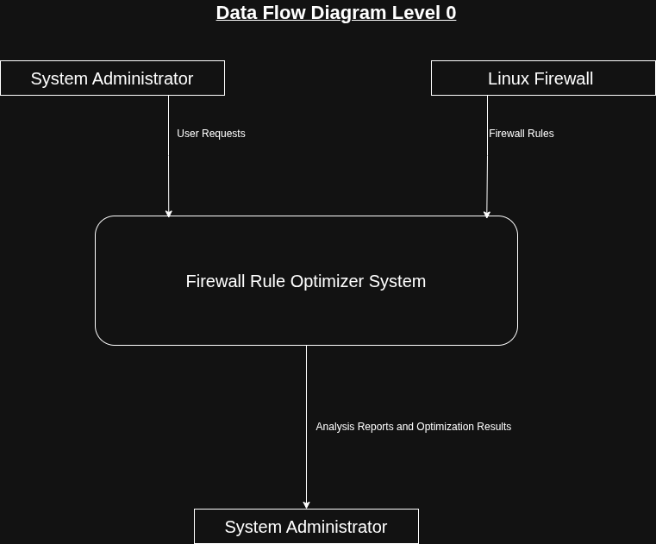
System Architecture & Data Flow

Slide 8
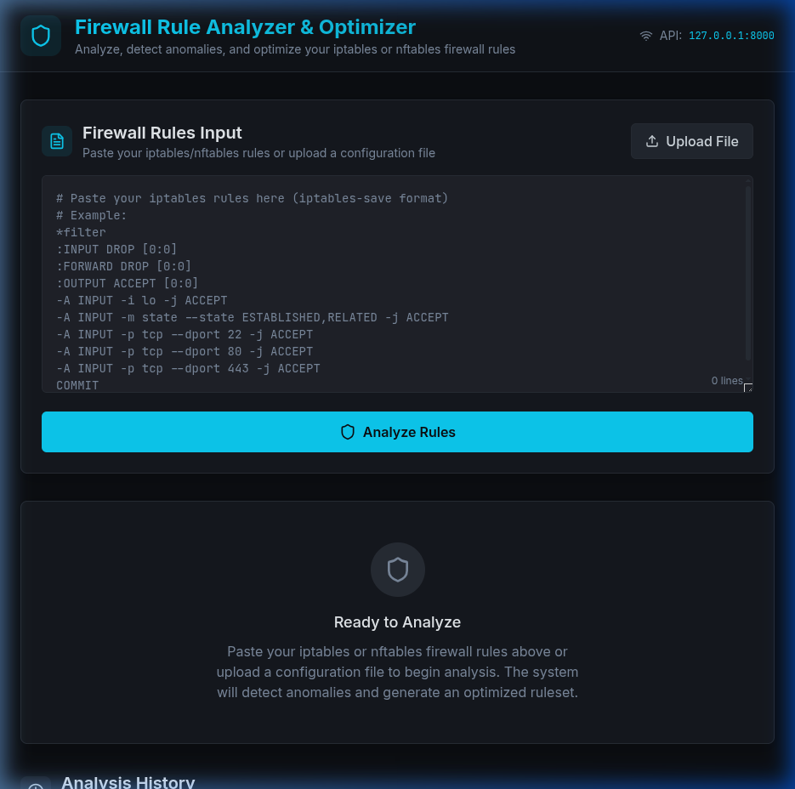
Implementation & Interface

Slide 9
Limitations & Conclusions
► Limitations:
► - Current lexical parser struggles with heavily obfuscated xtables addons.
► - Optimization focuses on deterministic rule removal rather than aggressive rule consolidation (which requires complex IP range merging).
► Conclusions:
► - FireOpt successfully translates complex firewall topologies into clear metrics.
► - By programmatically enforcing rule minimization, the system mathematically guarantees equivalent security with reduced processing overhead.
► - Eliminates human error during routine network hardening procedures.

Slide 10
References
► Al-Shaer, E. S., & Hamed, H. H. (2004). Discovery of policy anomalies in distributed firewalls.
► IEEE INFOCOM 2004. IEEE.
►
► Cheswick, W. R., Bellovin, S. M., & Rubin, A. D. (2003). Firewalls and Internet Security: Repelling the Wily Hacker. Addison-Wesley.
►
► Django Software Foundation. Django Documentation. https://docs.djangoproject.com
►
► Facebook Open Source. React Documentation. https://react.dev

