Slide 1
Opening organic based grocery stores in New York
A Borough-based examination of potential locations

Slide 2
Business Problem
To answer the question which areas show the best market potentials for opening organic grocery stores in New York the following variables are consider within a Cluster-Analysis:
Population Data of the five Boroughs of New York
Land area sizes of the five Boroughs of New York
Average per Capita income of the five Boroughs of New York
Number of existing organic based grocery stores in the five Boroughs of New York

Slide 3
Data
Dataset
Population
http://app.coredata.nyc
Borough area size
https://en.wikipedia.org/wiki/Boroughs_of_New_York_City
Household income
https://www.census.gov
Existing stores in NY
Foursqaure

Slide 4
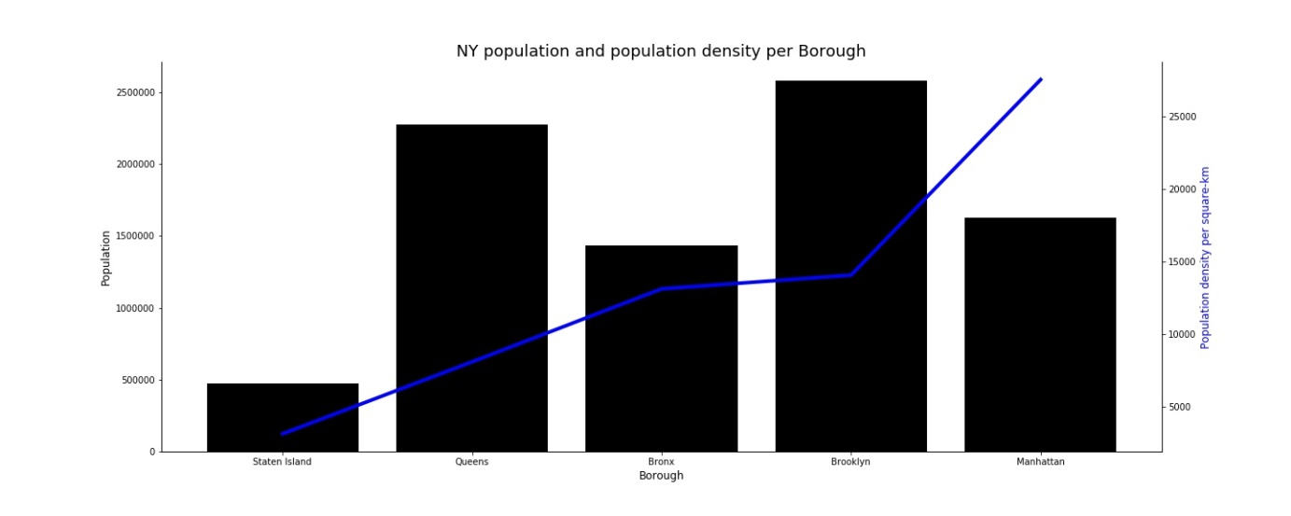
Methodology:
Population
Data from all the data-sources were collected and merged into one file to run the following analyzes.
•Staten Island has the lowest total population and the lowest population density.
•Manhattan has the highest population density with an average total population.
•Bronx, Brooklyn and Queens have average population densities but high total population, especially Brooklyn and Queens.

Slide 5
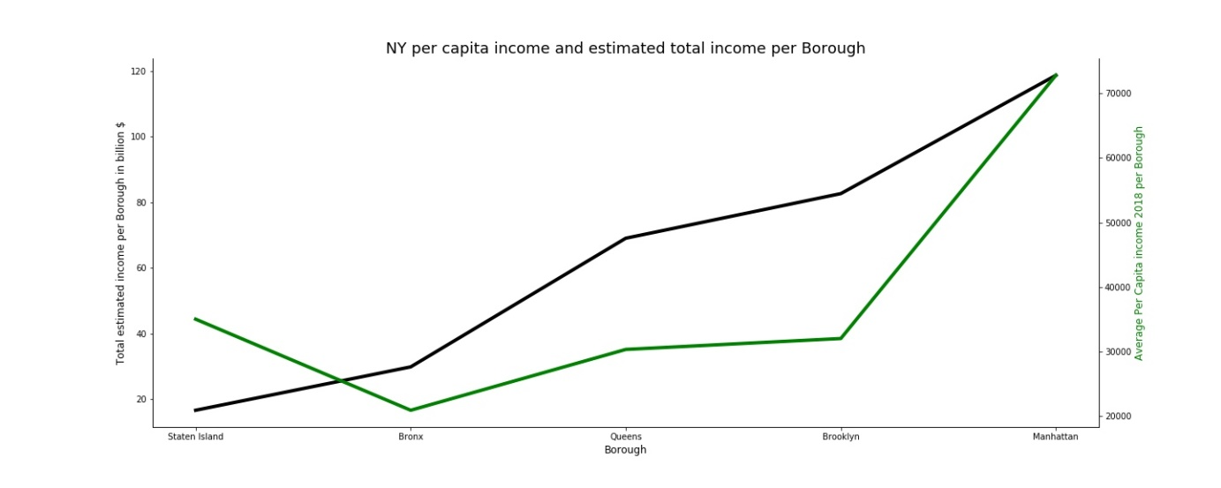
Methodology:
Income
The above Chart shows that in most Boroughs in New York, the per capita income and the estimated total income in each Borough are correlated, except Staten Island. This means that in Staten Island the total income is relatively low and is shared by only a relatively small number or people. Staten Island has also the second highest per capita income in New York. In Manhattan people have the highest per capita incomes and its the Borough with the highest total purchase power in New York.

Slide 6
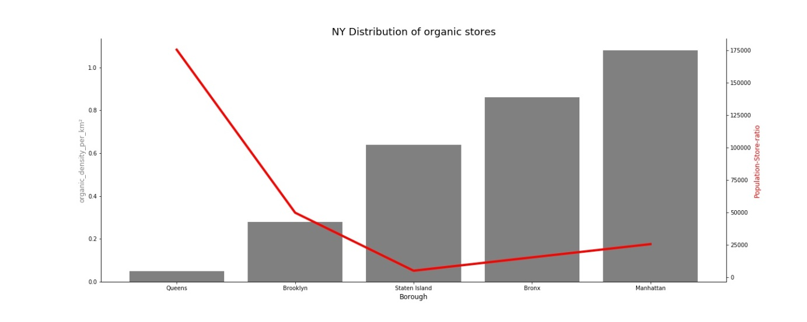
Methodology: existing organic stores
In this Chart we see that the Boroughs differ in their distribution of organic stores. While in Queens there are just a few stores, in Manhattan there is a plethora of organic stores. On the other hand, in Queens there comes one organic store on about 175,000 people while in Manhattan one store comes for about 25,000 people.

Slide 7
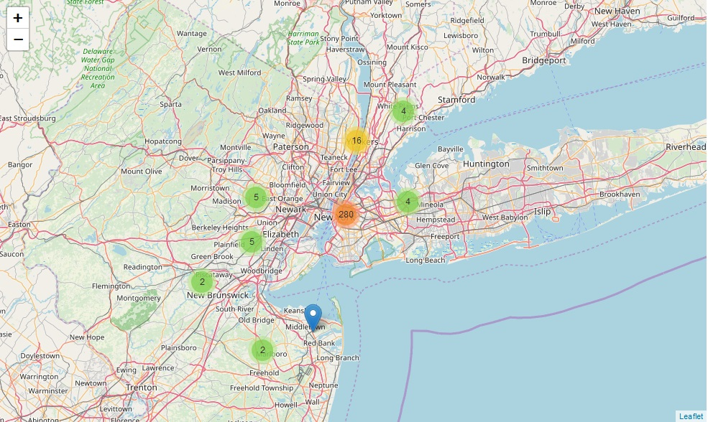
Methodology: existing organic stores
→ High density of existing organic stores in the center of New York (Manhattan and Brooklyn)

Slide 8
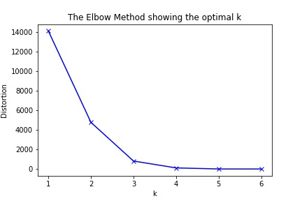
Methodology:
Clustering
Clustering by:
Average per Capita income
density of stores per km²
No of stores around 500 meters
Elbow Point shows up that k = 3 best fitting the Data

Slide 9
Methodology:
Clustering
Clusters:
Cluster 0: middle income; low density of existing stores; low number of stores around 500 meters
Cluster 1: high income; high density of existing stores; high number of stores around 500 meters
Cluster 2: low income; relatively high density of existing stores; relatively high number of stores around 500 meters

Slide 10
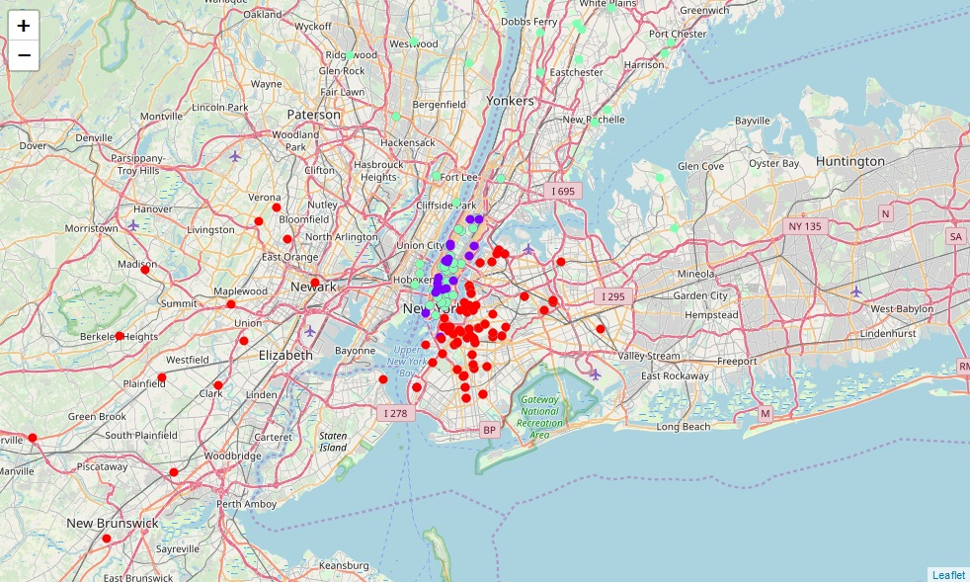
Results
Two valuable Cluster:
- Cluster 0 has the lowest density an number of stores around as well as a solid income-structure (red dots)
- Cluster 1 has already an existing market for organic stores but shows a very high-income structure

Slide 11
Discussion
organic products are especially bought by people with relatively high incomes
Another factor is clearly the already existing market (saturated markets vs. potential markets)
These factors were included in the above analysis and showed, that 3 clusters show up in New York.
All of those Cluster do differ but two of them can be seen as potential Clusters:
  Cluster 0 has a low density of existing stores and a solid income structure
  Cluster 1 has very high-income structure
  Contrary, Cluster 2 has low income structures as well as relatively saturated markets and should not be preferred to open new stores

Slide 12
Conclusion
above analysis is based on just a simple set of factors beeing considered
Factors like rentals, leases or even purchase prices for new stores are not considered
Also one could even go deeper into each Neighborhood or even streets
This analysis was meant to search for top-level suggestions and future analyzes should consider these recommendations
Nevertheless, this report gives a first impression of the structures of organic stores in the NY Boroughs in order to recommend deeper studies within this Borough or seek for possible Retail outlets

