Slide 1

Project Name.
iPark

Slide 2
Problem Statement.
An IBM study in 2011 showed that 30 percent of traffic holdup could be linked to people hunting for parking especially in the major cities.
A study conducted by the author The High Cost of Free Parking in the Los Angeles area of Westwood California, calculated that each day, there were 3,600 vehicle miles each day -- or 36 trips around the Earth each year -- just in people parking hunting in a single a 15-block neighborhood.
Reference:
Johnson, E. (2014, December 18). 6 Parking Apps That Save You Time and Money.
Retrieved from https://www.forbes.com/sites/emmajohnson/2014/12/18/5-parking-apps-that-help-you-save-time-and-money/#4446f96335ba

Slide 3
Project Description.
This project will be an IoT-enabled parking system that can be
attached to barrier arm gate in most parking lots.
This information will be published on Google maps so that as users
drive around the city, they can accurately determine where to park.

Slide 4
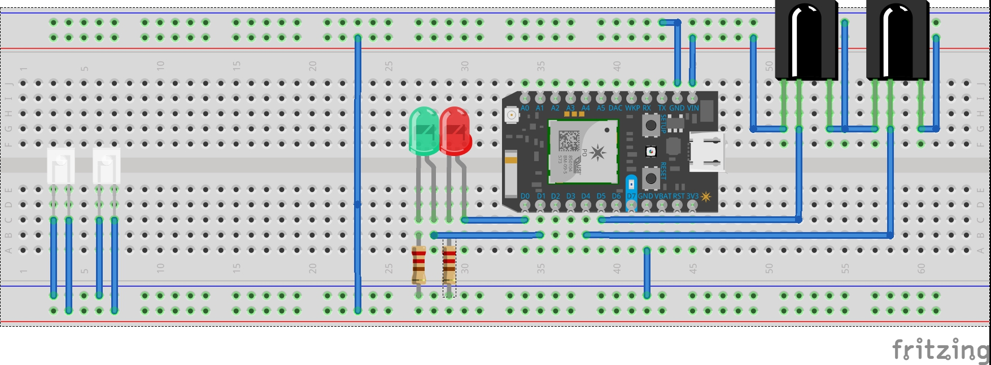
Architecture & Circuit Diagram
iPark IoT
WiFi or GSM
IoT Platform
Maps
Bill Board Gauge

Slide 5
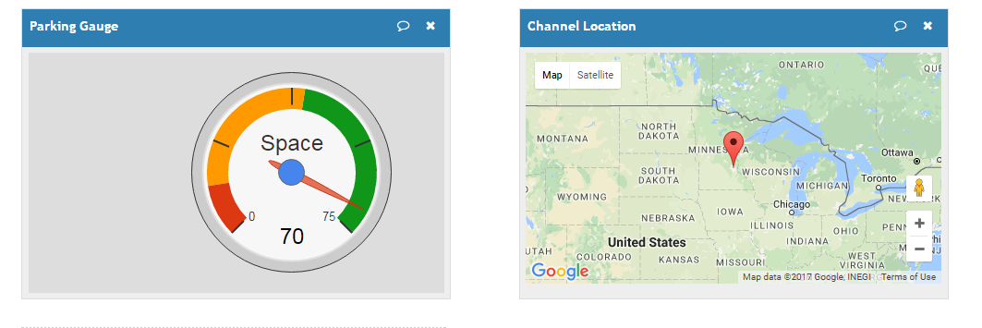
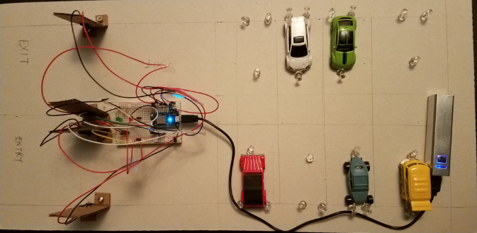
DEMO.
https://thingspeak.com/channels/267398/private_show

Slide 6
FUTURE ENCHANCEMENT.
Integration with Google Maps by overlaying with Parking Gauge.
Driving cost IoT device down to make it easy to adopt.
Easy Deployment such that it make use of existing infrastructures e.g. automatic gate arms.
Make use of inductive sensors.

