Slide 1
Garden Crop Monitoring, Classification & Weed Detection Using CV & ML
Presented by :
GIDEON MPUNGU 2300704617 2023/HD05/04617U
YouTube Video Link: https://youtu.be/IVQ76VWOdhI

Slide 2
Overview
Introduction
Methodology
Results and Discussion
Conclusion
References

Slide 3
Introduction
Ever growing world population set to hit almost 10 billion by 2050.
Crop fields face a challenge of weed control that cause {sun, nutrients, water} competition and thus low yields.
Calls for measures to ensure efficient and continuous food production for sustenance.
Use CV and ML to monitor gardens and detect weeds.
Current models show promise but mostly focus on one feature at a time.
Focus of research: To build accurate traditional ML models to properly classify crops(cassava, maize, sugarcane) and grass(weeds) in a garden based on a combination of features for optimal performance.

Slide 4
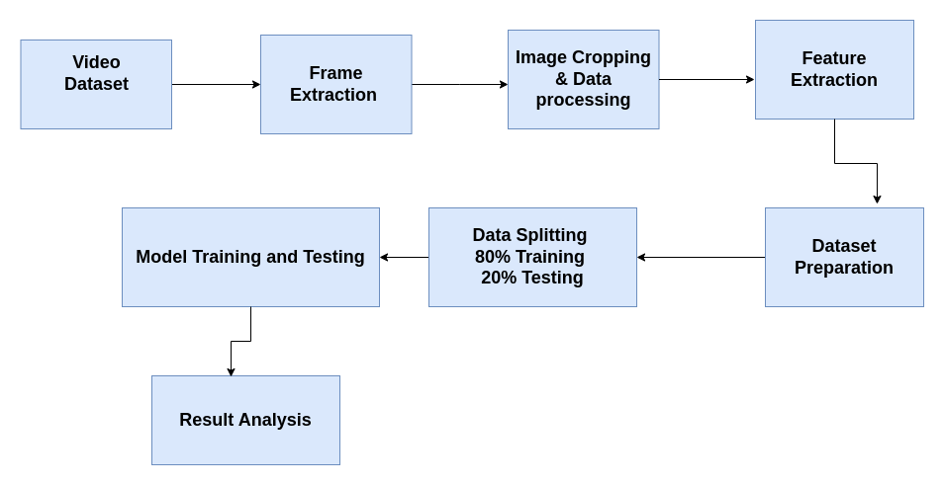
Methodology

Slide 5
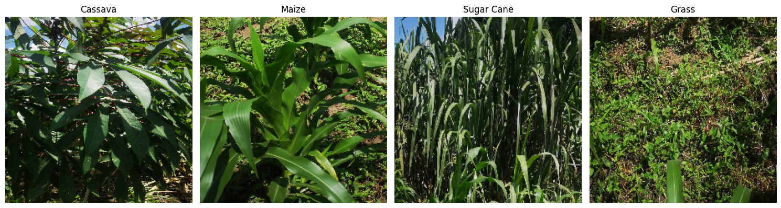
Dataset Description & Extraction
Obtained frames by passing the garden video through a cv2 package “cv2.VideoCapture” and specifying the framerate(0.5), i.e. 2 frames per second.
Saved frames were further manually cropped using snipping tool to obtain datasets of the chosen crops, i.e. cassava, maize, grass, sugarcane.
The resultant 1034 frames were saved in crop specific folders to form a dataset for our feature(s) extraction.

Slide 6
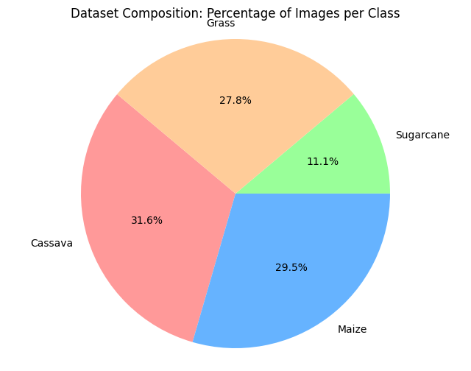
EDA & Data Processing
Image resizing: This was accomplished by resizing the frames to 500x500.
Dataset Distribution was fair among the crops apart from sugarcane.

Slide 7

Feature Extraction and Combination
Extracted 3 kinds of features;
Color Histogram
Edge Detection
Key points of Interest using ORB
Wrote functions for each of the above.
Combined all the features to create a training dataset.
Dataset split: 80% Training , 20% Testing.
Notes:
Color Histogram Feature Extraction Technique
We used the OpenCV library, a robust tool for computer vision tasks, to calculate the color histogram of our images. First, we read the image into an array of pixel values using OpenCV’s imread() function. To focus on color information, we separated the image into its Red, Green, and Blue color channels using the split() function. For each color channel, we computed a histogram using the calcHist() function, which provides a graphical representation of the tonal distribution in the image, capturing the frequency of each color intensity level.
To address potential sensitivity to illumination changes, which could affect the performance of our machine learning model, we normalized the histograms. This normalization process resulted in a set of features for each color channel, representing the distribution of pixel intensities. These features, encapsulating crucial color information, were then ready for input into our machine learning model for tasks such as image classification or object recognition.
Figure 2: Color histogram for cassava
Edge Detection Feature Extraction Technique
We performed edge detection using the OpenCV library. The process began by reading the image into an array of pixel values using OpenCV’s imread() function. We then applied the Canny edge detection method, a multi-stage algorithm effective at identifying a wide range of edges in images, using the Canny() function in OpenCV.
The Canny edge detection algorithm first applies a Gaussian blur to the image to reduce noise and detail. It then finds the image gradient to highlight regions with rapid intensity changes, which typically correspond to edges. Non-maximum suppression is applied to isolate the best edge pixels before using a double threshold to determine potential edges. Finally, edge tracking by hysteresis suppresses weak edges that are not connected to strong edges. The output of the Canny edge detection is a binary image where white pixels represent edges, and black pixels represent non-edges. This edge-detected image serves as a set of features capturing the structural information in the image, useful for further tasks such as image classification or object recognition.
Figure 3: Feature extraction with edge detection
Key Points of Interest Using ORB Feature Extraction Technique
In addition to color histograms and edge detection, we extracted key points of interest from images using the ORB (Oriented FAST and Rotated BRIEF) method. ORB is a fast and efficient alternative to SIFT and SURF, providing robust feature extraction while being computationally efficient.
We implemented ORB using OpenCV. The process began by converting the image to grayscale using the cvtColor() function. We then initialized the ORB detector using ORB_create() and detected key points and descriptors with the detectAndCompute() function. The detected key points and their descriptors were visualized by drawing the key points on the original image using drawKeypoints(). This method provided a set of robust features representing key points of interest in the image, useful for tasks such as object recognition and image matching.
By integrating these feature extraction techniques, we ensured a comprehensive and effective approach to capturing the essential characteristics of our images, facilitating the development of accurate and reliable machine learning models for crop and weed classification.

Slide 8
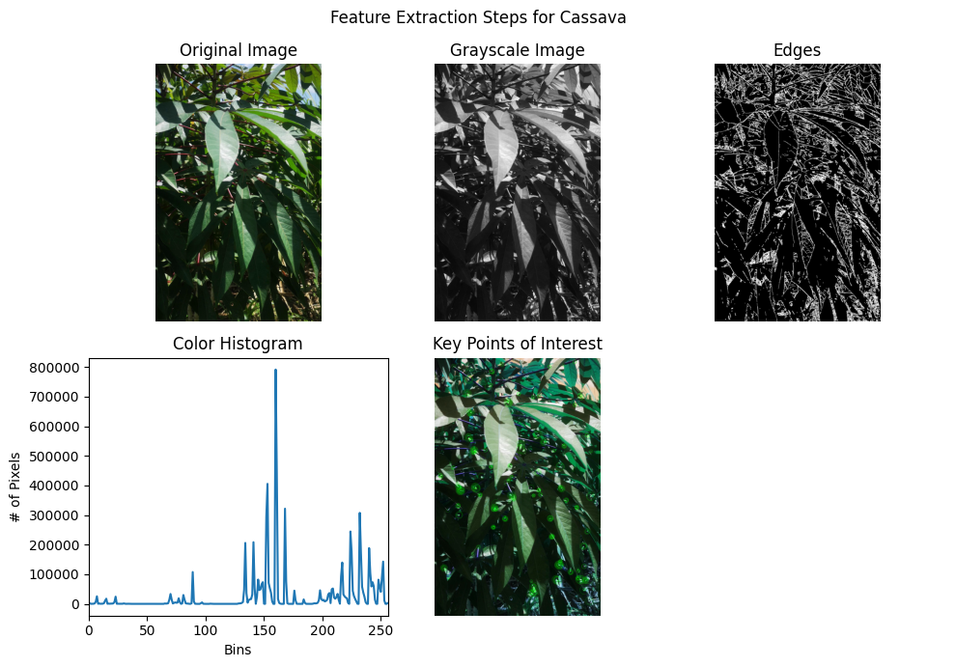
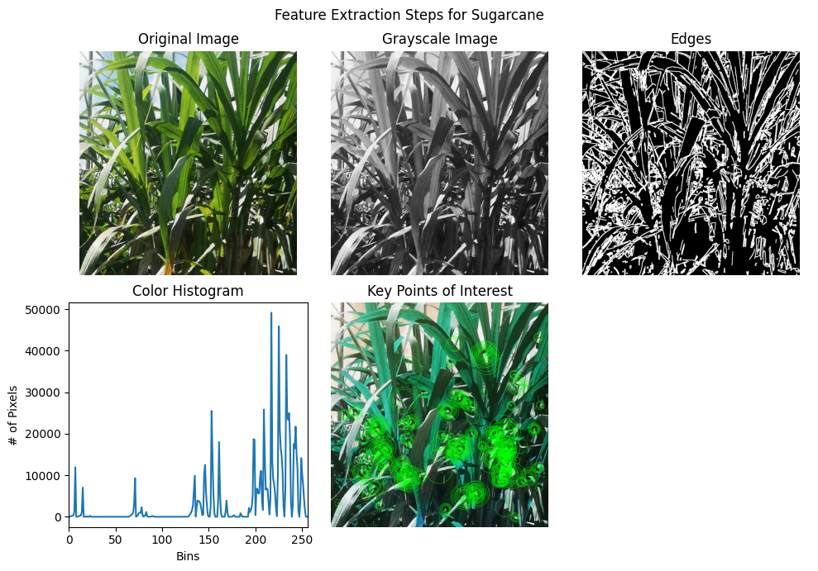
Sample Extracted Features

Slide 9
Models Trained
4 models were trained including;
Random Forest
Naïve Bayes
Decision Tree
SVM
The 3 best performers (Random Forest, Naïve Bayes, Decision Tree) were chosen to create a Voting Classifier ensemble model
All models were trained on the extracted training dataset of combined features.
Notes:
Random Forest
The Random Forest model is an ensemble learning method that constructs multiple decision trees and merges their results to improve accuracy and control overfitting. The Random Forest classifier used in this study was initialized with 100 trees.
Each tree in the forest was trained on a bootstrap sample of the training data, a random subset with replacement. This ensures robustness to overfitting by averaging out biases and variances. The model uses the Gini impurity measure to evaluate splits at each node, selecting the split that maximizes the reduction in impurity. After constructing the trees, the final prediction is made by aggregating the predictions from all trees, either by majority voting (for classification) or averaging (for regression).
3.3.2 Decision Tree
The Decision Tree model is a non-parametric supervised learning method used for classification and regression. It splits the data into subsets based on the value of input features, making it easy to understand and interpret. For this study, a Decision Tree classifier was trained using the same feature sets: color histograms, edge detection, and keypoints descriptors.
The Decision Tree classifier constructs a binary tree by recursively splitting the dataset into subsets. At each node, the algorithm selects the feature and threshold that results in the largest information gain (for classification) or reduction in variance (for regression). This process continues until the leaves are pure or other stopping criteria (e.g., maximum depth, minimum samples per leaf) are met.
3.3.3 Naive Bayes
The Naive Bayes classifier is based on Bayes' theorem and assumes independence between the features. It is particularly useful for large datasets and provides probabilistic interpretation. For this study, a Gaussian Naive Bayes model was trained using the extracted features from color histograms, edge detection, and keypoints descriptors.
The Gaussian Naive Bayes classifier estimates the parameters of the Gaussian distribution for each feature in each class. During prediction, the model calculates the posterior probability of each class given the observed features and selects the class with the highest posterior probability. This approach works well when the feature distributions closely follow a Gaussian distribution.
3.3.4 Support Vector Machine (SVM)
The Support Vector Machine (SVM) classifier is a powerful model used for classification tasks, which works by finding the hyperplane that best separates the data into different classes. For this implementation, a linear kernel was used.
The SVM model finds the optimal hyperplane by maximizing the margin between the closest points of the classes (support vectors). The linear kernel was chosen for its simplicity and efficiency in high-dimensional spaces. The model aims to minimize the hinge loss, which penalizes misclassified points and points that lie within the margin.
3.3.5 Ensemble: Voting Classifier
The Voting Classifier is an ensemble model that combines the predictions of multiple models to improve accuracy. In this study, a soft voting classifier was created using the Random Forest, Decision Tree, and Naive Bayes models. Soft voting was chosen to use the predicted probabilities from each classifier to make a final prediction.
The Voting Classifier aggregates the predicted probabilities from each base classifier and selects the class with the highest average probability. This approach leverages the strengths of individual classifiers, potentially improving overall performance.

Slide 10
Model Evaluation
Used the following evaluation criteria:
Accuracy
Classification Report {precision, recall, f1 score}
Confusion Matrix

Slide 11
Results & Discussion
Model | Accuracy (%) | F1 score | Precision | Recall
Random Forest | 97 | 0.96 | 0.95 | 0.96
Decision Tree | 95 | 0.92 | 0.96 | 0.94
Naïve Bayes | 93 | 0.93 | 0.90 | 0.91
SVM | 92 | 0.94 | 0.87 | 0.90
Voting Classifier | 98 | 0.97 | 0.97 | 0.97

Slide 12
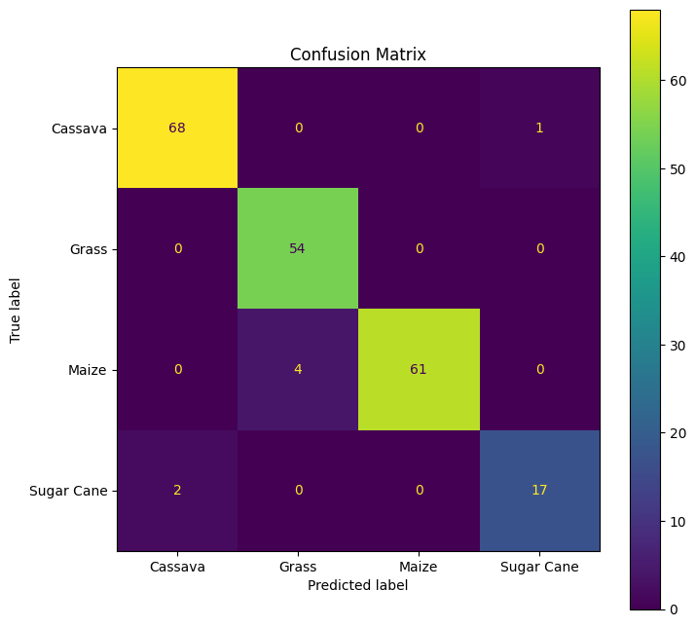
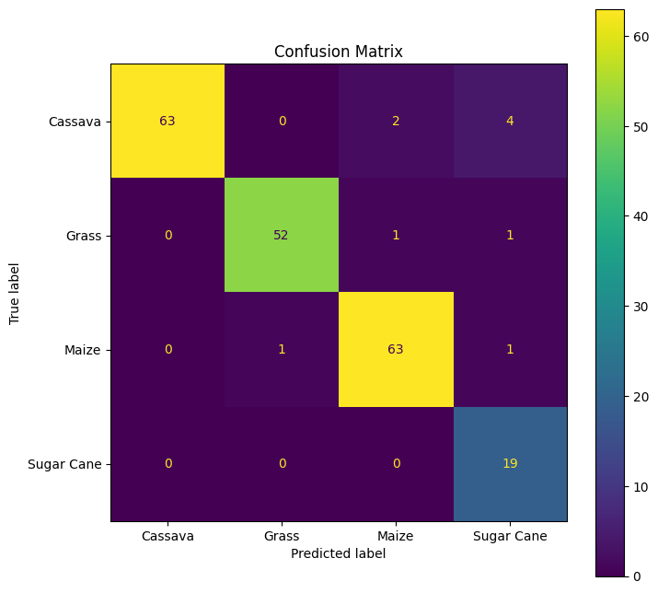
Results: Confusion Matrices – RF & DT
Random Forest
Decision Tree

Slide 13
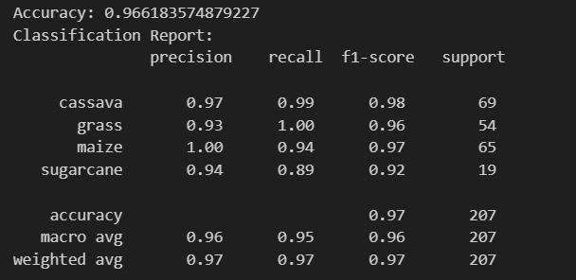
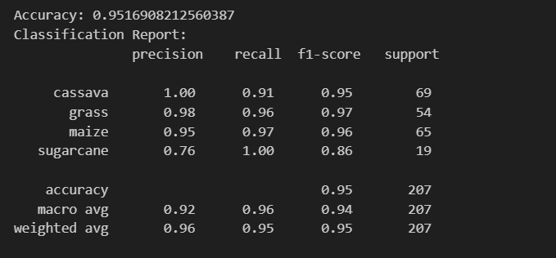
Results Discussion
Random Forest: Best performance achieving an accuracy score of 97% demonstrating a high percentage of correctly predicted crops.
Cassava: Model had a high precision & F1 score, and perfect recall score showing a high sensitivity for cassava
Grass: The model had a good precision and perfect recall score for grass. It correctly predicted all the grass instances.
Maize: The model had a perfect precision for maize meaning that out of all the instances predicted as maize, 100% were actually maize.
Sugarcane: The model had a good precision for sugarcane meaning that out of all the instances predicted as sugarcane, most were actually sugarcane.
Decision Tree: The model's overall accuracy is very high at approximately 95%, indicating excellent performance across the dataset.
Cassava: Showed very high precision, recall, and F1 score, suggesting the model is highly effective at identifying cassava. Only few instances of cassava were identified as maize or sugarcane.
Grass: Excellent recall and good precision, indicating the model correctly identifies almost all grass instances but with a few false positives.
Maize: Very high precision but slightly lower recall, suggesting the model is good at identifying maize when it predicts it but misses some actual maize instances and classifies them as grass or sugarcane.
Sugarcane: High precision and recall, indicating a good balance, though slightly lower than other classes, which suggests that the model performs well on sugarcane but with room for slight improvement

Slide 14
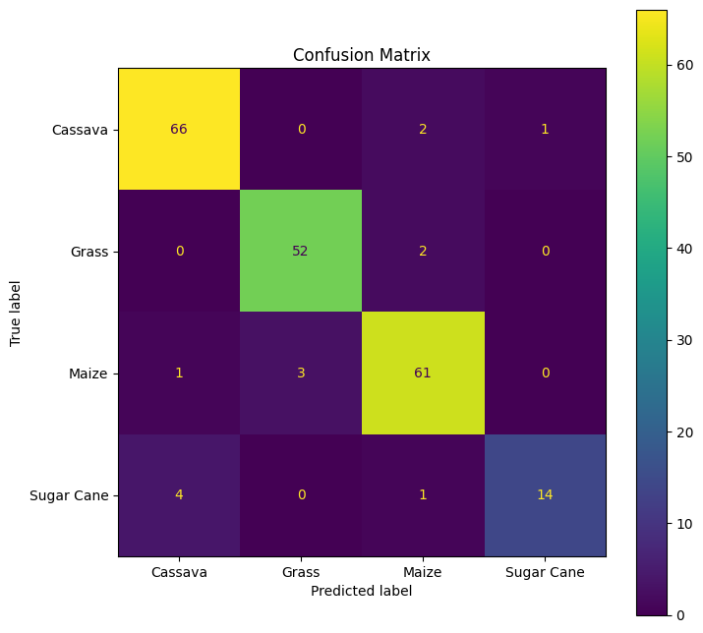
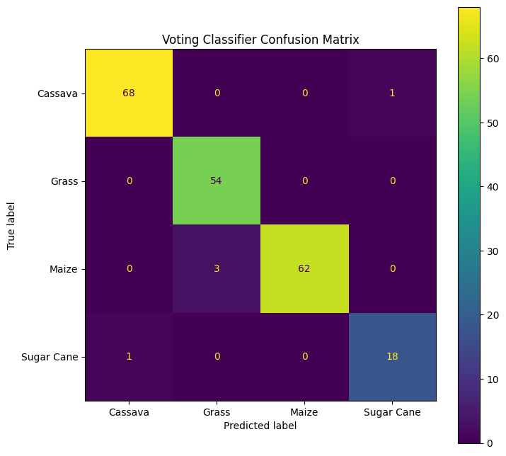
Results: Confusion Matrices – NB & VT Ensemble
Naïve Bayes
Ensemble Voting Classifier

Slide 15
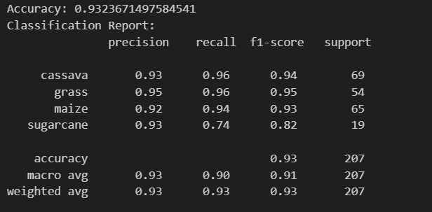
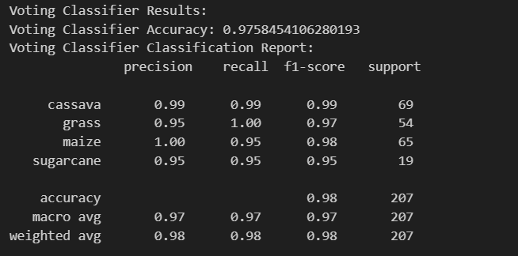
Results Discussion Cont'd
Naive Bayes: Naive Bayes had an accuracy score of 93% indicating good performance across the dataset.
Cassava: High precision, recall, and F1 score, suggesting the model is very effective at identifying cassava.
Grass: Slightly lower precision but excellent recall, indicating the model correctly identifies almost all grass instances but with some false positives where it would classify grass as sugarcane.
Maize: High precision but slightly lower recall, suggesting the model is good at identifying maize when it predicts it, but misses some actual maize instances and classifies them as cassava or sugarcane.
Sugarcane: Has the lowest precision and recall among the classes, indicating the model struggles more with sugarcane predictions, both in terms of false positives and false negatives.
Ensemble Model – Voting Classifier: The model attained the best overall accuracy of approximately 98%, indicating nearly perfect performance across the dataset.
Cassava: Showed perfect precision and near-perfect recall, suggesting the model was highly effective at identifying cassava. It only incorrectly classified one cassava instance as sugarcane.
Grass: Had perfect recall and high precision, indicating the model correctly identified all grass instances but with a few false positives.
Maize Had perfect precision and slightly lower recall, suggesting the model was good at identifying maize when it predicted it but missed a few actual maize instances and classified them as grass.
Sugarcane: Had very high precision and perfect recall, indicating the model performed excellently on sugarcane with very few false positives.
The excellent performance of the ensemble model showed the ability of this model to combine the strengths of all the individual models to obtain the best classification performance.

Slide 16
Conclusion
Traditional Machine learning models show potential in crop and weed monitoring, detection, and classification.
Adequately processing and nomalizing the dataset affects results.
Combining a variety of feature extraction techniques significantly impacts model performance.
Ensemble based models like Random Forest & the Voting Classifier yielded better results than other traditional ML models on the same training dataset
Future Directions
Experiment with Deep Learning models like CNNs on the same dataset to compare performance between traditional and deep learning models on the monitoring, detection, and classification of garden crops and weeds.
Given the superior performance of the ensemble models, further research into other ensemble models is recommended.

Slide 17
References
[1] ”World population to reach 8 billion this year, as growth rate slows”, news.un.org, (Accessed 1 Jul. 2023).
[2] J. H. Westwood, R. Charudattan, S. O. Duke, S. A. Fennimore, P. Marrone, D. C. Slaughter, and R. Zollinger, ”Weed management in 2050: Perspectives on the future of weed science,” Weed Science, vol. 66, no. 3, pp. 275-285, 2018.
[3] M. Fontanelli, C. Frasconi, L. Martelloni, M. Pirchio, and R. Foster, ”Weed management in autumn fresh market spinach: A nonchemical alternative,” HortTechnology, vol. 25, pp. 177-184.
[4] J. H. Westwood et al., ”Weed management in 2050: Perspectives on the future of weed science,” Weed Science, vol. 66, no. 3, pp. 275-285, 2018.
[5] T. Pun, A. Neupane, R. Koech, ”Quantification Of Root-knot Nematode Infestation In Tomato Using Digital Image Analysis”, Agronomy, vol. 11, no. 12, p. 2372, 2021. https://doi.org/10.3390/agronomy11122372
[6] M. Guzel, B. Turan, ̇I. Kadıog ̆lu, B. S ̧in, A. Basturk, K. Ragab, ”How To Affect the Number Of Images On The Success Rate For Detection Of Weeds With Deep Learn- ing”, Turkish JAF Sci.Tech., vol. 10, no. 8, p. 1441- 1446, 2022. https://doi.org/10.24925/turjaf.v10i8.1441- 1446.5183
[7] Z. Wu, Y. Chen, B. Zhao, X. Kang, Y. Ding, ”Re- view Of Weed Detection Methods Based On Computer Vision”, Sensors, vol. 21, no. 11, p. 3647, 2021. https://doi.org/10.3390/s21113647
[8] J. Tang, X. Chen, R. Miao, and D. Wang, ”Weed de tection using image processing under different illumination for site-specific areas spraying,” Comput. Electron. Agric., vol. 122, pp. 103-111, 2016.
[9] L. Pereira, R. Nakamura, G. Souza, D. Martins, and J. Papa, ”Aquatic weed automatic classification using ma chine learning techniques,” Comput. Electron. Agric., vol. 87, pp. 56-63.
[10] Y. Zhang, S. Wang, G. Ji, and P. Phillips, ”Fruit classification using computer vision and feedforward neu ral network,” J. Food Eng., vol. 143, pp. 167-177.
[11] A. Bakhshipour, A. Jafari, S. Nassiri, and D. Zare, ”Weed segmentation using texture features extracted from wavelet sub-images,” Biosyst. Eng., vol. 157, pp. 1-12, 2017.
[13] F.-M. De Rainville et al., “Bayesian classifica tion and unsupervised learning for isolating weeds in row crops,” Pattern Anal. Appl., vol. 17, no. 2, pp. 401–414, May 2014, doi: 10.1007/s10044-012-0307-5.
[14] F. Ahmed, H. Al-Mamun, A. Bari, E. Hossain, and P. Kwan, ”Classification of crops and weeds from digital images: A support vector machine approach,” Crop Prot., vol. 40, pp. 98-104.
[15] T. Rumpf, C. Romer, M. Weis, M. S ¨ okefeld, R. Ger- ¨ hards, and L. Plumer, ”Sequential support vector machine ¨ classification for small-grain weed species discrimination with special regard to Cirsium arvense and Galium aparine,” Comput. Electron. Agric., vol. 80, pp. 89-96.
[16] Y. Chen, P. Lin, Y. He, and Z. Xu, ”Classification of broadleaf weed images using Gabor wavelets and Lie group structure of region covariance on Riemannian manifolds,” Biosyst. Eng., vol. 109, pp. 220-227.

Slide 18
GitHub Link
https://github.com/giddy-mpungu/Garden-Monitoring-Tool-Using-Computer-Vision

