Slide 1
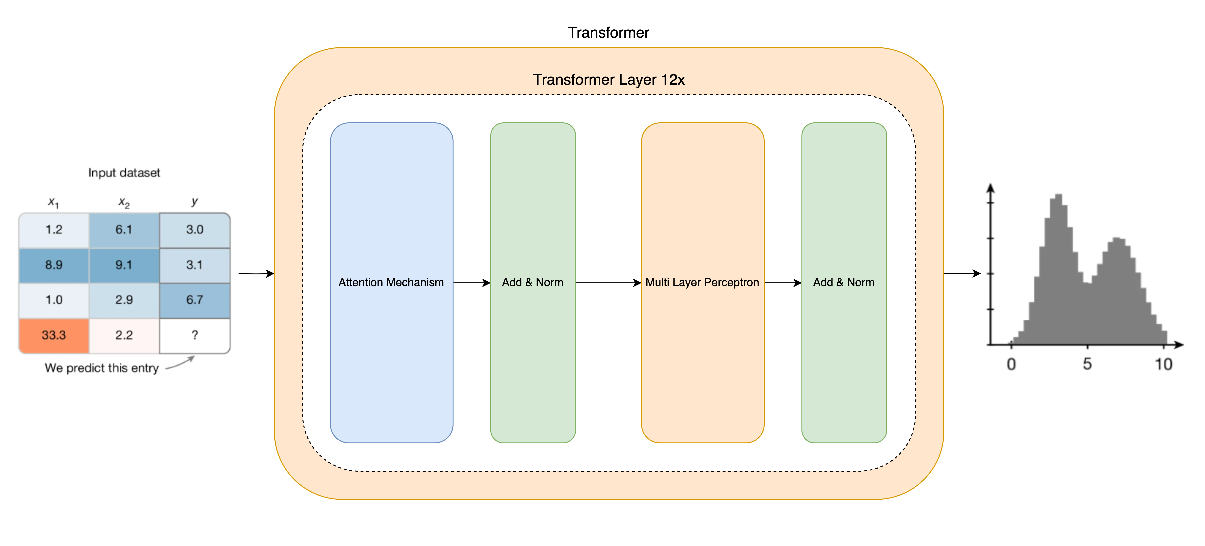
TabPFN

Slide 2
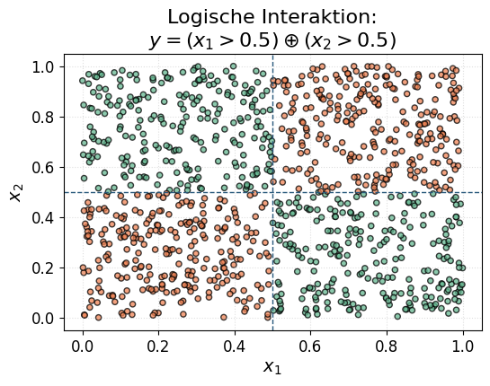
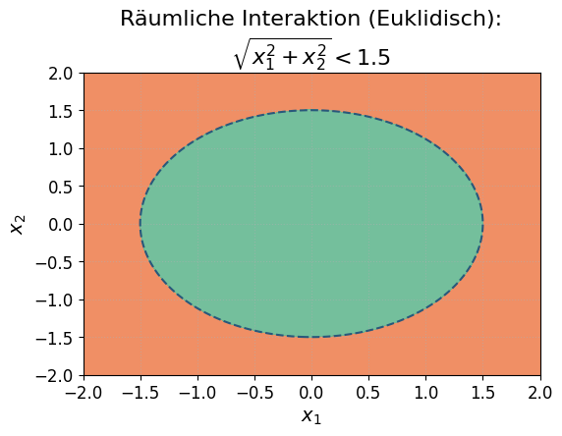
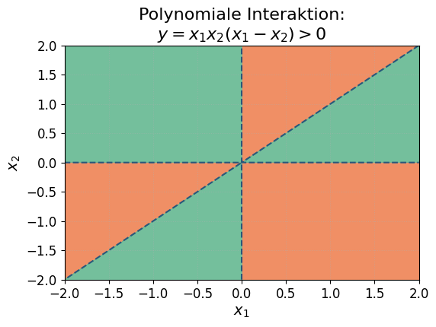
Feature-Interaktionen

Slide 3
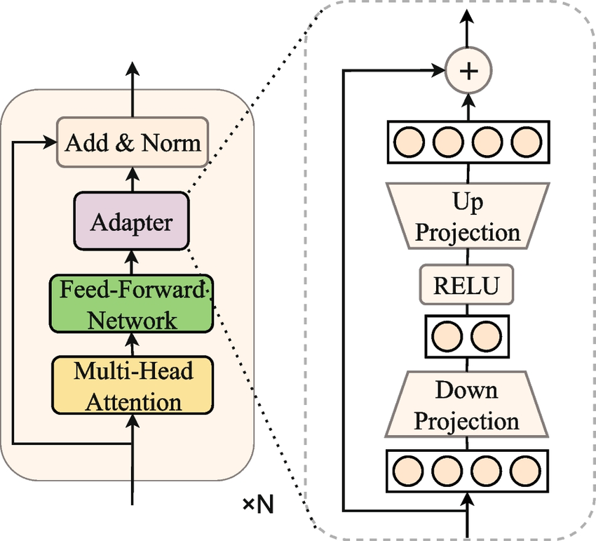
Fine Tuning
Notes:
https://www.researchgate.net/figure/The-typical-architecture-of-each-adapter-layer-The-adapter-is-designed-as-a-bottleneck_fig3_372135546

