Slide 1
Training and Optimizing Deep Neural Networks

Slide 2
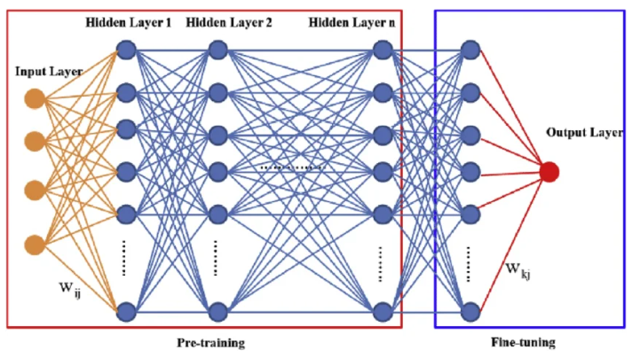
Overview of Deep Neural Networks
A deep neural network (DNN) is a machine learning model made of many simple units
called neurons, arranged in layers, that learn to map inputs (like pixels, words, data) to
outputs (like labels, predictions, decisions).
“Neural” because it’s loosely inspired by the brain.
“Network” because neurons are connected in a graph of layers.
“Deep” because it has multiple hidden layers, not just one.

Slide 3
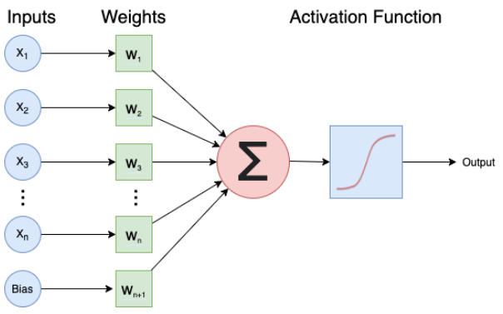
Overview of Deep Neural Networks
output=ƒ(input;parameters)
where the parameters are the weights and biases that the network learns from data.
The neuron computes a weighted sum: z=w₁x₁+w₂x₂+⋯+w_{n}x_{n}+b
Then it passes z through an activation function σ(⋅): output=a=σ(z)

Slide 4



Activation Functions
An activation function is a mathematical function inside each neuron of a neural
network that decides whether a neuron should “activate” and how strongly.
Without activation functions, a neural network would behave like a plain linear equation,
no matter how many layers we add. With activation functions, the network can learn
complex, nonlinear patterns like images, speech, and language.
Activation | Formula | Value | Output Range | Good For | Notes
ReLU (Rectified Linear Unit) | ReLU(z)=max(0,z) | If the signal is positive → pass it through if negative → output 0 | 0 to ∞ | Hidden layers | Fast, simple, widely used
Sigmoid |  | Squashes values between 0 and 1 Good for probabilities | 0 to 1 | Binary classification output | Can cause vanishing gradients
Tanh |  | Like sigmoid, but outputs between –1 and 1 Zero‑centered → often better than sigmoid in hidden layers | –1 to 1 | Hidden layers | Zero‑centered, smoother than sigmoid
Softmax |  | Turns a list of numbers into a probability distribution All outputs sum to 1 | 0 to 1 (sum=1) | Multi‑class output | Produces probabilities

Slide 5
DNN Architecture - Layers
A layer is a group of neurons that all look at the same input vector.
Input layer:
Holds the raw data (e.g., pixel values, features).
Usually no computation, just the starting point.
Hidden layers:
One or more layers between input and output.
Each hidden layer transforms the data into more abstract features.
Output layer:
Produces the final prediction (e.g., class probabilities, a number for regression).
A simple feedforward architecture diagram as a classic fully connected feedforward network, also called a multilayer perceptron.

Slide 6



DNN Architecture – Layers - Forward pass
Layer 1
(W₁,b₁,σ₁)
Layer 2
(W2,b₂,σ2)
Layer L
(WL,b_{L},σ_{L})
Ŷ
(prediction)
X
...
Loss function - measure error between predictions and true labels
Mean Squared Error (MSE) for regression
Cross-Entropy Loss for classification binary
Cross-Entropy Loss for classification multiclass

Slide 7
DNN Architecture – Layers – Back propagation
For each batch of training data, it does a forward pass to compute predictions ŷ then it
computes the loss L. The weights and biases are initialized randomly.
Forward
Ŷ
...
X
Layer 1
Layer 2
Layer L
Loss
Uses backpropagation to compute gradients and updates parameters using an
optimizer (i.e., gradient descent, adam).
Backward
...
dLoss/ dŷ
X
Layer 1
Layer 2
Layer L
computes gradients layer by layer, update W,b
Errors flow backward from the output to earlier layers and each layer learns
how to adjust its weights to reduce the loss

Slide 8
Weights Initialization
Before the training begins, every neural network layer needs initial weights.
These weights determine how the network behaves at the very first forward pass.
Why initialization matters:
- It affects how signals flow through the network
- It affects how gradients flow backward
- Good initialization → stable learning
- Bad initialization → exploding/vanishing gradients, slow training, or poor accuracy
Initialization is not just a detail — it’s a critical part of deep learning.
There are 2 major initialization strategies:
Glorot Uniform (Xavier Uniform) - default initializer in Keras
He Initialization (He Normal / He Uniform) - ReLU and its variants

Slide 9
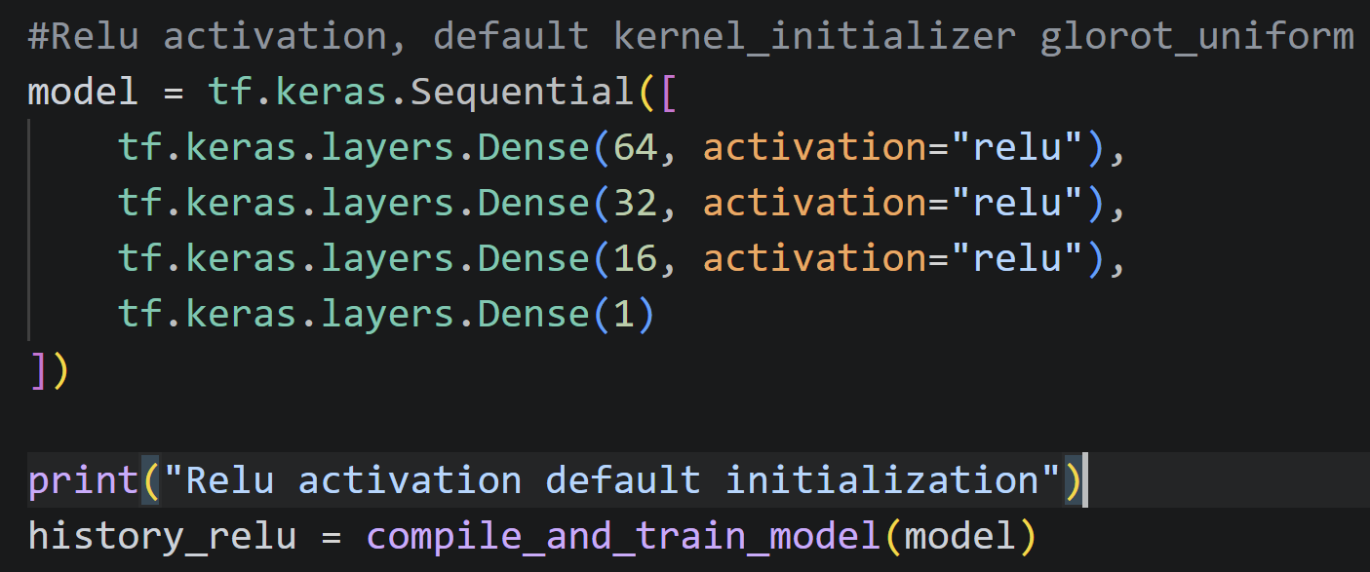
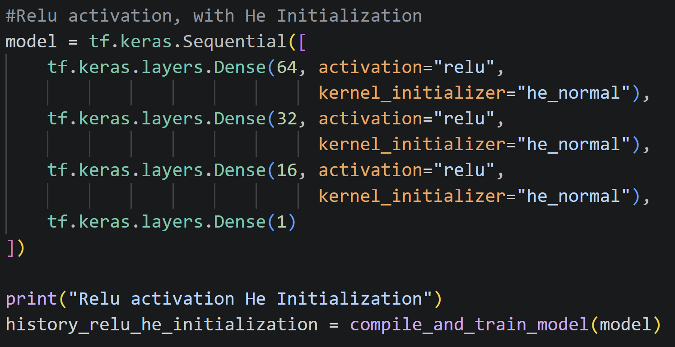
Weights Initialization
Default initialization (Glorot)
He Initialization

Slide 10
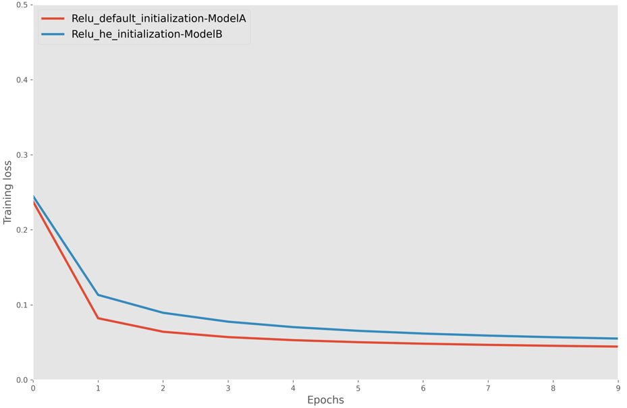
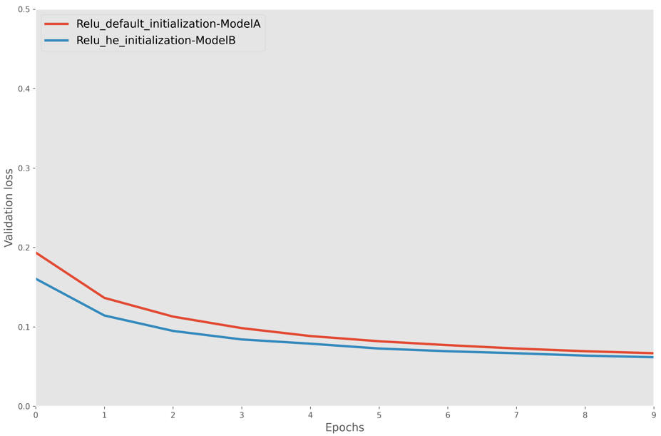
Weights Initialization
Weight initialization has a significant impact on training dynamics.
He initialization is better suited for ReLU, leading to:
Faster convergence
Lower validation loss
Better generalization
Glorot still performs well, however is not optimal for ReLU‑based networks.

Slide 11
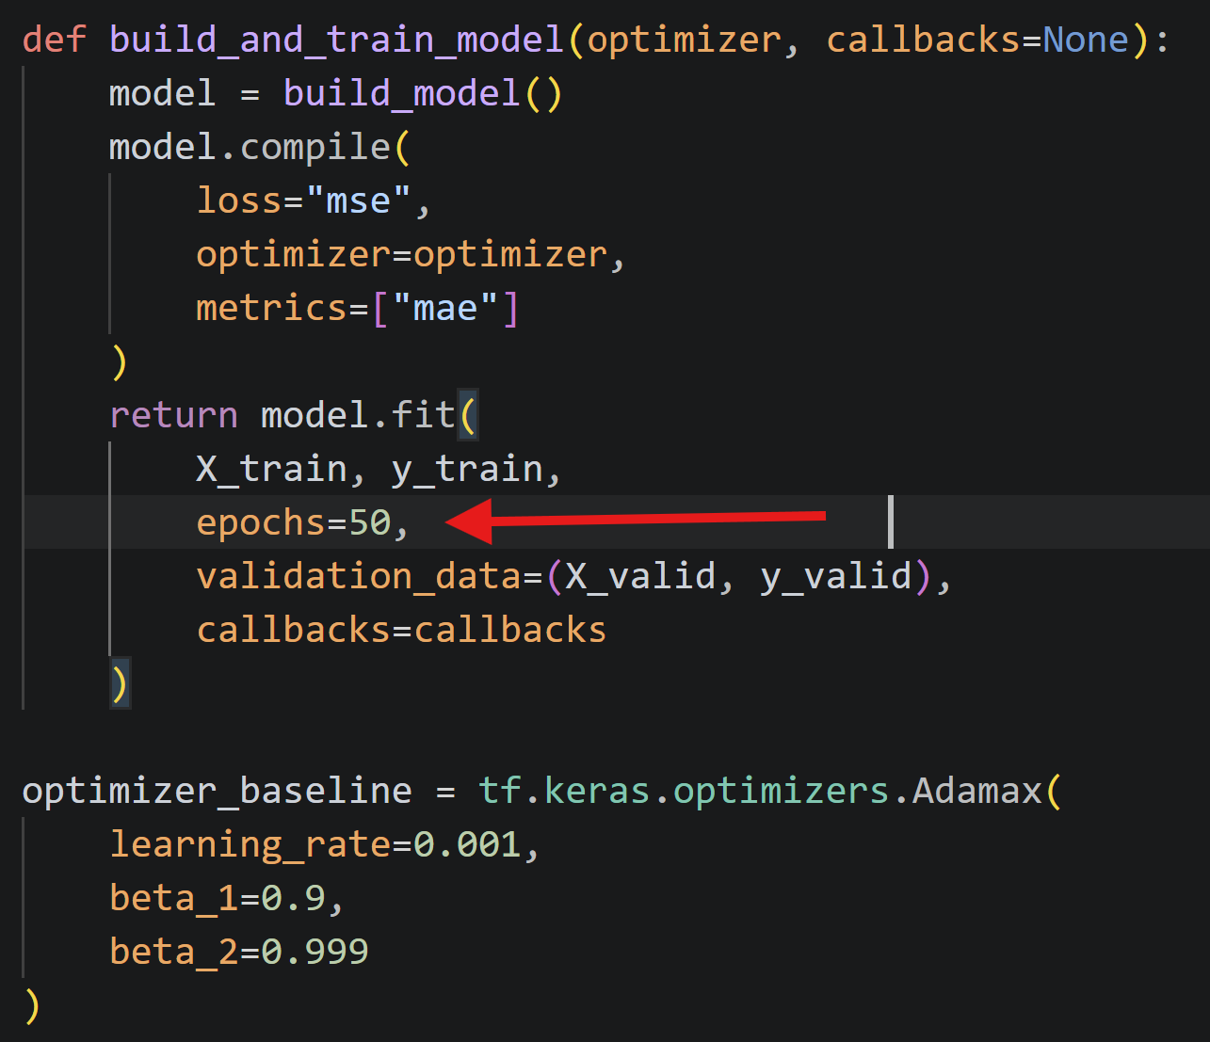
EARLY STOPPING
Early Stopping is a training technique where the model stops training automatically when it stops improving on the validation set, ensuring we get the best weights without wasting time or overfitting.
Automatically finds the best epoch.

Slide 12
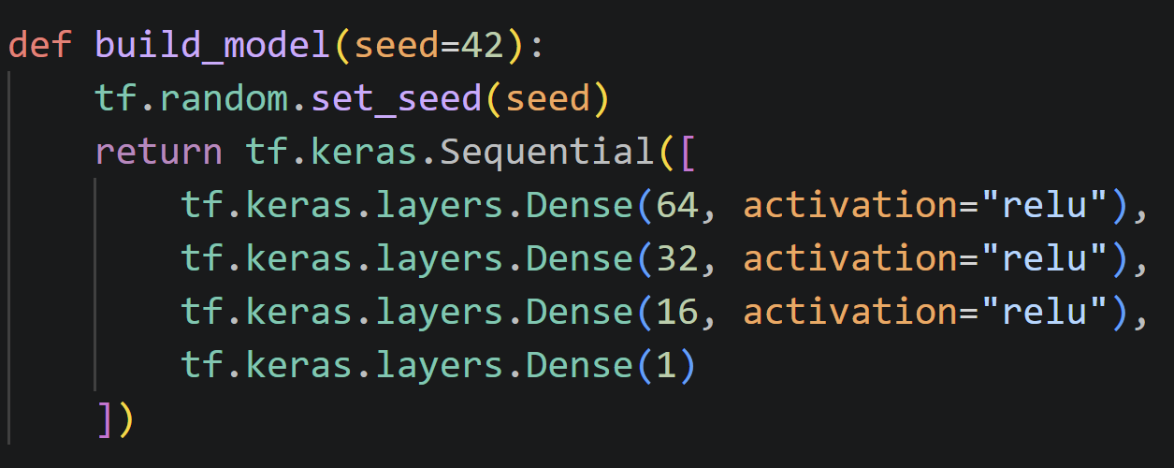
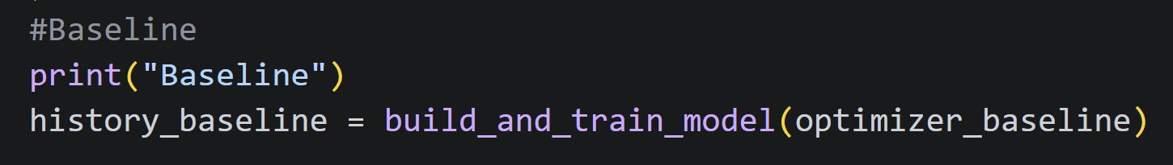
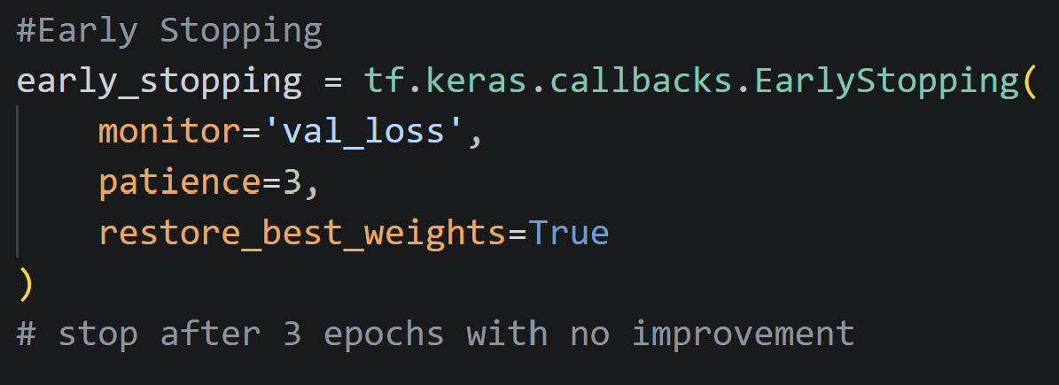
EArLY STOPPING
Executes 50 epochs despite reaching a
plateau which in indication that the model
does not ‘learn’ anymore.
Stops after 29 epochs which in indication
that the model needed only 29 epochs to
‘learn’.

Slide 13
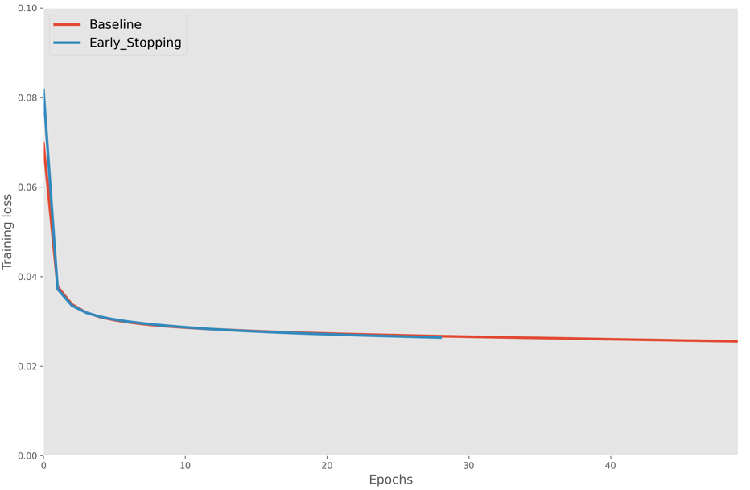
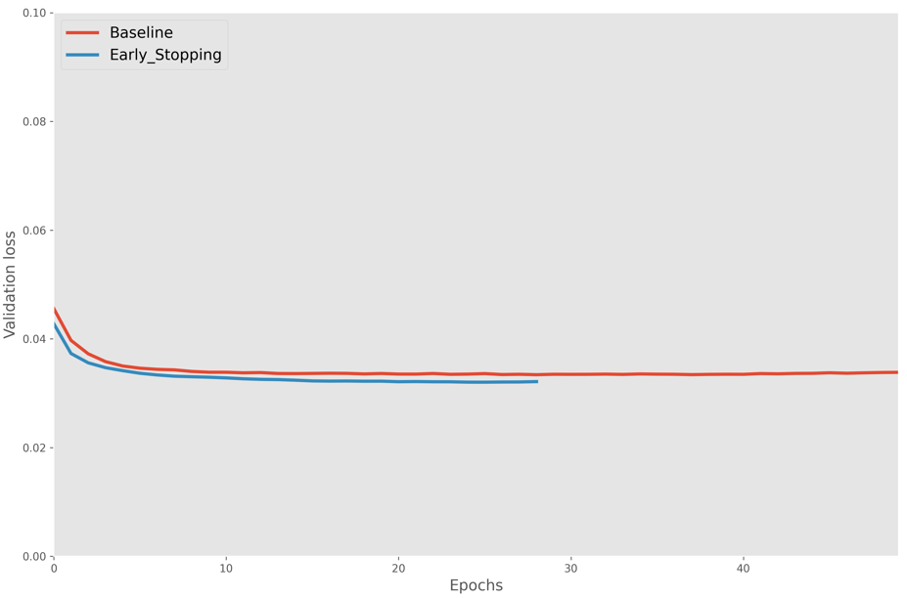
EARLY STOPPING
Baseline final val_loss: 0.03383053466677666
EarlyStopping best val_loss: 0.032020073384046555
EarlyStopping stopped at epoch: 29

Slide 14
The End

