Slide 1
Skipping the CURVE
authentic solutions
Presentation begins…

Slide 2
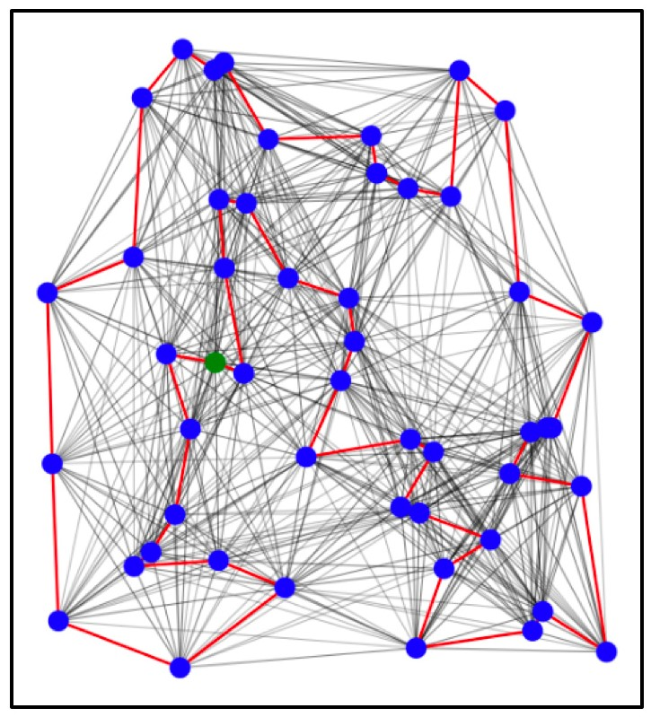
Situation and Trend
Combinatorial optimization problems are common across many industries, for example:
Vehicle routing problem (VRP) applications: finding best route for delivery (amazon), manufacturing of microchips (CMC), scheduling tasks on a computer (cloud service for computation)-
Knapsack problem
Combinatorial optimization problems are extremely hard (technical term: it’s NP-hard). For example, if you want to optimize the route for delivery, there are almost infinite number of ways you could test out.
As we increase the scale of the problem to the industrial level, the resources (time and compute) needed to optimize the problem grow exponentially with the size of the problem. Using route optimization as an example, Amazon on average delivers 1.6 million packages a day.
Finding most optimal solution using current computer (classical) is not possible for realistic problem sizes
Even though the current super computers could find an okay solution, there’s a lot of room for improvement. We could achieve the improvement by applying a quantum computer optimization algorithm.

Slide 3
Problem Statement
How we can tackle combination optimization problems

Slide 4
Solution
Use quantum computer and parts of our approach (QAOA) developed during the technical phase to find, develop and deploy solutions to challenging optimization industrial problems

Slide 5



Target market
Active – Passive MIX
Competitive advantage
High upfront cost
Vehicle routing problem : amazon/ UPS package delivery, large grocery stores for fresh product delivery : Industries : Transportation and logistics, etc.
Knapsack problem
Natural gas exploration for energy companies: sensors can be deployed to find the exact location of natural gas which is also a green energy alternative to fossil fuel.

Slide 6

Market, Budget and Product Analysis
Product Understanding
Market Understanding
Proven Problem
Consistent demand
Market as a solution that can be used in a wide array of industries
Industrial combinatorial expenditure in North America
TAM
$ 660.5 Billion¹
Budget
Industrial combinatorial expenditure in Canada
SAM
$ 168.8 Billion
$360 Million
SOM
Companies interesting in improving efficiency that can be targeted
$ 26 Billion

Slide 7


PORTER 5 FORCES
Threats of Substitute Products
Power of Suppliers
Threat of
New Entrants
Power of Buyers
HIGH
high
Competitive Rivalry
Moderate
LOW
high

Slide 8
RECOMMENDATION - Business CANVAS MODEL
Key Partners: - Pasqal - CMC - Other quantum hardware providers | Key Activities: - Priority access to quantum hardware - Solutions to previously unsolved or hard to solve problems in the industry | Value Propositions: - How are we different? Background experience Engineers and scientist publications/patent of ideas Priority access to pascal Sell priority access to customers How are we better? Quantum supremacy (compare to classical algorithm developed) Quantum advantage Large number of qubits which means large problems that be mapped on Neutral atom quantum computers Combinatorial optimization problems could be mapped naturally to quantum computers | Customer Segments: - Energy companies such shell, mobil, Total, etc - Online retail companies such as Amazon Google - Space companies such as NASA and Canada space agency - Shipping companies
 | Key Resources: - Quantum Developers - Financial Strength - Data and algorithm - Intellectual Properties
Cost Structure: - Quantum development cost Production CostsConsumption R&D costs Quantum Computer Rental Cost Power Consumption Cost |  | Revenue Stream: - Subscription Fee - Consultancy Fee - Retainer Fee

Slide 9
5-Year PLAN
YEAR
2023
2024
2022
2025
2026

