Slide 1
Adrenergic nervous system
By:- Belachew Umeta (MSc, B. pharm)
Email:- belachew.umeta@ju.edu.et

Slide 2
Learning objective
At the end of this session students are able to:
Differentiate types of adrenergic receptors
Discuss location of adrenergic receptors
Explain biosynthesis of catecholamines
Discuss metabolism of catecholamines
Differentiate different target site that can be used for development of drugs that act on adrenergic nervous system

Slide 3
Adrenergic nervous system
Peripheral nervous system
Adrenergic system uses chemical messengers adrenaline and noradrenaline
  Hormone and neurotransmitters released from adrenal medulla and sympathetic nerves and feed smooth muscle and cardiac muscle respectively
The action of noradrenaline to various tissue is opposite to acetylcholine
  tissues are under a dual control
The overall effect on the tissue depends on which effect is predominant
Fight or flight response

Slide 4
Central nervous system
There are also adrenergic receptors in CNS
Noradrenaline (norepinephrine) is important in controlling the following in central nervous system
  sleep, emotion, temperature regulation, and appetite

Slide 5
Adrenergic receptors
Types of adrenergic receptors
Two main type:- α and β
  Both of them are G-protein coupled receptors
α-adrenoceptors consist of α1 and α2 subtypes
  They differ both in structure and type of secondary messenger which is produced
  α-1 receptors produce inositol triphosphate and diacylglycerol as secondary messenger
  α-2 inhibit production of secondary messenger cyclic-AMP.

Slide 6
Cont…
The beta adrenoceptors consists of β1, β2, and β3
  All of them activate formation of cyclic-AMP.
All of adrenergic receptor types and subtypes are switched on by adrenaline and noradrenaline
They have slightly different structure
  Means it should be possible to design drugs which will be selective agonists and switch on only a few or just one of them.

Slide 7
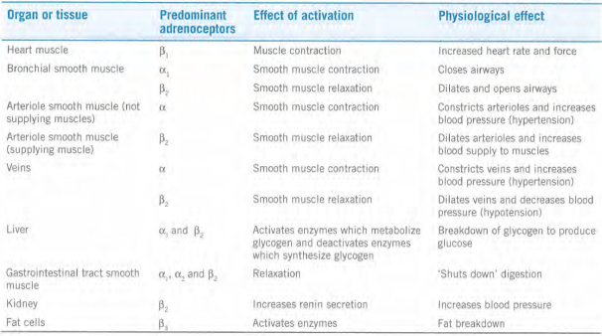
Distribution of receptors

Slide 8
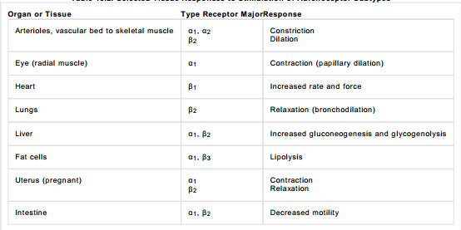
Receptor distribution

Slide 9
Clinical aspect of adrenergic agents

Slide 10
Endogenous agonists for adrenergic receptors
They include neurotransmitter noradrenaline and the hormone adrenaline
Both act as agonist and activate the receptors
They belong to group of compounds called catecholamine
  They contain alkylamine chain linked to catechol ring (1, 2-benzenediol ring)

Slide 11
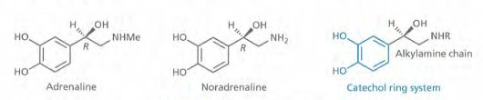

Slide 12
Biosynthesis of catecholamines
Start form amino acid L-tyrosine
Tyrosine hydroxylase catalyze formation of levodopa
Aromatic L-amino acid decarboxylase forms dopamine
  An important neurotransmitter

Slide 13
Cont…
By hydroxylation process noradrenaline is produced
Production of catecholamines are controlled by regulation of the first step catalyzed by tyrosine hydroxylase which is regulated by noradrenaline
  Self regulation mechanism

Slide 14
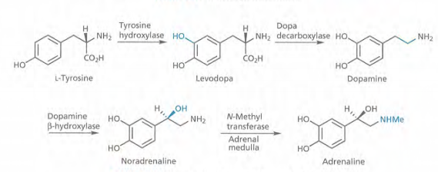
Biosynthesis…

Slide 15
Metabolism
Metabolism in the periphery takes place within cells and involves two enzymes
  Monoamine oxidase (MAO)
  Catechol O-methyltransferase (COMT)
Metabolism in the CNS is slightly different, but still involves MAO and COMT as the initial enzymes

Slide 16
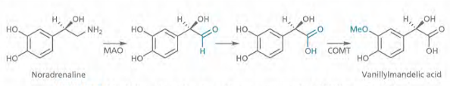
Metabolism…

Slide 17
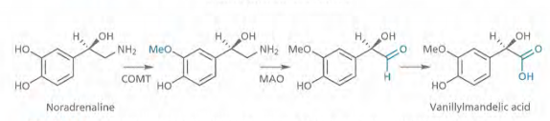
Metabolism…

Slide 18
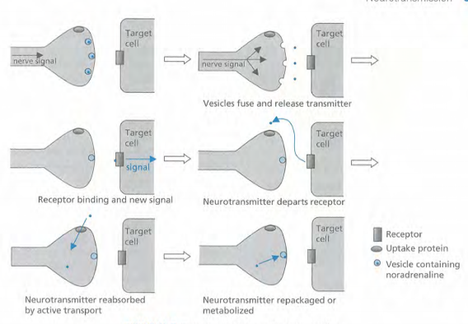
Neurotransmission
Neurotransmission process

Slide 19
Cotransmitters
Neurotransmitters released along with noradrenaline
Those neurotransmitter includes:-
  Adenosine triphosphate (ATP)
  Protein called chromogranin A
They interact with their specific receptors on the target cell
  Allows certain variation in speed and type of message which the target cell receives
For example ATP leads to faster response in smooth muscle contraction

Slide 20
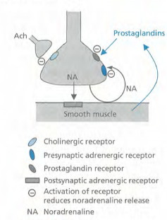
Presynaptic receptors and control

Slide 21
Drug targets
The biosynthetic enzyme involved in synthesis of noradrenaline within presynaptic neurons
The vesicle carriers that package noradrenaline within the presynaptic neuron prior to release
The process of exocytosis where the vesicle fuse with the cell membrane and release noradrenaline into the synaptic gap when the neuron is active

Slide 22
Drug target
4. Adrenergic receptors in the postsynaptic neuron
5. The transport proteins that are responsible for reuptake of noradrenaline from the synaptic gap
6. The metabolic enzyme that metabolize noradernaline
7. The presynaptic adrenergic receptors that regulate noradrenaline release

Slide 23
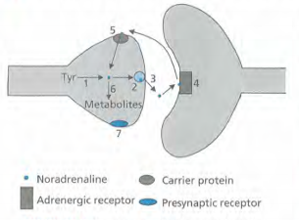
Drug target affecting noradrenaline transmission

Slide 24
Adrenergic binding site
Adrenergic receptors are G-protein linked receptors which consists of seven transmembrane (TM) helices
Knowledge of binding site is based on mutagenesis and molecular modelling
From this studies, it has been proposed that three transmembrane helices are involved (TM3, TM5 and TM6)
Mutagenesis studies have indicated the importance of an aspartic acid residue (Asp-113), a phenylalanine residue (Phe-290), and two serine residues (Ser-204 and 207)
Modelling study indicate how this group interact with noradrenaline and adrenaline

Slide 25
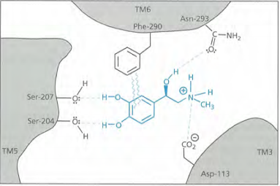
Binding site

Slide 26
Structure-activity relationships
Important binding groups on catecholamines
The alcohol group
the R enantiomer of noradrenaline is more active than the S enantiomer
  Indicating involvement of secondary alcohol in hydrogen bonding
Compounds lacking hydroxyl group have greatly reduced interaction
  Some of the activity is retained, indicating that the alcohol group is important but not essential
  Eg. Dopamine

Slide 27
SAR
The amine group
normally protonated and ionized at physiologic ph.
Replacing it with carbon result in a large drop in activity
Primary and secondary amine have good adrenergic activity
Tertiary and quaternary ammonium salt do not

Slide 28
SAR
The phenol substituents
are important
Phenol groups can be replaced by other groups capable of interacting with the binding site by hydrogen bonding
Particularly true for meta phenol group which can be replaced by CH2OH, CH2CH2OH, NH2, NHMe, NHCOR, NMe2, and NHSO2R
  Eg. Tyramine and amphetamine have no affinity for adrenoceptors
  They have an effect on adrenergic system. How?

Slide 29


Slide 30
SAR
Alkyl substituents on the side chain linking the aromatic ring to the amine decrease activity at both type of receptors
  due to steric effect or preventing the molecule to adopt the active conformation

Slide 31
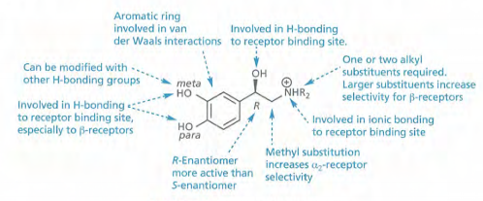
Important binding groups

Slide 32
Selectivity for α and β adrenoceptors
SAR study demonstrate certain feature which demonstrate a level of receptor selectivity between the two types of receptors
N- Alkyl substitution:- adrenaline has the same potency for both types receptors, where as noradrenaline has greater potency for α than β adrenoceptors.

Slide 33
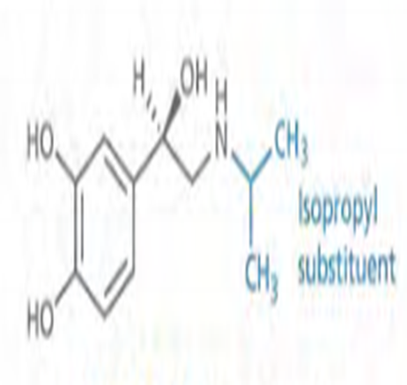
Cont…
Indicating that N- alkyl substituent has a role to play in receptor selectivity
  Increasing the size of the N-alkyl substituent resulted in loss of potency at the α receptors but an increased potency at β receptors
    For example synthetic analogue isoprenaline is a power full beta stimulant devoid of α agonist activity.

Slide 34
Cont…
The presence of bulky N-alky group such as isopropyl or tertiary butyl, is particularly good for β adrenoceptor activity.
  Indicating that the β adrenoceptor has a hydrophobic pocket into which a bulky alkyl group can fit, where as α adrenoceptors do not
Phenol group:- if they are absent, activity drops more significantly for β than α receptors
  Important for β receptors

Slide 35
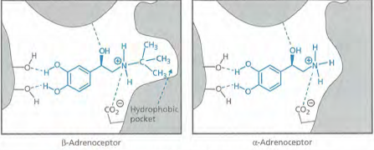
Comparison of β and α adrenoceptor binding site

Slide 36

Cont…
α methyl substitution:- addition of an α methyl group increase α2 receptor selectivity
  Eg. α-methyl noradrenaline

Slide 37
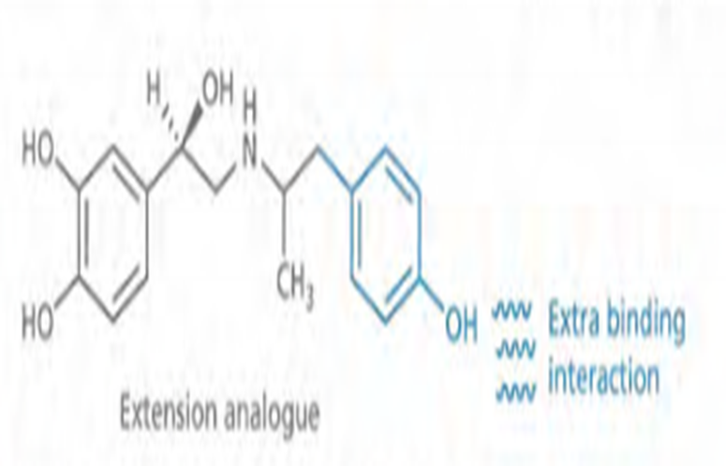
Extension:- increasing the size of alkyl group more than t-butyl offer no advantage.
  But, placing polar functional group at the end of alky chain increase activity.
    Particularly adding phenol group at the end of C2 alkyl chain increase activity
    Indicating that extra polar binding region has been assessed which is involved in hydrogen bonding

Slide 38
Adrenergic agonists
General adrenergic agonists
Adrenaline
is agonist for all adrenergic receptors
Frequently used in emergency situation such as cardiac arrest and anaphylactic reaction
  Its fast acting
Can be administered with local anesthetics to prolong its activity
Drawback
short duration of action
Non selective leading to more side effects
    Nausea, tachycardia, arrhythmias, hypertension, sweating etc.

Slide 39
Ephedrine
Natural product present in various plants which have been used in folk medicine for many years
Activate both types of receptors
Used as vasopressor, cardiac stimulant and as bronchodilator
Not susceptible to metabolism by COMT because it lack phenolic group

Slide 40
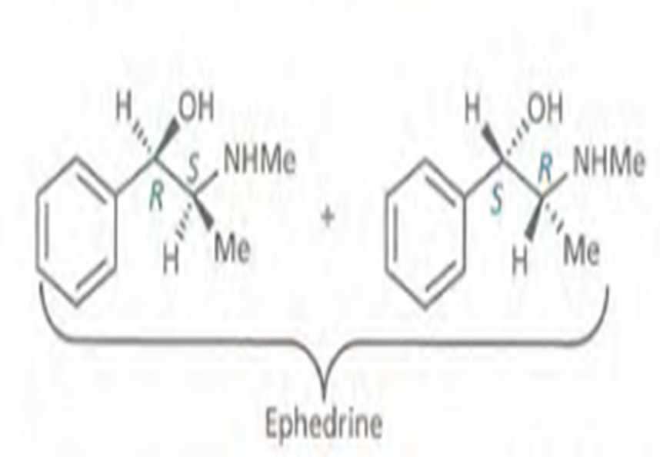
Cont…
Has two asymmetric centers
Exist as racemate of R,S and S,R stereoisomers
Has lipophilic character
  Can cross BBB and act as stimulant

Slide 41
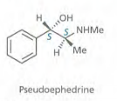
Pseudoephedrine
Exist in certain plant species
It is the S,S diastereomer of ephedrine
Used as nasal decongestant in preparation such as Sudafed, Benylin, and Lemsip.

Slide 42
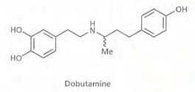
α1-, α2-, β1-, and β3- agonists
Dobutmine
Its B1 agonist
Used to treat cardiogenic shock

Slide 43
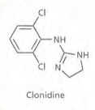
Clonidine
Selective α2 agonist
Used in the treatment of hypertension
There is strong evidence as it act as an analgesic, especially if its injected directly into spinal cord

Slide 44
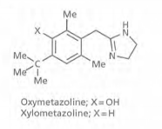
Oxymetazoline and Xylometazoline
Selective α1 agonists
Act as vasoconstrictor
Used as topical medicine for the treatment of nasal congestion and bloodshot eyes

Slide 45
β2 agonists and the treatment of asthma
The most useful adrenergic agonists in medicine today
They can be used to relax smooth muscle of the uterus to delay premature labour
They are more commonly used for the treatment of asthma
Adrenaline is often used to dilate air way in emergency situation but its not suitable for long term use
  short duration of action and
  non selectivity (cardiovascular side effect)

Slide 46

Isoprenaline
shows some selectivity for β receptors over α receptors because of bulky N-alkyl substituent
was used for sometimes as an anti asthmatic agent
  Shows no selectivity between the different subtypes of β receptors
The search was now on to find an agonist which is:-
  selective to β2 receptors
  could be inhaled and
  have a longer duration of action

Slide 47
Cont…
Further study demonstrate that selectivity between different types of β receptor is obtained by:-
  Introducing alkyl substituents to the side chain linking the aromatic ring and the amine and/or
  Varying the alkyl substituents on the nitrogen

Slide 48
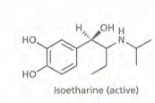
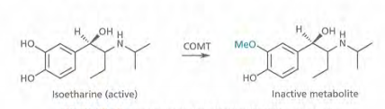
Isoetharine
Selective to β2 receptors
Drawback
Short duration of action
Reason
Susptible to COMT enzyme which methylate and form inactive ether

Slide 49
Cont…
Strategy
Modifying the meta phenol group and make it more resistant to metabolism
  It was not an easy task because phenolic group is important for activity. So, how?
    Replacing phenol group which could still bind to the receptors and retain biological activity and
    would not be recognized by metabolic enzyme
  Meta phenol group was replaced by various groups

Slide 50
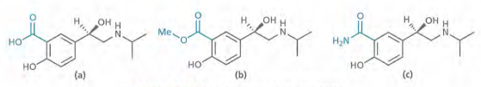
Metabolism of isoetharine
A meta phenol group was replaced by variety of different substituents
  Carboxylic acid group was tried
  An ester and an amide were then tried

Slide 51
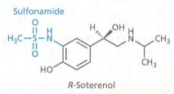
Soterenol
Meta phenol group was Replaced by sulfonamide
Long lasting selective β2 agonist
Never used clinically due to discovery of better compound in salbutamol (known as albuterol in USA)

Slide 52
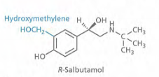
Salbutamol
Meta phenol group was replaced by hydroxymethylene group
Have same potency with isoprenaline, but 2000 times less selective on heart
It has duration of 4 hours
Its not taken up by transport proteins and not metabolized by COMT

Slide 53

Cont…
Was marketed as racemate
The R-enantiomer is 68 times more active than the S-enantiomer
The S-enantiomers accumulate to greater extent in the body
  Produce more side effect
Consequently the pure R-enantiomer (levalbuterol) was eventually marketed
  An example of chiral switching

Slide 54
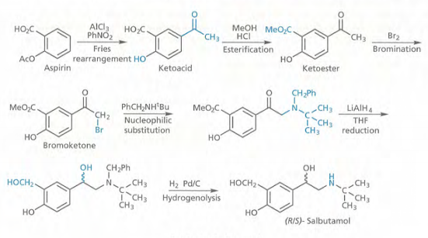
Synthesis of salbutamol

Slide 55
Analogues of salbutamol
Several analogue of salbutamol were synthesized
Analogue were prepared to test whether the meta CH2OH could be modified further

Slide 56
Cont..
These and previous results demonstrated the following requirements for meta substituents
It has to be capable of taking part in hydrogen bonding
  MeSO2NHCH2, HCONHCH2, and H2NCONHCH2 permitted this
Substituents with an electron withdrawing effect on the ring have poor activity (eg. CO2H)

Slide 57
Cont..
Bulky meta substituents are bad for activity
  Prevent the substituents adopting the necessary conformation for hydrogen bonding
The CH2OH can be extended to CH2CH2OH but not further

Slide 58
Salmefamol
Attention turned to N-alkyl substituents
N-aryl alkyl substituent were now added which would be capable of reaching the polar region of binding site (extension strategy)
Given by inhalation
In severe attack it can be given intravenously

Slide 59
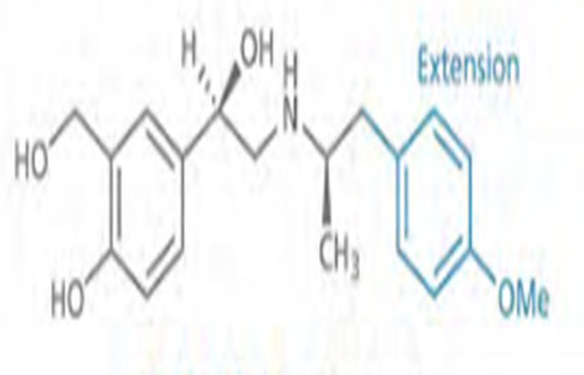
Cont…
Has longer duration of action (6 hours)
1.5 times more active than salbutamol

Slide 60

Salmeterol
More lipophilic
Twice potent than salbutamol
Longer duration of action( 12 hrs)
Used to treat nocturnal asthma

Slide 61
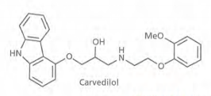
Adrenergic antagonists
General alpha/beta blockers
Carvedilol
act as an antagonists at both α and β receptors
Used as antihypertensive
Can be used to treat cardiac failure

Slide 62
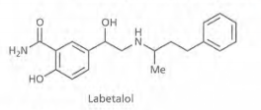
Labetalol
Antagonist at both α and β receptors
Can be used to treat hypertension

Slide 63
α-blockers
Prazosin
First α1 selective antagonist to be used for treatment of hypertension
Short acting

Slide 64
Doxazosin and Terazosin
Selective α1 antagonist
Have longer duration of action
Can be used to treat hypertension
  Given once daily dosing
Can be used to treat enlarged prostate

Slide 65
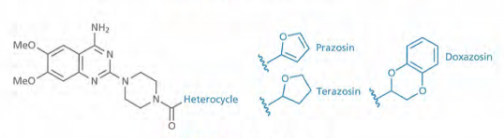
Selective α1 antagonist

Slide 66
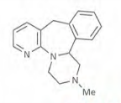
Mirtazepine
Its α2 antagonist
Increase level of noradrenaline
Increase level of serotonin
Used as antidepressant

Slide 67
β-blockers as cardiovascular drugs
First generation β-blockers
The most useful adrenergic antagonist used in medicine today
Originally designed to act as antagonist at β1 receptors of the heart

Slide 68
Isoprenaline
Lead compound for development of β blockers
  Even though it act as an agonist it does not have activity on alpha adrenoceptors
  Modifying the molecule and change it into antagonist
The phenolic groups are important for agonist activity

Slide 69
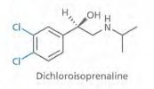
Dichloroisoprenaline
Replacing the phenol with chloro substituents
It has partial agonist activity
What does partial agonist means?

Slide 70

Pronethalol
Chloro group was replaced by extra benzene ring to give naphthalene ring system
Still partial agonist activity
First beta blockers to be used clinically for angina, arrhythmia, and high blood pressure
Needs to convert agonist into antagonist

Slide 71
Propranolol
Produced by chain extension process between the aromatic ring and the amine
  Introduction of various linking groups between naphthalene ring and ethanolamine group
Discovered by chance
Has pure antagonist activity
Have 10-20 times greater activity than pronethalol

Slide 72
Cont…
It was introduced into clinic for the treatment of angina
Although its used as racemate the S-enantiomer is the active
The inventor James Black got noble prize in 1988
Drawback
  Non selective for β1 and β2 receptors

Slide 73
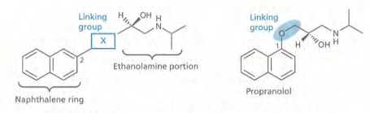

Slide 74
Structure activity relationship of aryloxypropanolamines
Propranolol is an example of aryloxypropanolamine
Branched bulky N-alkyl substituents such as isopropyl and t-butyl groups are good for β antagonist activity
  Suggesting an interaction with a hydrophobic pocket in the binding site

Slide 75
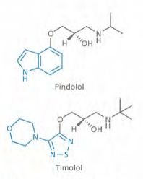
SAR
Variation of aromatic ring is possible
  Heteroaromatic ring can be introduced such as in pindolol and timolol

Slide 76
SAR
Substitution on the side chain methylene group increase metabolic stability but lower activity
The alcohol group on the side chain is essential for activity
Replacing the ether oxygen on the side chain with S, CH2 or Nme is detrimental (damage causing)
  Tissue selective beta blockers has been obtained replacing O with NH.

Slide 77
SAR
N-alkyl substituents longer than isopropyl or t-butyl are less effective
Adding N-arylethyl group such as –CHMe2, -CH2ph or CHMe-CH2 ph is beneficial
  Extension
The amine must be secondary

Slide 78
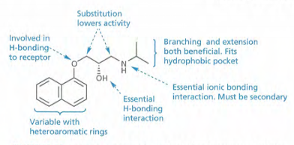
SAR of aryloxypropanolamines

Slide 79
Clinical aspects of β-blockers
β-blockers are used in the treatment of angina, myocardial infraction, arrhythmia and hypertension
First generation β blockers have various side effect
  Bronchoconstriction in asthmatic patients
  Fatigue and tiredness of limps due to reduced cardiac output

Slide 80
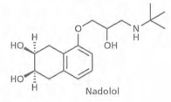
  CNS effect (dizziness, nightmares and sedation)
    propranolol, pindolol, which can cross BBB,
    nadolol is less likely to have such side effects. why?
coldness of extremities
Heart failure for patients on the verge of heart attack
Inhibition of noradrenaline release at synapse

Slide 81
Selective β1 blockers(second generation β- blockers)
Practolol
First cardioselective β1 blocker used for treatment of angina and hypertension
Selective for cardiac β1 receptors
Less potent than propranolol
Has much fever CNS effect than propranolol
  Its polar

Slide 82
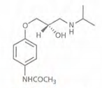
Cont…
Withdrawn from the market due to unexpected but serious side effect
  Skin rash, eye problem and peritonitis

Slide 83
SAR of selective β1 blockers
Investigation on selectivity of β1 adrenoceptors illustrate the following
  The amido group had to be in para position of the aromatic ring rather than meta or ortho position if the structure is required to retain selectivity for β1 receptors
    Which indicate extra hydrogen bonding interaction taking place with β1 receptors which was not taking place with β2 receptors

Slide 84
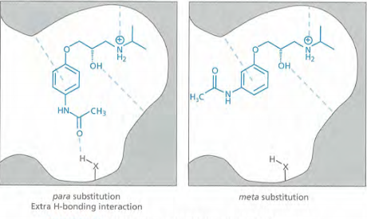
Binding interaction of antagonists with β1 receptors

Slide 85
SAR
Replacement of acetamido group with other groups capable of hydrogen bonding leads to series of cardioselective β1 blockers
  Acebutolol, atenolol, metoprolol, and betaxolol

Slide 86
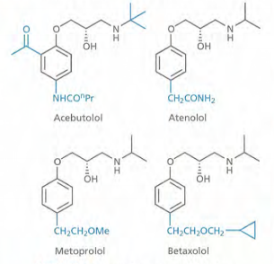
Second generation beta blockers

Slide 87
Third generation beta blockers
Produced by extension tactic
Addition of arylalkyl groups to nitrogen atom which bind to β1 receptors or using an additional hydrogen bonding interaction
  Includes epanolol, primidolol, and xamoterol

Slide 88
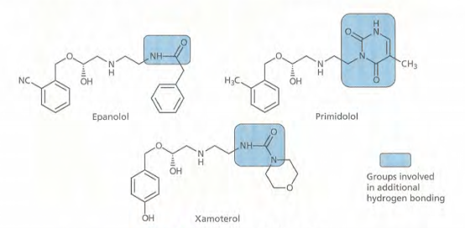
Third generation beta blockers

Slide 89
Clinical aspect of second and third generation β blockers
Xamoterol which is very selective β1 -partial agonist, is used in treatment of mild heart attack
They counter act over production of catecholamines resulted from enlarged thyroid gland or tomours of adrenal gland
Alleviate trauma of alcohol or drug withdrawal

Slide 90
Cont…
Relieving stress associated with situations such as exam, public speech etc
Timolol and betaxolol are used in treatment of glaucoma
Propranolol can be used to treat anxiety and migraine
  Unknown mechanism

Slide 91
Other drugs affecting adrenergic transmission
1. Drugs that affect the biosynthesis of adrenergics

Slide 92
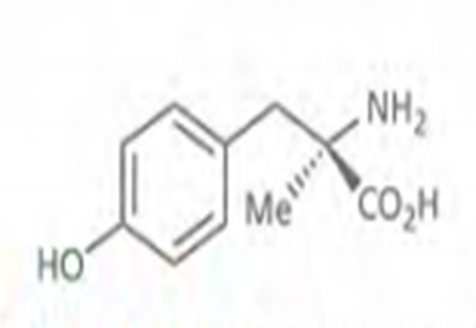
α -methyl tyrosine
Inhibit tyrosine hydroxylase
Sometimes used clinically to treat tumour cells which overproduce catecholamines

Slide 93
Cont…
Its sometimes possible to “fool” the enzyme of biosynthetic process into accepting an unnatural substrate such that false transmitter is produced and stored in storage vesicles

Slide 94
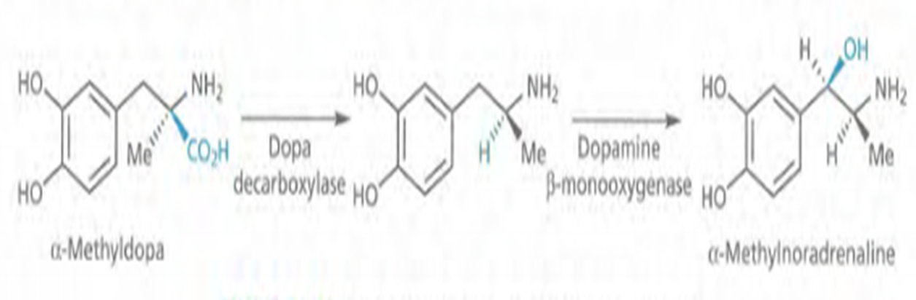
For example α -methyldopa is converted and stored in vesicles as α -methylnoradrenaline and displaces noradrenaline
  Such false transmitters are less effective than noradrenaline, so this is another way of down regulating adrenergic system
  Limited for the treatment of hypertension in late pregnancy
  Have series side effect which limit its therapeutic use

Slide 95
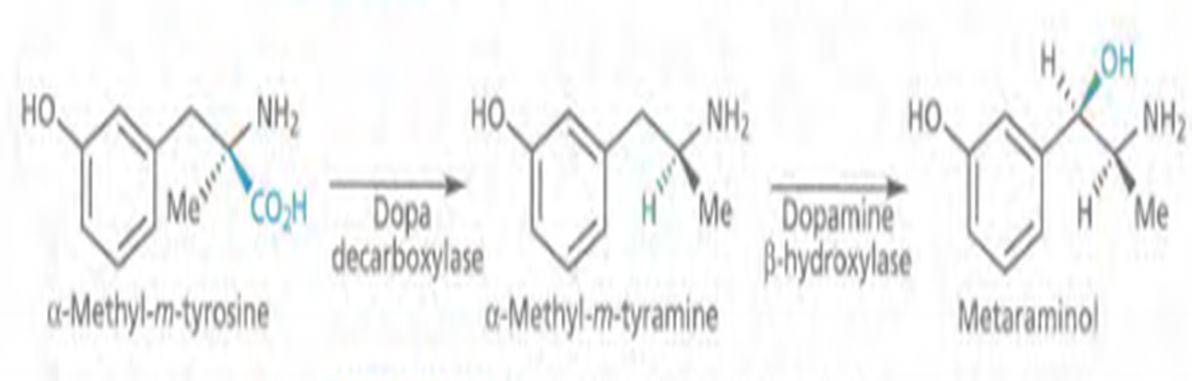
Cont…
Another example is α -methyl-m-tyrosine which is converted into metaraminol and stored

Slide 96
2. Drugs inhibiting uptake of noradrenaline into storage vesicles
Reserpine
bind to transport protein and inhibit it
  which is responsible to transport noradrenaline into vesicle
  leads to accumulation of noradrenaline in cytoplasm and its metabolism by MAO
As noradrenaline level drops, adrenergic activity drops
Used as an antihypertension. But no longer used
  Series side effect such as depression

Slide 97
3. Release of noradrenaline from storage vesicle
Guanethidine and Bretylium
Taken up into presynaptic neurons and storage vesicles by the same transport protein as noradrenaline
Displace noradrenaline in the same way as reserpine
Prevent exocytosis of the vesicle
  prevents release of the vesicle contents into the synaptic gap

Slide 98
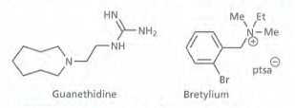
Guanethidine is effective antihypertensive agent but no longer used clinically
  Higher side effect
Bretylium is sometimes used to treat irregular heart rhythm

Slide 99
4. Reuptake inhibitors of noradrenaline
TCA (desipramine, imipramine, and amitriptyline)
Inhibit uptake by inhibiting the transport protein
Used for the treatment of depression
Able to act as inhibitors
  Superimposable on noradrenaline
Non selective and have higher side effect
  Interact with reuptake protein with serotonin
  Interact with sodium and calcium ion channels on the heart
    cardiotoxicity
  Interact with receptors for histamine, acetylcholine and noradrenaline

Slide 100
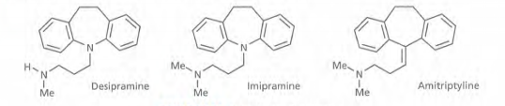

Slide 101
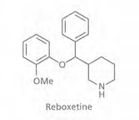
Reboxetine
Selectively inhibit noradrenaline uptake
No appreciable action on cholinergic and α1 adrenergic receptors
Rapidly desensitize α2 adrenergic receptors
  Enhance its activity further and speed up its onset of action

Slide 102
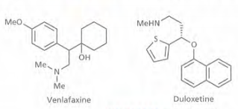
Duloxetine and Venlafaxine
Dual noradrenaline and serotonin reuptake inhibitor
More selective than classical TCA
Used in the treatment of depression

Slide 103

Bupropion
Inhibit reuptake of noradrenaline and dopamine
Used to treat depression
Aid to giving up smoking

Slide 104
Drugs which have structural similarity with noradrenaline
  Tyramine, amphetamine and ephedrine
  Transported into nerve terminal by noradrenaline transport protein
  Compete with noradrenaline leading to slow reabsorption of noradrenaline
  More importantly as foreign amines are transported into the nerve cell, noradrenaline transport out by the same transport protein
  They have indirect agonist effect on adrenergic system

Slide 105
Inhibition of metabolic enzyme
Inhibitors of MAO enzyme
Phenelzine, iproniazid and tranylcypromine
They interact with other drugs and foods
  Tyramine containing foods

Slide 106
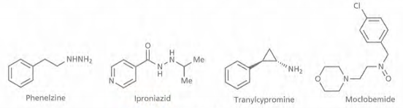

Slide 107
Antagonist of α2 adrenoceptors
They are autoreceptors present on presynaptic neuron that release noradrenaline and serotonin

Slide 108
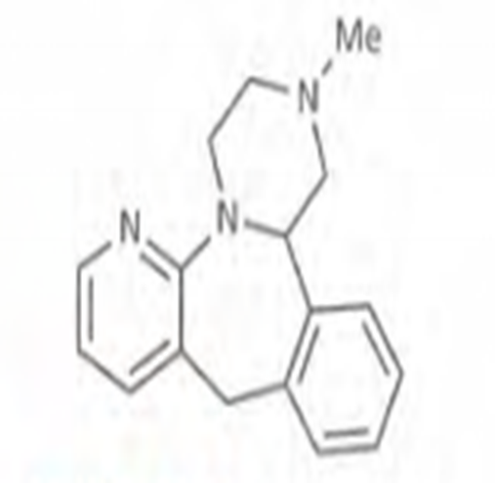
Mirtazapine
Antagonist of alpha 2 adrenoceptors
Used as antidepressant
Current work is looking at designing dual action drug that include the ability to block α2 adrenocepters and increase the concentration of noradrenaline

Slide 109
Thank you!!!

