Slide 1
Autacoids
Drug used for treatment of Inflammatory disorders

Slide 2
Autacoids
Autacoids or "autocoids" are biological factors (molecules) which act like local hormones
Have a brief duration, and act near their site of synthesis
The word autacoid comes from the Greek "autos" (self) and "acos" (relief; i.e., drug)
The effects of autacoids are primarily local, though large quantities can be produced and moved into circulation
  Autacoids may have systemic effects by being transported via the circulation

Slide 3
Classification
Biogenic amines: Histamine, 5-hydroxytryptamine
Biogenic Peptides: Angiotensin and kinins
Small Proteins: cytokines
Membrane derived lipids:
  Leukotrienes, Prostaglandins, Thromboxane A2, Platelate activating factors (PAF)
Endothelium-derived agents:
  Nitric oxide(gas), Endothelins (peptide)

Slide 4
Histamine
Histamine is synthesized by decarboxylation of L-histidine by histidine decarboxylase using pyridoxal phosphate as cofactor
Functions
Role in allergic responses
Release of other autacoids
Gastric secretagogue
Neurotransmitter → increased wakefulness, thermo regulation

Slide 5
Histamine Receptors and their Distribution
H1, H2 - located in post synaptic membrane
H1 - predominant in endotracheal & smooth muscle
H2 - facial veins, carotid a, pulm. a, heart, gastric mucosa, smooth muscle & some immune cells
H3 – several areas in CNS, presynaptic
H4-immune active cells & GI

Slide 6
Antihistamines
Divided into first-generation and second-generation agents.
The first-generation drugs are distinguished by the relatively strong sedative effects and more likely to block autonomic receptors.
The second-generation drugs are less sedating characteristic owing to less lipid-soluble to enter the CNS with difficulty or not at all
They are longer-acting.

Slide 7
First generation agents
Ethanolamines: Diphenhydramine, Dimenhydrinate
Ethylenediamines: Tripelennemine, Pyrilamine
Alkylamines: Chlorpheniramine maleate
Piperidines: Cyproheptadine, Phenindamine
Phenothiazines: Promethazine
Piperazines : Cyclizine , meclizine
Second generation Agents
Alkylamines: Acrivastine
Piperazines: Cetirizines
Piperidines: Loratadine, Fexofenadine

Slide 8
First generation H₁-blockers
Are the older and still widely used because they are effective & inexpensive.
↑Penetration to the CNS→ cause sedation.
Interact with other receptors producing a variety of unwanted side effects.
  Antimuscarinic, α-receptor blocking activity
Central depression usually accompanies therapeutic doses of the older H₁ antagonists.

Slide 9
Second generation antihistamines
The development of non sedating antihistamines was an important advance that allowed the general use of these agents.
The second-generation ("non sedating") H₁ antagonists are largely excluded from the brain when given in therapeutic doses
  because they do not cross the blood-brain barrier appreciably
have no effect on muscarinic and α receptors

Slide 10
Pharmacokinetics
The H₁ antagonists are well absorbed from the GI tract
peak plasma concentrations are achieved in 2 to 3 hours, and effects usually last 4 to 6 hours
Peak concentrations of these drugs are achieved rapidly in the skin and persist after plasma levels have declined
Most first generations are distributed widely throughout the body, including the CNS

Slide 11
Metabolized by liver. Also induce hepatic CYP450 enzymes and thus may facilitate their own metabolism.
Little, if any, is excreted unchanged in the urine; most appears there as metabolites
Astemizole and terfenadine induce a potentially fatal arrhythmia, torsades de pointes, when their metabolism was impaired
The withdrawal of terfenadine prompted the development of its active metabolite, fexofenadine , as a replacement
  lacks the toxic side effects of terfenadine and excreted primarily in the feces

Slide 12
Cetirizine, loratadine, and fexofenadine are all well absorbed and are excreted mainly in the unmetabolized form
Adverse Effects
The most frequent side effect is sedation.
loss of appetite, nausea, vomiting, epigastric distress, and constipation or diarrhea.
Anti-choliergic side effects.

Slide 13
α- blocking effect →postural hypotension, reflex tachycardia.
Several antihistamines (e.g.fexofenadine) showed teratogenic effects in animal studies
Others (e.g., chlorpheniramine, diphenhydramine, cetirizine, and loratadine) did not .
Can be excreted in small amounts in breast milk

Slide 14
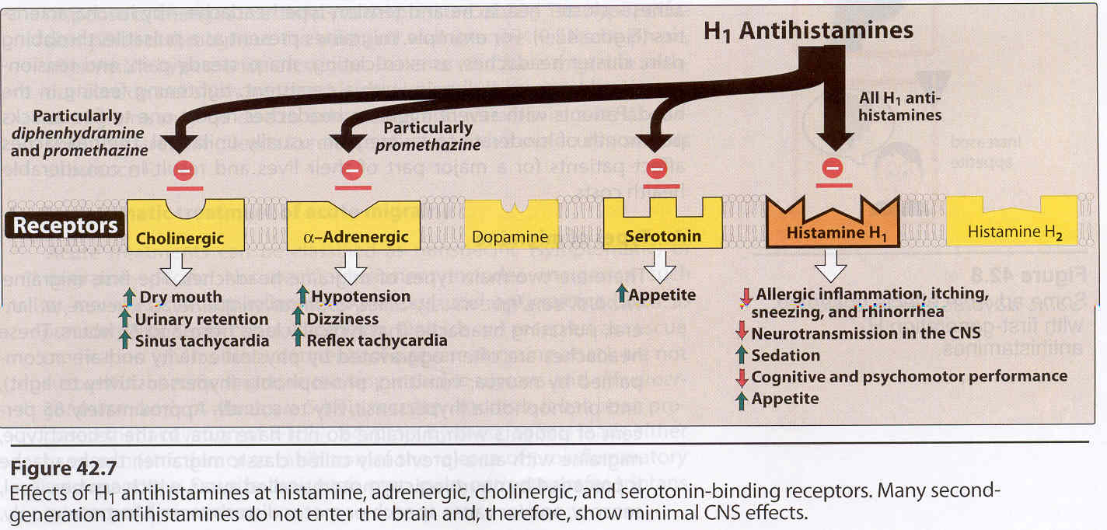

Slide 15
Eicosanoids
Membrane derived lipids
Most are produced from arachidonic acid a polyunsaturated fatty acid (5,8,11,14-eicosatetraenoic acid) (C20:4)
The eicosanoids are considered "local hormones."
Have specific effects on target cells close to their site of formation
Rapidly degraded, so they are not transported to distal sites within the body

Slide 16
Membrane phospholipids serve as reservoirs for arachidonic and related precursor fatty acids
Phosphatidyl-
choline
Eicosatrienoic
acid (C20:3)
Arachidonic
acid (C20:4)
Eicosapentanoic
acid (C20:5)

Slide 17
Pathways of arachidonic acid release
P
Lyso-PC
P
PLA₂
DAG-
Lipase
PLC
sPLA2
cPLA2
iPLA2
Diacylglycerol
Monacylglycerol
P

Slide 18
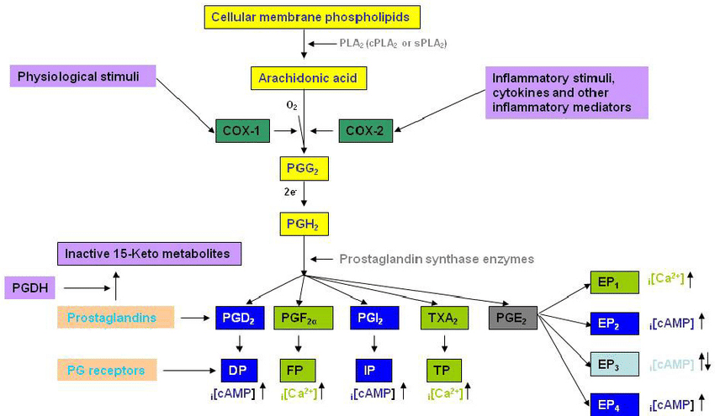
Synthesis of prostanoids

Slide 19
Functions of Ecosanoids
Inflammation: Prostaglandins E, I
Fever, pain: Prostaglandin E
Regulation of blood pressure: PGE
Blood clotting: PGE & PGI2
Immune system modulation :PGE2

Slide 20
Thrombocyte aggregation: stimulated by thromboxaneA_{2,} inhibited by prostaglandins E and I
Uterine contraction: PGE, PGF_{2α}
Integrity of gastric mucosa: Prostaglandins E, F
Regulation of blood flow and urine secretion in the kidney: Prostaglandin E, prostacyclin, thromboxane A2
Gastrointestinal motility: Prostaglandins E, F, I

Slide 21
Non Steroidal Anti Inflammatory drugs (NSAIDs)
The vast majority of NSAIDs are organic acids
They generally are well absorbed orally, highly bound to plasma proteins, and excreted either by glomerular filtration or by tubular secretion
They also accumulate in sites of inflammation, potentially confounding the relationship between plasma concentrations and duration of drug effect.
Include those with shorter (less than 6 hours) or longer (greater than 10 hours) half-lives.

Slide 22
Efforts to produce COX-2 selective led to the approval and marketing of rofecoxib, celecoxib, and valdecoxib
Diclofenac have cox2 selectivity ratios comparable to those of the least-selective of the novel COX-2 inhibitors, celecoxib
Acetaminophen at daily dose of 1000 mg, is associated with a reduced incidence of GI adverse effects.
At this dose, acetaminophen inhibits both COX by about 50%.

Slide 23
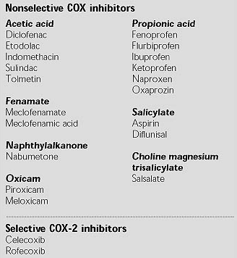
Classification

Slide 24
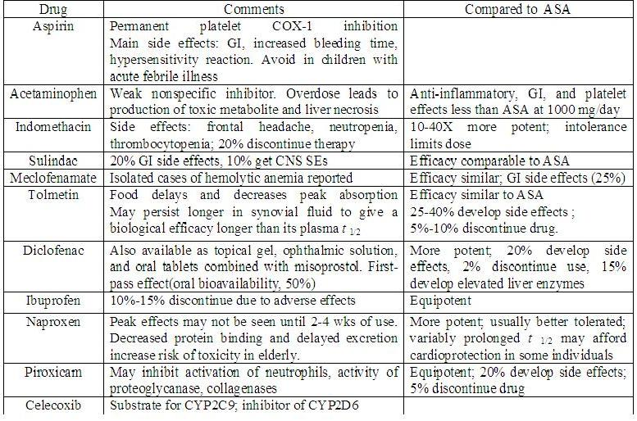

Slide 25
Therapeutic Effects
Usually effective only against pain of low-to-moderate intensity-dental pain, Chronic postoperative pain or pain arising from inflammation, menstrual pain.
Reduce fever in most situations, but not the circadian variation in temperature or the rise due to exercise or increased ambient temp.
Comparative analysis of the impact of NSAIDs and selective COX-2 inhibitors suggests that COX-2 is the dominant source of prostaglandins mediating the rise in temp
In general, NSAIDs provide only symptomatic relief from pain and inflammation associated with the disease, do not arrest the progression of pathological injury to tissue

Slide 26
Acetyl Salicylic Acid (ASA)
Irreversibly modifies COX-1 and COX-2; thus, the duration of aspirin's effects is related to the turnover rate of COX .
The duration of effect of other NSAIDs relates more directly to the time course of drug disposition.
The importance of enzyme turnover in relief from aspirin action is most notable in platelets.
The consequences of inhibition of platelet COX-1 last for the lifetime of the platelet, 8 to 12 days.
The unique sensitivity of platelets to inhibition by such low doses of aspirin is related to their presystemic inhibition in the portal circulation before aspirin is deacetylated to salicylate on first pass through the liver

Slide 27
Pharmacokinetics
Rapidly and completely absorbed from the GIT, with peak concentrations occurring within 1-4 hrs.
Extensively protein-bound (95% to 99%) and undergo hepatic metabolism and renal excretion.
Excreted in the urine as free salicyluric acid (75%), salicylic acid (10%), and salicylic phenolic (10%).

Slide 28
Adverse Effects
NVD, gastric erosions/ulcers, anemia, GI hemorrhage
Gastric perforation and Hypersensitivity
Salicylates intoxication: tinnitus, N, V, vertigo
Reye’s syndrome
When administered during the third trimester there is also an increase in perinatal mortality, anemia, antepartum and postpartum hemorrhage, prolonged gestation, and complicated deliveries
Salt and water retention
  decrease activities of antihypertensive medications, decreased urate excretion (at Low doses:1 or 2 g per day)

Slide 29
Contraindication
Children and young adults less than 20 years old with fever associated with viral illness for fear of Reye's syndrome
Reye's syndrome is characterized by
the acute onset of encephalopathy
liver dysfunction,
fatty infiltration of the liver and other viscera.

Slide 30
Acetaminophen
An effective alternative to aspirin as an analgesic-antipyretic
Well tolerated and has a low incidence of GI side effects
Acute overdosage can cause severe hepatic damage.
Acetaminophen has been found to be a selective COX-3 inhibitor in rodent studies.
Excellent bioavailability PO.
Peak plasma concentrations occur within 30 to 60 minutes
the half-life in plasma is about 2 hours after therapeutic doses.

Slide 31
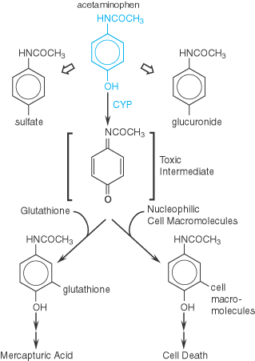
Metabolism

Slide 32
Adverse effects
Rash and other allergic reactions occur occasionally.
Potentially fatal hepatic necrosis
Renal tubular necrosis and hypoglycemic coma also may occur.
N- acetylcysteine (NAC) is antidote for acetaminophen toxicity.
  It both replete GSH stores and may conjugate directly with NAPQI by serving as a GSH substitute
NAC may protect against extrahepatic injury by its antioxidant and anti-inflammatory properties

Slide 33
Indomethacin
More potent inhibitor of COX than aspirin, but patient intolerance generally limits its use to short-term dosing
Effective for relieving joint pain, swelling, and tenderness, increasing grip strength, and decreasing the duration of morning stiffness
A very high percentage (35% to 50%) of patients receiving usual therapeutic doses of indomethacin experience untoward symptoms
GI complaints (can be serious), severe frontal headache and hematopoietic reactions .

Slide 34
Diclofenac
Its potency against COX-2 is substantially greater than that of indomethacin, naproxen, or several other NSAIDs.
appears to reduce intracellular concentrations of free AA in leukocytes, perhaps by altering its release or uptake.
Diclofenac has rapid absorption, extensive protein binding, and a short half-life
long-term symptomatic treatment of rheumatoid arthritis, and osteoarthritis
Causes GI side effects and moderate increase of transaminase
not recommended for children, or pregnant women

Slide 35
Ibuprofen
Nonselective cyclooxygenase inhibitor
Thought to be better tolerated than aspirin and indomethacin and has been used in patients with a history of GI intolerance than other NSAIDs.
Patients who develop ocular disturbances should discontinue the use of ibuprofen
Used in the treatment of rheumatoid arthritis and osteoarthritis .

Slide 36
COX-2 inhibitors
The first COX-2 inhibitors (e.g., celecoxib, rofecoxib, and valdecoxib) gained FDA approval based on a superior side-effect profile in gastrointestinal endoscopy studies when compared to tNSAIDs (t=traditional)
None of the coxibs has established clinical efficacy over tNSAIDs, while celecoxib has failed to establish superiority over tNSAIDs in reducing gastrointestinal adverse events.
The coxibs should be avoided in patients prone to cardiovascular or cerebrovascular disease.
Approved for treatment of osteoarthritis and rheumatoid arthritis.

Slide 37
Drugs used for treatment of Inflammation
The inflammatory process is the response of vascular tissues to an injurious stimulus
It can be evoked by a wide variety of noxious agents (e.g., infections, antibodies, or physical injuries)
The ability to mount an inflammatory response is essential for survival in the face of environmental pathogens and injury;
The inflammatory response may be exaggerated and sustained without apparent benefit and even with severe adverse consequences

Slide 38
The function of inflammation
  to eliminate the initial cause of cell injury
  clear out necrotic cells and tissues damaged from the original insult and the inflammatory process, and initiate tissue repair.
The five classical signs of inflammation irrespective of the type of noxious stimulus
  heat, pain, redness, swelling, and loss of function (Latin calor, dolor, rubor, tumor, and functio laesa)

Slide 39
Inflammatory responses occur in three distinct temporal phases, each apparently mediated by different mechanisms:
an acute phase, characterized by transient local vasodilation and increased capillary permeability;
a delayed, subacute phase characterized by infiltration of leukocytes and phagocytic cells; and
a chronic proliferative phase, in which tissue degeneration and fibrosis occur
Inflammatory mediators:
Prostaglandins, leukotrienes, inflamatory cytokines, histamines bradykinins, 5-HT, PAF etc

Slide 40
Gouty Arthritis
Gouty arthritis results from the precipitation of urate crystals in the tissues and the subsequent inflammatory response.
The pathophysiology of gout is understood poorly.
In most patients with gout, hyperuricemia arises from under excretion rather than overproduction of urate.
Urate tends to crystallize in colder or more acidic conditions.
Drugs used for treatment of gout are classified as
Reduce inflammation : Colchicine, NSAIDs and corticosteroids
Facilitate excretion of uric acid (uricosuric ): probenecid
Inhibit synthesis of uric acid: Allopurinol

Slide 41
Colchicine
Relieves the pain and inflammation of gouty arthritis in 12-24 hours without altering the metabolism or excretion of urates.
0.5-1 mg p.o. initially, followed by 0.5 mg every 30 minutes to 1 hour for a total dose of 6 mg
Mechanism of Action
Not well understood but proposed mechanisms include:-
  Inhibit phagocytosis (microtubular system): inhibit migration of granuloctes into the inflammed area and decrease metabolic and phagoctic activity of granulocytes
  Affect motility and adhesion of neutrophil

Slide 42
  Reduce release PGE2 and LTB4
  Replaced by NSAIDs because of the troublesome diarrhea
ADR
  Colchicine often causes diarrhea and may occasionally cause nausea, vomiting, and abdominal pain
  Rarely: - alopecia, bone marrow depression, peripheral neuritis and myopathy

Slide 43
Uricosuric agents
  Uricosuric agents increase the rate of excretion of uric acid
  Drugs include: Probenecid and Sulfinpyrazone.
  Probenecid, 500 mg p.o. 12 hourly.
Mechanism of Action
  Compete with urate inhibiting its re absorption via the urate-anion exchanger system.
  Uricosuric drugs may either decrease or increase the excretion of uric acid depending on dosage, increase at high dose and decrease at low dose

Slide 44
E.g low dosages of probenecid compete active secretary system.
One uricosuric drug may either add to or inhibit the action of another.
The drug may inhibit the secretion of the uricosuric agent, reduce access to its site of action
The inhibition of urate secretion by one drug may counterbalance the inhibition of urate reabsorption by the other
In a patient who excretes large amounts of uric acid, the uricosuric agents should not be used.
Therapy should be started at a lower dose
To avoid marked uricosuria

Slide 45
Take more fluid with probenicid treatment, b/c there is tendency to produce uric acid stones
ADR
  Both sulfinpyrazone and probenecid cause gastrointestinal irritation, but sulfinpyrazone is more active in this regard
  Rash develops for either drugs
  Nephrotic syndrome has occurred after the use of probenecid
  Both may rarely cause aplastic anemia

Slide 46
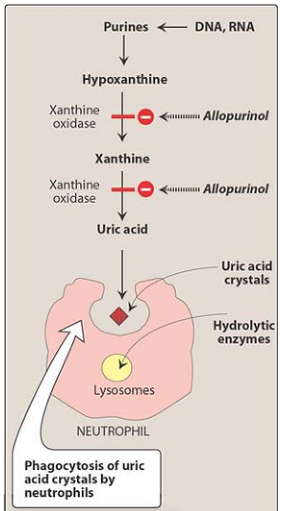
Xanthine oxidase inhibitors
Drug: Allopurinol
Drug used primarily to treat hyperuricemia
Reduces production of uric acid
Useful in chronic gout to prevent future attacks

Slide 47
  Allopurinol itself is metabolized by xanthine oxidase to form the active metabolite oxypurinol.
  Oxypurinol tends to accumulate after chronic administration of allopurinol.
    Contributes to the therapeutic effectiveness of allopurinol in long-term use.
  Oxypurinol itself is not administered because it is not well absorbed orally.

Slide 48
ADR
  Gastrointestinal intolerance, including nausea, vomiting, and diarrhea, may occur
  Peripheral neuritis and necrotizing vasculitis, depression of bone marrow elements, and rarely aplastic anemia may also occur.
  Hepatic toxicity and interstitial nephritis have been reported.
  Allergic skin reactions also occur.

Slide 49
Pegloticase
a medication for the treatment of severe, treatment-refractory, chronic gout
The drug is administered by infusion intravenously
Mechanism of action
Pegloticase is a recombinant porcine-like uricase
it metabolises uric acid to allantoin
This reduces the risk of precipitates, since allantoin is five to ten times more soluble than uric acid.

Slide 50
Uricase is a hepatic enzyme that converts uric acid into allantoin
Allantoin is more easily excreted by the kidney because of its water-solubility
In humans, a missense and frame shift mutation during evolution resulted in an inactivated gene encoding uricase
PEGylation is the process of attaching the strands of the polymer PEG to molecules
it reduces: immunogenicity, antigenicity, enzymatic degradation of drugs

Slide 51
Rheumatoid arthritis(RA)
Chronic, systemic auto immune inflammatory disease.
Characterized by persistent joint synovial tissue inflammation.
  Over time, bone erosion, destruction of cartilage, and complete loss of joint integrity can occur.
Most commonly, the small joints in the hands and feet are affected, but larger joints (Shoulders, knees etc) can also be affected.
Extra-articular involvement of multiple organ systems deformity.

Slide 52
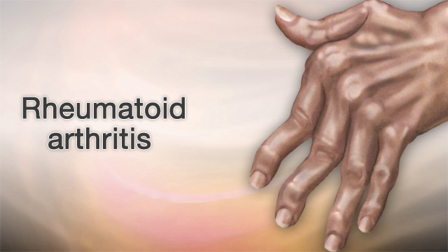

Slide 53
affects 1% of the population.
The pharmacological management of RA includes symptomatic relief through the use of NSAIDs.
However, although they have anti-inflammatory effects, NSAIDs have minimal, if any effect on progression of joint deformity.
DMARDs (disease-modifying anti-rheumatic drugs), on the other hand, reduce the disease activity of rheumatoid arthritis and retard the progression of arthritic tissue destruction.

Slide 54
Disease-Modifying Anti-Rheumatic Drugs
Methotrexate: Anti-folate
Leflunomide:Pyrimidine synthase inhibitor
Sulfasalazine: Salicylate
Azathioprine: Purine synthase inhibitor
Adalimumab, Infliximab: neutralize the activity of TNF-α
Entanrecept : TNF- α receptor blocker
Anakinra: IL-1-receptor antagonist
Short-term glucocorticoids often are used to bring the level of inflammation quickly under control
Glucocorticoids are not suitable for long-term use because of adrenal suppression.

Slide 55
Corticoseteroids
There action is non specific and covers all components and stages of inflammation.
They cause reduction in the increased capillary permeability, local exudation, cellular infiltration, phagocytic activity, capillary proliferation, collagen deposition, fibroblastic activity, and scar formation

Slide 56
Multiple mechanisms are involved in the suppression of inflammation by corticosteroids
  They have profound effects on the concentration, distribution, and function of peripheral leukocytes.
  They suppress the effects of inflammatory cytokines and chemokines.
  They depress the release of arachidonic acid from phospholipids and hence the production of arachidonic acid metabolites through the formation of lipocortin, an inhibitor of phospholipase A2.

Slide 57
General mechanism of actions
Corticosteroids interact with specific cytoplasmic receptor proteins → regulate the expression of corticosteroid-responsive genes → regulation of protein synthesis
  Upregulate anti inflammatory genes and downregulate pro-inflamamatory genes
Effects are not immediate but become apparent after several hours
However effects persist much longer than the steroid itself

Slide 58
Preparations
Prednisolone
  Four times more potent than hydrocortisone
  It is more selective glucocorticoid but fluid retention can occur at higher doses
Methylprednisolone
  Slightly more potent and more selective than prednisolone

Slide 59
Triamcinolone
  Slightly more potent than prednisolone but highly selective glucocorticoid
Dexamethasone
  Very potent and highly selective glucocorticoid
  Fluid retention and hypertension are not problem
Betametasone
  Similar to dexamethasone

Slide 60
Beclomethasone, and budensonide
  Topically active glucocorticoids
  Used topically in asthma (inhalation), nasal allergy ( sprays)

