Slide 1
Factor Timing – Impact of Timing on Factor Returns

Slide 2
Background
Two opposing schools of thought about factor timing discuss whether factor timing significantly improves portfolio returns
Project Goals
Explore the relationship between timing variables and factor returns
Define trading strategies using timing information
Check if the strategies generate a positive alpha in comparison with the factor itself

Slide 3
Data Description
Factor Data:
Fama French (FF) value and momentum factors from 1973 to 2018
Timing Variables Data:
Factor’s recent performance over N-period window (measured by factor momentum)
Performance of equity market ( FF Market – Risk free)
Growth rate of industrial production

Slide 4
Predicting factor returns
Univariate regression – one for each timing variable
Multivariate regression – Using all timing variables
Loop for different values of lookback period (N)
From this analysis, we found that multivariate regression yields the best results in terms of MSE and adjusted R²

Slide 5
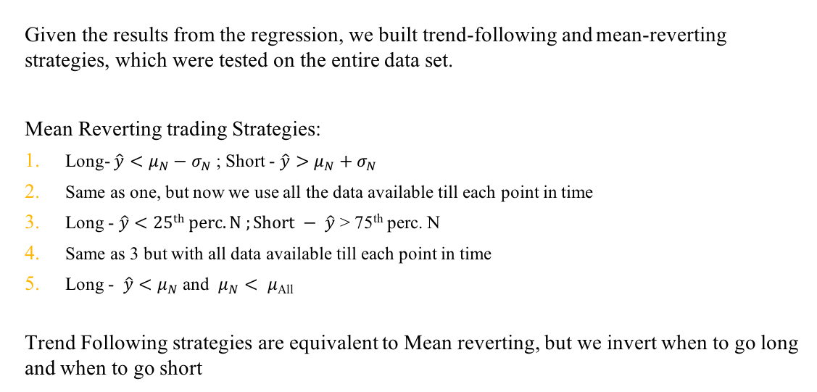
Testing Strategies
Given the results from the regression, we built trend-following and mean-reverting strategies, which were tested on the entire data set.
Mean Reverting trading Strategies:
Long- $\hat{y}<μ_{N}−σ_{N}$ ; Short - $\hat{y}>μ_{N}+σ_{N}$
Same as one, but now we use all the data available till each point in time
Long - $\hat{y}<25th perc. N ;Short − \hat{y}$ > 75th perc. N
Same as 3 but with all data available till each point in time
Long - $\hat{y}<μ_{N}$ and $μ_{N}< μ$_{All}
Trend Following strategies are equivalent to Mean reverting, but we invert when to go long and when to go short

Slide 6
And tables to compare data
 | A | B | C
Yellow | 10 | 20 | 7
Blue | 30 | 15 | 10
Orange | 5 | 24 | 16

