Slide 1





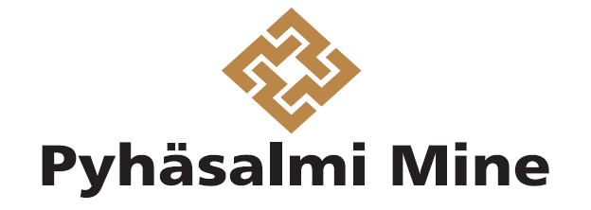

A mine as a source of geothermal energy case study from Pyhäsalmi, Finland
K. Piipponen, J. Hietava, N. Leppäharju, A. Martinkauppi, K. Korhonen and L. Ahonen
Geological Survey of Finland
kaiu.piipponen@gtk.fi

Slide 2
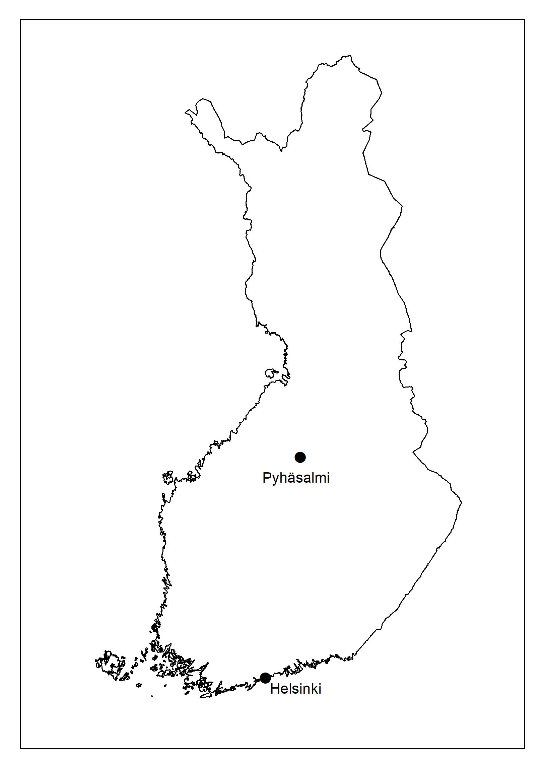
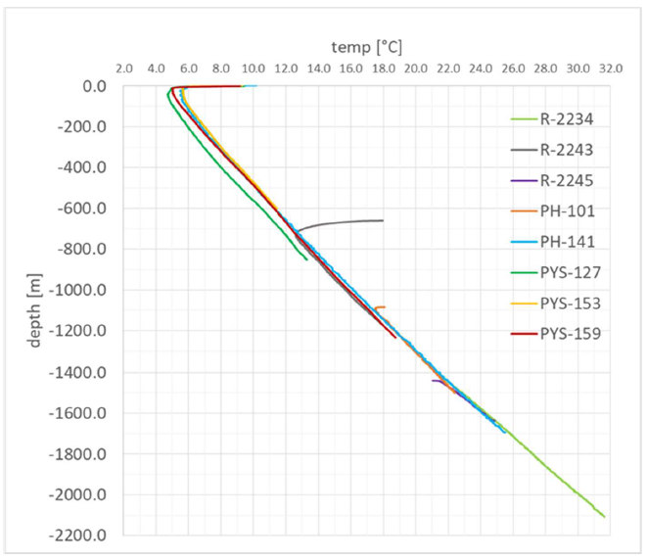
Project overview
Finland
Pyhäsalmi mine is a 1440 m deep Cu-Zn-S mine. It is located in Fennoscandian shield, with Precambrian crystalline rock, low thermal gradient and low surface temperature
Pyhäjärvi is a municipality of 5100 people. Pyhäsalmi mine is the largest employer of the area, but it will be decommissioned in 2021
Pyhäjärvi
In the project ”Energy Mine” we studied possibilities for geothermal energy utilization and heat storage in a borehole heat exchanger (BHE) field
The mine is a unique, vast underground space, so the aim is to make the best use of it without flooding the mine
Other projects considered in the mine include neutron detecting facility (Laguna, decommissioned), pumped storage hydropower plant, fish and vegetable farming, drying food, and tourism, among others
Near-surface annual average temperature is about 4 °C and geothermal gradient is 12-14 K/km. Temperature at the bottom of the mine is 20 - 25 °C

Slide 3
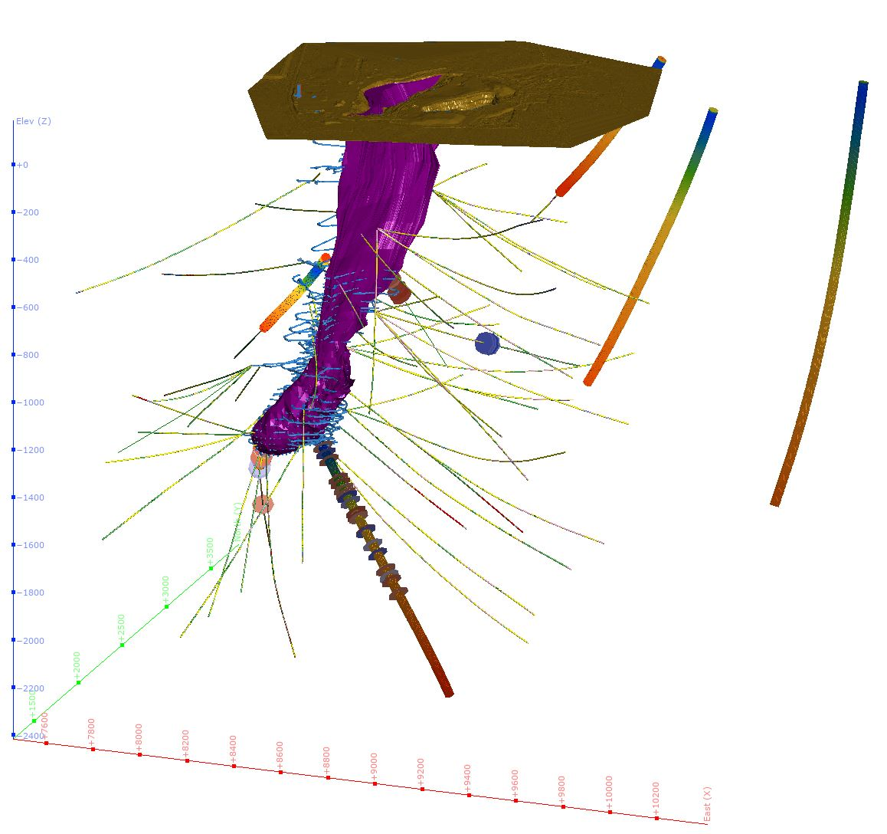
Thermogeology: measurements and 3D model
All drilling data and geological data is from Pyhäsalmi Mine
The figure shows the ore body (purple), tunnels in the mine (blue lines) and drillholes
The use of the 3D model in the Energy Mine Project:
Selection of suitable Distributed Thermal Sensing (DTS) measurement locations and drillholes
4 boreholes from the surface and 4 from the mine (thick lines in the figure)
Selection of petrophysical thermal conductivity samples from specific drillholes
57 samples from 4 drillholes (marked with disks in the figure)
Descriptions and modelling of specific structural geology issues
Design of the location and dimensions of a BHE field

Slide 4
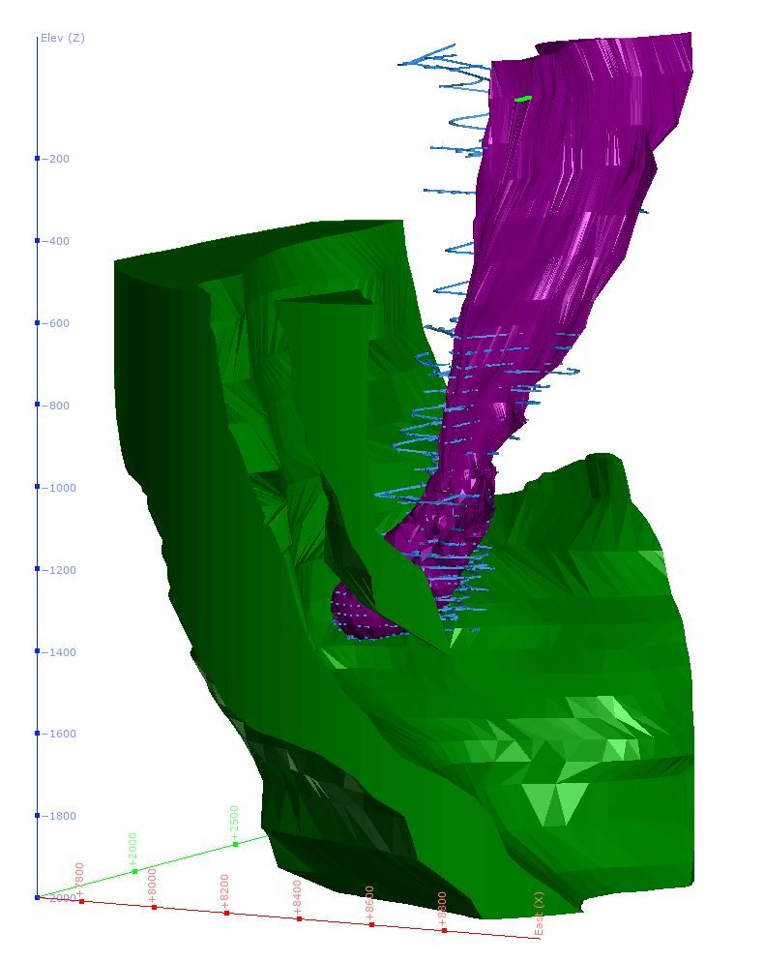
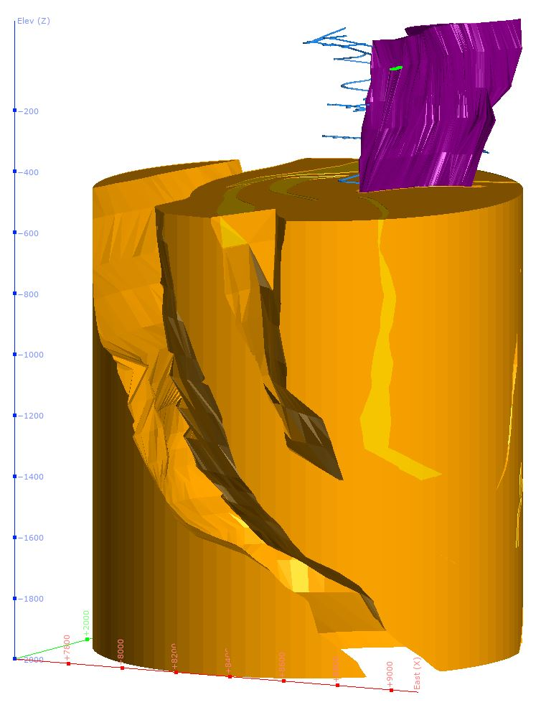
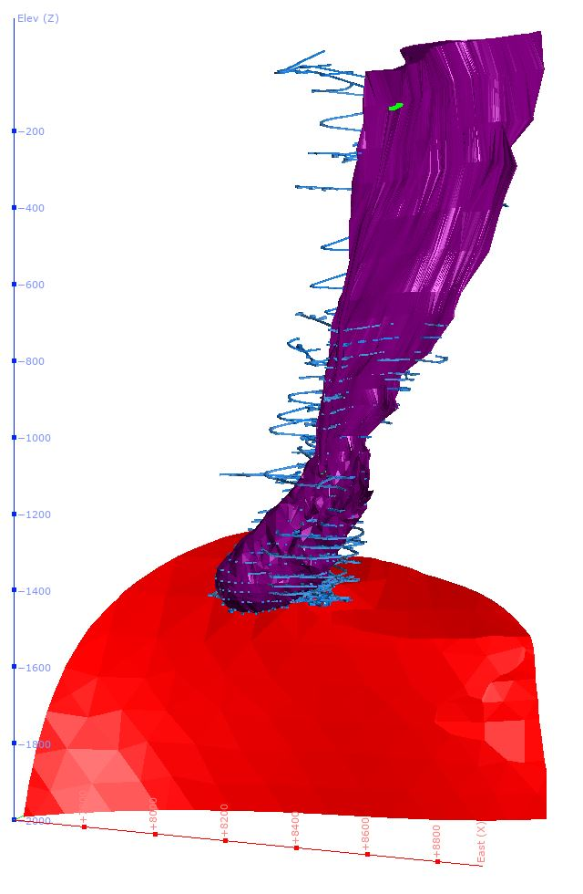
Thermogeologically the Pyhäsalmi rocks can be broadly divided into three parts:
Mafic volcanic rock; intermediate thermal conductivity; thermal anisotropy
Felsic volcanic rock; good thermal conductivity; thermal anisotropy
Porphyry granite, good thermal conductivity, thermal isotropy
Generalized rock species |  | Density | Thermal conductivity | Specific heat capacity
 | ∑ samples | [kg/m³] | [W m⁻¹ K⁻¹] | [J kg⁻¹ K⁻¹]
Mafic volcanic | 22 | 2975±76 | 2.27±0.16 | 682±22
Felsic volcanic | 21 | 2708±46 | 3.40±0.44 | 681±24
Granitoid | 14 | 2639±18 | 3.24±0.22 | 685±33
Summary | 57 | 2794±156 | 2.92±0.61 | 682±25

Slide 5
Geothermal heat production
Borehole heat exchanger optimization was done to compare 300 m deep U-tube and coaxial collectors. We also compared different insulation levels for the coaxial tube and flow direction in the coaxial collector
The results show that insulated coaxial collector has the best performance. Injection through annulus is X% more effective than injection through central pipe.
See details in presentation: D923 | EGU2020-8696 Geothermal energy in Pyhäsalmi mine, Finland: performance evaluation of heat collector type
The best performing collector was placed to the underground borehole field of hemispherical shape
The results show that a borehole field of 136 BHE’s can produce up to 1 MW production for 25 years
See details in presentation: D925 | EGU2020-9104 Hemispherical underground borehole heat exchanger field as a source of geothermal energy

