Slide 1
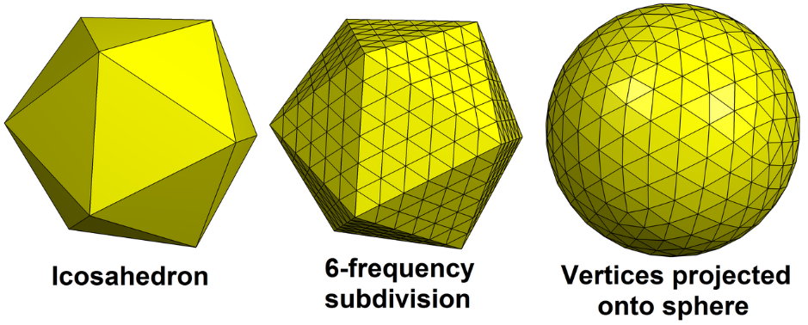
Generating the BHE field 1/2
The BHE field geometry was based on a geodesic sphere that is generated from an icosahedron
The triangular faces of an icosahedron are subdivided using smaller triangles
The resulting new vertices are projected onto the surface of the sphere
The number of resulting triangles depend on the subdivision level
The triangles in the resulting tessellation have edges that are approximately equal in length
All tessellations were generated using Python and meshzoo by Nico Schlömer (github.com/nschloe/meshzoo)
Level 6
subdivision
After Tomruen CC BY-SA 4.0
https://commons.wikimedia.org/w/index.php?curid=56100755

Slide 2
Generating the BHE field 2/2
The direction vectors of BHEs were calculated as
Only lower hemisphere vertices (z ≤ 0) were used (no upward inclined BHEs)
Each vertex in the lower hemisphere is an endpoint of a BHE
The BHEs cannot start from the same starting point
Would lead to problems in numerical modelling
In reality boreholes are drilled through cavern walls, not from a single point

