Slide 1

The CIA Framework
Confidentiality – Prevents unauthorised access to information
Integrity – Protects accuracy and completeness of information
Availability – Ensures systems and data are accessible when required
Notes:
The CIA triad is a foundational framework used to analyse and manage information security risks. It provides a conceptual structure for understanding how information assets can be compromised. Confidentiality addresses who can access information, integrity focuses on whether information can be trusted, and availability ensures information and systems are accessible to support business operations. At a strategic level, organisations must balance all three elements based on risk appetite, regulatory requirements, and operational priorities.

Slide 2
Threats to Confidentiality
Espionage and trespass
Industrial espionage
Shoulder surfing
Social engineering
Phishing and pharming
Password attacks
Packet sniffing and spoofing
Man-in-the-middle attacks
Information extortion
Intellectual property theft
Notes:
Confidentiality threats involve the unauthorised disclosure of information, often without immediate detection. Many of these threats exploit human behaviour rather than technical weaknesses, particularly social engineering and phishing. At an organisational level, confidentiality breaches can result in legal penalties, loss of intellectual property, and reputational damage. Effective mitigation therefore requires technical controls, governance oversight, and staff awareness training.

Slide 3
Threats to Integrity
Human error or failure
Accidental data deletion or modification
Erroneous data entry
Malware (viruses, worms, Trojans)
Software bugs and vulnerabilities
SQL injection
Command injection
Cross-site scripting (XSS)
Sabotage and vandalism
Website defacement
Notes:
Integrity threats compromise the accuracy and reliability of information. Human error remains a dominant factor, highlighting the importance of process controls and validation mechanisms. Technical attacks such as SQL injection allow attackers to modify data directly. Integrity failures are particularly dangerous because incorrect data may be trusted and used for decision-making before the issue is detected.

Slide 4
Threats to Availability
Denial-of-Service (DoS) attacks
Distributed Denial-of-Service (DDoS) attacks
Mail bombing
ISP and hosting failures
Telecommunications failures
Utility service disruptions
Power irregularities
Hardware failures
Technological obsolescence
Forces of nature
Notes:
Availability threats prevent authorised users from accessing systems and information when required. These threats often have immediate and visible business impacts such as service outages and revenue loss. At an advanced level, organisations must address availability through redundancy, disaster recovery planning, business continuity strategies, and supplier risk management rather than relying solely on technical defences.

Slide 5
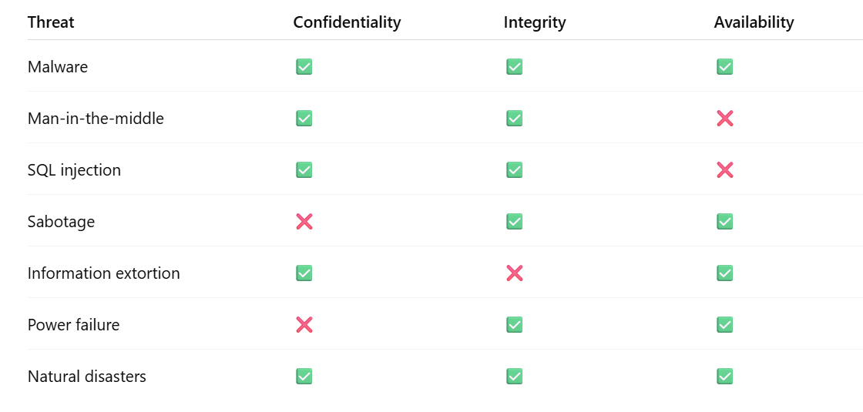
Overlap summary

