Slide 1
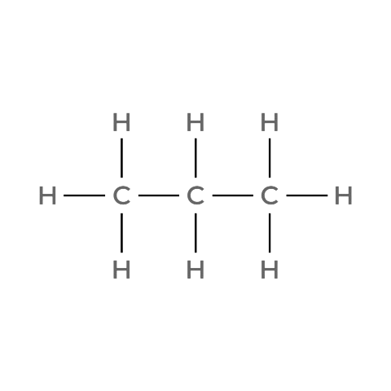
CARD 01 — PROPANE
CHEM 13 • ACTIVITY 02
Molecular Formula: C₃H₈
1. MOLECULAR FORMULA
2. LEWIS STRUCTURE
C₃H₈
3. CONDENSED STRUCTURAL FORMULA
4. BOND-LINE FORMULA (KETCHER)
CH₃CH₂CH₃
VERIFICATION STRIP
✔
✔
✔
Bond order checked
Same connectivity confirmed
✔
Atom count verified
Valence checked

Slide 2
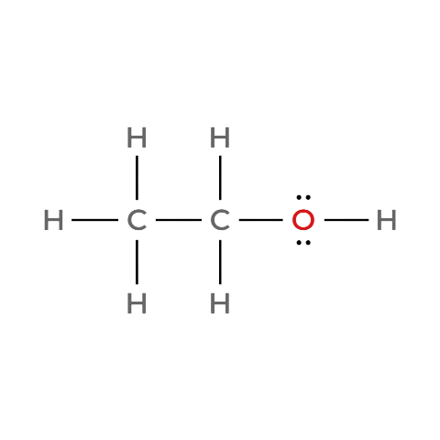

CARD 02 — ETHANOL
CHEM 13 • ACTIVITY 02
Molecular Formula: C₂H₆O
1. MOLECULAR FORMULA
2. LEWIS STRUCTURE
C₂H₆O
3. CONDENSED STRUCTURAL FORMULA
4. BOND-LINE FORMULA (KETCHER)
CH₃CH₂OH
VERIFICATION STRIP
✔
✔
✔
Bond order checked
Same connectivity confirmed
✔
Atom count verified
Valence checked

Slide 3
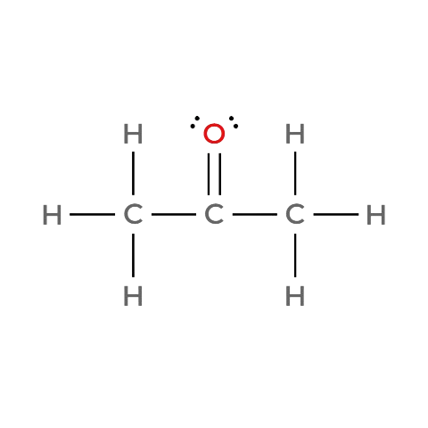

CARD 03 — ACETONE (PROPAN-2-ONE)
CHEM 13 • ACTIVITY 02
Molecular Formula: C₃H₆O
1. MOLECULAR FORMULA
2. LEWIS STRUCTURE
C₃H₆O
3. CONDENSED STRUCTURAL FORMULA
4. BOND-LINE FORMULA (KETCHER)
CH₃C(=O)CH₃
VERIFICATION STRIP
✔
✔
✔
Bond order checked
Same connectivity confirmed
✔
Atom count verified
Valence checked

Slide 4
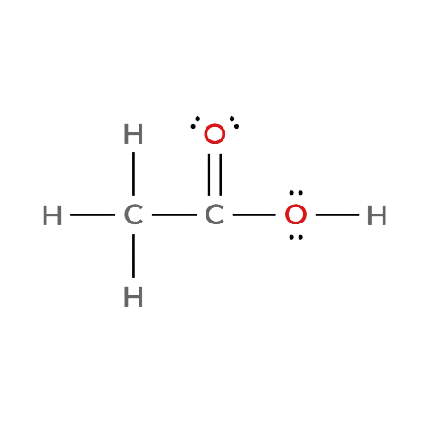

CARD 04 — ACETIC ACID (ETHANOIC ACID)
CHEM 13 • ACTIVITY 02
Molecular Formula: C₂H₄O₂
1. MOLECULAR FORMULA
2. LEWIS STRUCTURE
C₂H₄O₂
3. CONDENSED STRUCTURAL FORMULA
4. BOND-LINE FORMULA (KETCHER)
CH₃C(=O)OH
VERIFICATION STRIP
✔
✔
✔
Bond order checked
Same connectivity confirmed
✔
Atom count verified
Valence checked

Slide 5
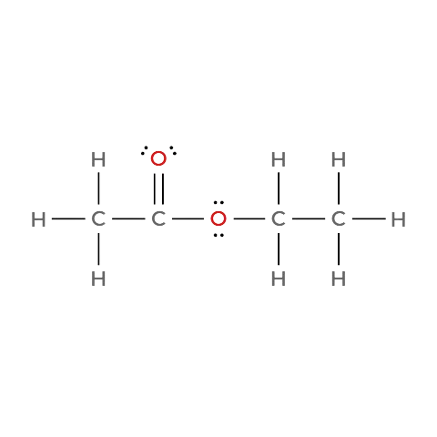

CARD 05 — ETHYL ACETATE (ETHYL ETHANOATE)
CHEM 13 • ACTIVITY 02
Molecular Formula: C₄H₈O₂
1. MOLECULAR FORMULA
2. LEWIS STRUCTURE
C₄H₈O₂
3. CONDENSED STRUCTURAL FORMULA
4. BOND-LINE FORMULA (KETCHER)
CH₃C(=O)OCH₂CH₃
VERIFICATION STRIP
✔
✔
✔
Bond order checked
Same connectivity confirmed
✔
Atom count verified
Valence checked

Slide 6
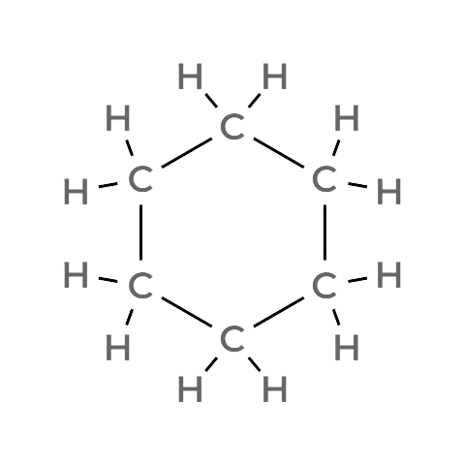

CARD 06 — CYCLOHEXANE
CHEM 13 • ACTIVITY 02
Molecular Formula: C₆H₁₂
1. MOLECULAR FORMULA
2. LEWIS STRUCTURE
C₆H₁₂
3. CONDENSED STRUCTURAL FORMULA
4. BOND-LINE FORMULA (KETCHER)
(CH₂)₆ (ring)
VERIFICATION STRIP
✔
✔
✔
Bond order checked
Same connectivity confirmed
✔
Atom count verified
Valence checked

Slide 7
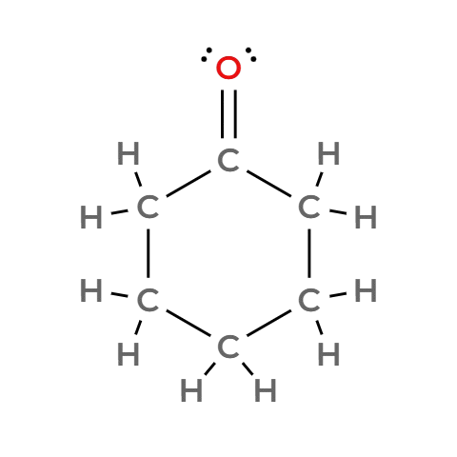

CARD 07 — CYCLOHEXANONE
CHEM 13 • ACTIVITY 02
Molecular Formula: C₆H₁₀O
1. MOLECULAR FORMULA
2. LEWIS STRUCTURE
C₆H₁₀O
3. CONDENSED STRUCTURAL FORMULA
4. BOND-LINE FORMULA (KETCHER)
cyclo-(CH₂)₅C=O
VERIFICATION STRIP
✔
✔
✔
Bond order checked
Same connectivity confirmed
✔
Atom count verified
Valence checked

Slide 8
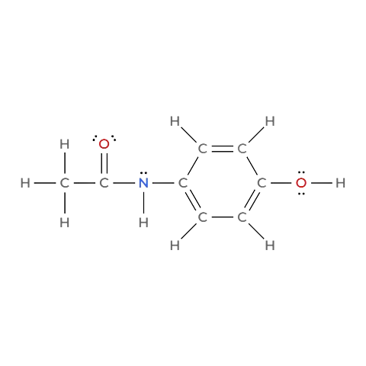
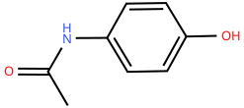
CARD 08 — ACETAMINOPHEN (PARACETAMOL)
CHEM 13 • ACTIVITY 02
Molecular Formula: C₈H₉NO₂
1. MOLECULAR FORMULA
2. LEWIS STRUCTURE
C₈H₉NO₂
3. CONDENSED STRUCTURAL FORMULA
4. BOND-LINE FORMULA (KETCHER)
CH₃C(=O)NH–C₆H₄–OH
VERIFICATION STRIP
✔
✔
✔
Bond order checked
Same connectivity confirmed
✔
Atom count verified
Valence checked

Slide 9
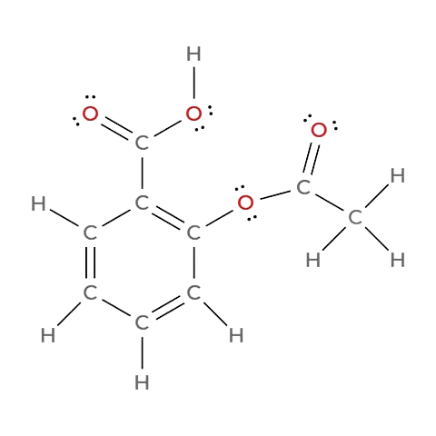
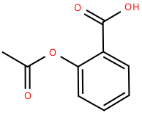
CARD 09 — ASPIRIN (ACETYLSALICYLIC ACID)
CHEM 13 • ACTIVITY 02
Molecular Formula: C₉H₈O₄
1. MOLECULAR FORMULA
2. LEWIS STRUCTURE
C₉H₈O₄
3. CONDENSED STRUCTURAL FORMULA
4. BOND-LINE FORMULA (KETCHER)
CH₃C(=O)O–C₆H₄–C(=O)OH
VERIFICATION STRIP
✔
✔
✔
Bond order checked
Same connectivity confirmed
✔
Atom count verified
Valence checked

Slide 10
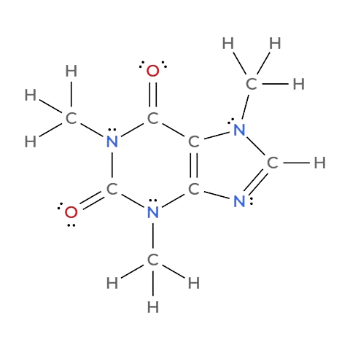
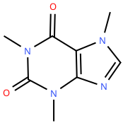
CARD 10 — CAFFEINE
CHEM 13 • ACTIVITY 02
Molecular Formula: C₈H₁₀N₄O₂
1. MOLECULAR FORMULA
2. LEWIS STRUCTURE
C₈H₁₀N₄O₂
3. CONDENSED STRUCTURAL FORMULA
4. BOND-LINE FORMULA (KETCHER)
CH₃–N¹–CH=N–C²=C¹–C(=O)–N(CH₃)–C(=O)–N²–CH₃
VERIFICATION STRIP
✔
✔
✔
Bond order checked
Same connectivity confirmed
✔
Atom count verified
Valence checked

