Slide 1
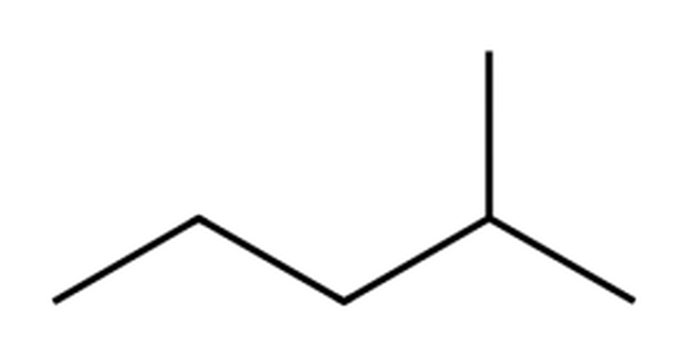
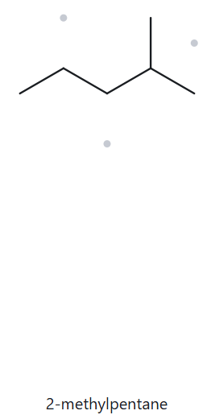
A01 FOUNDATION Part A · Structure → Name
Molecular formula:
C₆H₁₄
1 · NUMBERED PARENT
2 · NAMING TRAIL
Parent: longest chain = 5 C → pentane.
Numbering: left → right gives 4; right → left gives 2. 2 < 4, so number from the right.
Substituents: methyl on C2 → 2-methyl.
4
2
5
3
1
3 · MY NAME
4 · THE ALKANE CHECK
2-methylpentane
Returned name:
2-methylpentane
✓ Match
Same as my name (2-methylpentane): parent, locants, substituents and punctuation all agree.
✓ longest chain confirmed ✓ lowest locants ✓ alphabetical order ✓ punctuation ✓ formula counted

Slide 2
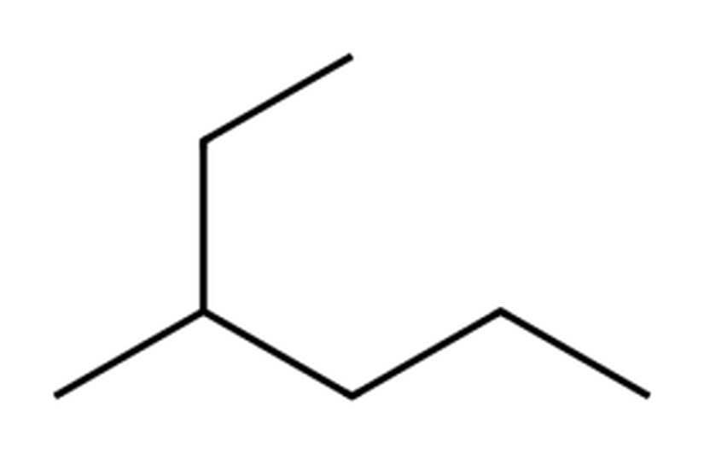
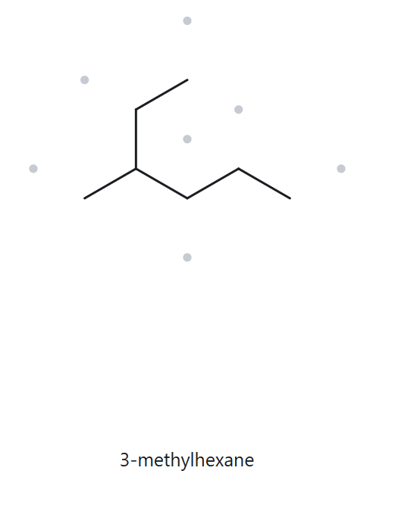
A02 FOUNDATION Part A · Structure → Name
Molecular formula:
C₇H₁₆
1 · NUMBERED PARENT
2 · NAMING TRAIL
1
Parent: longest chain = 6 C → hexane (not the horizontal line: top end → branch carbon → lower zigzag).
Numbering: top end → bottom-right end gives 3; bottom-right end → top end gives 4. 3 < 4, so number from the top end.
Substituents: methyl on C3 → 3-methyl.
2
3
5
4
6
3 · MY NAME
4 · THE ALKANE CHECK
3-methylhexane
Returned name:
3-methylhexane
✓ Match
Same as my name (3-methylhexane): parent, locants, substituents and punctuation all agree.
✓ longest chain confirmed ✓ lowest locants ✓ alphabetical order ✓ punctuation ✓ formula counted

Slide 3
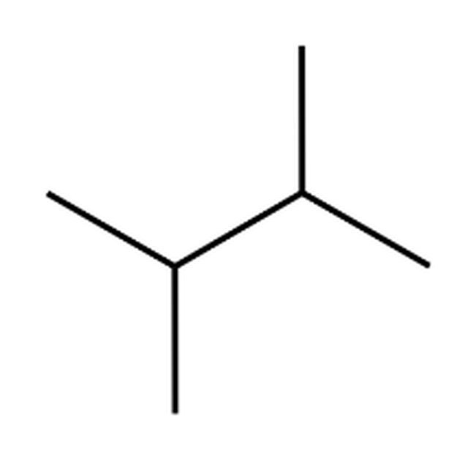
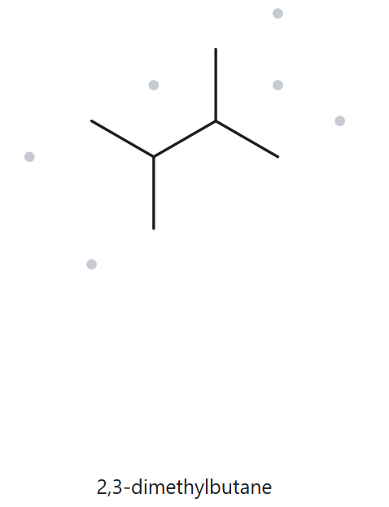
A03 FOUNDATION Part A · Structure → Name
Molecular formula:
C₆H₁₄
1 · NUMBERED PARENT
2 · NAMING TRAIL
Parent: longest chain = 4 C → butane.
Numbering: left → right gives 2,3; right → left gives 2,3. Tie: both directions give the same name.
Substituents: methyl on C2 and on C3 → 2,3-dimethyl.
1
3
2
4
3 · MY NAME
4 · THE ALKANE CHECK
2,3-dimethylbutane
Returned name:
2,3-dimethylbutane
✓ Match
Same as my name (2,3-dimethylbutane): parent, locants, substituents and punctuation all agree.
✓ longest chain confirmed ✓ lowest locants ✓ alphabetical order ✓ punctuation ✓ formula counted

Slide 4
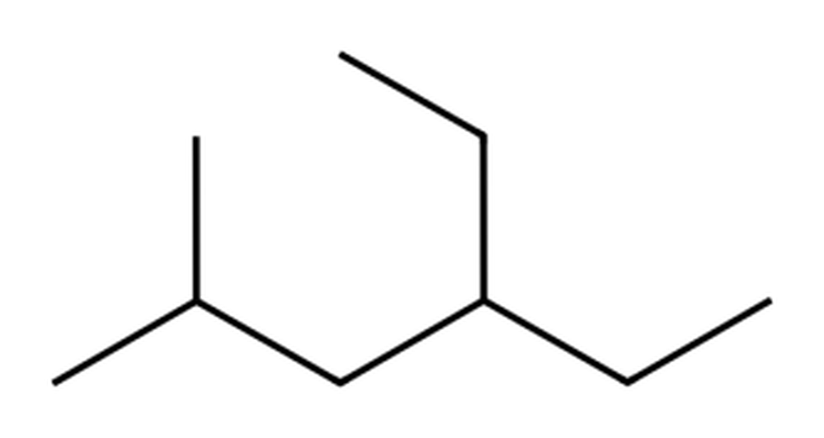
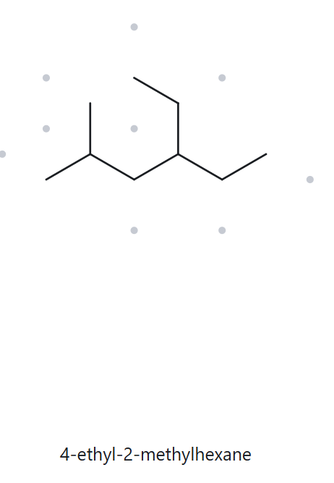
A04 DEVELOPING Part A · Structure → Name
Molecular formula:
C₉H₂₀
1 · NUMBERED PARENT
2 · NAMING TRAIL
Parent: longest chain = 6 C → hexane (the equal-length chains all carry one methyl and one ethyl).
Numbering: left → right gives 2,4; right → left gives 3,5. First point of difference: 2 < 3, so number from the left.
Substituents: A→Z: ethyl on C4, methyl on C2 → 4-ethyl-2-methyl.
2
4
6
1
3
5
3 · MY NAME
4 · THE ALKANE CHECK
4-ethyl-2-methylhexane
Returned name:
4-ethyl-2-methylhexane
✓ Match
Same as my name (4-ethyl-2-methylhexane): parent, locants, substituents and punctuation all agree.
✓ longest chain confirmed ✓ lowest locants ✓ alphabetical order ✓ punctuation ✓ formula counted

Slide 5
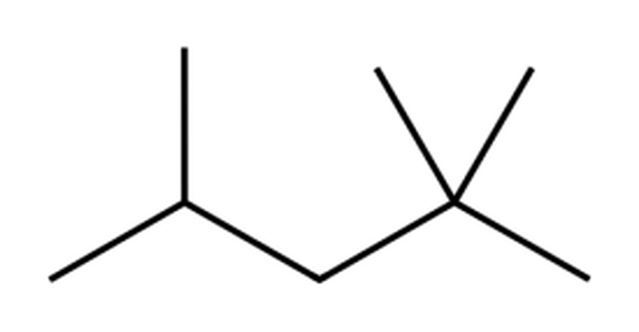
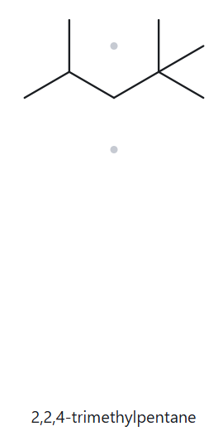
A05 DEVELOPING Part A · Structure → Name
Molecular formula:
C₈H₁₈
1 · NUMBERED PARENT
2 · NAMING TRAIL
Parent: longest chain = 5 C → pentane (the equal-length chains all carry three methyls).
Numbering: right → left gives 2,2,4; left → right gives 2,4,4. First point of difference: 2 < 4, so number from the right.
Substituents: methyl on C2 (two) and on C4 → 2,2,4-trimethyl.
4
2
5
3
1
3 · MY NAME
4 · THE ALKANE CHECK
2,2,4-trimethylpentane
Returned name:
2,2,4-trimethylpentane
✓ Match
Same as my name (2,2,4-trimethylpentane): parent, locants, substituents and punctuation all agree.
✓ longest chain confirmed ✓ lowest locants ✓ alphabetical order ✓ punctuation ✓ formula counted

Slide 6
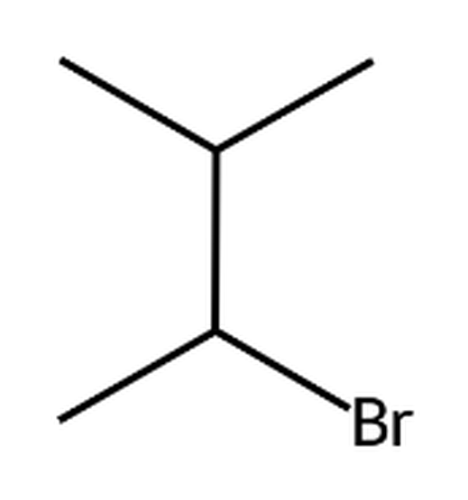
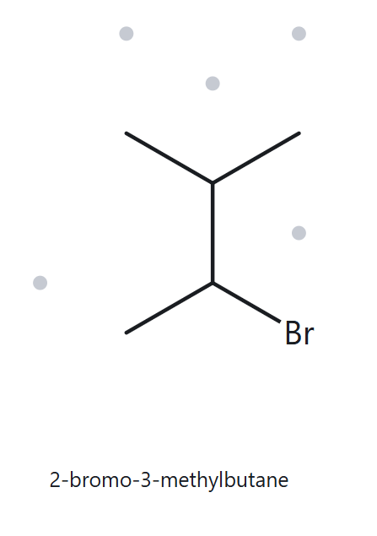
A06 DEVELOPING Part A · Structure → Name
Molecular formula:
C₅H₁₁Br
1 · NUMBERED PARENT
2 · NAMING TRAIL
4
Parent: longest chain = 4 C → butane (bromine is a substituent).
Numbering: bottom → top gives 2,3; top → bottom gives 2,3. Tie: bromo is first alphabetically, so it takes C2 (number from the bottom).
Substituents: A→Z: bromo on C2, methyl on C3 → 2-bromo-3-methyl.
3
2
1
3 · MY NAME
4 · THE ALKANE CHECK
2-bromo-3-methylbutane
Returned name:
2-bromo-3-methylbutane
✓ Match
Same as my name (2-bromo-3-methylbutane): parent, locants, substituents and punctuation all agree.
✓ longest chain confirmed ✓ lowest locants ✓ alphabetical order ✓ punctuation ✓ formula counted

Slide 7
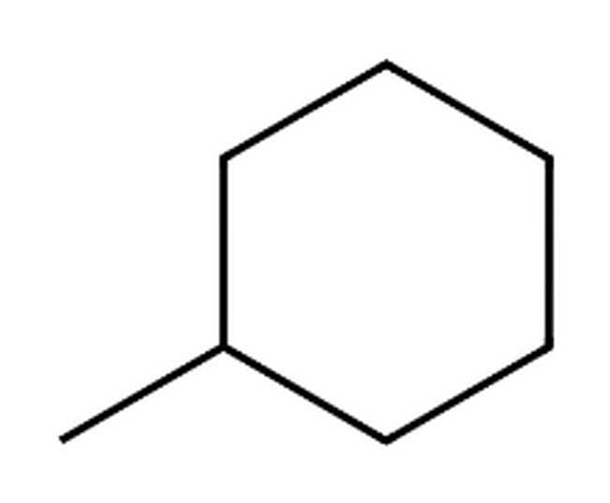
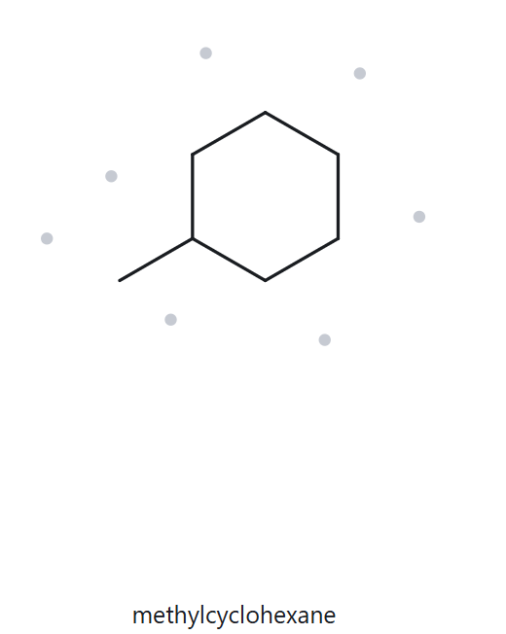
A07 DEVELOPING Part A · Structure → Name
Molecular formula:
C₇H₁₄
1 · NUMBERED PARENT
2 · NAMING TRAIL
3
Parent: ring of 6 C → cyclohexane (the ring is the parent).
Numbering: one substituent: its carbon is C1; either way round gives the same name.
Substituents: methyl on C1 → methyl (no locant for a single substituent on a ring).
2
4
1
5
6
3 · MY NAME
4 · THE ALKANE CHECK
methylcyclohexane
Returned name:
methylcyclohexane
✓ Match
Same as my name (methylcyclohexane): parent, locants, substituents and punctuation all agree.
✓ longest chain/ring confirmed ✓ lowest locants ✓ alphabetical order ✓ punctuation ✓ formula counted

Slide 8
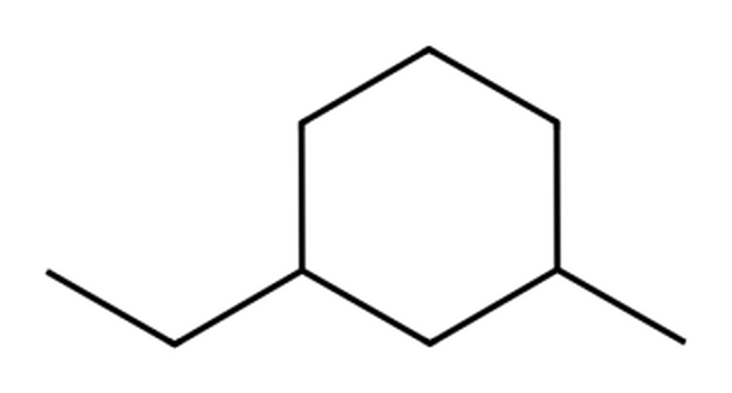
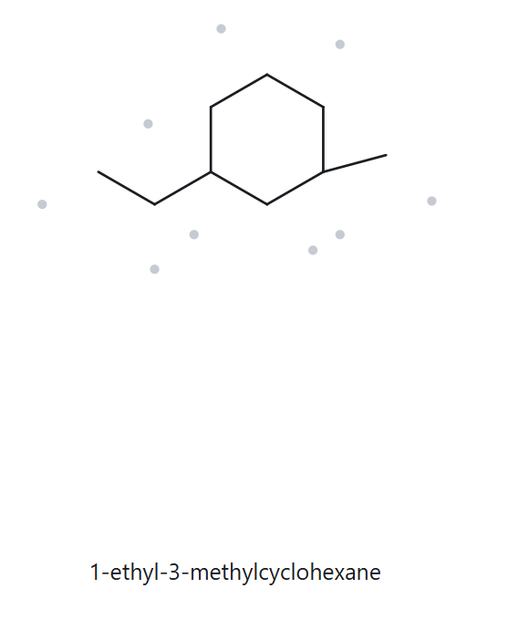
A08 CHALLENGE Part A · Structure → Name
Molecular formula:
C₉H₁₈
1 · NUMBERED PARENT
2 · NAMING TRAIL
5
Parent: ring of 6 C → cyclohexane (the ring is the parent).
Numbering: short way round gives 1,3 from either substituent: tie. Ethyl is first alphabetically, so it takes C1.
Substituents: A→Z: ethyl on C1, methyl on C3 → 1-ethyl-3-methyl.
6
4
1
3
2
3 · MY NAME
4 · THE ALKANE CHECK
1-ethyl-3-methylcyclohexane
Returned name:
1-ethyl-3-methylcyclohexane
✓ Match
Same as my name (1-ethyl-3-methylcyclohexane): parent, locants, substituents and punctuation all agree.
✓ longest chain/ring confirmed ✓ lowest locants ✓ alphabetical order ✓ punctuation ✓ formula counted

Slide 9
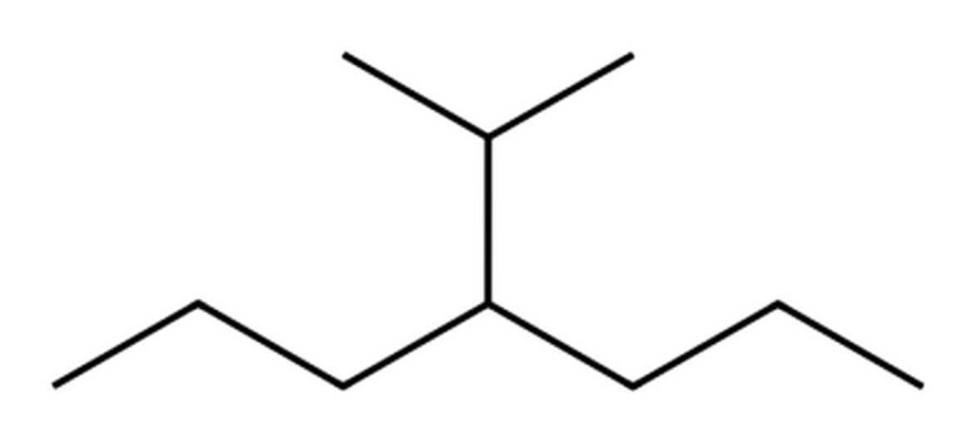
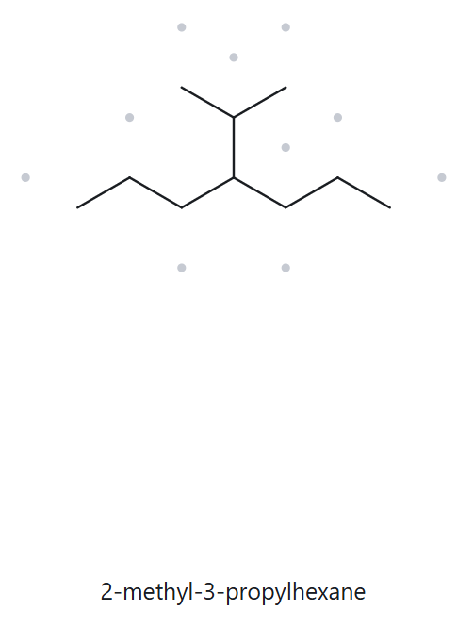
A09 CHALLENGE Part A · Structure → Name
Molecular formula:
C₁₀H₂₂
1 · NUMBERED PARENT
2 · NAMING TRAIL
Parent: longest chain = 7 C → heptane (left propyl arm + branch carbon + right propyl arm; through the branch only 6 C).
Numbering: left → right gives 4; right → left gives 4. Tie: both directions give the same name.
Substituents: isopropyl on C4 → 4-isopropyl.
2
6
4
1
3
5
7
3 · MY NAME
4 · THE ALKANE CHECK
4-isopropylheptane
Returned name:
2-methyl-3-propylhexane
✗ Mismatch
Correct name: 4-isopropylheptane (= 4-(1-methylethyl)heptane).
Rule not followed: the parent is the longest continuous chain. The tool used a 6-C chain (hexane) through the isopropyl branch; the longest chain is 7 C (heptane), through both propyl arms, so the branch is isopropyl on C4. Same compound (C₁₀H₂₂), but only 4-isopropylheptane obeys the rule.
✓ longest chain confirmed ✓ lowest locants ✓ alphabetical order ✓ punctuation ✓ formula counted

Slide 10
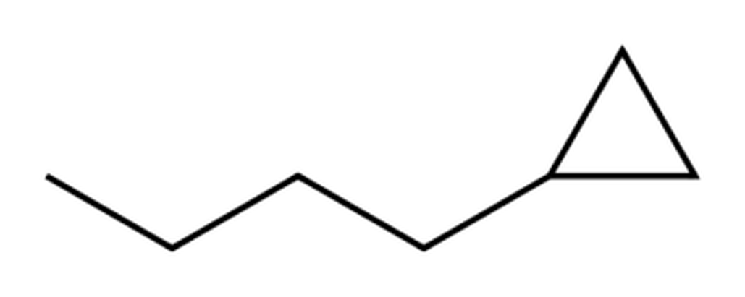
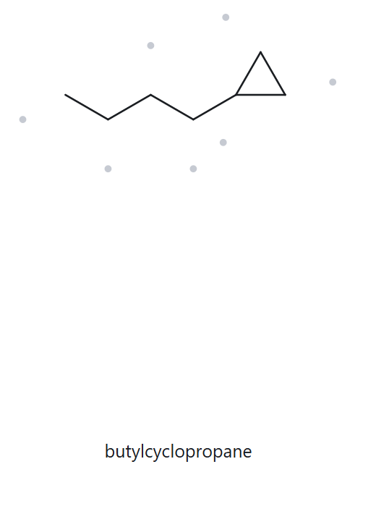
A10 CHALLENGE Part A · Structure → Name
Molecular formula:
C₇H₁₄
1 · NUMBERED PARENT
2 · NAMING TRAIL
2
Parent: ring of 3 C → cyclopropane (the ring is the parent, even though the chain has 4 C).
Numbering: one substituent: its carbon is C1; either way round gives the same name.
Substituents: butyl on C1 → butyl (no locant for a single substituent on a ring).
1
3
3 · MY NAME
4 · THE ALKANE CHECK
butylcyclopropane
Returned name:
butylcyclopropane
✓ Match
Same as my name (butylcyclopropane): parent, locants, substituents and punctuation all agree.
✓ longest chain/ring confirmed ✓ lowest locants ✓ alphabetical order ✓ punctuation ✓ formula counted

Slide 11
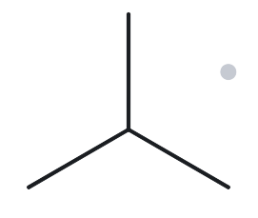
B01 FOUNDATION Part B · Name → Structure
Given name: 2-methylpropane
1 · NAME DECODED
2 · BOND-LINE STRUCTURE (THE ALKANE)
Parent: propane → a 3-carbon chain.
Substituents: methyl on C2.
Expected formula: 3 + 1 = 4 C; open chain → C₄H₁₀.
3 · FORMULA CHECK
4 · BACK-CHECK
Counted from the drawing: C₄H₁₀
Open chain: CnH2n+2 with n = 4 → C₄H₁₀ ✓
Returned name: 2-methylpropane
✓ Match — same as the given name
The tool returned 2-methylpropane: parent length, substituent identity and locants agree with the name I decoded, and the formula agrees.
✓ parent length matches ✓ substituent positions match ✓ formula agrees ✓ back-check recorded

Slide 12
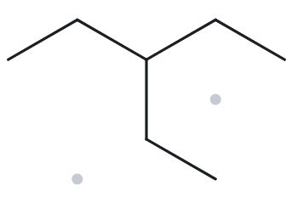
B02 FOUNDATION Part B · Name → Structure
Given name: 3-ethylpentane
1 · NAME DECODED
2 · BOND-LINE STRUCTURE (THE ALKANE)
Parent: pentane → a 5-carbon chain.
Substituents: ethyl on C3 (the middle carbon).
Expected formula: 5 + 2 = 7 C; open chain → C₇H₁₆.
3 · FORMULA CHECK
4 · BACK-CHECK
Counted from the drawing: C₇H₁₆
Open chain: CnH2n+2 with n = 7 → C₇H₁₆ ✓
Returned name: 3-ethylpentane
✓ Match — same as the given name
The tool returned 3-ethylpentane: parent length, substituent identity and locants agree with the name I decoded, and the formula agrees.
✓ parent length matches ✓ substituent positions match ✓ formula agrees ✓ back-check recorded

Slide 13
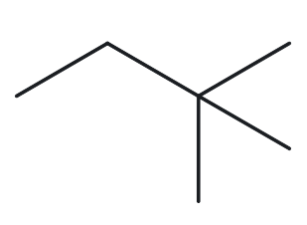
B03 FOUNDATION Part B · Name → Structure
Given name: 2,2-dimethylbutane
1 · NAME DECODED
2 · BOND-LINE STRUCTURE (THE ALKANE)
Parent: butane → a 4-carbon chain.
Substituents: two methyl groups, both on C2.
Expected formula: 4 + 2 = 6 C; open chain → C₆H₁₄.
3 · FORMULA CHECK
4 · BACK-CHECK
Counted from the drawing: C₆H₁₄
Open chain: CnH2n+2 with n = 6 → C₆H₁₄ ✓
Returned name: 2,2-dimethylbutane
✓ Match — same as the given name
The tool returned 2,2-dimethylbutane: parent length, substituent identity and locants agree with the name I decoded, and the formula agrees.
✓ parent length matches ✓ substituent positions match ✓ formula agrees ✓ back-check recorded

Slide 14
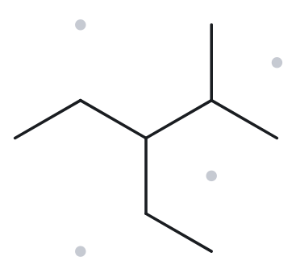
B04 DEVELOPING Part B · Name → Structure
Given name: 3-ethyl-2-methylpentane
1 · NAME DECODED
2 · BOND-LINE STRUCTURE (THE ALKANE)
Parent: pentane → a 5-carbon chain.
Substituents: ethyl on C3; methyl on C2 (neighbouring carbons).
Expected formula: 5 + 2 + 1 = 8 C; open chain → C₈H₁₈.
3 · FORMULA CHECK
4 · BACK-CHECK
Counted from the drawing: C₈H₁₈
Open chain: CnH2n+2 with n = 8 → C₈H₁₈ ✓
Returned name: 3-ethyl-2-methylpentane
✓ Match — same as the given name
The tool returned 3-ethyl-2-methylpentane: parent length, substituent identity and locants agree with the name I decoded, and the formula agrees.
✓ parent length matches ✓ substituent positions match ✓ formula agrees ✓ back-check recorded

Slide 15
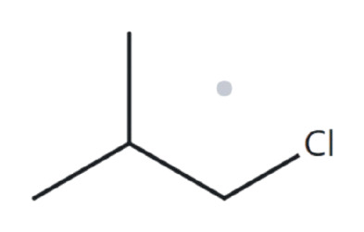
B05 DEVELOPING Part B · Name → Structure
Given name: 1-chloro-2-methylpropane
1 · NAME DECODED
2 · BOND-LINE STRUCTURE (THE ALKANE)
Parent: propane → a 3-carbon chain.
Substituents: chloro on C1 (terminal carbon); methyl on C2.
Expected formula: 3 + 1 = 4 C; open chain → C₄H₁₀; Cl replaces one H → C₄H₉Cl.
3 · FORMULA CHECK
4 · BACK-CHECK
Counted from the drawing: C₄H₉Cl
Open chain: CnH2n+2 with n = 4 → C₄H₁₀; Cl replaces one H → C₄H₉Cl ✓
Returned name: 1-chloro-2-methylpropane
✓ Match — same as the given name
The tool returned 1-chloro-2-methylpropane: parent length, substituent identity and locants agree with the name I decoded, and the formula agrees.
✓ parent length matches ✓ substituent positions match ✓ formula agrees ✓ back-check recorded

Slide 16
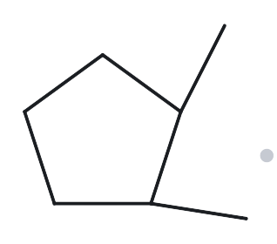
B06 DEVELOPING Part B · Name → Structure
Given name: 1,2-dimethylcyclopentane
1 · NAME DECODED
2 · BOND-LINE STRUCTURE (THE ALKANE)
Parent: cyclopentane → a 5-carbon ring.
Substituents: methyl on C1 and on C2 (adjacent ring carbons).
Expected formula: 5 + 2 = 7 C; one ring → C₇H₁₄.
3 · FORMULA CHECK
4 · BACK-CHECK
Counted from the drawing: C₇H₁₄
One ring: CnH2n with n = 7 → C₇H₁₄ ✓
Returned name: 1,2-dimethylcyclopentane
✓ Match — same as the given name
The tool returned 1,2-dimethylcyclopentane: parent length, substituent identity and locants agree with the name I decoded, and the formula agrees.
✓ parent length matches ✓ substituent positions match ✓ formula agrees ✓ back-check recorded

Slide 17
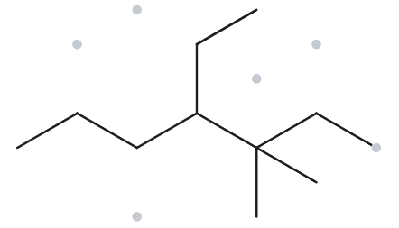
B07 DEVELOPING Part B · Name → Structure
Given name: 4-ethyl-3,3-dimethylheptane
1 · NAME DECODED
2 · BOND-LINE STRUCTURE (THE ALKANE)
Parent: heptane → a 7-carbon chain.
Substituents: ethyl on C4; two methyl groups, both on C3.
Expected formula: 7 + 2 + 2 = 11 C; open chain → C₁₁H₂₄.
3 · FORMULA CHECK
4 · BACK-CHECK
Counted from the drawing: C₁₁H₂₄
Open chain: CnH2n+2 with n = 11 → C₁₁H₂₄ ✓
Returned name: 4-ethyl-3,3-dimethylheptane
✓ Match — same as the given name
The tool returned 4-ethyl-3,3-dimethylheptane: parent length, substituent identity and locants agree with the name I decoded, and the formula agrees.
✓ parent length matches ✓ substituent positions match ✓ formula agrees ✓ back-check recorded

Slide 18
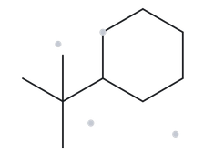
B08 CHALLENGE Part B · Name → Structure
Given name: tert-butylcyclohexane
1 · NAME DECODED
2 · BOND-LINE STRUCTURE (THE ALKANE)
Parent: cyclohexane → a 6-carbon ring.
Substituents: tert-butyl on C1 (locant omitted: one substituent). tert-butyl = (CH₃)₃C– = (1,1-dimethylethyl) = 2-methylpropan-2-yl (App. B.3).
Expected formula: 6 + 4 = 10 C; one ring → C₁₀H₂₀.
3 · FORMULA CHECK
4 · BACK-CHECK
Counted from the drawing: C₁₀H₂₀
One ring: CnH2n with n = 10 → C₁₀H₂₀ ✓
Returned name: (1,1-dimethylethyl)cyclohexane
✗ Mismatch in wording only — same compound ✓
Why: The Alkane writes tert-butyl in its bracketed systematic form, (1,1-dimethylethyl) (App. B.3, C.6). Both names describe the same group, (CH₃)₃C–, on a 6-C ring: C₁₀H₂₀ either way. The drawing is correct, so it is not changed; the given name tert-butylcyclohexane is an accepted equivalent and earns full credit.
✓ parent length matches ✓ substituent positions match ✓ formula agrees ✓ back-check recorded

Slide 19
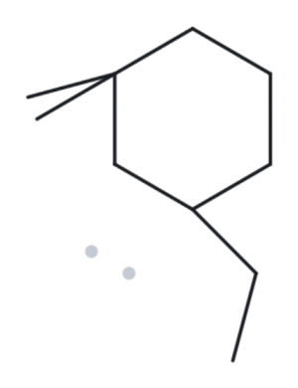
B09 CHALLENGE Part B · Name → Structure
Given name: 3-ethyl-1,1-dimethylcyclohexane
1 · NAME DECODED
2 · BOND-LINE STRUCTURE (THE ALKANE)
Parent: cyclohexane → a 6-carbon ring.
Substituents: two methyl groups on C1 (same carbon); ethyl on C3 (C2 lies between them).
Expected formula: 6 + 2 + 2 = 10 C; one ring → C₁₀H₂₀.
3 · FORMULA CHECK
4 · BACK-CHECK
Counted from the drawing: C₁₀H₂₀
One ring: CnH2n with n = 10 → C₁₀H₂₀ ✓
Returned name: 3-ethyl-1,1-dimethylcyclohexane
✓ Match — same as the given name
The tool returned 3-ethyl-1,1-dimethylcyclohexane: parent length, substituent identity and locants agree with the name I decoded, and the formula agrees.
✓ parent length matches ✓ substituent positions match ✓ formula agrees ✓ back-check recorded

Slide 20
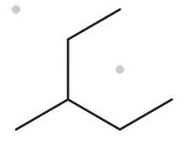
B10 CHALLENGE Part B · Name → Structure
Given name: 2-ethylbutane
1 · NAME DECODED
2 · BOND-LINE STRUCTURE (THE ALKANE)
Parent: butane (as printed) → a 4-carbon chain.
Substituents: ethyl on C2 — drawn exactly as the name says.
Expected formula: 4 + 2 = 6 C; open chain → C₆H₁₄.
3 · FORMULA CHECK
4 · BACK-CHECK
Counted from the drawing: C₆H₁₄
Open chain: CnH2n+2 with n = 6 → C₆H₁₄ ✓
Returned name: 3-methylpentane
✗ Mismatch — the given name is wrong, not the drawing
Correct name: 3-methylpentane (given: 2-ethylbutane)
Rule broken: the parent must be the longest continuous chain. In 2-ethylbutane the ethyl group lengthens the chain: the longest path is 5 C (pentane), running through the ethyl. What is left is one methyl on the middle carbon, C3. The drawing is exactly what the name says (C₆H₁₄), and the structure itself gives the correct name.
✓ parent length matches ✓ substituent positions match ✓ formula agrees ✓ back-check recorded

