Slide 1
Digital Portfolio
STUDENT NAME: GIFTA S
REGISTER NO AND NMID: 222401242 and asunm11024ai132
DEPARTMENT: B.Sc.Computer Science with Artificial Intelligence
COLLEGE: DRBCCC Hindu College/Madras University

Slide 2
PROJECT TITLE
Digital
Portfolio

Slide 3
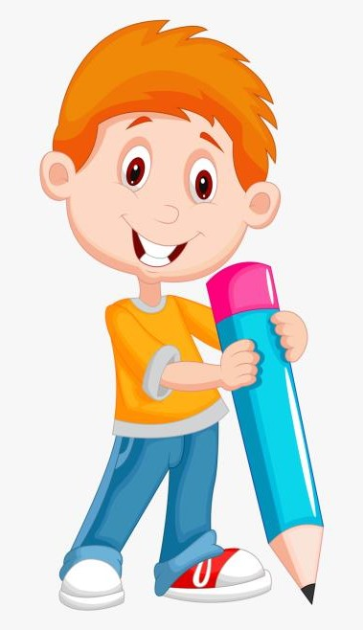

AGENDA
Problem Statement
Project Overview
End Users
Tools and Technologies
Portfolio design and Layout
Features and Functionality
Results and Screenshots
Conclusion
Github Link
3/21/2024 Annual Review

Slide 4

PROBLEM STATEMENT
In today’s digital world, students need a personal platform to showcase their skills, projects, and achievements in a visually engaging way. Traditional resumes often fail to demonstrate creativity, technical ability, and personality. Without an interactive portfolio, it becomes difficult for potential employers, mentors, or collaborators to fully recognize a student’s capabilities.

Slide 5

PROJECT OVERVIEW
In the competitive digital era, students face the challenge of presenting their skills, creativity, and achievements in ways that stand out from traditional paper resumes. While resumes provide information, they fail to reflect design sense, technical expertise, interactivity, and personality.This project addresses these challenges by developing a unique animated student portfolio website.

Slide 6

WHO ARE THE END USERS?
Employers → People who hire you for jobs or internships.
Faculty → They check your portfolio for project evaluation. Professionals → They guide you and give feedback. General Visitors → Anyone who wants to know about you and your work.

Slide 7

TOOLS AND TECHNIQUES
HTML – To create the structure of the portfolio. CSS – To style the pages with gradients, colors, and layouts. JavaScript – To add interactivity like animations and navbar toggle.
Responsive Design – Works on mobile, tablet, and desktop. CSS Animations – Fade-in, bounce, hover effects, glowing logo.(Codepen)

Slide 8
POTFOLIO DESIGN AND LAYOUT
Header & Navbar – Glowing logo with navigation bar and burger menu for mobile. Hero Section – Intro with name, course, and profile picture in round frame. Skills & Projects – Colorful skill boxes and project cards with hover animations. Contact & Footer – Simple contact form and footer with crafted message.
8

Slide 9
FEATURES AND FUNCTIONALITY
Modern colorful design with gradients, animations, and responsive layout. Navbar with burger menu and smooth section reveal on scroll.
Skills & Projects shown in colorful cards with hover effects. Contact form with thank-you alert on submit.

Slide 10

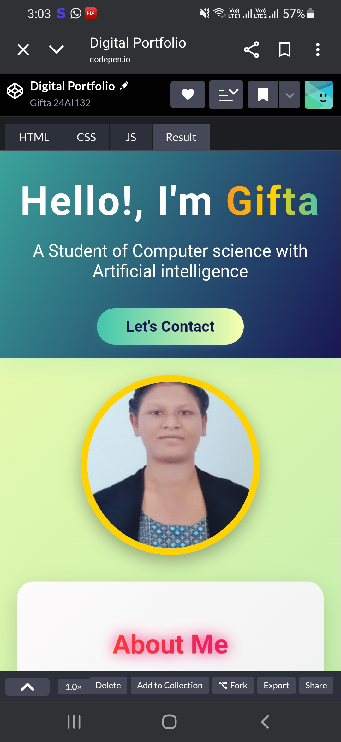
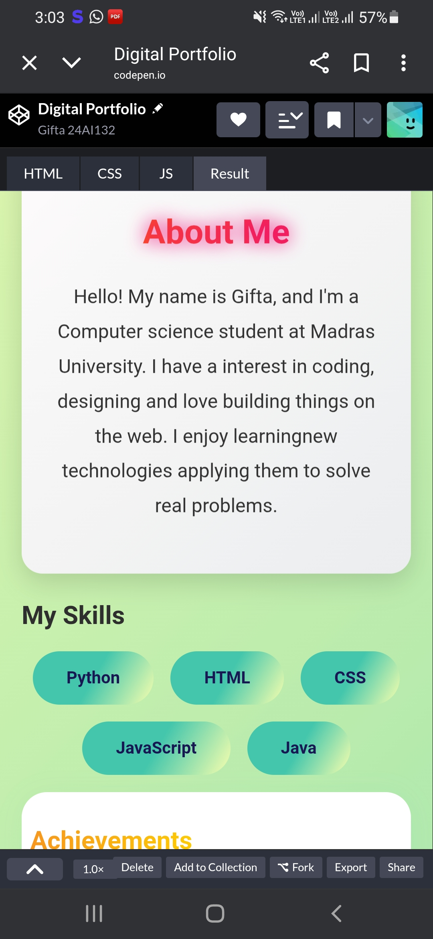
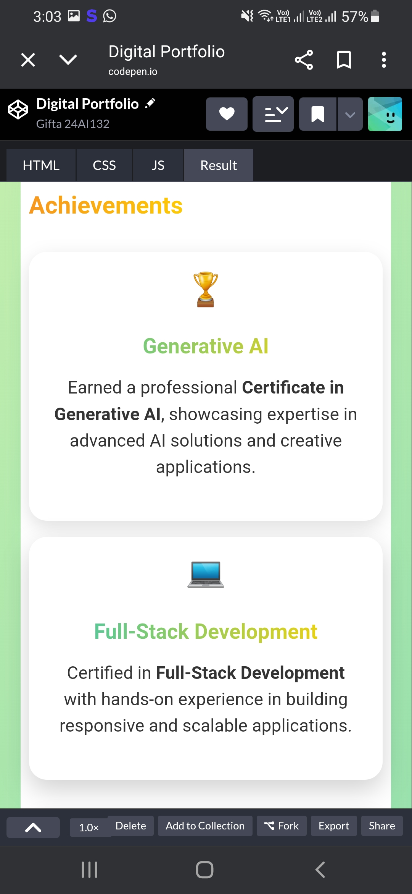
RESULTS AND SCREENSHOTS
Screenshorts of each section
Before vs After (plain HTML With CSS and JS)
3/21/2024 Annual Review
10

Slide 11
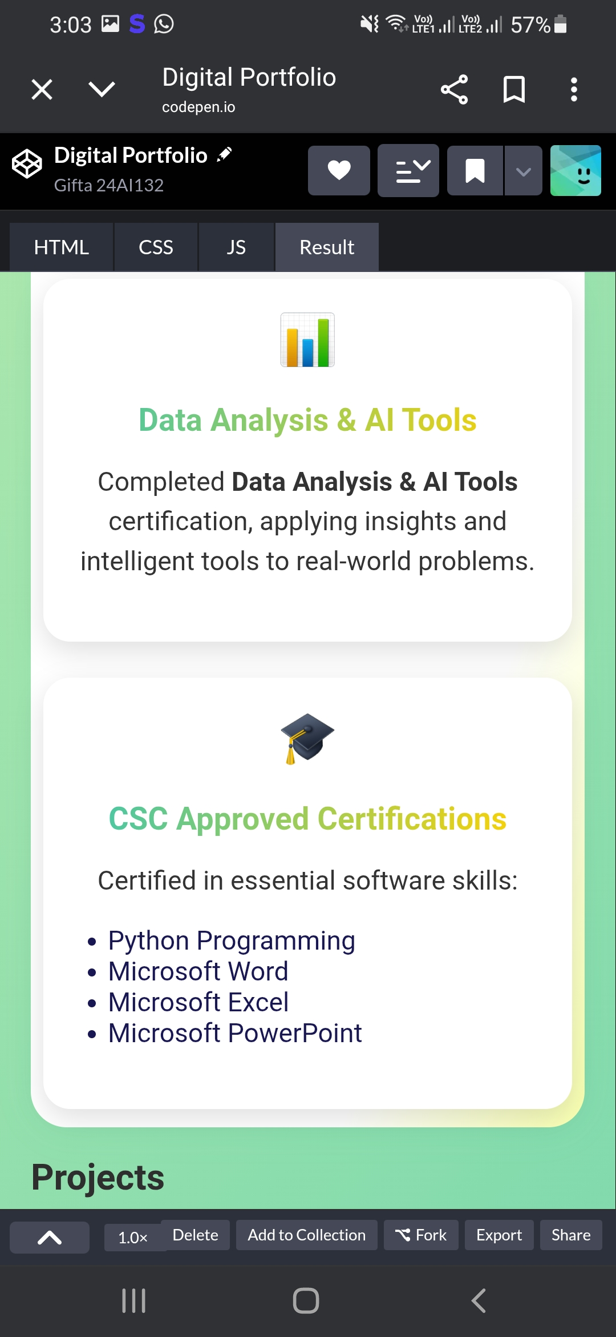
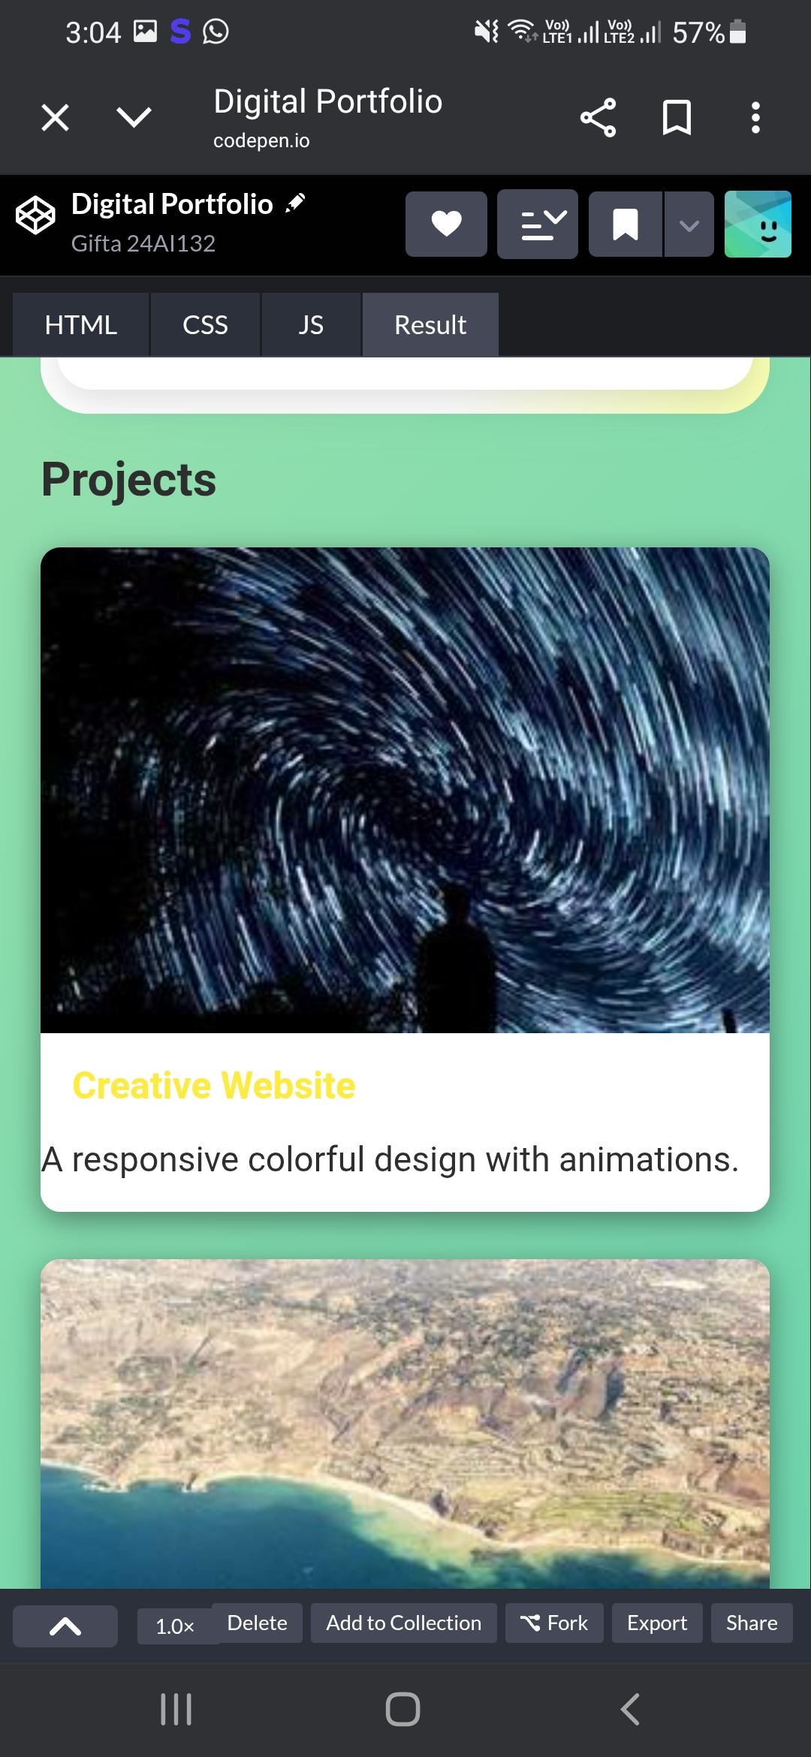
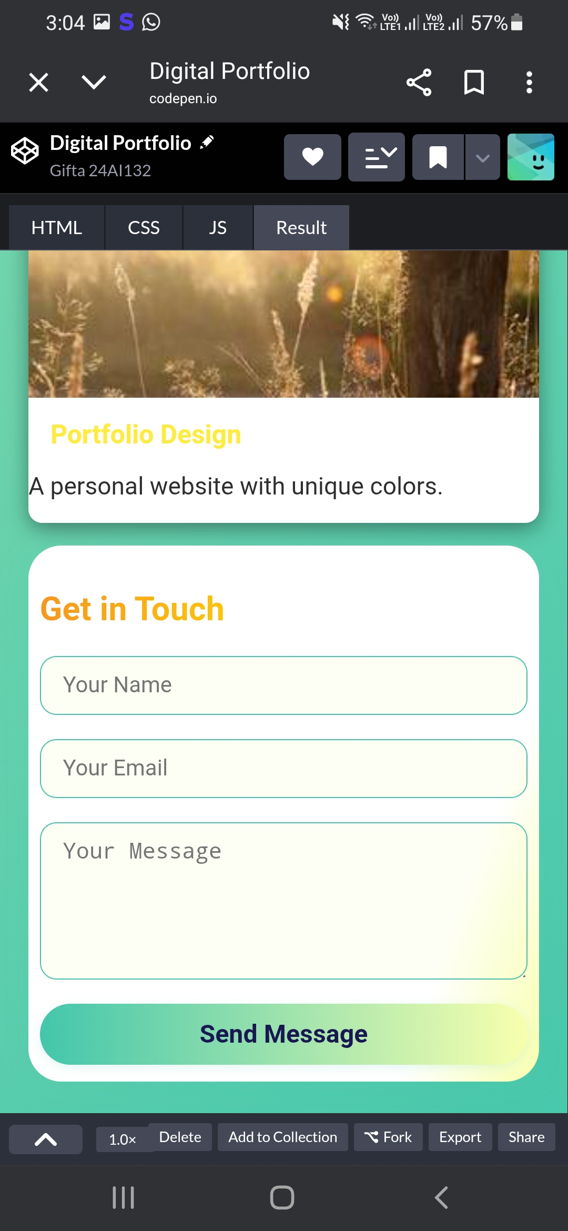
11

Slide 12
CONCLUSION
My portfolio is a modern, colorful, and responsive website that highlights my skills, projects, and contact details with smooth animations. It serves as a personal platform to showcase my work and connect with others.

