Slide 1


CISCO VIRTUAL INTERNSHIP PROJECT
DESIGN SECURE NETWORK FOR KARUNYA UNIVERSITY
Presented by
Degree
GIFTON PAUL IMMANUEL B
URK21CS5054
B.Tech CSE(AI)
Submitted for the project fulfillment
of
Cybersecurity stream
in
CISCO Virtual Internship
Cyber Security Stream

Slide 2
Content
Abstract
Introduction
Theory and Fundamentals
Objectives
Network Topology
Network Connectivity
Security Features
Cyber attacks and vulnerabilities
Cyber Security measures
Conclusion
Design Secure Network for Karunya University
2

Slide 3
1. Abstract
This project is based on creating a network of my University campus with the help of my knowledge on the fields of Cybersecurity and Networking. This project is solely done by me.
Design Secure Network for Karunya University
3

Slide 4

2. Introduction
This project is the solution to the problem statement given to me
from Cisco Virtual Internship (Cyber Security)
I am thankful to Cisco for giving me this opportunity to work
in this problem statement
Cisco Packet Tracer tool is used for simulation of the network
The Topology and Technologies of the network will be discussed.
The Security measures as well as vulnerabilities expected
will be researched.
Design Secure Network for Karunya University
4

Slide 5

3. Theory and fundamentals
Packet tracer is a cross-platform visual simulation tool designed by
Cisco Systems.
It allows users to create network topologies and imitate modern
networks
Key Features:
Unlimited devices.
E-learning.
Customize single/multi user activities.
Interactive Environment.
Visualizing Networks.
Real-time mode and Simulation mode.
Self-paced.
Supports majority of networking protocols.
Design Secure Network for Karunya University
5

Slide 6
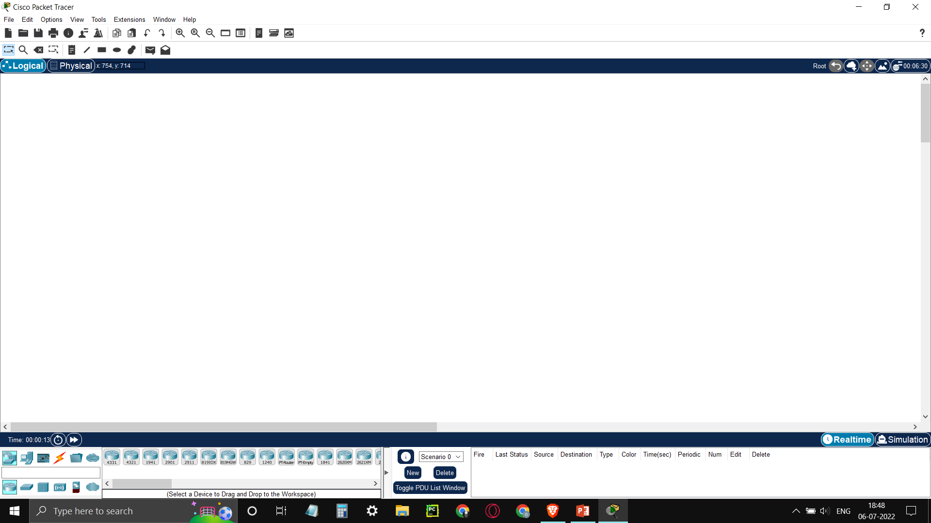
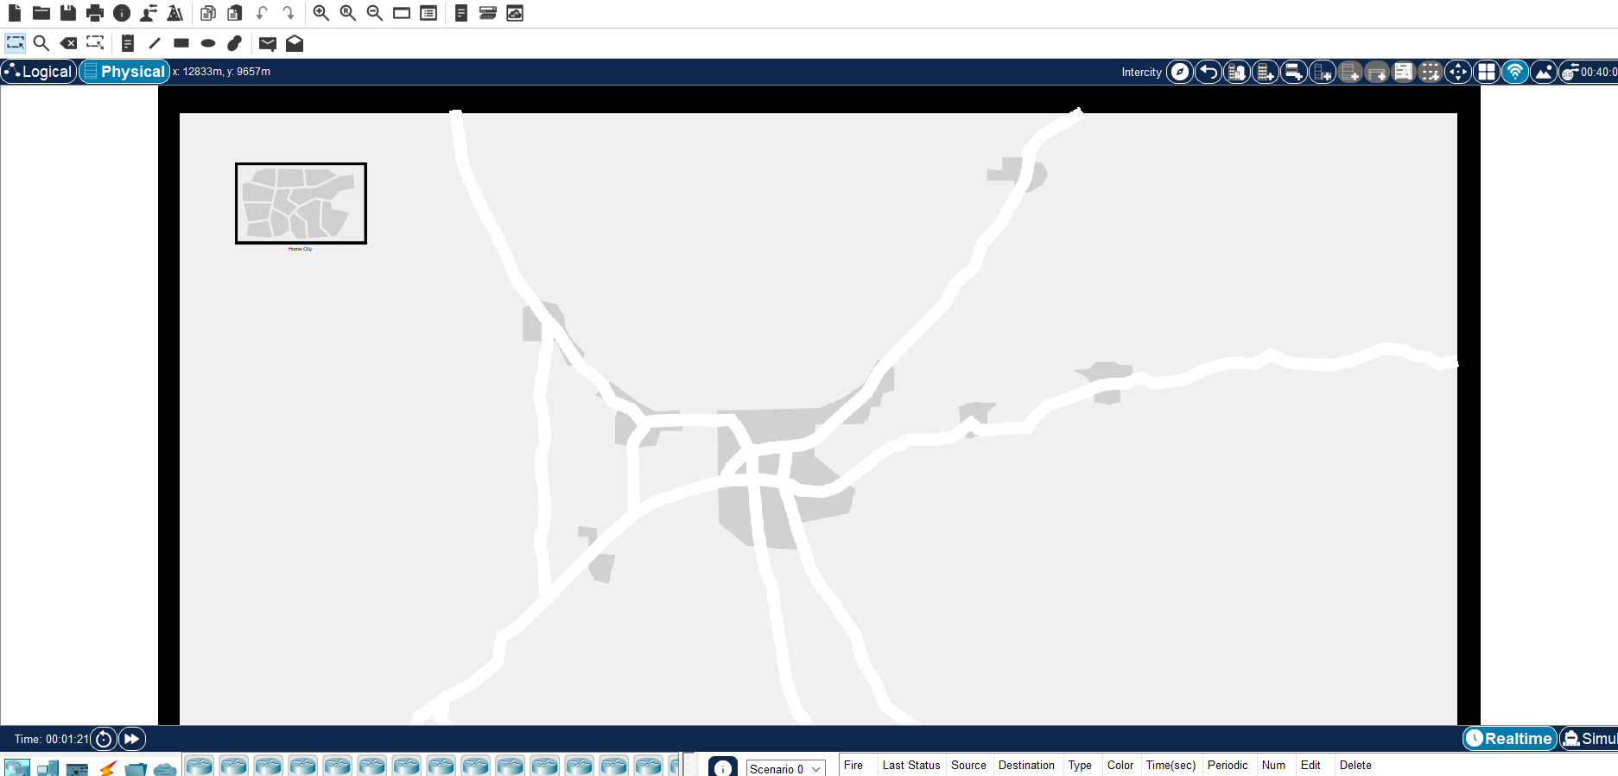
3. Theory and fundamentals
WORKSPACES:
Logical –
Logical workspace shows the logical network topology of the
network the user has built. It also represents the placing,
connecting and clustering virtual network devices.
Physical –
Physical workspace shows the graphical physical dimension of
the logical network. It depicts the scale and placement in how
network devices such as routers, switches and hosts would look
in a real environment. It also provides geographical
representation of networks, including multiple buildings,
cities and wiring closets.
Design Secure Network for Karunya University
6

Slide 7
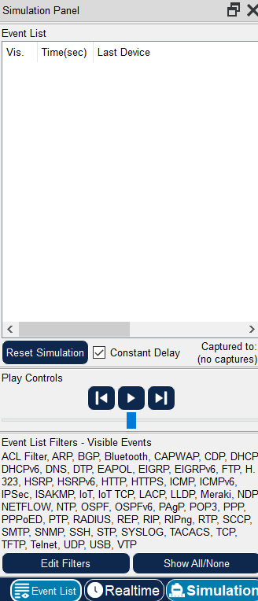
3. Theory and fundamentals
Modes:
Real Time mode –
In real-time mode the network behaves in the actual way the
real devices do, with immediate real-time response for all
network activities. It is an alternative to real equipment.
Simulation mode –
In simulation mode the user can see and control time intervals,
the inner workings of data transfer, and the propagation of data
across a network. This helps students understand the fundamental
concepts behind network operations.
Design Secure Network for Karunya University
7

Slide 8
4. Objectives
To simulate the network of our institution with its topology and devices.
To identify the vulnerabilities in the network and to provide suitable solutions.
To predict the cyber threats and analyze them.
Design Secure Network for Karunya University
8

Slide 9
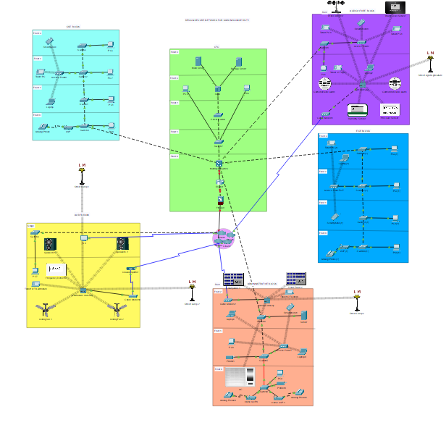
5. Network Topology
Our University network is an example for Star Topology.
I have implemented the network for 6 of the buildings.
Design Secure Network for Karunya University
9

Slide 10
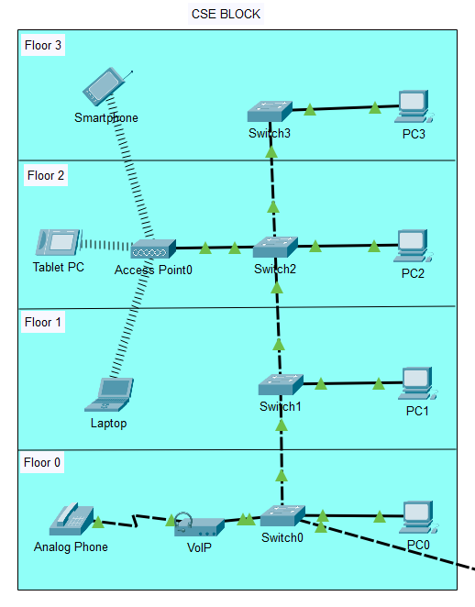
6. Network Connectivity
Building-1 CSE BLOCK
The wireless devices of the building are connected with the
access point which is connected to the switch.
The wired devices are connected directly to the respective
switches in the floor.
Analog phone is connected with the VoIP which is
(Voice over Internet Protocol) and then connected with
the Switch.
The Switch in the Ground floor is connected with the
multilayer switch of the other building
Design Secure Network for Karunya University
10

Slide 11
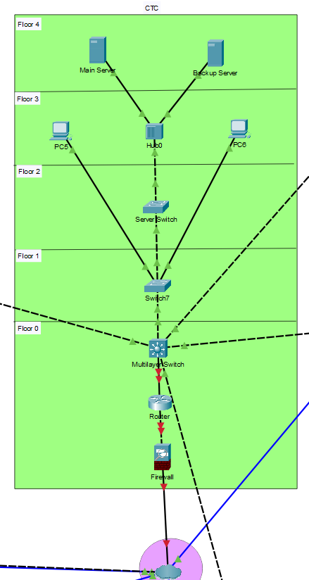
6. Network Connectivity
Building-2 CTC
The servers of the building are connected with the Hub which is
connected with the Server Switch to the F1 Switch.
The PC’s are connected with the F1 Switch.
The F1 Switch is connected with the Multilayer Switch in the
ground floor.
The Multilayer switch is connected with the Router which is
secured with the firewall and then passed to the Internet.
Design Secure Network for Karunya University
11

Slide 12
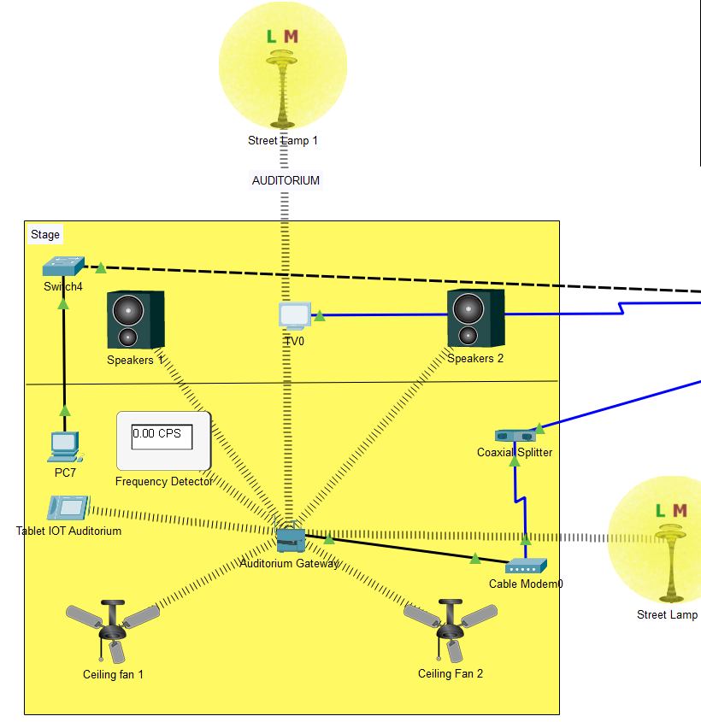
6. Network Connectivity
Building-3 Auditorium
The stage has speakers and a Television.
The Television is connected to the Cloud and can be used from
PC7 and is connected with the Switch to the Internet.
The Auditorium gateway acts as a gateway for the IoT Devices
including Street Lamps, Speakers, etc.,
The Tablet is used for controlling the devices using GUI.
The gateway is connected to the internet through coaxial splitter
and cable modem.
Design Secure Network for Karunya University
12

Slide 13
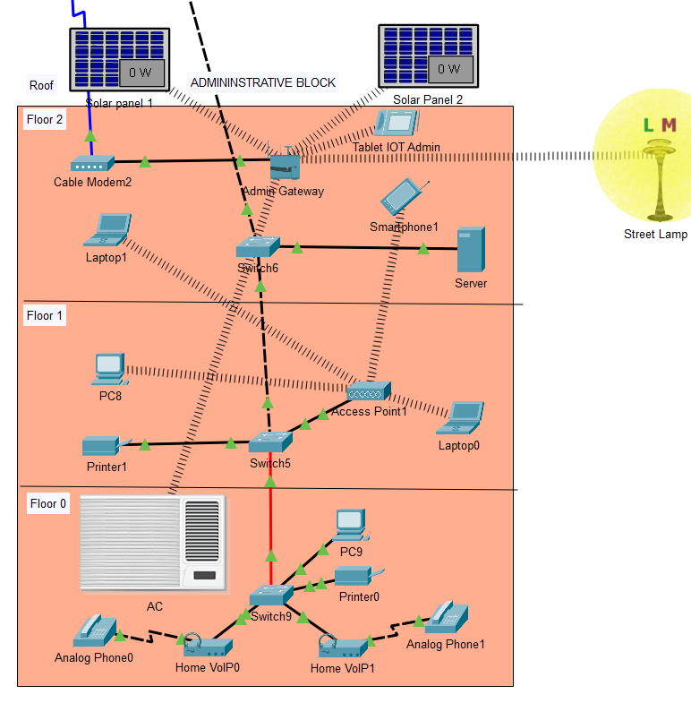
6. Network Connectivity
Building-4 Administration Block
The Ground floor has 2 phones connected with the VoIP to the
switch along with the PC and printer.
The Access point connects all the wireless devices and it is
connected with the Switch in Floor 1.
The switches are connected with each other to the Multilayer
Switch in CTC block.
The Gateway connects IoT devices such as the Solar panels
on the roof, the street lamp, AC and the Tablet for control of
these devices.
The gateway is connected to the internet through cable modem.
Design Secure Network for Karunya University
13

Slide 14
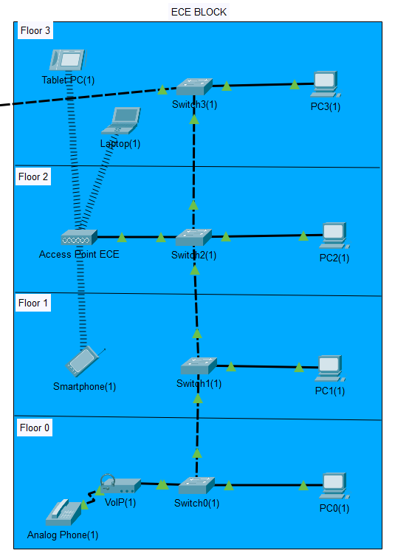
6. Network Connectivity
Building-5 ECE Block
The Ground floor has a phone and PC connected with the switch.
The Access point connects all the wireless devices and it is
connected with the Switch in Floor 2.
The switches are connected with each other.
Finally the switch is connected with the multilayer switch of CTC.
Design Secure Network for Karunya University
14

Slide 15
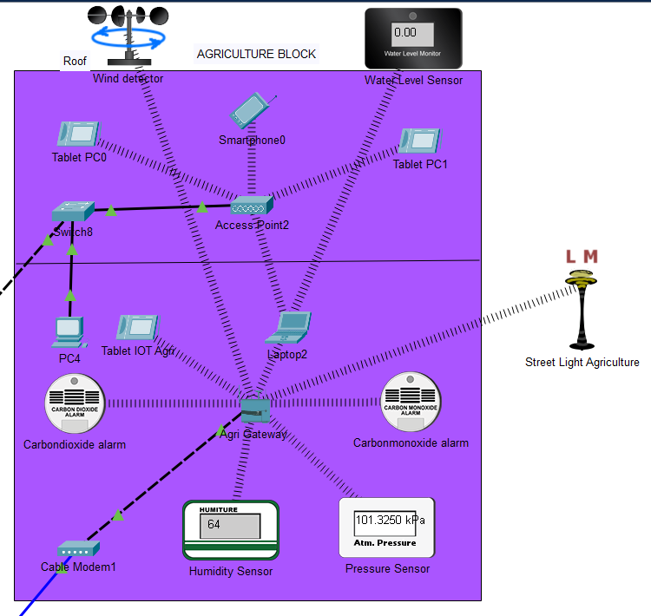
6. Network Connectivity
Building-6 Agriculture Block
The Ground floor has the gateway which connects all the
IoT Devices and also connects the Tablet control used to
control the devices.
The GUI in the tablet can be used to monitor the sensors.
The access point which connects all the wireless devices
is connected with the switch which is connected to the
multilayer switch of CTC.
The gateway is connected with the cable modem to the
Internet.
Design Secure Network for Karunya University
15

Slide 16

7. Security Features
The Network Wi-fi is secured with WPA2 (Wi-Fi Protected
Access 2) and encryption.
Firewall is used to secure the router.
Remote Access VPN is used.
Data Loss Prevention (DLP) regulates prevention of
the exposure of sensitive information outside the organization.
High quality switches, hubs and other networking devices are
used for ensuring quality of the network.
Design Secure Network for Karunya University
16

Slide 17
8. Cyber Attacks and Vulnerabilities
Distributed denial-of-service (DDoS) attack, multiple compromised computer systems that attack a target and cause a denial of service for users of the target. The target can be the server.
Phishing. An attempt by cybercriminals posing as reputed institutions, usually through email, to obtain sensitive information from targeted resources.
SQL injection, also known as SQLI, is an attack that uses malicious SQL code for backend database manipulation to access valuable information.
Too many Internet of Things (IoT) devices are cheaply made and have inadequate security quality.
Buggy / Outdated Software.
Trickery or Deception of Users can also lead to a vulnerability
Hardware Issues can also be considered as a vulnerability of the network.
Firewall Issues. Firewall is the first layer of defence, failing can be a serious
threat.
Design Secure Network for Karunya University
17

Slide 18
9. Cyber Security Measures
Better Code and Greater Vigilance.
Preventing Phishing through Training and Heightened Suspicion.
Stopping SQLi attacks through Prepared Statements, Stored Procedures, and Input Validation.
Strong password protected end-devices.
Updating the security hardware and software.
Raising awareness among the employees and users too.
Ensure server redundancy .
Limit Networking broadcasting. An effective way to disrupt a high-volume DDoS attempt.
Using cloud-based protection.
Preparing a DDoS response plan.
Always look for warning signs.
Design Secure Network for Karunya University
18

Slide 19

10. Conclusion
Our institution’s network, the connectivity, the possible cyber attacks
and their security measures and features have been demonstrated in the
above slides.
The courses and materials given were very helpful for me to understand
the tool and get knowledge in the field of cyber security.
Design Secure Network for Karunya University
19

Slide 20


