Slide 1
INTRODUCTION TO ROUTER
Introduction to Network Security & Firewalls
By
Dr.Col Joseph Kalunga (Ph.D)

Slide 2
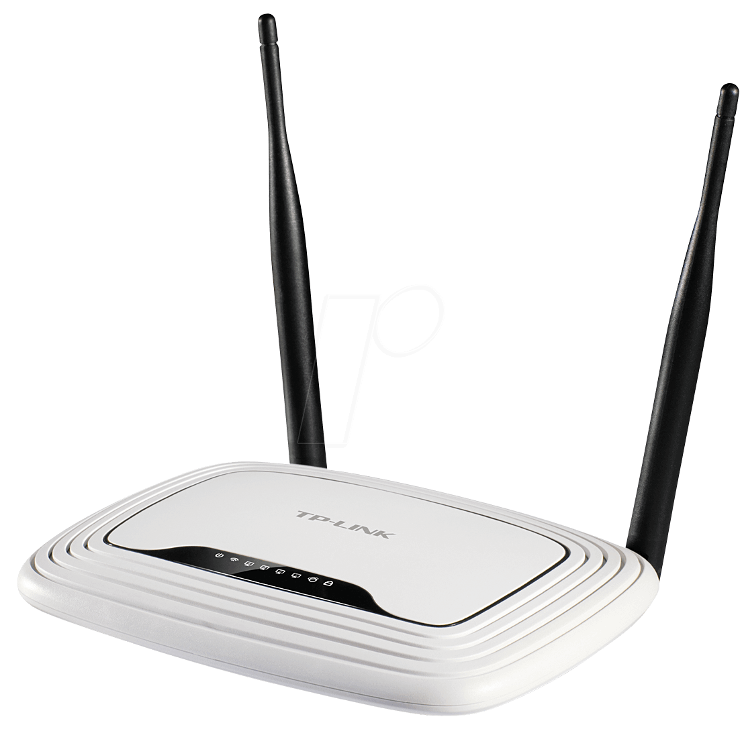
A router is a networking device that forwards data packets between computer networks.
A router is connected to at least two networks, commonly two LANs or WANs, or a LAN and its ISP's network.
Routers perform the traffic directing functions on the Internet.
Data sent through the internet, such as a web page or email, is in the form of data packets.

Slide 3
Ports of Router:
There are 2 types of ports of router.
Line Ports
Used for device configuration
Interface Ports
Used for data communication
Configuration:
To change default behaviour of any device

Slide 4
Lines
Console 0:
Local Administrative Port
Most powerful port
Can perform function that we can’t do by connecting with other ports.
VTY 0 4:
Virtual Teletype
Not Physical but Virtual Port
Remote Administrative Port
Allows 5 simultaneous virtual connections
0 means one Port

Slide 5
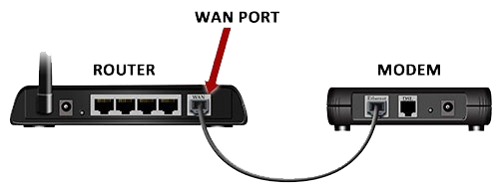
Lines
Auxiliary 0:
Remote Administrative Port
Can connect extra modem with router through auxiliary cable.
LAN PORTS

Slide 6
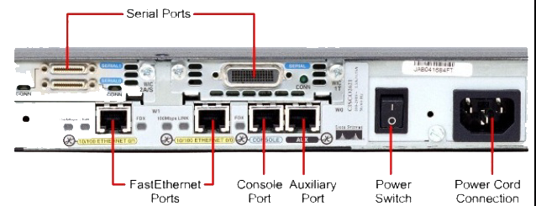
Interfaces
fa0/0:
Fast-Ethernet/Gigabit Interface
LAN Connectivity
Provide data rate of 100Mbps 100BASE-T
s0/0/0:
Serial Interface
WAN Connectivity

Slide 7
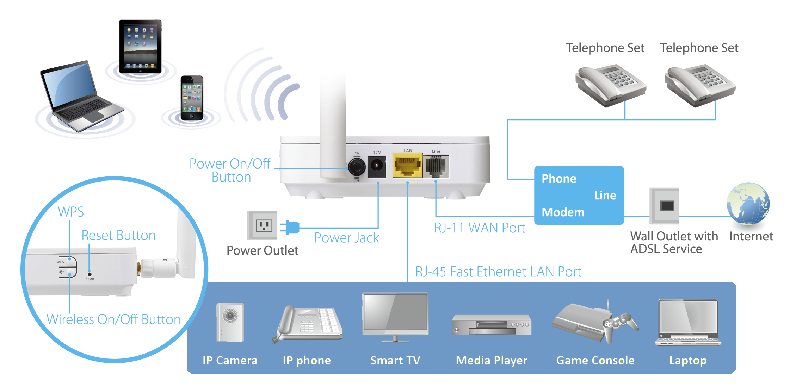

Slide 8
Control Plane:
Functions and Processes that determine which path to use.
Routing protocols, spanning tree, ldp, etc.
The users who can configure web server have access of control plane.
Data Plane:
Functions and Processes that forward packets from one interface to another.
The users who can access/view the hosted website or it’s contents have access of Data Plane.

Slide 9
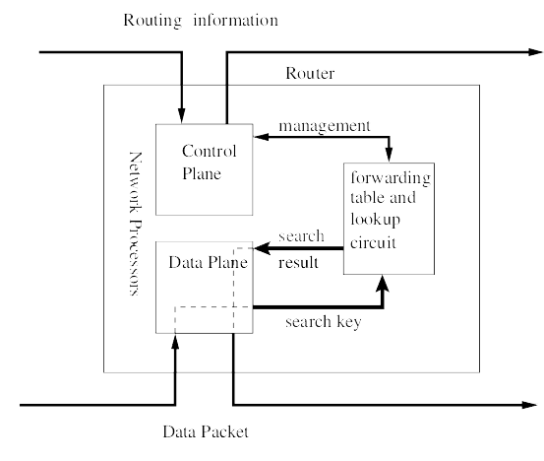
Management Plane:
Functions used to control and monitor devices.
Manage the router/switch/device that are compliant with standard protocols.
SNMP, TELNET, SSH, NETCONF, etc.

Slide 10
Router
Console
Control Plane
Auxiliary
fa0/0
s0/0/0
Data Plane
fa0/1
s0/0/1

Slide 11
Types of Router
Wired Router:
Box-shaped device connected directly to computers through wired connections.
Support Network Address Translation (NAT) technology which allows multiple computers to connect in a wired router to share a single IP address.
Use (SPI) firewalls for the security purpose.
Wireless Router:
Connects directly to a modem through a cable for receiving internet data packets.
Distribute data packets using one or more Antenna.
Convert data packets (binary) into Radio Signals, then antenna broadcast wirelessly.
Engage wireless MAC address filtering and Wi-Fi Protected Access (WPA) security.

Slide 12
Types of Router
Edge Router:
A wired or wireless router that forward data packets between one or more networks.
Located at a network boundary that enables an internal network to connect to external networks.
Communicate with different networks and does not distribute data packets within a network.
Core Router:
A wired or wireless router that forward data packets to computer hosts within a network.
It do not forward data packets with multiple networks.
Manage traffic to prevent congestion and packet loss, often using multiplexing.

Slide 13
Types of Router
Virtual Router:
A software-based default routing framework that allows the host machine to perform as a typical hardware router over a LAN.
It shares a network using the Virtual Router Redundancy Protocol (VRRP).
Active when a primary/physical router fails, otherwise becomes disabled.

Slide 14
Memory of Router
ROM:
Basic I/O system.
Stores router bootstrap detail (Cisco router)
Baby IOS
RAM:
Load IOS (Internet Operating System) from Flash
Store Routing table, Configuration files, Cache & Buffering detail
Apply Start-up configuration from NVRAM
IOS + Start-up config = Running Config

Slide 15
Flash:
Include IOS
Hold operating system image
“In case IOS image is not available in flash i.e. Failed to load, it will take you to the ROMMON (ROM Monitor) mode.
Where you can copy IOS image into Flash memory using some Remote Device Configurations”
NVRAM:
Non-Volatile Random Access Memory
Store Router start-up configuration files
“In case start-up config is not available in NVRAM, it will take you to the System Configuration Dialog”

