Slide 1
Subnetting
Advanced TCP/IP
Subnetting
By
Dr.Col Joseph Kalunga (Ph.D)

Slide 2
What is Subnetting?
Allows Creating multiple network from a single address block.
Subnetting is a process of breaking large network in small networks known as subnets.

Slide 3
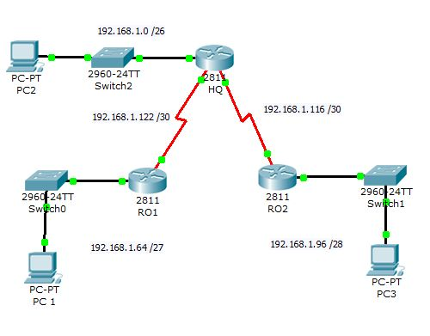
Diagram

Slide 4
Why Subnetting?
Maximise addressing efficiency.
Extend the life of IPV4.
Public IPV4 Addresses are scare.
Easy to manage.
Subnetting reduces network traffic by removing collision and broadcast traffic, that overall improve performance.
Subnetting allows you to apply network security polices at the interconnection between subnets

Slide 5
How?
CIDR [ Classless Inter Domain Routing]
CIDR is a slash notation of subnet mask. CIDR tells us number of on bits in a network address
CIDR | Decimal | Binary
/25 | 128 | 10000000
/26 | 192 | 11000000
/27 | 224 | 11100000
/28 | 240 | 11110000
/29 | 248 | 11111000
/30 | 252 | 11111100

Slide 6
Formulas & Variables
h=number of host bits
n=number of host bit use in network bits
Number of new networks reulting from the subnetting: =2^n
Number of hosts per new network: =2^h-2
One is network another is broadcast
Broadcast address is the last address of subnet.
Block size or increment number is used to calculate the valid subnets

Slide 7
Example:-1
Subnet base address
New CIDR length /25
→255.255.255.128(Subnet Mask)
n = 1 [Number of host bit used in network] n
h = 7 [Remaining host bits]
192 | 168 | 1 | 0/24
11111111 | 11111111 | 11111111 | 00000000
N | N | N | H
192 | 168 | 1 | 0/25
11111111 | 11111111 | 11111111 | 10000000

Slide 8
Example:-1
Total subnets ( 2^n ) :- 2^1 = 2.
Block size (256 - subnet mask) :- 256 - 128 = 128
Valid subnets 0,128
Valid host per subnets (2^h-2)=2^7-2=126
Subnets | Subnet 1 | Subnet 2
Network ID | 192.168.1.0 | 192.168.1.128
First host | 192.168.1.1 | 192.168.1.129
Last host | 192.168.1.126 | 192.168.1.254
Broadcast ID | 192.168.1.127 | 192.168.1.255

Slide 9
Example:-2
New Perfix length /26
→255.255.255.192(Subnet Mask)
n = 2 [Number of host bit used in network] n
n = 6 [Remaining host bits]
Total subnets ( 2^n ) :- 2² = 4.
Block size (256 - subnet mask) :- 256 - 192 = 64.
Valid subnets ( Count blocks from 0) :- 0,64,128,192
192 | 168 | 1 | 0/26
11111111 | 11111111 | 11111111 | 11000000

Slide 10
Example:-2
Total hosts (2^{h}) :- 2⁶ = 64
Valid hosts per subnet ( 2^h- 2 ) :- 64 - 2 = 62
Subnets | Subnet 1 | Subnet 2 | Subnet 3 | Subnet 4
Network ID | 0 | 64 | 128 | 192
First host | 1 | 65 | 129 | 193
Last host | 62 | 126 | 190 | 254
Broadcast ID | 63 | 127 | 191 | 255

Slide 11
Subnet Mask
Subnet mask is a 32 bits long address used to distinguish between network address and host address in IP address. Subnet mask is always used with IP address. Subnet mask has only one purpose, to identify which part of an IP address is network address and which part is host address.
IP | 192 | 168 | 1 | 1
Subnet mask | 255 | 255 | 255 | 128

Slide 12
Case Study
In Real Life Example

Slide 13
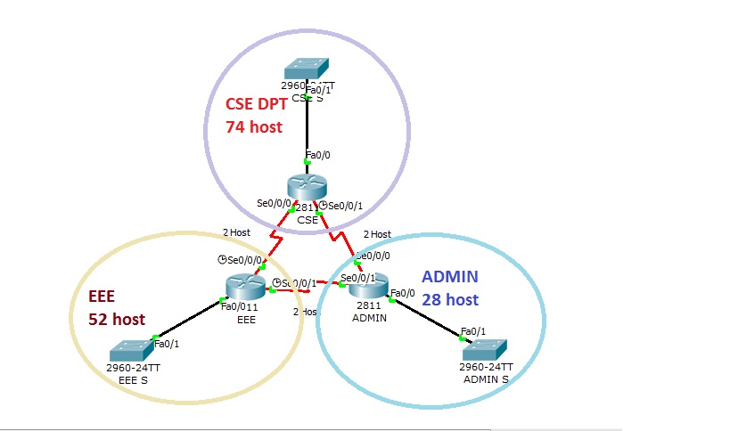
Diagram

Slide 14
In real life scenario
some subnets may require large number of host addresses while other may require only few addresses.
Assume that you are a network administrator & EDU has three departments connected with wan links.
CSE department has 74 computers.
EEE department has 52 computers.
Administrative department has 28 computers.
All departments are connected with each other via wan link.
Each wan link requires two IP addresses.

Slide 15
Choose address
First choice (purchase a class B IP address)
172.168.1.0/23
Subnetting of this address would give us 128 subnets and 510 hosts in each subnet. Our network requires only 6 subnets and 160 addresses. We would have to pay for 65356 addresses while you need only 160 addresses. Every IP address adds more dollars in company bill. Would you consider this address space for company?

Slide 16
Second choice (purchase at least two Class C IP addresses)
192.168.1.0/25
192.168.1.0/26
Subnetting of first address 192.168.1.0/25 would give us 2 subnets and 126 hosts in each subnet.
Subnetting of second address 192.168.1.0/26 would give us 4 subnets and 62 hosts in each subnet.
Collectively we are getting 6 subnets and 500 hosts from these two address spaces. We are still wasting more than 300 IP address, and we would have to purchase two address spaces.

Slide 17
Step-1
Oder all segments according the hosts requirement (Largest to smallest).
Subnet | Segment | Host
1 | CSE | 74
2 | EEE | 52
3 | Administration | 28
4 | Wan link 1 | 2
5 | Wan link 2 | 2
6 | Wan link 3 | 2

Slide 18
Step-2
Do Subnetting for largest segment. Our largest segment needs 74 host addresses. /25 provide us two subnets with 126 hosts in each subnet.
192.168.1.0/25
Subnet | Subnet 1 | Subnet 2
Network ID | 192.168.1.0 | 192.168.1.128
First host address | 192.168.1.1 | 192.168.1.129
Last host address | 192.168.1.126 | 192.168.1.254
Broadcast ID | 192.168.1.127 | 192.168.1.255

Slide 19
Step-3
Assign subnet mask to the largest segment. As you can see in above table, subnet 1 fulfill our largest segment requirement. Assign it to our segment.
Segment | CSE
Requirement | 74
CIDR | /25
Subnet mask | 255.255.255.128
Network ID | 192.168.1.0
First hosts | 192.168.1.1
Last hosts | 192.168.1.126
Broadcast ID | 192.168.1.127

Slide 20
Step-4
Do subnetting for second largest segment from next available subnet. Next segment requires 52 host addresses. Subnetting of /25 has given us two subnets with 128 hosts in each, from that we have assigned first subnet to CSE segment. Second segment is available, we would do subnetting of this.
/26 provide us 4 subnets with 62 hosts in each subnet.
192.168.1.0/26
Subnet | Subnet 1 | Subnet 2 | Subnet 3 | Subnet 4
Network ID | 0 | 64 | 128 | 192
First address | 1 | 65 | 129 | 193
Last address | 62 | 126 | 190 | 254
Broadcast ID | 63 | 127 | 191 | 255

Slide 21
We cannot use subnet 1 and subnet 2 ( address from 0 to 127 ) as they are already assigned to CSE department. We can assign subnet 3 to our EEE department.
Segment | EEE
Requirement | 52
CIDR | /26
Subnet mask | 255.255.255.192
Network ID | 192.168.1.128
First hosts | 192.168.1.129
Last hosts | 192.168.1.190
Broadcast ID | 192.168.1.191

Slide 22
Step-5
Our next segment requires 28 hosts. From above subnetting we have subnet 3 and subnet 4 available. Do subnetting for the requirement of 28 hosts. 192.168.1.0/27
Subnet | Sub 1 | Sub 2 | Sub 3 | Sub 4 | Sub 5 | Sub 6 | Sub 7 | Sub 8
Net ID | 0 | 32 | 64 | 96 | 128 | 160 | 192 | 224
First Host | 1 | 33 | 65 | 95 | 129 | 161 | 193 | 225
Last Host | 30 | 62 | 94 | 126 | 158 | 190 | 222 | 254
Broad- cast ID | 31 | 63 | 95 | 127 | 159 | 191 | 223 | 255

Slide 23
Subnets 1 to 6 [address from 0 to 191] are already occupied by previous segments. We can assign subnet 7 to this segment.
Segment | Administration
Requirement | 28
CIDR | /27
Subnet mask | 255.255.255.224
Network ID | 192.168.1.192
First hosts | 192.168.1.193
Last hosts | 192.168.1.222
Broadcast ID | 192.168.1.223

Slide 24
Step-6
Our last three segments require 2 hosts per subnet. Do subnetting for these-192.168.1.0/30
Valid subnets are:-
0,4,8,12,16,20,24,28,32,36,40,44,48,52,56,60,64,68,72,76,80,84,88,92,96,100,104,108,112,116,120,124,128,132,136,140,144,148,152,156,160,164,168,172,176,180,184,188,192,196,200,204,208,212,216,220,224,228,232,236,240,244,248,252,256
Subnet | Subnet 57 | Subnet 58 | Subnet 59
Network ID | 224 | 228 | 232
First host | 225 | 229 | 233
Last host | 226 | 230 | 234
Broadcast ID | 227 | 231 | 235

Slide 25
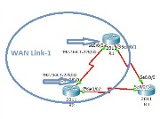
WAN Link 1
Segments | Wan Link 1
Requirement | 2
CIDR | /30
Subnet mask | 255.255.255.252
Network ID | 192.168.1.224
First hosts | 192.168.1.225
Last hosts | 192.168.1.226
Broadcast ID | 192.168.1.227

Slide 26
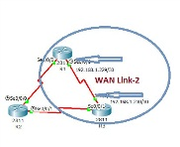
WAN Link-2
Segments | Wan Link 2
Requirement | 2
CIDR | /30
Subnet mask | 255.255.255.252
Network ID | 192.168.1.228
First hosts | 192.168.1.229
Last hosts | 192.168.1.230
Broadcast ID | 192.168.1.231

Slide 27
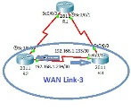
WAN Link-3
Segments | Wan Link 3
Requirement | 2
CIDR | /30
Subnet mask | 255.255.255.252
Network ID | 192.168.1.232
First hosts | 192.168.1.233
Last hosts | 192.168.1.234
Broadcast ID | 192.168.1.235

Slide 28
THANK YOU

