Slide 1
Intro Web Programming
By Gergana Dobrikova

Slide 2
CSS
CSS stands for Cascading Style Sheets
CSS describes how HTML elements are to be displayed on screen, paper, or in other media
CSS saves a lot of work. It can control the layout of multiple web pages all at once
External stylesheets are stored in CSS files

Slide 3
CSS History
HTML was NEVER intended to contain tags for formatting a web page!
HTML was created to describe the content of a web page, like:
<h1>This is a heading</h1>
<p>This is a paragraph.</p>
When tags like <font>, and color attributes were added to the HTML 3.2 specification, it started a nightmare for web developers. Development of large websites, where fonts and color information were added to every single page, became a long and expensive process.
To solve this problem, the World Wide Web Consortium (W3C) created CSS.
CSS removed the style formatting from the HTML page!

Slide 4
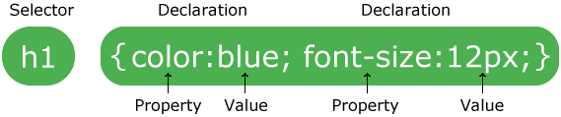
CSS Syntax

Slide 5
CSS Selectors
The element Selector
The id Selector
The class Selector
Grouping Selectors

Slide 6
CSS Insert
External style sheet
<head> <link rel="stylesheet" type="text/css" href="mystyle.css"> </head>
Internal style sheet
Inline style
<h1 style="color:blue;margin-left:30px;">This is a heading</h1>

Slide 7
Cascading Order
What style will be used when there is more than one style specified for an HTML element?
Generally speaking we can say that all the styles will "cascade" into a new "virtual" style sheet by the following rules, where number one has the highest priority:
Inline style (inside an HTML element)
External and internal style sheets (in the head section)
Browser default

Slide 8
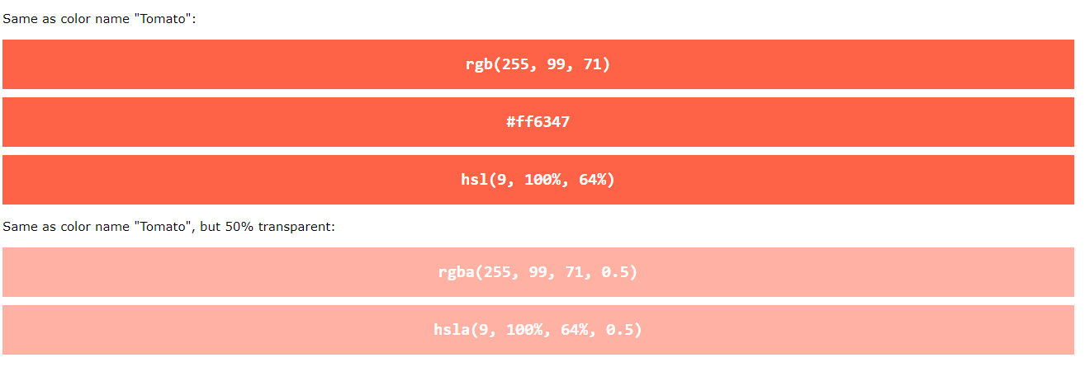
CSS Colors
Color Names: Link
RGB values, HEX values, HSL values, RGBA values, and HSLA values
CSS Properties:
background-color
color

Slide 9
CSS Background Image
background-image: url(“image.png");
background-repeat
background-position

Slide 10
Css Borders
Properties
border-style Types
border-width
border-color
border-radius
Border - Individual Sides
Border - Shorthand Property
border-width
border-style (required)
border-color

Slide 11
CSS Height and Width
The height and width properties are used to set the height and width of an element.

Slide 12
If the border-style property has four values:
border-style: dotted solid double dashed;
top border is dotted
right border is solid
bottom border is double
left border is dashed
If the border-style property has three values:
border-style: dotted solid double;
top border is dotted
right and left borders are solid
bottom border is double
If the border-style property has two values:
border-style: dotted solid;
top and bottom borders are dotted
right and left borders are solid
If the border-style property has one value:
border-style: dotted;
all four borders are dotted

Slide 13
CSS Margin
The CSS margin properties are used to create space around elements, outside of any defined borders.
auto - the browser calculates the margin
length - specifies a margin in px, pt, cm, etc.
% - specifies a margin in % of the width of the containing element
inherit - specifies that the margin should be inherited from the parent element
The auto Value

Slide 14
CSS Padding
The CSS padding properties are used to generate space around an element's content, inside of any defined borders.
length - specifies a padding in px, pt, cm, etc.
% - specifies a padding in % of the width of the containing element
inherit - specifies that the padding should be inherited from the parent element

Slide 15

CSS Box Model

Slide 16
CSS Text
color
text-align
text-decoration
text-transform
letter-spacing
line-height
word-spacing
text-shadow Generator

Slide 17
CSS Fonts
font-family Safe Fonts
font-style
font-size
font-weight

