Slide 1
Intro Web Programming
By Gergana Dobrikova

Slide 2
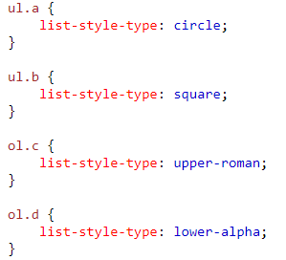
CSS List Properties
list-style-type
list-style-image: url('sqpurple.gif');
list-style-type: none;

Slide 3
Borders Styles
border-collapse: collapse;
table, th, td { border: 1px solid black; }
table { border: 1px solid black; }

Slide 4
Display
The display property specifies if/how an element is displayed.
Every HTML element has a default display value depending on what type of element it is. The default display value for most elements is block or inline.

Slide 5
Override The Default Display Value
Every element has a default display value. However, you can override this.
Changing an inline element to a block element, or vice versa, can be useful for making the page look a specific way, and still follow the web standards.
A common example is making inline <li> elements for horizontal menus.

Slide 6
Display types
display: none;
display: inline;
display: block;
display: inline-block;
More Here

Slide 7
Position
The position property specifies the type of positioning method used for an element (static, relative, fixed, absolute or sticky).
There are five different position values:
static
relative
fixed
absolute
sticky

Slide 8
Position
position: static;
HTML elements are positioned static by default.
Static positioned elements are not affected by the top, bottom, left, and right properties.
position: relative;
An element with position: relative; is positioned relative to its normal position.
Setting the top, right, bottom, and left properties of a relatively-positioned element will cause it to be adjusted away from its normal position. Other content will not be adjusted to fit into any gap left by the element.
position: fixed;
An element with position: fixed; is positioned relative to the viewport, which means it always stays in the same place even if the page is scrolled. The top, right, bottom, and left properties are used to position the element.
A fixed element does not leave a gap in the page where it would normally have been located.

Slide 9
Position
position: absolute;
An element with position: absolute; is positioned relative to the nearest positioned ancestor (instead of positioned relative to the viewport, like fixed).
However; if an absolute positioned element has no positioned ancestors, it uses the document body, and moves along with page scrolling.
Note: A "positioned" element is one whose position is anything except static.
Overlapping Elements
z-index

Slide 10
Css Overflow
The CSS overflow property controls what happens to content that is too big to fit into an area.
The overflow property has the following values:
visible - Default. The overflow is not clipped. It renders outside the element's box
hidden - The overflow is clipped, and the rest of the content will be invisible
scroll - The overflow is clipped, but a scrollbar is added to see the rest of the content
auto - If overflow is clipped, a scrollbar should be added to see the rest of the content

Slide 11
Css Float and Clear
The CSS float property specifies how an element should float.
The CSS clear property specifies what elements can float beside the cleared element and on which side.
The float property can have one of the following values:
left - The element floats to the left of its container
right- The element floats to the right of its container
none - The element does not float (will be displayed just where it occurs in the text). This is default
inherit - The element inherits the float value of its parent

Slide 12
Css Float and Clear
The clear property specifies what elements can float beside the cleared element and on which side.
The clear property can have one of the following values:
none - Allows floating elements on both sides. This is default
left - No floating elements allowed on the left side
right- No floating elements allowed on the right side
both - No floating elements allowed on either the left or the right side
inherit - The element inherits the clear value of its parent
The most common way to use the clear property is after you have used a float property on an element.
When clearing floats, you should match the clear to the float. If an element is floated to the left, then you should clear to the left. Your floated element will continue to float, but the cleared element will appear below it on the web page.

Slide 13
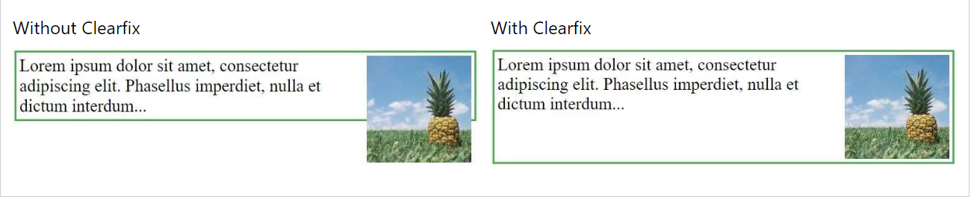
The clearfix Hack
.clearfix { overflow: auto; }

Slide 14
CSS Combinators
There are four different combinators in CSS:
descendant selector (space)
child selector (>)
adjacent sibling selector (+)
general sibling selector (~)

Slide 15
CSS Pseudo-classes & CSS Pseudo Elements
Here

Slide 16
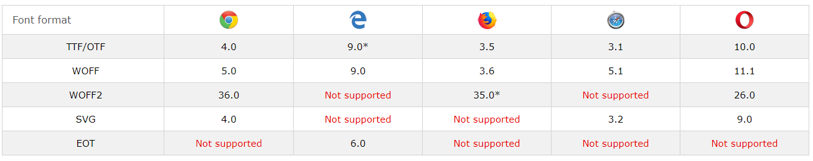
CSS @font-face Rule
@font-face { font-family: myFirstFont; src: url(sansation_light.woff); }

