Slide 1
N
NAVIGATOR
Walk into every appointment prepared.
A local-first PWA for parents managing a child’s complex psychiatric care.
Product & Engineering Proposal
Powered by NovaSapien Labs · Internal stakeholder brief · 2026

Slide 2
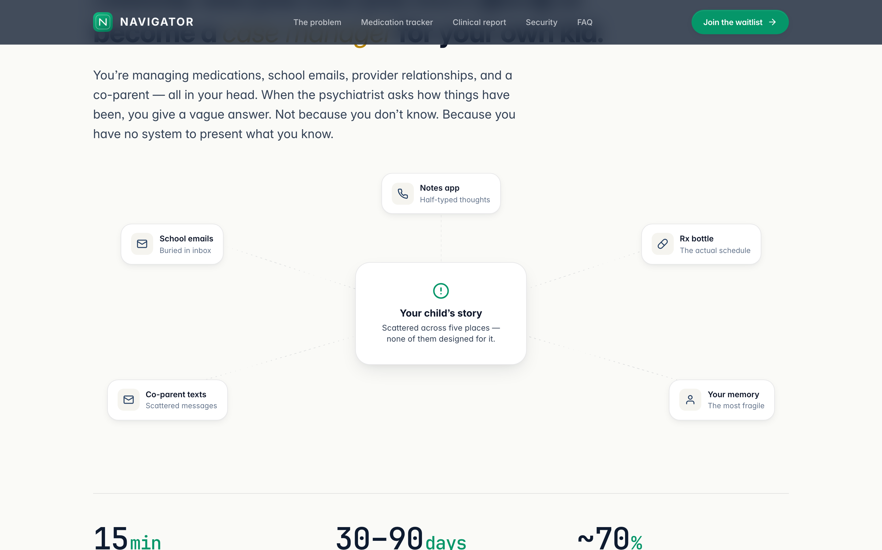
THE PROBLEM
Nobody told you you’d become a case manager for your own kid.
A child’s psychiatric story ends up scattered across five places — a pill organizer, a calendar, teacher emails, a notes app, and the parent’s memory. None of them designed for it.
15 min
Average psychiatrist visit — 90 days recalled from sticky notes.
30–90 days
Between every appointment. A lot happens, and is forgotten.
~70%
Of patterns get missed without a system to surface them.
Navigator · Powered by NovaSapien Labs

Slide 3
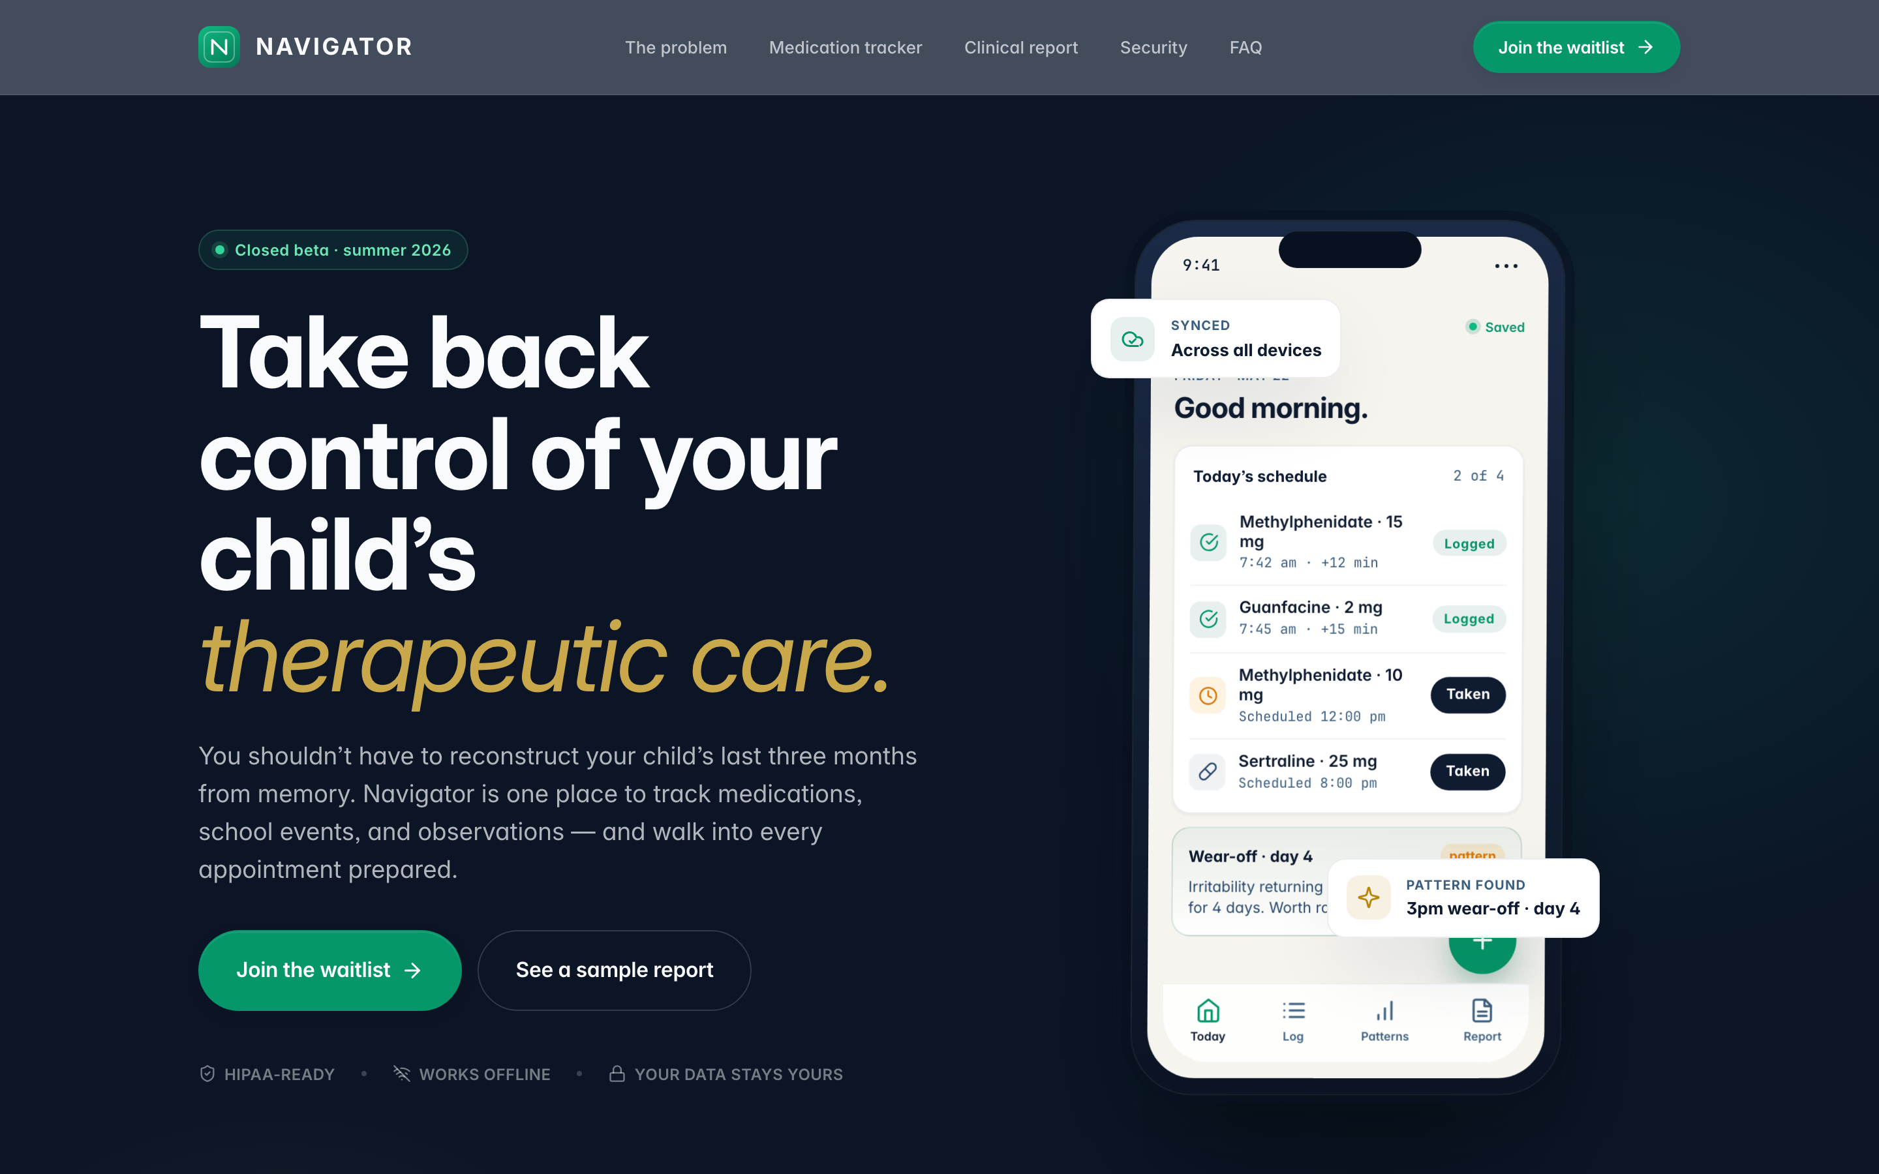
THE SOLUTION
One place to log it — one tap to a clinical report.
Navigator turns everyday logging, done in seconds, into a structured 90-day clinical summary. Local-first, private, and built for the hardest version of the problem.
1
Log in seconds
One-tap dose outcomes, tagged notes, voice.
2
See it on one timeline
Concurrent regimens, corrections, patterns.
3
Walk in prepared
A 90-day report a clinician reads in a minute.
Navigator · Powered by NovaSapien Labs

Slide 4
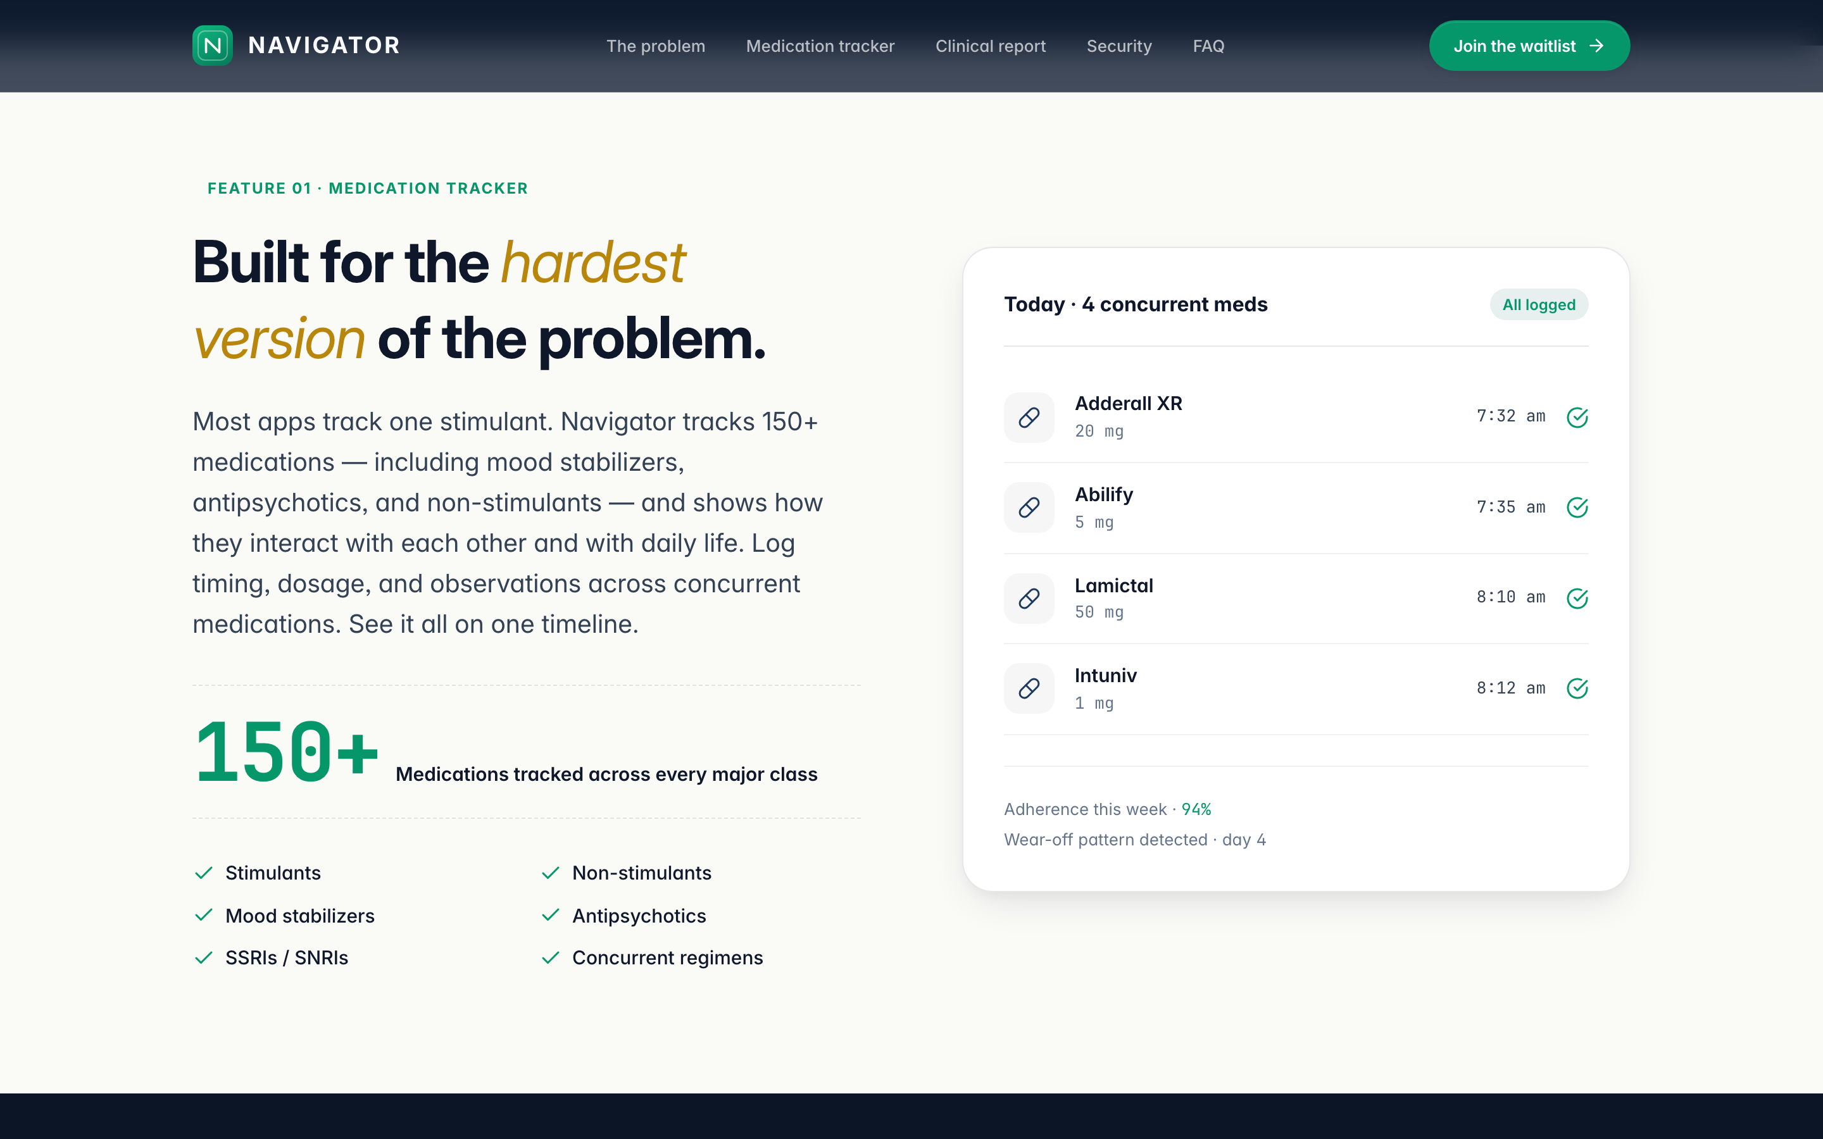
PRODUCT · FEATURE 01
Built for the hardest version of the problem.
Medication tracker
150+ medications across every major class — stimulants, non-stimulants, mood stabilizers, antipsychotics, SSRIs/SNRIs. Navigator shows how concurrent regimens interact with each other and with daily life.
A dose-log tap updates the UI in under 50 ms — because every read and write is on-device.
Navigator · Powered by NovaSapien Labs

Slide 5
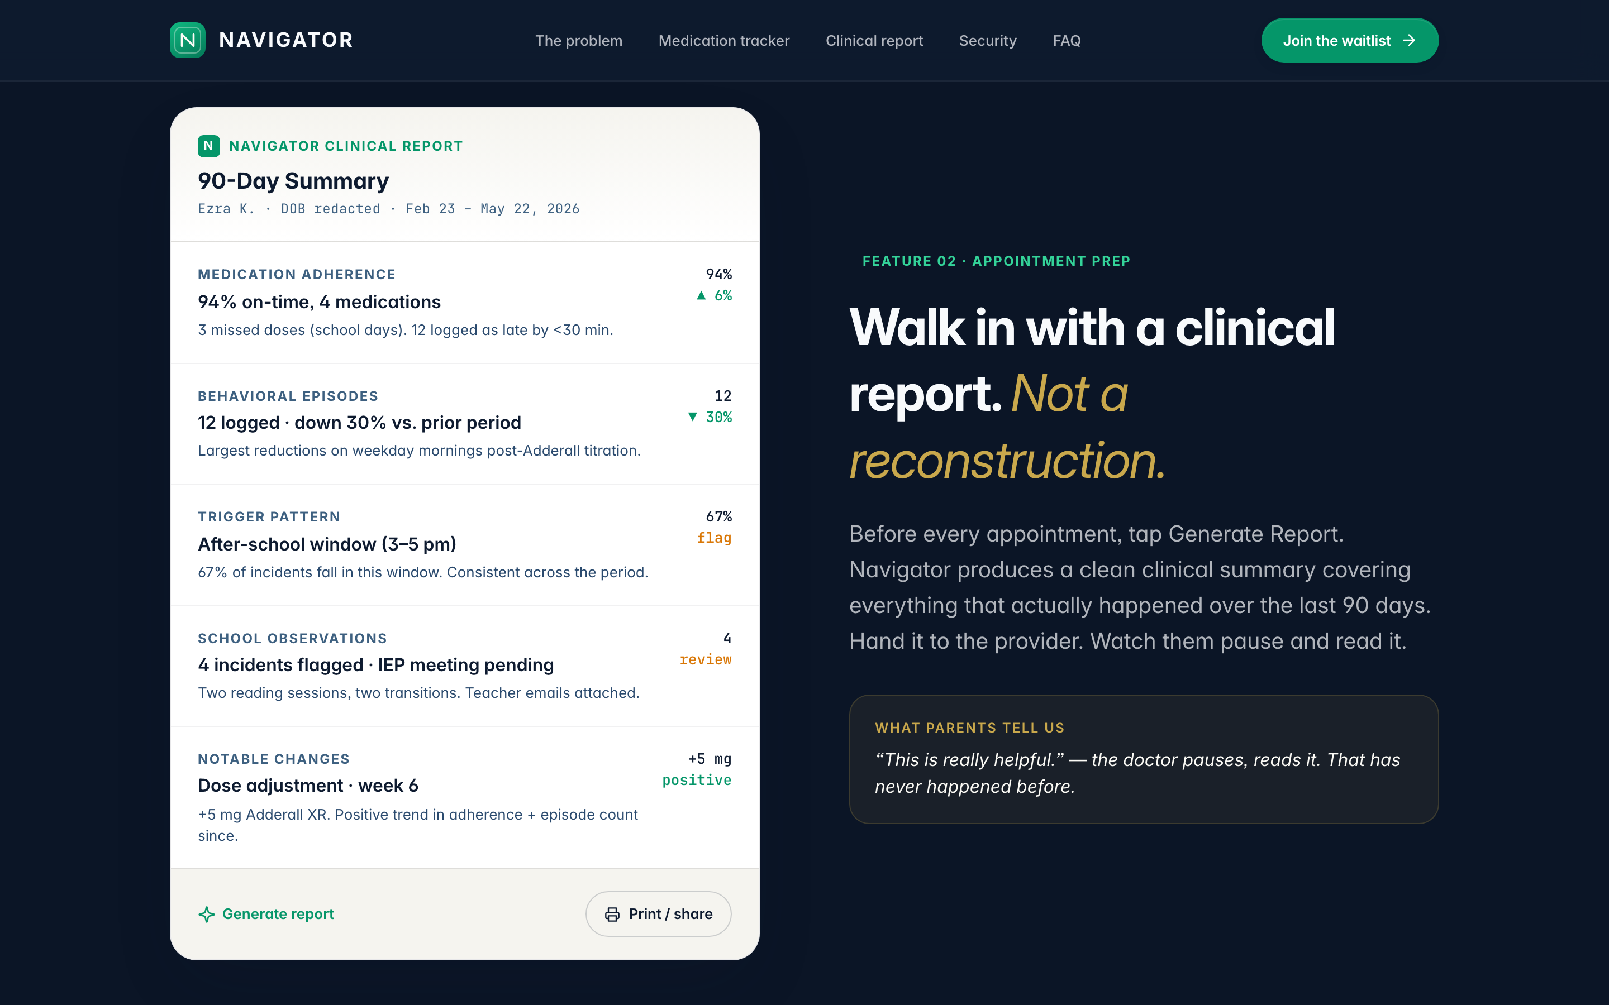
PRODUCT · FEATURE 02
Walk in with a clinical report. Not a reconstruction.
Before each appointment, one tap generates a 90-day summary: adherence, behavioral episodes, trigger patterns, school observations, and notable changes.
Every figure is derived from the logged data — never invented — with an honest ‘on track’ or ‘review’ signal. Exports to PDF on-device.
Navigator · Powered by NovaSapien Labs

Slide 6
PRODUCT · CAPTURE
Fast to log. Quiet to use. AI where it earns its place.
1
Fast logging
2
Voice notes
One-tap outcomes — taken, late, missed, refused — plus tagged observations on an append-only log that never loses history.
Speak an observation; a Whisper-backed function transcribes it into a structured event.
3
AI narrative
4
Keys stay server-side
A Claude-backed function turns the report into a calm, clinician-fluent summary.
Both AI features run behind a server boundary and degrade gracefully when unconfigured.
Navigator · Powered by NovaSapien Labs

Slide 7
WHY NAVIGATOR IS DIFFERENT
Four bets, baked into the architecture.
Local-first
Privacy by architecture
The interface never waits on the network. A dose log is instant; sync is additive, not a dependency.
Data lives encrypted on the device before it leaves it. AI requests are scoped, redacted, and never trained on.
Clinical, not consumer
Built for the hardest case
The report is the product — specific, honest, readable by a clinician in under a minute.
Concurrent regimens, corrections without data loss, and a voice designed for a stressed caregiver.
Navigator · Powered by NovaSapien Labs

Slide 8
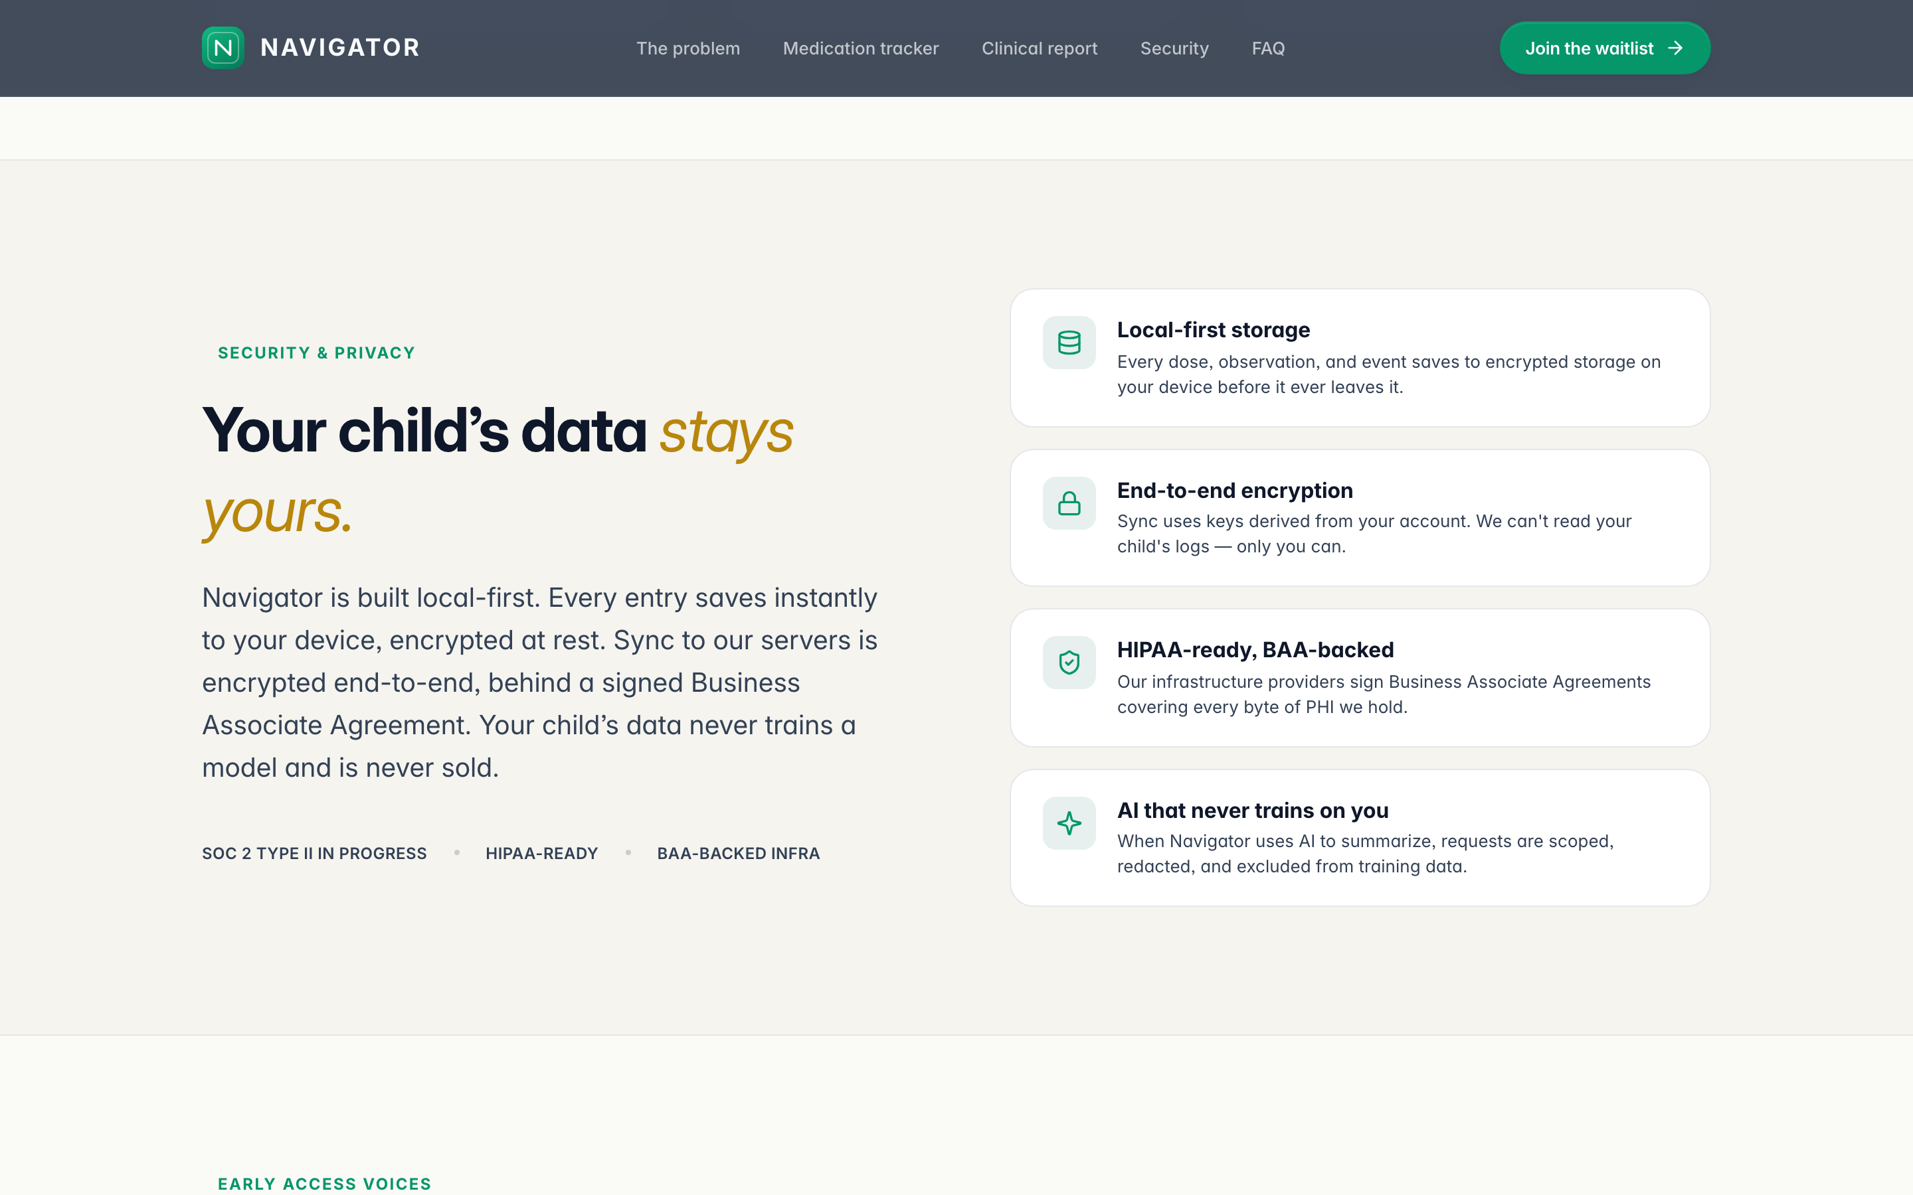
SECURITY & PRIVACY
Your child’s data stays yours.
Local-first storage
Encrypted on your device before it ever leaves it.
End-to-end encryption
Sync keys derive from your account — only you can read the logs.
HIPAA-ready, BAA-backed
Infrastructure providers sign Business Associate Agreements.
AI that never trains on you
Requests are scoped, redacted, and excluded from training.
Navigator · Powered by NovaSapien Labs

Slide 9
ENGINEERING POSTURE
Built to be trusted with sensitive health data.
On-device database
Event sourcing
PGlite — Postgres compiled to WASM — persisted in the browser. Reactive reads keep the UI live.
The log is append-only. Edits are corrections; nothing is overwritten — enforced with hard database triggers.
Server boundary + RLS
One design system
Auth, sync, and AI sit behind a server boundary with row-level security on every table.
Every color and size comes from one token source, enforced by lint.
Navigator · Powered by NovaSapien Labs

Slide 10
QUALITY & HARDENING
Shipped, then hardened — and verified on every change.
Security
Accessibility
Performance
CSP + hardening headers, server-fn authorization, owner-scoped RLS, PII redaction.
WCAG AA: focus rings, 44px targets, status never color-alone, pinch-zoom restored.
Primary route under the 250 KB budget; the database loads off the critical path.
Responsive
Verification
Coverage
Fluid type, codified breakpoints, reading-width, safe-area — 320px to 1920px.
CI gate: typecheck, lint (token + voice rules), unit + e2e tests, production build.
Required tests on the report engine and database migrations.
Navigator · Powered by NovaSapien Labs

Slide 11
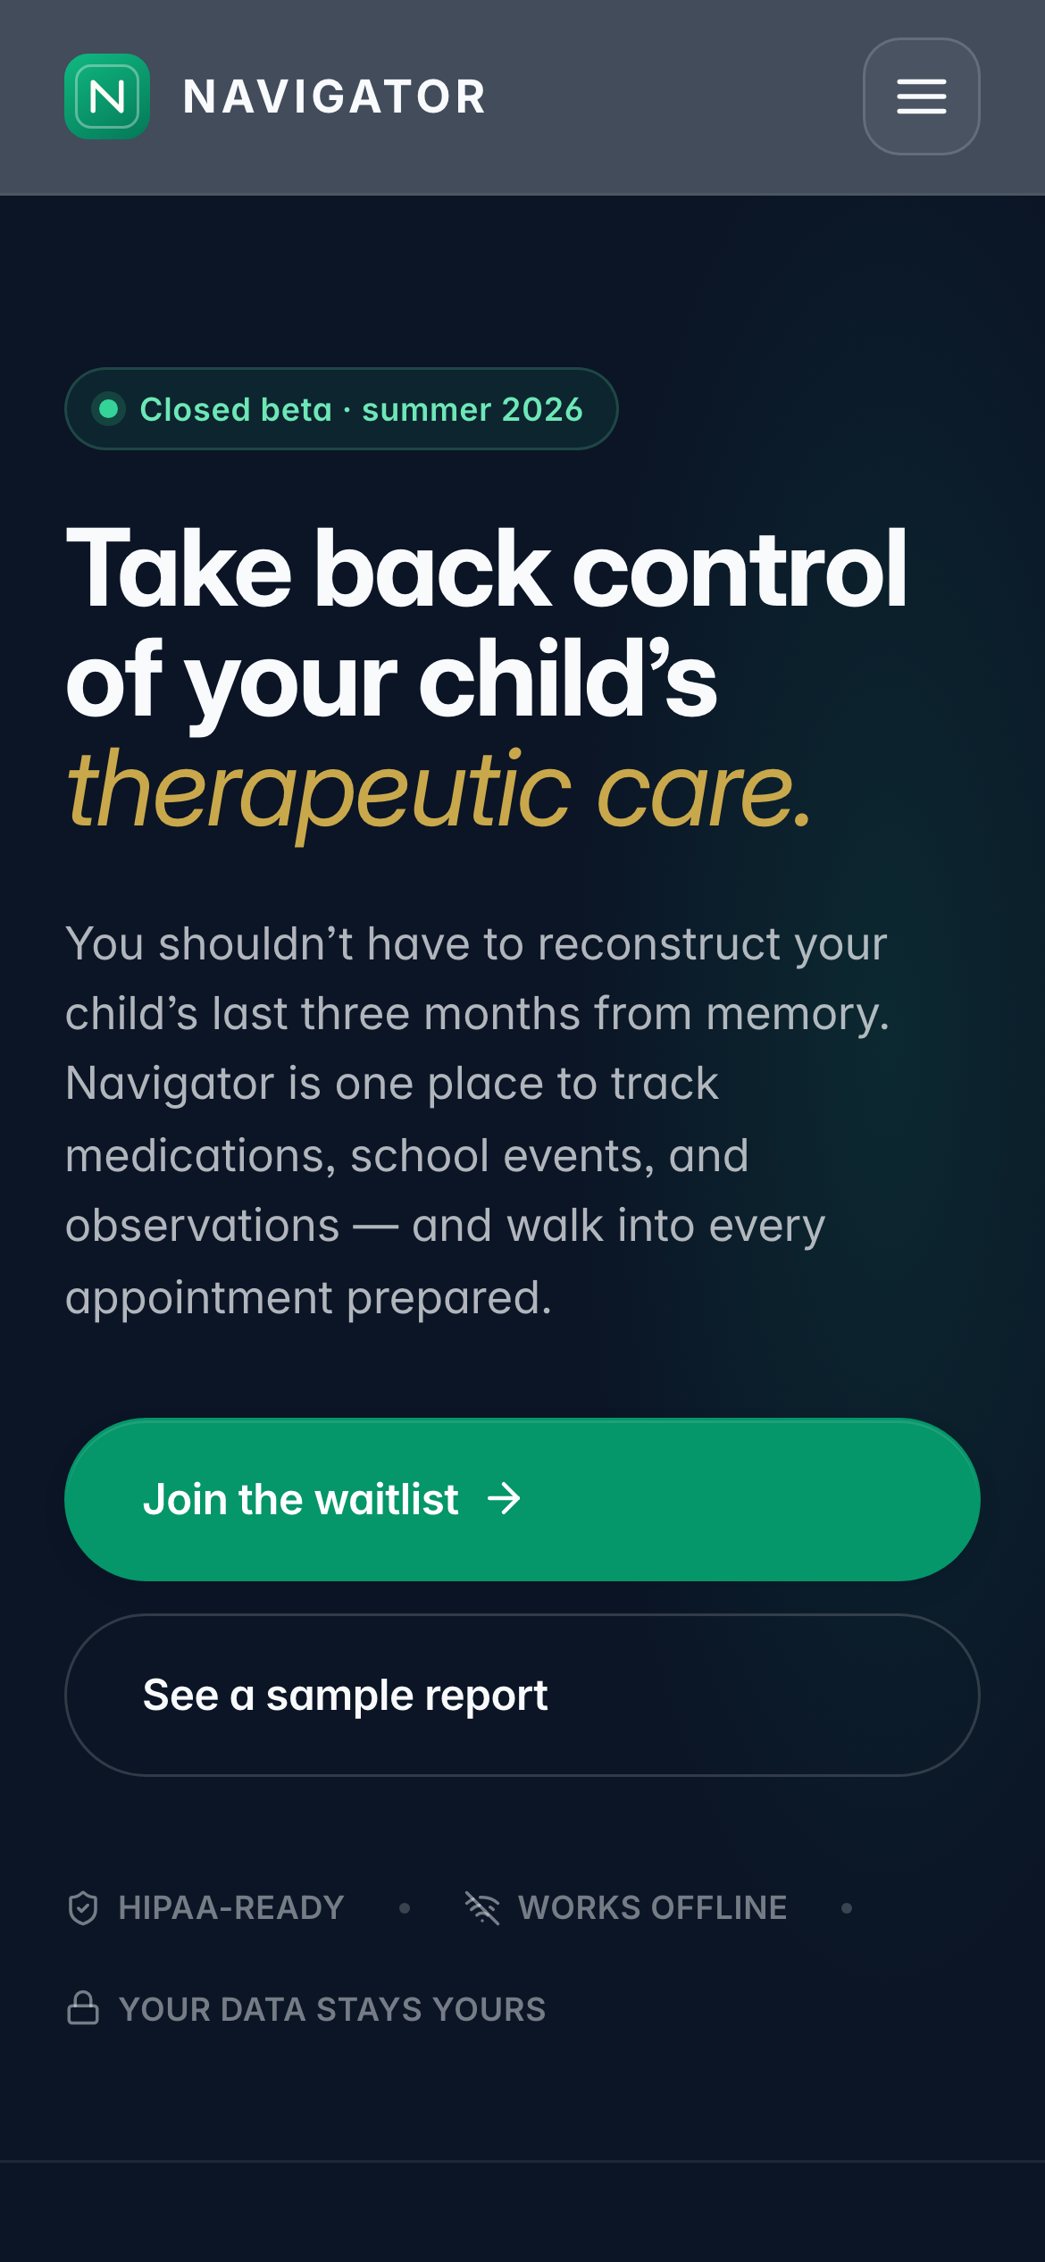
EVERYWHERE · OFFLINE
An installable app that works with no network.
The same surface adapts intact to a 390px phone — an accessible menu, cleanly stacked actions, and no overflow at any width.
Installable
Add to home screen; runs full-screen like a native app.
Offline-first
The data layer is on-device; the shell is cached for offline launch.
Calm updates
New versions surface without disrupting a logging session.
Navigator · Powered by NovaSapien Labs

Slide 12
ROADMAP
Built → Building → Envisioned.
BUILT
BUILDING
ENVISIONED
Phase 1 — shipped
Phase 2 — next
Phase 3 — beyond the parent
Passwordless auth, local-only mode
On-device DB, reactive reads, one-tap logging
Today, timeline, report, prep, patterns, settings, onboarding
Voice, AI narrative, PDF, PWA, waitlist
Security + a11y + perf + responsive hardening
Cross-device sync (interface defined)
Co-parent sharing + per-row attribution
Pattern detection across events
Push dose reminders
Read-only clinician portal
Payer-grade / IEP exports
IEP document parsing
Google OAuth sign-in
Navigator · Powered by NovaSapien Labs

Slide 13
SUMMARY
Phase 1 is shipped, hardened, and verified.
Navigator shows that NovaSapien Labs can take a genuinely hard problem — the invisible labor of managing a child’s psychiatric care — and deliver a private, fast, clinical-grade tool a stressed parent can actually use. Phase 2 and 3 extend this foundation, not rebuild it.
Recommended next steps
1
Open the closed beta to the first cohort of families.
2
Wire cross-device sync onto the existing interface.
3
Begin clinician discovery for the read-only portal.

Slide 14
Navigator
Walk into every appointment prepared.
Powered by NovaSapien Labs
Navigator does not diagnose, prescribe, or treat. For clinical decisions, always consult your child’s provider.

