Slide 1
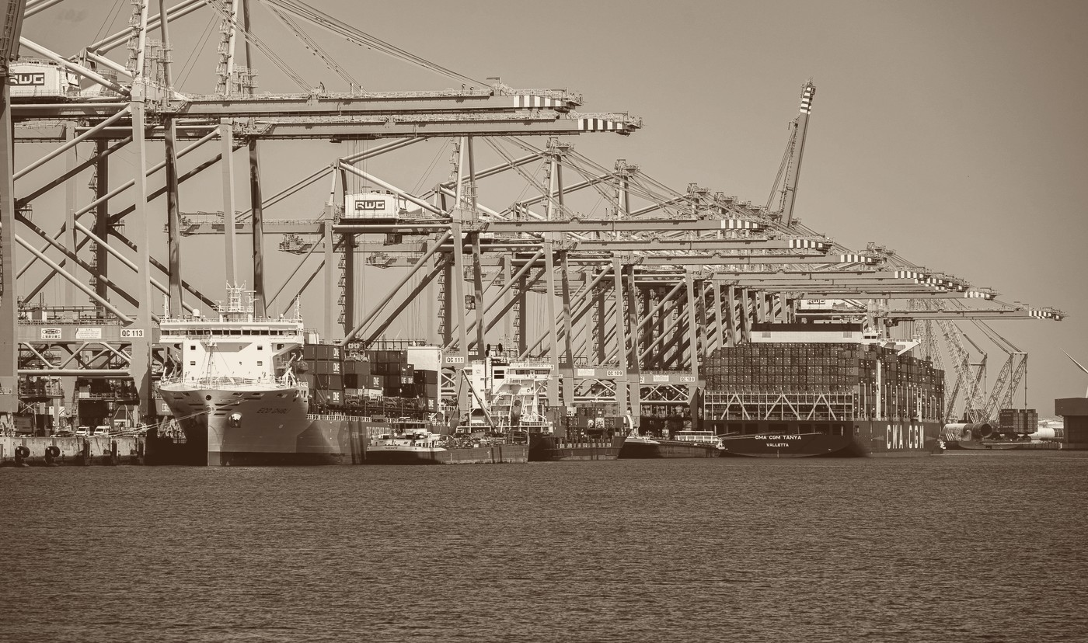

Global Superstore · Revival Strategy
Board of Directors briefing
Global Superstore:
The Revival Strategy
From forensic diagnosis to a 6-12 month turnaround plan
Syndicate 6
1. Giga Hidjrika Aura Adkhy (388)
5. Nurul Aulia Rahmawati (359)
2. Safia Aisyah Nur Savanah (364)
6. Cindy Monica Manurung (384)
3. Adiva Fitri Khalishah Cipta Raharja (377)
7. Louis Alessandro Bonaparte (356)
4. Azka Ghossani A. (357)
Analytics Taskforce for the Chief Strategy Officer · FY2011-FY2014 transaction ledger, 51,290 order lines
Global Superstore · Revival Strategy
Notes:
[0:30 - Slide 1 of 18]
SAY: "Good morning. Four years of transaction data - 51,290 order lines - and one finding: Global Superstore does not have a growth problem. It has a pricing problem. In the next ten minutes we will show you exactly where the profit leaks, and a three-lever plan that recovers $1.23M without a dollar of new capital."
DELIVERY: One line of team intro - Syndicate 6, seven analysts - then move. Do not read the roster aloud.
TRANSITION: "Let us start with the headline number."

Slide 2
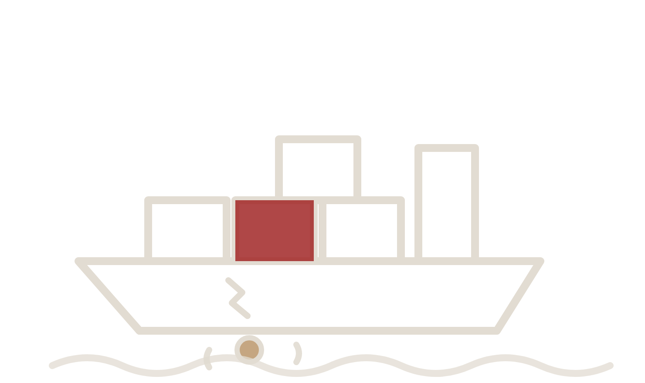
Global Superstore · Revival Strategy
Executive summary
Sales are growing; profit is leaking through discounting and freight
The evidence in four numbers
One key message for the Board
Global Superstore does not have a growth problem. It has a margin-leakage problem: about a quarter of all order lines sell at a loss, and the loss is concentrated in deep discounts and loss-making overseas territories. Tightening price control and fixing those territories recovers roughly $1.23M of operating profit without adding a single new sale.
$2.26M → $4.30M
Revenue over four years (+90.3%, 23.9% a year)
11.6%
Operating margin, four-year average (annual range: 11.0% to 11.9%)
-$920,646
Profit destroyed by 12,544 loss-making lines (24.5%)
+$1.23M
Operating profit recoverable on the current ledger (+84%)
Source: Global Superstore transaction ledger, FY2011-FY2014 (51,290 order lines). Operating profit is reported profit after cost of goods and freight. Recovery is the base-case simulation output (analytics model, this deck), about $0.31M a year on the same run-rate.
Global Superstore · Revival Strategy
1
Notes:
[0:45 - Slide 2 of 18]
SAY: Four numbers tell the whole story. Revenue nearly doubled, $2.26M to $4.30M, up 90.3% - so the rumors of stagnation are false. Yet margin is stuck at 11.6%. Why? One in four order lines sells at a loss, destroying $920,646. The fix is not more sales - it is three policy levers that recover $1.23M, an 84% uplift, with zero new capital.
DELIVERY: Point at each of the four cards as you name it. Pause after "$920,646".
IF ASKED "is $1.23M realistic?": It is the base case of our simulator; even the conservative case returns +$0.91M - slide 14 covers the stress test.
TRANSITION: "First, the diagnosis. Is the growth real?"

Slide 3
Global Superstore · Revival Strategy
Diagnosis · Growth
Revenue grew 90% to $4.3M and operating profit more than doubled
Gross sales and operating profit
Growth is genuine and volume-driven
$ million (bars), FY2011-FY2014
Revenue rose every year, from $2.26M in FY2011 to $4.30M in FY2014 (+90.3%).
Operating profit rose every year too, from $249K to $504K (+102.5%).
Order volume grew from 4,440 to 8,531 orders; average order value stayed flat at about $505.
Growth came from more customers and orders, not from raising prices.
Order Volume: 4,440 → 8,531 (+92.1%) | Avg Order Value: ~$505 (flat, -0.9%)
Gross sales ($M) & Operating profit ($M)
Year-on-year growth: +18.5%, +27.2%, +26.3%
Source: Global Superstore transaction ledger, FY2011-FY2014. Operating profit is reported profit after cost of goods and freight.
Global Superstore · Revival Strategy
2
Notes:
[0:30 - Slide 3 of 18]
SAY: Growth is genuine and volume-driven. Revenue rose every single year - +18.5%, +27.2%, +26.3% - and operating profit more than doubled to $504K. Orders grew from 4,440 to 8,531; average order value stayed flat at about $505. We grew by adding customers and orders, not by raising prices - which is precisely why margin never improved.
TRANSITION: "Zoom out and the pattern is stark: every extra dollar arrived at the same thin margin."

Slide 4

Global Superstore · Revival Strategy
Diagnosis · Margin
Operating margin stayed near 11% while sales climbed 90%
Gross sales and operating margin
Volume was rewarded, margin was not
$ million (top) · margin % (bottom)
Revenue compounded at 23.9% a year, but operating margin moved only from 11.0% to 11.7%.
Profit grew almost exactly in line with revenue, so every extra dollar of sales carried the same thin margin.
The company measures and pays for gross volume, so sales teams had no reason to defend price.
Margin, not revenue, is the number the Board should track from here.
Gross sales (top)
Operating margin (bottom)
Source: Global Superstore transaction ledger, FY2011-FY2014. Operating margin = profit / gross sales.
Global Superstore · Revival Strategy
3
Notes:
[0:30 - Slide 4 of 18]
SAY: Margin hovered between 11.0% and 11.9% for four straight years - profit grew exactly in line with revenue, so scale bought us nothing. The reason is incentive design: we measure and pay for gross volume, so nobody defended price. Margin - not revenue - is the number this Board should track from here.
TRANSITION: "So where does the profit actually go? A quarter of everything we sell loses money."

Slide 5

Global Superstore · Revival Strategy
Diagnosis · Profit leakage
One in four order lines loses money and drains $921K of earned profit
From earned profit to reported profit
What the bridge shows
$ million, FY2011-FY2014 cumulative
Profitable lines earn $2.39M before the losses; that core is strong on its own.
12,544 lines (24.5% of all lines) were priced at a loss and removed $0.92M of that profit.
Reported operating profit of $1.47M understates how profitable the healthy core really is.
The loss is a pricing and cost-to-serve outcome, not a weak market.
Earned
Lost
Reported
Source: Global Superstore transaction ledger, FY2011-FY2014. A line is loss-making where reported profit, net of cost of goods and freight, is negative.
Global Superstore · Revival Strategy
4
Notes:
[0:45 - Slide 5 of 18]
SAY: Walk the bridge. Profitable lines earn $2.39M - that core is strong on its own. But 12,544 lines - one in four - were priced below cost and wiped out $920,646 of it. Reported profit: $1.47M. Our healthy core is being taxed by our own pricing.
DELIVERY: Slow down on "one in four".
IF ASKED "is 24.5% normal?": Healthy retail runs low-single-digit loss-line rates. Ours is an outlier caused by policy, not by the market - slide 8 shows the exact mechanism.
TRANSITION: "Where is the loss concentrated? First, geography."

Slide 6

Global Superstore · Revival Strategy
Diagnosis · Geography
Losses concentrate in four countries, led by Turkey and Nigeria
Operating profit by country
A company-policy loss, not a market loss
$ thousand, FY2011-FY2014 cumulative
Turkey (-$98K) and Nigeria (-$81K) alone account for $179K of the deficit.
29 of 147 countries are net-negative; the top four carry 56% of that deficit.
Both were sold at extreme average discounts: 60% in Turkey and 70% in Nigeria.
The EMEA market (Europe, Middle East and Africa) runs a 5.4% margin, well below 12-13% in the other markets.
No discount or freight cost was charged back to these territories, so their losses were absorbed centrally.
Source: Global Superstore transaction ledger, FY2011-FY2014. Discount is the order-line average; country profit is net of all lines in that country.
Global Superstore · Revival Strategy
5
Notes:
[0:30 - Slide 6 of 18]
SAY: 29 of 147 countries are net-negative, and Turkey (-$98K) and Nigeria (-$81K) carry most of the deficit. Both were sold at 60-70% average discounts, with cross-border freight absorbed centrally. This is a company-policy loss, not a market loss: EMEA runs 5.4% margin against 12-13% in our healthy markets.
TRANSITION: "One product line tells exactly the same story."

Slide 7
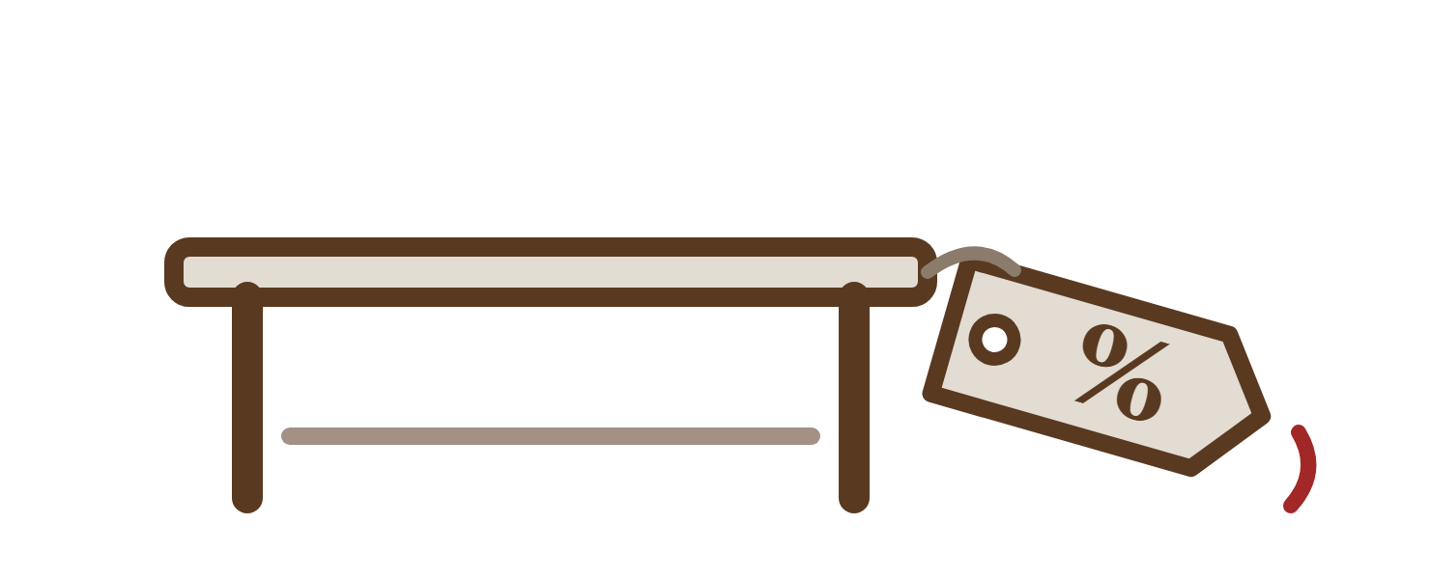
Global Superstore · Revival Strategy
Diagnosis · Product
Tables is the only one of 17 sub-categories that loses money
Operating profit by sub-category
A pricing and freight problem, not demand
$ thousand, FY2011-FY2014 cumulative
Tables lost $64.1K on $757K of sales, a -8.5% margin, and is the only deficit sub-category.
It carried a 29.1% average discount plus the highest freight per unit of any line.
The rest of the portfolio is profitable: Copiers +$259K, Phones +$217K, Bookcases +$162K.
Furniture overall runs a 6.9% margin against 14.0% for Technology.
Loss-making
Profitable
Source: Global Superstore transaction ledger, FY2011-FY2014. All 17 sub-categories, ranked by operating profit.
Global Superstore · Revival Strategy
6
Notes:
[0:30 - Slide 7 of 18]
SAY: Sixteen of seventeen sub-categories are profitable - Copiers +$259K, Phones +$217K. Tables is the only loser: -$64.1K on $757K of sales, carrying a 29.1% average discount plus the highest freight per unit in the catalogue. That drags Furniture to a 6.9% margin against Technology's 14.0%.
TRANSITION: "But the biggest single cause is a line you can draw on a chart: twenty percent."

Slide 8
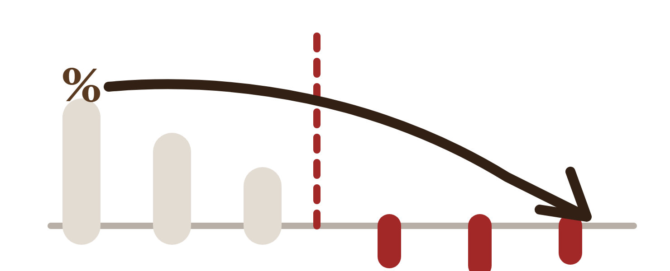
Global Superstore · Revival Strategy
Diagnosis · Discounting
Order economics invert once the discount passes 20%
Operating margin by discount band
The 20% break-even
margin %, all order lines FY2011-FY2014
20% discount line
Below 20% every line is profitable: margin runs from +25.3% at no discount to +9.9% at 10-20%.
Above 20% every band is loss-making, sliding from -5.5% to -111%.
11,328 lines (22.1%) were priced above the 20% line and lost $814,682 in total.
Gross margin cannot cover concessions deeper than 20%, so the cap follows from the data.
Past 50% off, 100% of orders lose money.
Profitable (≤20% discount)
Operating deficit (>20% discount)
Source: Global Superstore transaction ledger, FY2011-FY2014. Bands follow the discount distribution in the ledger. Discount-profit rank correlation: -0.60 (Pearson: -0.32).
Global Superstore · Revival Strategy
7
Notes:
[1:00 - Slide 8 of 18]
SAY: This is the most important chart in the deck. Below 20% discount, every band is profitable: +25.3% with no discount, still +9.9% at 10-20%. Above 20%, every band loses: -5.5%, worsening to -111% past 50%. 11,328 lines - 22.1% of the ledger - were priced past that line and lost $814,682: that is 88.5% of ALL loss dollars.
DELIVERY: Trace the cliff with your hand. Pause at "88.5%".
IF ASKED "why 20% exactly?": It is where the data inverts, not a round number we picked - gross margin cannot carry concessions deeper than 20%.
TRANSITION: "Discounting has an accomplice: freight."

Slide 9
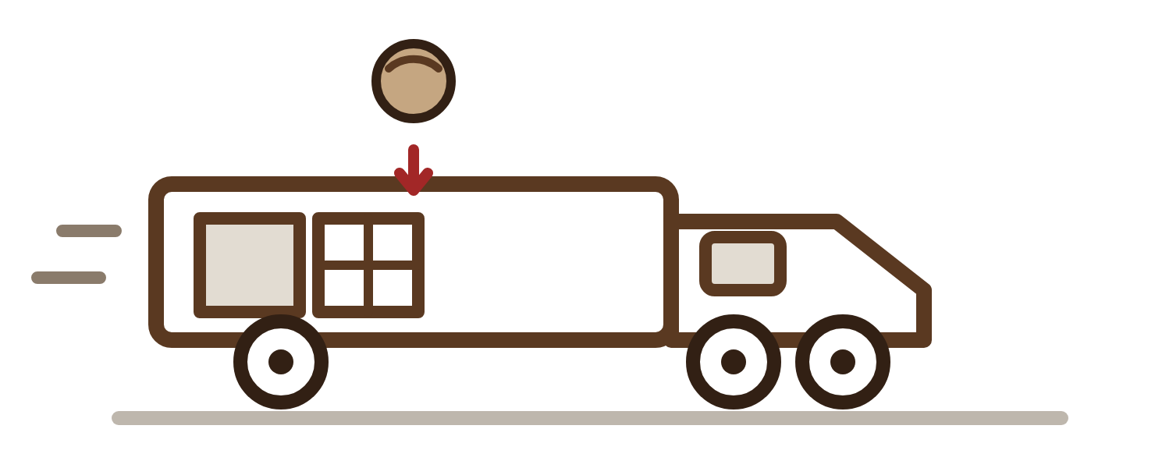
Global Superstore · Revival Strategy
Diagnosis · Cost to serve
Expedited orders lose up to 24% of sales value to freight
Freight cost as a share of sales
Cost to serve is never charged back
% of invoiced sales
Critical-priority orders spend 23.8% of their sales value on freight; Same Day spends 17.4%.
Standard Class spends only 8.1%, a third of the Critical rate.
Company-wide freight is 10.7% of sales and is not passed through on bulky or expedited lines.
Deep discounts and heavy freight co-occur on the same orders, so those orders struggle to recover.
Order priority
Ship mode
Source: Global Superstore transaction ledger, FY2011-FY2014. Freight ratio = shipping cost / gross sales.
Global Superstore · Revival Strategy
8
Notes:
[0:30 - Slide 9 of 18]
SAY: Critical-priority orders spend 23.8% of their sales value on freight; Same Day spends 17.4% - against 8.1% for Standard Class, a third of the rate. Company-wide, freight is 10.7% of sales and is never charged back. Deep discounts and heavy freight land on the same orders - that is why they never recover.
TRANSITION: "Put the three together and the root causes are simple and few."

Slide 10
Global Superstore · Revival Strategy
Diagnosis · Root causes
Deep discounts, loss-making territories and bulky Tables drive the $921K leak
Root cause | Evidence in the data | Where it concentrates | Profit recovered by the fix
Uncontrolled discounting | 22.1% of lines were priced above a 20% discount Margin inverts at the 20% line, from +9.9% to -5.5% | Every market; worst in EMEA and LATAM | +$1.03M
Loss-making overseas territories | Turkey -$98K and Nigeria -$81K at 60-70% average discounts EMEA margin 5.4% against 12-13% elsewhere | Turkey, Nigeria, Netherlands | +$0.18M
Bulk freight on Tables | Tables -$64K at a 29.1% average discount Expedited freight runs at 17-24% of sales | Tables within Furniture | +$0.05M
Recovery exceeds the reported $921K loss because capping discounts at 20% returns those lines to a positive margin (+9.9%), rather than just break-even.
Source: base-case simulation on the FY2011-FY2014 ledger, before the churn allowance. Figures are an analytics estimate, not a forecast.
Global Superstore · Revival Strategy
9
Notes:
[0:30 - Slide 10 of 18]
SAY: Three root causes, all policy, none market-driven. Uncontrolled discounting, worth +$1.03M to fix. Loss-making overseas territories served direct, +$0.18M. Bulky Tables freight never billed, +$0.05M. Recovery exceeds the reported $921K leak because capping discounts returns those lines to positive margin - not just to break-even.
TRANSITION: "Before we commit to this plan - what else did we consider?"

Slide 11
Global Superstore · Revival Strategy
Turnaround · Options considered
The three-lever recovery plan outearns every alternative tested
Alternative considered | What it promises | Why it is eliminated | Verdict
Raise list prices, allow deeper discounts | Bigger concessions look affordable from a higher invoice price | The leak follows the discount, not the list price: margin runs +9.9% at 10-20% off but -5.5% at 20-30%, and 88.5% of loss dollars sit above the 20% line | Eliminated
Exit Turkey and Nigeria entirely | Instant stop to the -$179K country deficit | Abandons $163K of revenue and two developing markets; 3PL restructuring removes the same losses while keeping every sale | Eliminated
Renegotiate carrier rates company-wide | Cheaper freight on every order | Freight is $1.35M over four years; a realistic ~10% cut returns ~$0.14M after 12+ months of contracting, leaving the $814,682 discount leak untouched | Support lever only
Capping discounts at 20% dominates: it is the only alternative that returns more than it risks, needs no capital, and takes effect inside two months.
Source: alternatives assessed on the FY2011-FY2014 ledger. Freight totals $1.35M (10.7% of sales); deep-discount losses $814,682 across 11,328 lines; Turkey and Nigeria revenue $163K. Modelling estimates, not forecasts.
Global Superstore · Revival Strategy
10
Notes:
[0:45 - Slide 11 of 18]
SAY: Three alternatives, three eliminations. First: raise list prices and allow deeper discounts - rejected, because the leak follows the discount depth, not the list price: 88.5% of loss dollars sit above the 20% line, so a bigger cap re-opens the wound. Second: exit Turkey and Nigeria - rejected: it forfeits $163K of revenue; 3PL removes the same $179K loss while keeping every sale. Third: renegotiate all carrier rates - demoted to support: a realistic 10% cut returns about $0.14M after a year of contracting and never touches the $814,682 discount leak.
IF ASKED "why not raise prices anyway?": A price rise hits our 75.5% healthy lines too. The cap only touches the 22% that lose money.
TRANSITION: "That leaves the three-lever plan - here it is."

Slide 12
Global Superstore · Revival Strategy
Turnaround · Plan
$1.23M of operating profit is recoverable on the full-ledger basis
Initiative | Owner | Timing | KPI to track | Expected impact
1. Pricing governance: cap discounts at 20% | Chief Commercial Officer | Months 1-2 | Orders above 15% discount: below 2% Average discount: below 12% | +$1.03M
2. Restructure loss-making territories to third-party logistics (3PL) | VP Global Supply Chain | Months 3-4 | Country operating margin: break-even within 90 days Freight: below 12% of sales | +$0.18M
3. Tables freight pass-through and repricing | Head of Merchandising | Months 5-7 | Tables operating margin: above +10% Dimensional freight recovery: 100% | +$0.05M
Source: base-case simulation on the FY2011-FY2014 ledger; levers are gross and the $1.23M headline is net of a churn allowance, about $0.31M a year on the same run-rate. Modelling estimate, not a forecast.
Global Superstore · Revival Strategy
11
Notes:
[0:45 - Slide 12 of 18]
SAY: Three initiatives, each with an owner and a date. One: pricing governance - a hard 20% cap in order entry - Chief Commercial Officer, months 1-2, +$1.03M. Two: Turkey and Nigeria restructured to bonded third-party logistics - VP Global Supply Chain, months 3-4, +$0.18M. Three: Tables freight pass-through and repricing - Head of Merchandising, months 5-7, +$0.05M. Note the KPI column: the first one is "no order above 15% discount below 2% of orders".
TRANSITION: "Net of churn, here is the money."

Slide 13
Global Superstore · Revival Strategy
Turnaround · Financial impact
The base case lifts operating profit 84% and margin to 19.9%
Operating profit bridge, baseline to projected
The recovery path
$ million, FY2011-FY2014 ledger basis
+$0.18M
+$0.05M
$2.70M
Baseline operating profit on the four-year ledger is $1.467M at an 11.6% blended margin.
The 20% discount cap contributes +$1.03M, the largest single lever.
Territory restructuring adds +$0.18M and Tables freight +$0.05M.
After the churn allowance the company lands at $2.70M and a 19.9% blended margin, about $0.31M a year higher.
+$1.03M
-$0.02M
$1.47M
Baseline
Discount cap
Territory 3PL
Freight
Churn (5%)
Projected
Baseline
Recovery levers
Churn allowance
Projected
Source: analytics simulation on the FY2011-FY2014 ledger (base case: 20% cap, $15 per table unit surcharge, full 3PL transition, 5% churn allowance). Modelling estimate, not a forecast.
Global Superstore · Revival Strategy
12
Notes:
[0:30 - Slide 13 of 18]
SAY: From $1.47M baseline: plus $1.03M from the cap, plus $0.18M from 3PL, plus $0.05M freight, minus $0.02M for a 5% churn allowance - landing at $2.70M projected. Margin moves from 11.6% to 19.9%. That is about $0.31M a year on the same run-rate.
IF ASKED about the 5% churn: It is a deliberate penalty for price-sensitive buyers who walk. The stress test on the next slide shows we are robust even at 7%.
TRANSITION: "And the plan holds under stress."

Slide 14
Global Superstore · Revival Strategy
Turnaround · Sensitivity
The recommendation holds under conservative and aggressive assumptions
Scenario | Discount cap | Tables surcharge | Churn allowance | Projected profit | Margin | Uplift
Baseline (status quo) | No cap | $0 | 0.0% | $1.467M | 11.6% | n/a
Conservative | 25% | $0 | 7.0% | $2.373M | 17.8% | +$0.91M
Base case (recommended) | 20% | $15 | 5.0% | $2.701M | 19.9% | +$1.23M
Aggressive | 15% | $25 | 3.0% | $2.997M | 21.7% | +$1.53M
Source: analytics simulation on the FY2011-FY2014 ledger. Highlighted row is the recommended plan; all figures are on the four-year ledger basis and are modelling estimates, not forecasts.
Global Superstore · Revival Strategy
13
Notes:
[0:15 - Slide 14 of 18]
SAY: The conservative case - a 25% cap, no surcharge, 7% churn, half the 3PL transition - still lifts profit +$0.91M to $2.37M. The aggressive case reaches $3.0M. One sentence: the recommendation does not depend on optimism.
TRANSITION: "Execution is a four-phase, twelve-month program."

Slide 15
Global Superstore · Revival Strategy
Turnaround · Roadmap
Execution runs from immediate price controls to a permanent margin committee
Four-phase implementation
months 1-12
1 Commercial control
2 Territory restructuring
3 Freight and Tables repricing
4 Institutional review
Lock a 20% discount ceiling into order entry and move sales pay from volume to margin contribution.
Move Turkey and Nigeria to local master distributors and bonded third-party logistics, ending cross-border air freight.
Add dimensional freight surcharges on bulky lines and reprice the Tables portfolio.
Run quarterly margin audits across all territories and stand up a permanent margin committee.
Months 1-2 · Target: no order above 20% without approval
Months 3-4 · Target: regional loss cut 70%
Months 5-7 · Target: Tables at break-even
Months 8-12 · Target: margin above 15.5%
Source: turnaround plan derived from the FY2011-FY2014 diagnosis. Phase 1 begins on Board approval.
Global Superstore · Revival Strategy
14
Notes:
[0:30 - Slide 15 of 18]
SAY: Phase 1, months 1-2, is an order-entry rule - no capital, no new systems. Phase 2, months 3-4, cuts the regional loss by 70%. Phase 3, months 5-7, brings Tables back to break-even. Phase 4, months 8-12, makes it permanent: quarterly margin audits and a standing margin committee, with company margin above 15.5% as the exit target.
TRANSITION: "So what does the future look like if we execute?"

Slide 16
Global Superstore · Revival Strategy
What's next
What Happens Next: $5.3M Forecast, a Near-Neutral Cap, Named Churn Risks
What happens next | The number | How we know it is real | What it means
FY2015 revenue forecast | $5.28M (+22.8% vs FY2014) | Tested on FY2014, a year the model never saw: mean error 10%, bias -1% | The fix needs no heroic growth
Volume effect of the 20% cap | 101% of volume kept | Measured from the ledger's own discount response, with product, market, and season controls | No churn guess needed
Customer churn risk | Top tenth of customers lapse 2.9x the average rate | Scored on pre-2014 behaviour only (AUC 0.80 on a customer holdout) | Target retention effort first
FY2015 assumes current trends continue. The volume response is measured from the ledger's own discount history; the churn score uses only pre-2014 behaviour, so it is a genuine prediction.
Source: predictive models on the FY2011-FY2014 ledger. Forecast: tested on FY2014 (mean error 10%). Demand response: controlled regression across all 51,290 lines. Churn: logistic model, AUC 0.80 on a customer holdout. Modelling estimates, not forecasts.
Global Superstore · Revival Strategy
15
Notes:
[0:30 - Slide 16 of 18]
SAY: Before the decision - what happens next. Three answers, all model-based and all tested on data the models never saw. One: if trends hold, FY2015 revenue lands at $5.3M, +23%. Two: capping discounts at 20% keeps essentially all volume - measured from our own ledger, not assumed. Three: the riskiest tenth of our customers lapse at nearly three times the average rate, and we can name them.
DELIVERY: "Volume-neutral" is the phrase to land - the cap costs almost no demand.
IF ASKED "how reliable are these numbers?": the forecast's error on unseen data was 10%; the churn model separates leavers from stayers at 0.80 AUC.
TRANSITION: "Which brings us to the three approvals we need today."

Slide 17

Global Superstore · Revival Strategy
Board decision
The Board must approve the 20% discount cap and 3PL restructuring this quarter
Three decisions requested
What the Board gets in return
Approve the 20% discount cap in order entry, with VP sign-off for discounts between 15% and 20% and a hard block above 20%.
Authorise the 3PL transition for Turkey and Nigeria to remove the cross-border loss.
Charter a margin committee chaired by the CFO to review discount leakage and Tables margin every quarter.
+$1.23M
Operating profit, full-ledger basis (+84% on $1.467M)
19.9%
Operating margin, from 11.6% and above the 15.5% target
$0
New capital spend required; Phase 1 is an order-entry rule
Decision today, first savings inside 90 days
Phase 1 needs no new capital and no new systems beyond an order-entry rule.
Source: base-case simulation on the FY2011-FY2014 ledger. Returns are on the four-year ledger basis and depend on the 5% churn assumption holding. Modelling estimate, not a forecast.
Global Superstore · Revival Strategy
16
Notes:
[0:30 - Slide 17 of 18]
SAY: Three decisions. Approve the 20% discount cap with VP sign-off between 15% and 20% and a hard block above 20%. Authorize the 3PL transition for Turkey and Nigeria. Charter a margin committee chaired by the CFO. Zero new capital; first savings inside 90 days; +$1.23M and a 19.9% margin on the full ledger.
IF ASKED "what if we only approve the cap?": The cap alone delivers $1.03M of the $1.23M - but the territories keep bleeding $179K, so we would be back asking for phase 2 within the year.
TRANSITION: "Thank you - we are ready for your questions."

Slide 18


Global Superstore
Revival Strategy
“Beware of little expenses; a small leak will sink a great ship.”
Benjamin Franklin
Prepared for the Board of Directors
Source data: Global Superstore transaction ledger, FY2011-FY2014 (51,290 order lines). Deck produced with consulting-pptx-skill (github.com/carnot-tech/consulting-pptx-skill).
Global Superstore · Revival Strategy
Notes:
[0:15 - Slide 18 of 18]
SAY: Close on the quote, then: "The ship is taking on $921K a year. We know exactly where the leak is, and the repair is three decisions - not a rescue plan. We recommend approval this quarter."
Q&A PREP - the three toughest questions:
1. "Is 5% churn not optimistic?" - Conservative case carries 7% churn and still returns +$0.91M (slide 14).
2. "Why not simply raise prices?" - The leak follows discount depth, not list price; 88.5% of losses sit above the 20% cap (slide 11).
3. "3PL execution risk in volatile markets?" - Phased and reversible per country, bonded master distributors, break-even KPI inside 90 days (slide 12).

