Slide 1
WebAssembly
Kotovich Dmitry Laptev Nikita

Slide 2
* it is a low-level assembly-like language with a compact binary format that runs with near-native performance and provides languages such as C/C++ with a compilation target so that they can run on the web

Slide 3
const SOME FACTS = { anonce: ‘june 17, 2015’, support: [‘C’, ‘C++’, ‘Rust’, ‘Java’, ‘C#’], browserSupport: [ ‘Firefox’, ‘Chrome’, ‘Safari’, ‘EDGE’ ] }

Slide 4
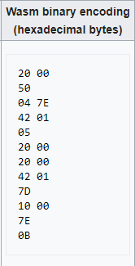
GOALS * be fast * readable & debaggable * keep secure * don’t break the web

Slide 5
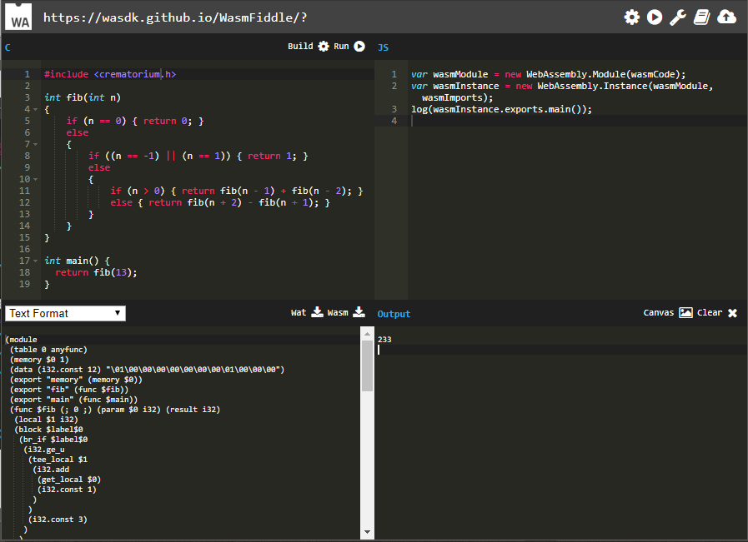
https://wasdk.github.io/WasmFiddle/

Slide 6
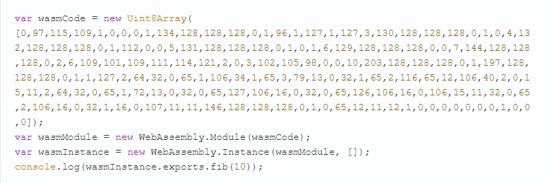

Slide 7
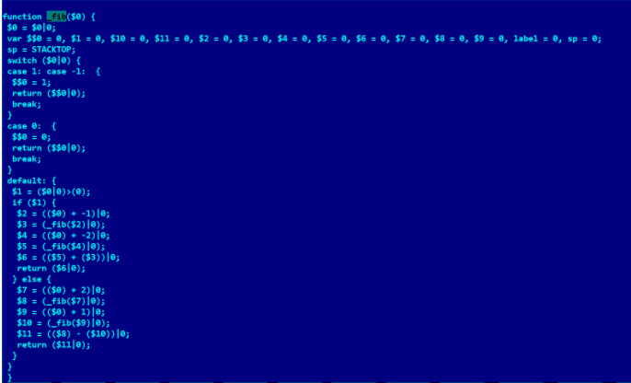

Slide 8
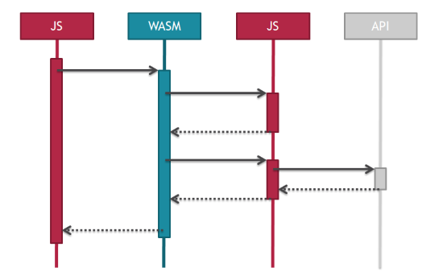

Slide 9

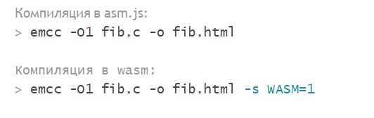
HOW TO USE
http://emscripten.org/
emsdk update
emsdk install latest
emsdk activate latest

Slide 10
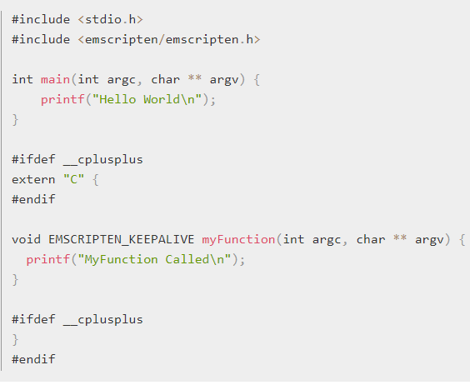
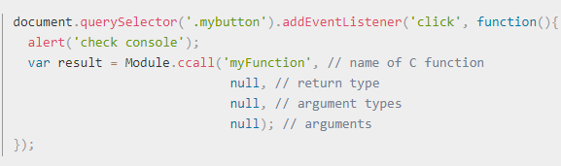

Slide 11
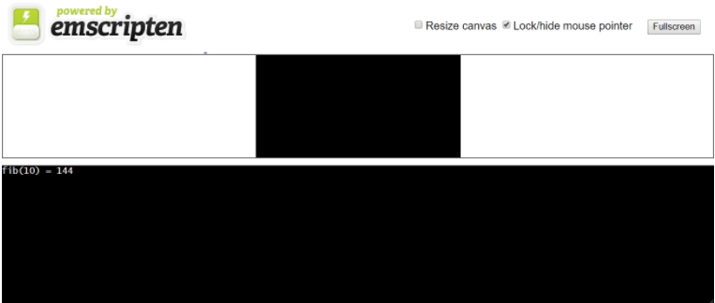

Slide 12
IN DEVELOPMENT * Threads * SIMD * Exceptions * GC

Slide 13
USE CASES * up speed of calculations * up speed of loading * use C/C++ code

Slide 14
THANKS FOR ATTENTION!!!

