Slide 1


Slide 2

Windows PowerShell Best Practices and Patterns
DCIM-B418
Don Jones
Concentrated Tech

Slide 3
Welcome
Don Jones
Microsoft MVP Award Recipient
President and CEO of PowerShell.org, Inc.
Senior Partner and Principal Technologist at Concentrated Tech
Author, “Learn Windows PowerShell in a Month of Lunches” and other books
Practices and Patterns
This session is adapted from “The Community Book of PowerShell Practices,” a free ebook available at http://powershell.org/wp/ebooks.

Slide 4
Q&A
Please ask as we go!
Most of this session consists of live demonstration of main DSC techniques, with a minimum of slides. Feel free to pop in with questions whenever you feel the urge.
If I can’t answer every question, please find me at The TechNet Script Center pod in the expo area, or look for a book signing time at the TechEd Bookstore.

Slide 5
How We’ll Proceed
Demos!
This session is primarily built around examples of good and bad practices.
Slides are included as additional reference / background material, but we won’t be spending much time actually looking at those.
Examples are already posted on PowerShell.org. During TechEd, they should be near the top of the list on the home page; http://powershell.org/wp/?p=15193

Slide 6
Key Practices: Documentation
Write Comment-Based Help
Describe Each Parameter
Provide Usage Examples
Comment Your Code
Example 1

Slide 7
Key Practices: Performance
If it Matters, Test it
Consider tradeoffs between performance and appearance
Piping: Often slower to run, uses less memory
Structured: Often faster, may use more memory
DEPENDS A LOT ON WHAT YOU ARE DOING… TEST!!!!
Example 2, 9

Slide 8
Key Practices: Aesthetics
Indent your code
Avoid backticks
Example 3, but isn’t Example 1 beautiful?

Slide 9
Key Practices: Output
Avoid Write-Host unless building a Show- command
Use Write-Verbose, -Warning, and –Debug
Note Example 1 again

Slide 10
Key Patterns: Tools vs. Controllers
Are you writing a tool or controller?
Make tools modular
Make tools reusable
Use standard naming
Output raw data (tools)
Output formatted data (controllers)
Example 4, 5

Slide 11
Key Practices: Wasting Effort
Don’t re-invent the wheel
Report bugs and make suggestions
Example 6

Slide 12
Source Control
C’mon.
TFS. CVS. Git. SAPIEN VersionRecall. Doesn’t have to be difficult, but has to be done.

Slide 13
Stay Pure.
Stick with “pure” PowerShell when it’ll do the job.
“Devolve” when it won’t.
But don’t overthink it. This is about maintenance, not necessarily anything else.
Example 7

Slide 14
Thank You
Last Chance for Q&A right now
Although, please find me at The TechNet Script Center pod if you’d like to discuss further
Contact Me
On Twitter @concentrateddon
On Facebook.com/concentrateddon
In the Q&A forums at PowerShell.org
Don’t Forget
Free ebook: “Community Book of PowerShell Practices” is available at http://powershell.org/wp/ebooks.

Slide 15
Related content
Breakout Sessions & Instructor-Led Labs
DCIM-B318 Windows PowerShell Unplugged with Jeffrey Snover
DCIM-B361 Automating System Center Deployments with the PowerShell Deployment Toolkit
DCIM-B417 A Practical Overview of Desired State Configuration
NOTE: Some of these have already happened; grab their session materials and watch for the recorded version!
Find Me Later At the TechNet Script Center pod

Slide 16

For More Information
Windows Server
Windows Server 2012 R2
http://technet.microsoft.com/en-US/evalcenter/dn205286
System Center
System Center 2012 R2
http://technet.microsoft.com/en-US/evalcenter/dn205295
Azure Pack
Azure Pack
http://www.microsoft.com/en-us/server-cloud/products/windows-azure-pack
Microsoft Azure
Microsoft Azure
http://azure.microsoft.com/en-us/
Come Visit Us in the Microsoft Solutions Experience!
Look for Datacenter and Infrastructure Management TechExpo Level 1 Hall CD

Slide 17

Resources
Learning
Sessions on Demand
Microsoft Certification & Training Resources
http://channel9.msdn.com/Events/TechEd
www.microsoft.com/learning
TechNet
msdn
Resources for IT Professionals
Resources for Developers
http://microsoft.com/technet
http://microsoft.com/msdn

Slide 18
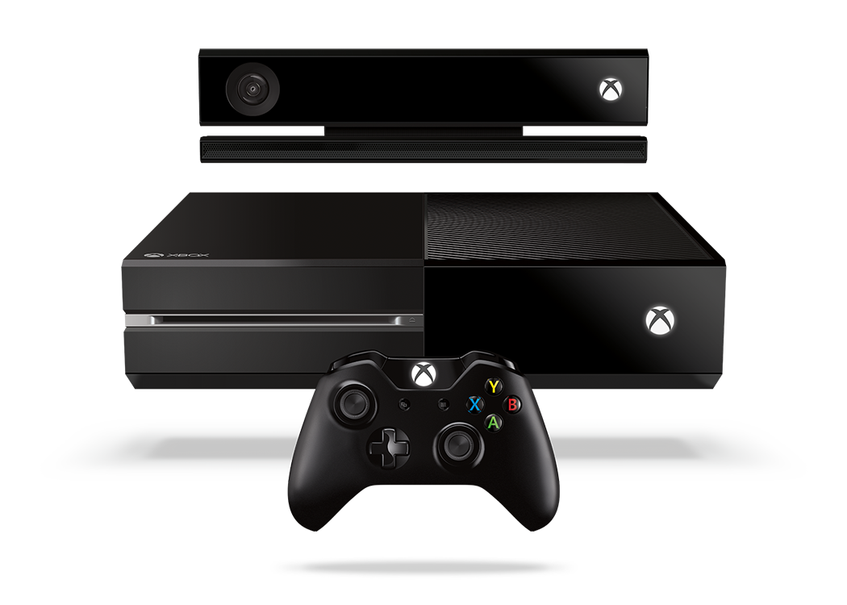


Complete an evaluation and enter to win!

Slide 19
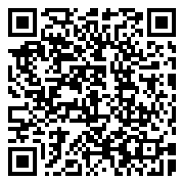
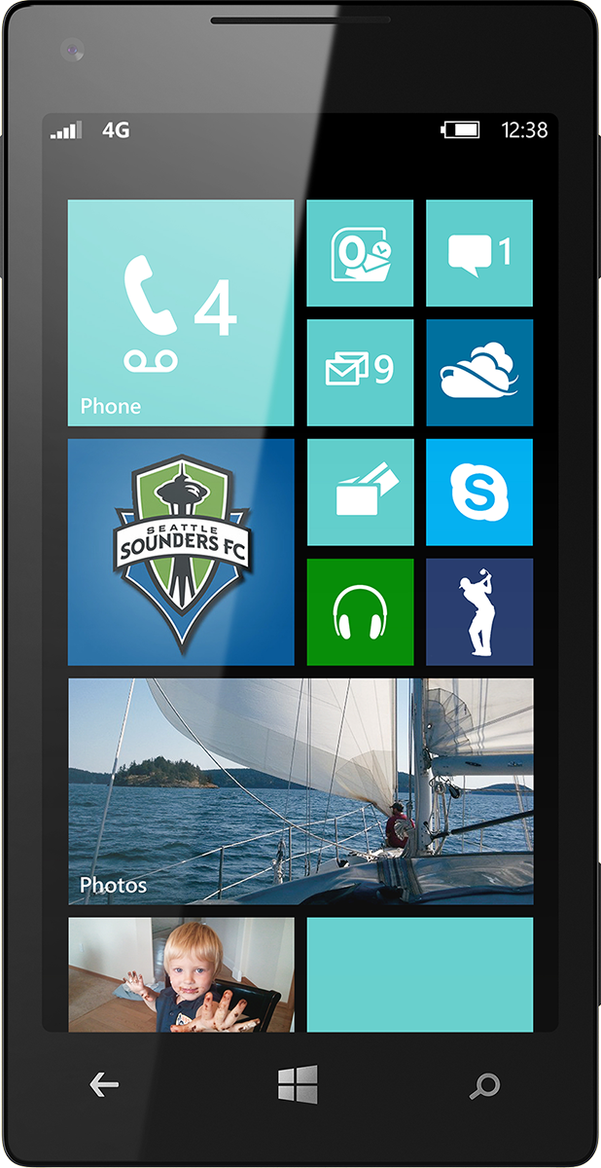
Evaluate this session
Scan this QR code to evaluate this session.

Slide 20


© 2014 Microsoft Corporation. All rights reserved. Microsoft, Windows, and other product names are or may be registered trademarks and/or trademarks in the U.S. and/or other countries.
The information herein is for informational purposes only and represents the current view of Microsoft Corporation as of the date of this presentation. Because Microsoft must respond to changing market conditions, it should not be interpreted to be a commitment on the part of Microsoft, and Microsoft cannot guarantee the accuracy of any information provided after the date of this presentation. MICROSOFT MAKES NO WARRANTIES, EXPRESS, IMPLIED OR STATUTORY, AS TO THE INFORMATION IN THIS PRESENTATION.

Slide 21
A Practical Overview of Desired State Configuration
DCIM-B418
Don Jones
Concentrated Tech & PowerShell.org

