Slide 1
Introduction
SURP 2020 Python Bootcamp
Ohio State Astronomy
Slides by: James W. Johnson

Slide 2
Hello!
Third/Fourth year PhD student in the Astronomy Department
Research Interests
Theoretical galactic archaeology (David Weinberg, Jennifer Johnson, Fiorenzo Vincenzo)
Dark matter halo angular momenta and spatial clustering (Ariyeh Maller, Andreas Berlind)
Versatile Integrator for Chemical Evolution (VICE; https://github.com/giganano/VICE.git)
59,700 lines (Python & C) as of May 6, 2020 supporting Python >= 3.5 (and 2.7 in initial release)
We’ll do a mix of slides and exercises – I won’t be collecting and grading anything. This isn’t a course. What you get out of this will reflect what you put into it.

Slide 3
Survey Responses
Q1: 1A, 3B, 6C, 9D
Most of you have written code from scratch for class/research
Q2: 8A, 5B, 5C, 1D
Most of you are comfortable with if/else, for/while, def, etc.
Q3: 8A, 6B, 3C, 2D
About half of you have written a class, the rest have not
Q4: 9A, 8B, 2C
About half of you have used “import _____” to use code from another file
Q5: 8A, 8B, 3C
About half of you have used GitHub/Bitbucket, the rest haven’t
Q6: 11A, 2B, 1D, 4E, 1F
Most of you code entirely in notebooks, others mostly text (fairly binary)
Q7: 4A, 1B, 6C, 3D, 4E
Most of you have experience with a terminal, a couple have never used it

Slide 4
Survey Responses
New material:
How to import your own code from elsewhere in your computer
Object oriented programming (OOP): classes and inheritance
GitHub/Bitbucket/etc if we get to it
Note: the new material is either impossible or quite difficult when coding in a notebook. I advise all of you to use this bootcamp as practice for working in text files.

Slide 5
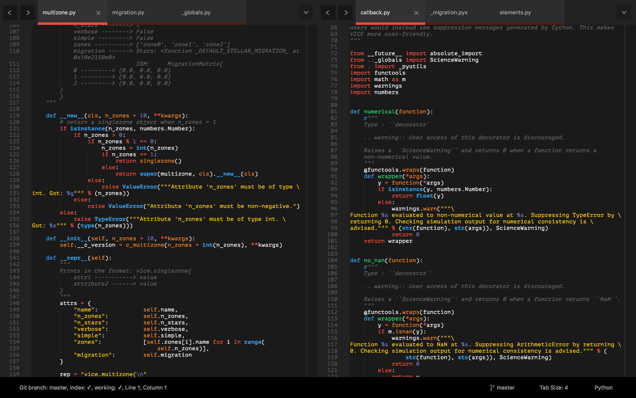
Tools: A Text Editor
Differs from an Integrated Development Environment (IDE) in that IDEs will run the code – all they do is open, create, edit, etc. plain text files
pycharm, spyder
I recommend Sublime Text
https://www.sublimetext.com/

Slide 6
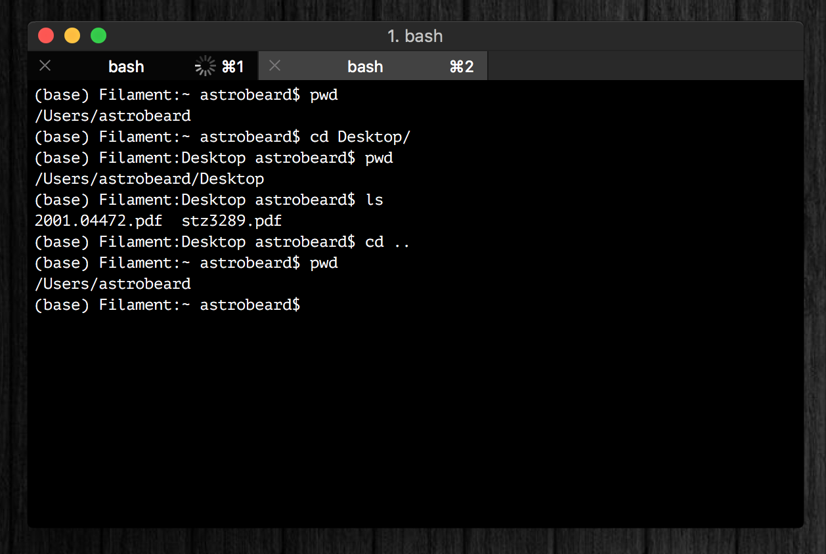
Tools: A Terminal
I recommand iTerm2
Terminal replacement
https://www.iterm2.com/
You should think of a terminal as just a different interface on a Finder window
Tip: you can run python line-by-line in a terminal (python or ipython)

Slide 7
Tools: A Terminal
If you’re running Windows, your terminal will be different than some of the notes and exercises here, unless you take some extra steps at the beginning to set up a bash interpreter.
Talk to me if you need help with this!

Slide 8
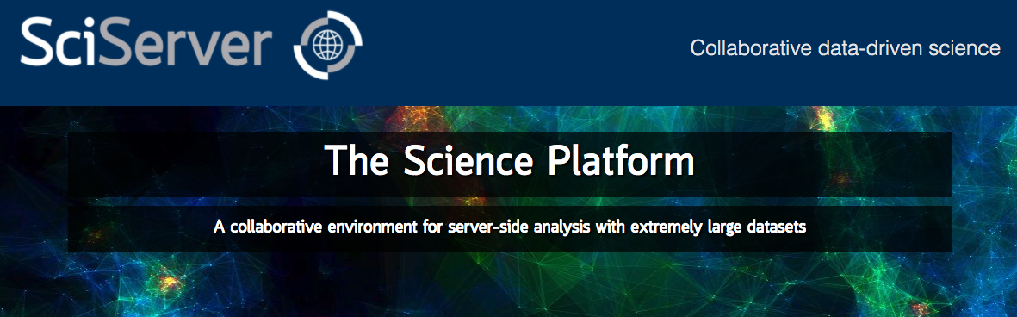
Tools: Cloud Computing
Allows you to run python on a remote server
SciServer is a popular platform across many STEM fields:
https://www.sciserver.org/
In the long run you should choose the tools that you’re most comfortable with

Slide 9
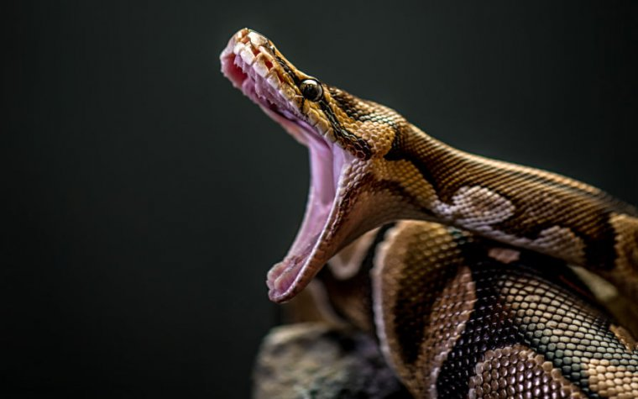
If You Haven’t Already
https://www.anaconda.com/products/individual
This will install Python, Anaconda, and Jupyter Notebooks
Latest version of python: 3.8.2
Most libraries now require >= 3.5
Python 2.7 is deprecated

Slide 10
Other Resources
Python Foundation’s Beginner’s Guide: https://www.python.org/about/gettingstarted/
https://www.learnpython.org/ - There is also an iOS app for this
Code Academy: https://www.codecademy.com/learn/learn-python-3

Slide 11
Goals
What we’ll aim to cover:
Review of how to use a terminal
Review of the basics: control structures, data types, functions, import, etc.
How to read documentation
How to import your own code, and how to set up a directory tree to organize it
Classes: how to make new objects
Inheritance and Composition
Some basic software engineering principles (i.e. good habits)
If we have time:
git for version control and general organization
A simple Makefile

