Slide 1
Classes
SURP 2020 Python Bootcamp
Ohio State Astronomy
Slides by: James W. Johnson

Slide 2
What are they? Why should I care?
A class is how you implement a new object.
Python is an object-oriented programming language - if you’re a python programmer and you’ve never written a class, you’re missing out on the single most powerful aspect of the language by far.

Slide 3
Recall: The Python Model
Everything is an object in Python, whether you knew it or not.
Objects have …
Attributes
Functions
Data
… which is unique to the object, as well as interactions with other objects.

Slide 4

An Example Object: A Dog
Attributes: color, breed, name, gender
Functions: bark, roll over, shake, eat, drink, chase tail
Data: date of birth, veterinary records, previous owners
Interactions with other objects: play with other dogs/owner, chase cats

Slide 5
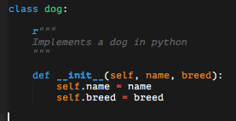
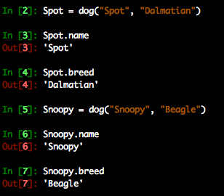
Dogs in Python
How you create instances of the class (i.e. objects) is determined by the __init__ function.
The first argument to __init__ should always be self – this is true of most functions in a class, and refers to the object itself being passed

Slide 6
Dogs in Python
How you create instances of the class (i.e. objects) is determined by the __init__ function.
The first argument to __init__ should always be self – this is true of most functions in a class, and refers to the object itself being passed
This gets the job done, but…

Slide 7
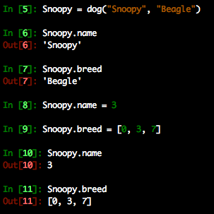
Dogs in Python
How you create instances of the class (i.e. objects) is determined by the __init__ function.
The first argument to __init__ should always be self – this is true of most functions in a class, and refers to the object itself being passed
This gets the job done, but it’s easily broken

Slide 8
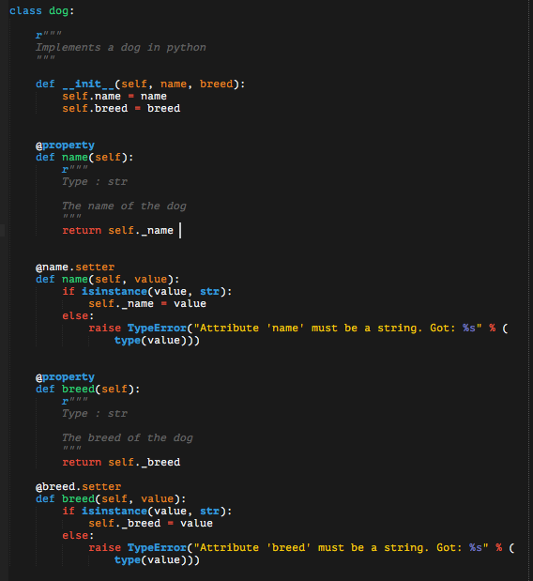
Dogs in Python
Error-handling of attributes requires property and setter functions
self._property is a conventional way of storing self.property under the hood, protected by error-handling
This throws a TypeError whenever the user tries to set name or breed to something other than a str

Slide 9
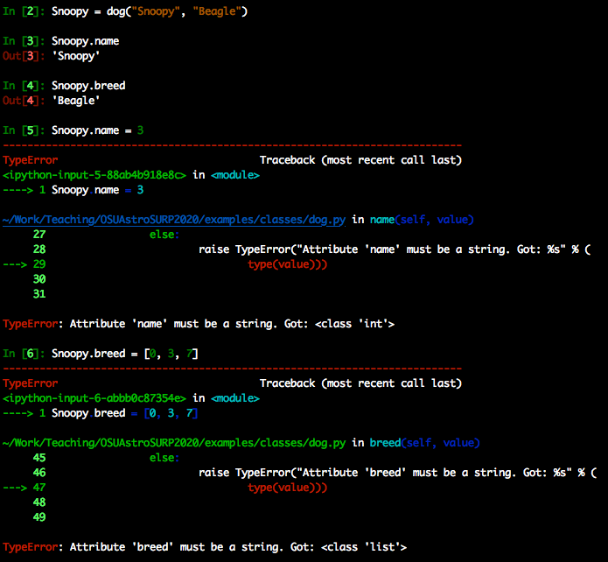
Dogs in Python
Error-handling of attributes requires property and setter functions
self._property is a conventional way of storing self.property under the hood, protected by error-handling
This throws a TypeError whenever the user tries to set name or breed to something other than a str

