Slide 1
Review
SURP 2020 Python Bootcamp
Ohio State Astronomy
Slides by: James W. Johnson

Slide 2
Objectives
Built-in Data Types: int, float, list, tuple, dict, array, etc.
Conditionals: if/else statements
Loops: for and while
Functions: def statements

Slide 3
Numeric Types
Built-in numeric types are int (integers) and float (real numbers)
Some packages (e.g. NumPy) implement their own numeric types (e.g. np.int64)
Numeric operations
=, ==, +, -, *, /, //, %, +=, -=, *=, /=, //=, %=
Recall: x += y is the same as x = x + y
/ vs. //: true division vs. floor division (i.e. integer quotient)
3 / 2 returns 1.5, but 3 // 2 returns 1
%: modulo (calculates remainder)
5 % 2 returns 1; 5 % 3 returns 2; 5 % 1 returns 0

Slide 4
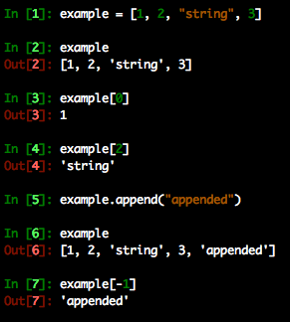
List
A sequence of objects
Created with square brackets [ ]
Can be any mix of types
Access an element of the sequence by its position
Negative indices start at the end of the list and count backwards
Modification proceeds in the same manner
Append function adds an element to the end
Can also use ‘+’ to combine lists

Slide 5
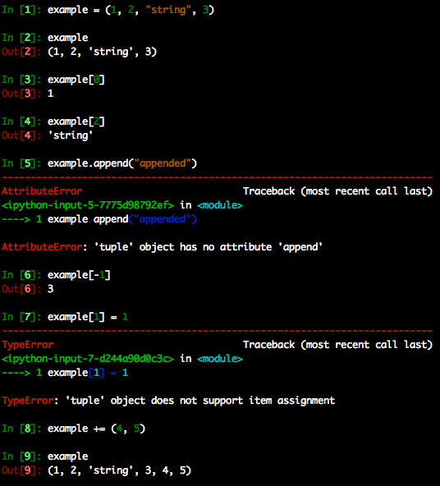
Tuple
An immutable sequence of objects
Created with parentheses ( )
Can be any mix of types
Access an element of the sequence by its position
Negative indices start at the end of the tuple and count backwards
Modification not allowed (immutability)
Can still use ‘+’ to add elements to the end

Slide 6
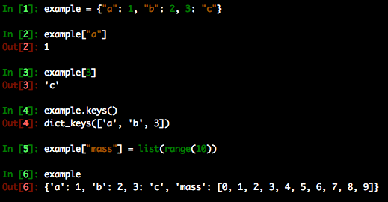
Dictionary
Python’s version of a hash table.
Can be used to map objects to other objects
Stored values can be accessed via their key
keys() function returns each key
Popular method of storing data b/c keys can be strings which describe the data, allowing very readable code

Slide 7
Arrays
In practice the same as a list, but has some special implementation of tracking data types under the hood
Can often speed up code
There is a built-in array object, but in practice, most people use the NumPy array
The single most important thing to remember about arrays:
LISTS AND ARRAYS ARE NOT THE SAME THING

Slide 8
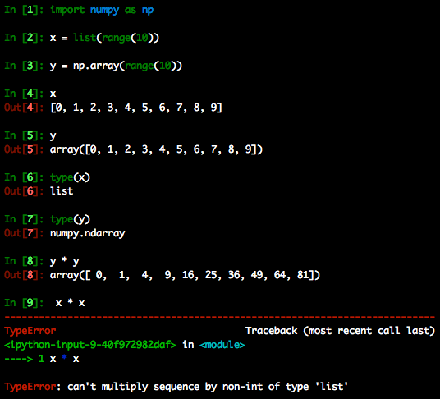
Lists vs. Arrays
They are different objects meant to store the similar data
Example: NumPy arrays allow multiplication with another array. A list does not.
Advice: Pick one of either lists or arrays for a given program and stick to it

Slide 9
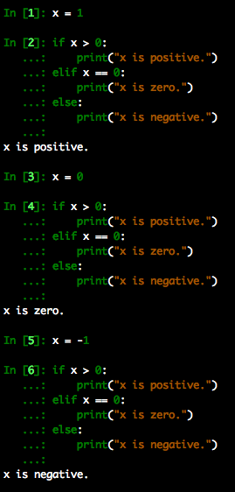
Conditions
Conduct different operations based on whether or not a given condition is satisfied
Uses boolean logic: True and False
Note: Numbers can be used as well – anything nonzero evaluates to True.

Slide 10
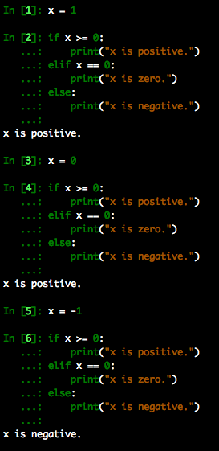
Conditions
Conduct different operations based on whether or not a given condition is satisfied
Uses boolean logic: True and False
Note: Numbers can be used as well – anything nonzero evaluates to True.
Note: if/elif/else blocks executed in order.

Slide 11
Loops
Two types
For- and while-loops
Both execute the same block of code some number of times
Both types of loops can be forced to terminate with the command “break”, and to start the next iteration with “continue”

Slide 12
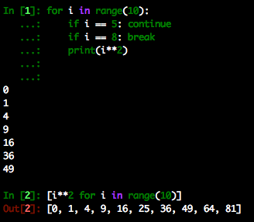
For-loops
Should be used when you know exactly how many times the block should repeat
Come in two flavors:
Explicit for loop: “for i in <some list>” followed by an indented block (example: top)
Implicit for loop: occurs within a list comprehension (example: bottom)

Slide 13
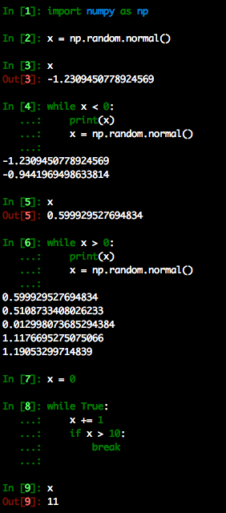
While-loops
Should be used when you don’t know how many times the block should repeat
while True: <…> break is not uncommon, but generally considered bad practice
Advantage: The loop will always execute at least once. Other languages achieve this with what is called a do-while loop.

Slide 14
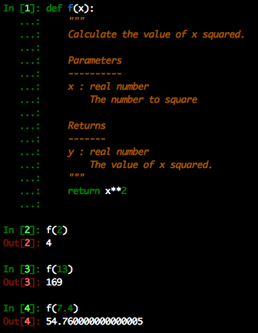
Functions
Often referred to as “methods” in other languages
Created with the def keyword followed by an indented block. Between the def statement and the body of the function is where you should put a docstring.
Astronomers (and scientists in general) are notorious for thin documentation if they document at all.

Slide 15
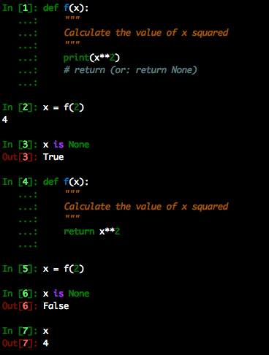
Functions: The Implicit Return
Unless otherwise specified, a function will return None.
In order to obtain an object from a function, you have to override this with a return statement
A note about variable scope: variables declared inside a function cannot be accessed outside the function.

