Slide 1
Tools to Get You Started
SURP 2020 Python Bootcamp
Ohio State Astronomy
Slides by: James W. Johnson

Slide 2
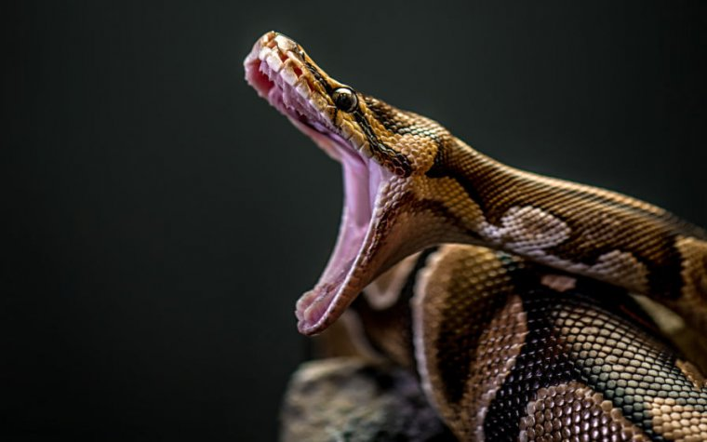
What You’ll Need
Python (duh)
Anaconda
A text editor
A command line
We will be starting with python written in text files and ran from a terminal, then moving to jupyter notebooks. It is easier to go from text/terminal to jupyter than jupyter to text/terminal

Slide 3
Python!
url: https://www.anaconda.com/distribution/
This will take care of Python, Anaconda, and Jupyter Notebooks
Latest version: 3.8.2
Most libraries now require >= 3.5
Python 2.7 is deprecated

Slide 4
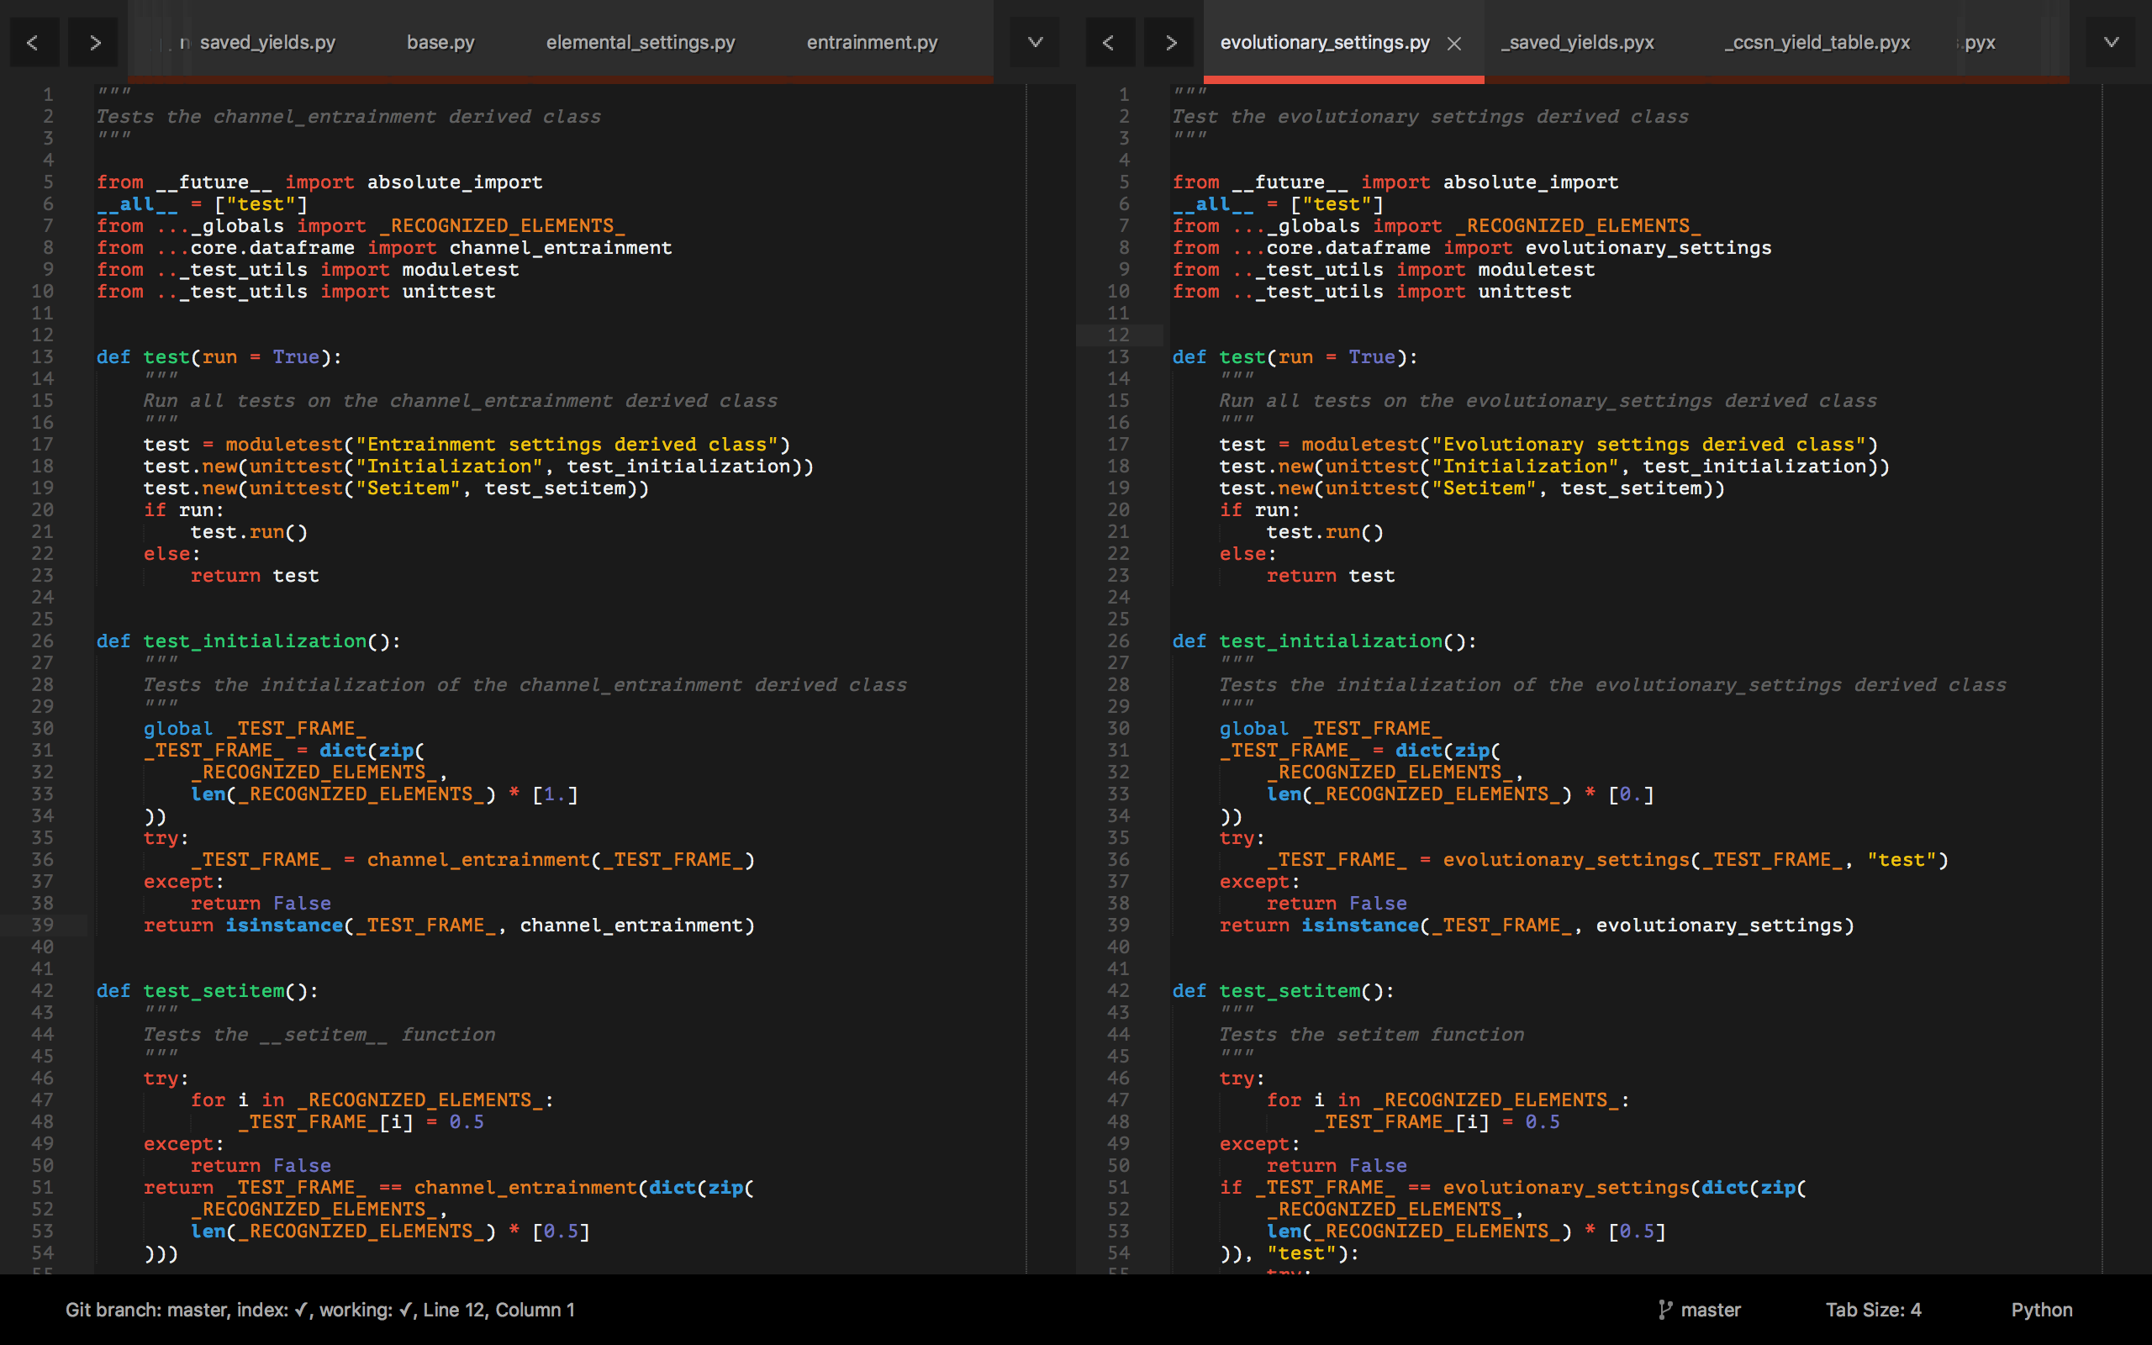
A Text Editor: Sublime Text
A program for opening, editing, creating, etc. plain text files
url: https://www.sublimetext.com/
Sublime has some powerful features

Slide 5
Terminal: iTerm
A command line interface
We will only need a few commands
Disclaimer: Windows command line is not the same as Mac or Linux
If you’re a windows user, you will need to upgrade to Windows 10 and download the Windows Terminal for that
Alternatively, create a virtual environment and install a Linux OS inside of it
The computers in the astronomy dept. run on a Linux OS (CentOS)

Slide 6
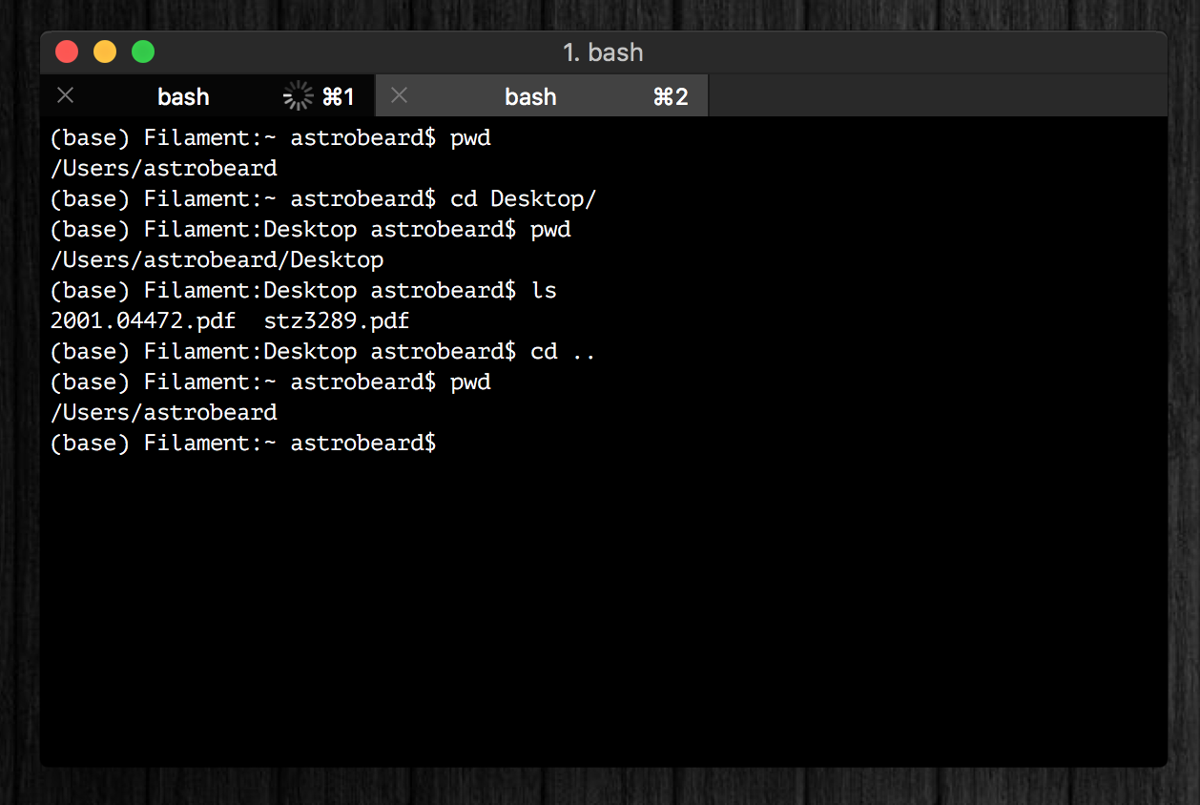
Terminal: iTerm
A command line interface
We will only need a few commands
url: https://iterm2.com/
Can also use built-in terminal

Slide 7
Terminal: iTerm
pwd
“print working directory”
The directory or file you are in
cd
“change directory”
Go to a different directory or file
Home directory: ~
Parent directory: ..

Slide 8
Terminal: iTerm
ls
“list”
List all files in a directory
mv
“move” – rename a file or directory
mkdir
“make directory”
The same as opening a finder window and clicking “New Folder”

