Slide 1
Documentation in Python
SURP 2020 Python Bootcamp
Ohio State Astronomy
Slides by: James W. Johnson

Slide 2
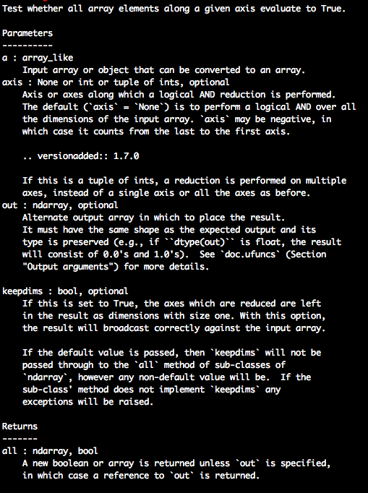
reStructuredText (RST)
The standard format of python documentation
Easily ported into HTML and PDF formats, among others
Relatively easy to read
For the most part you’ll see the HTML output from RST, and raw RST only from docstrings when viewed in python.
Example: numpy.all docstring

Slide 3
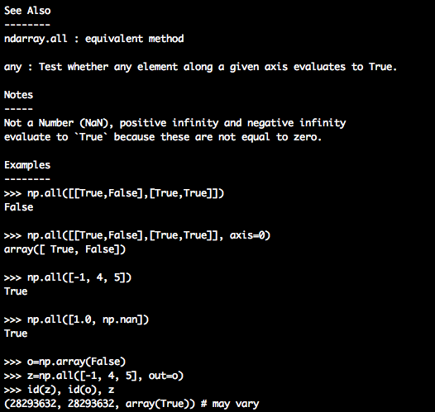
reStructuredText (RST)
The standard format of python documentation
Easily ported into HTML and PDF formats, among others
Relatively easy to read
For the most part you’ll see the HTML output from RST, and raw RST only from docstrings when viewed in python.
Example: numpy.all docstring

Slide 4
Example RST
This is the all function from NumPy.
Most of the documentation astronomers will see looks very similar to this.

Slide 5
Example RST
Short description
Parameters (in the order they should be passed) and subsequent keyword arguments. Their data type is noted along with a description of what it represents.
What it returns, if anything, and a data type and description for that too

Slide 6
Example RST
See Also for other relevant parts of the documentation
Notes – any caveats or relevant pieces of information on the function’s implementation.
Example code

Slide 7
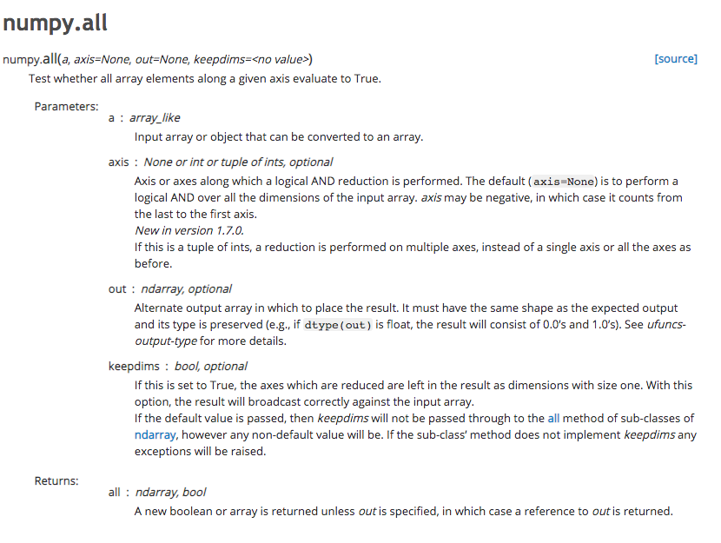
What This Example Looks Like in HTML
Same information as the RST, but formatted nicely.

Slide 8
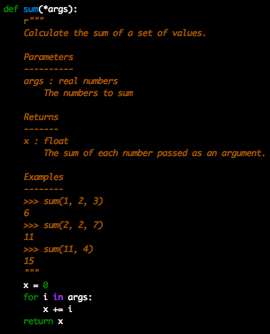
*args
Indicates that the function accepts an arbitrary number of positional arguments (i.e. non-keyword arguments)
The data type and description that follows applies to all of them
args in this case is a tuple
Example: calculate sum of an unknown number of numbers.

Slide 9
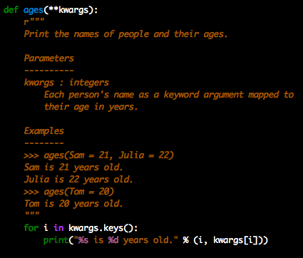
**kwargs
Indicates that the function accepts an arbitrary number of keyword arguments.
Sometimes these are keyword arguments which will be passed to another function. This will be made clear usually in the Parameters section of a docstring.
kwargs in this case is a dict
Example: print names and ages for an unknown number of people.

