Slide 1
The Terminal
SURP 2022 Python Bootcamp
Ohio State Astronomy
Slides by: James W. Johnson

Slide 2
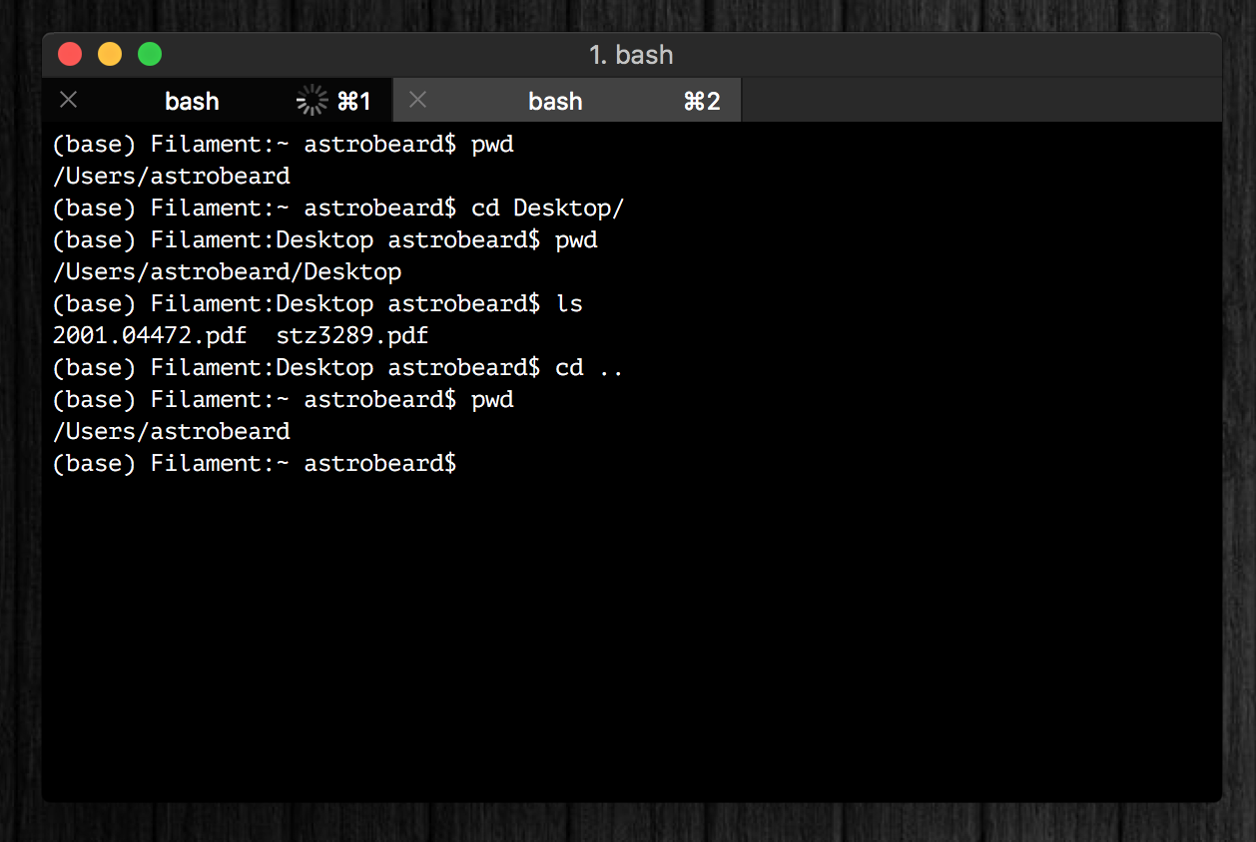
What is a Terminal?
A command-line interpreter
Executes single commands entered by the user one after another
Think of this as a different interface on a Finder window when learning it

Slide 3
Disclaimer
There are different types of Terminals - the most common one is bash, ran in Linux and Mac OS environments
The Windows command-line is NOT a bash environment – to access a bash environment in Windows, you need the Windows Subsystem for Linux (WSL)
https://www.microsoft.com/en-us/p/windows-terminal-preview/9n0dx20hk701?activetab=pivot:overviewtab
Note: This requires Windows 10 version 18362.0 or later
Another option is use a virtual environment, though these are more data-intensive as they’re often running another OS
Where Unix terminals use $ to reference variables, MS-DOS uses enclosing % symbols
Notes:
The reason for the differences is that Mac OS and Linux OS’s are derived from the Unix kernel, whereas Windows OS is derived from the DOS kernel (Disk Operating System). We won’t go into too much detail on this, but the kernel is more or less an additional layer between the hardware and the operating system. Happy to answer questions on this at the end of the session. Mac OS now uses ZSH as the default shell since Catalina, though it’s similar to bash, and you can revert to a bash default if you so choose.

Slide 4
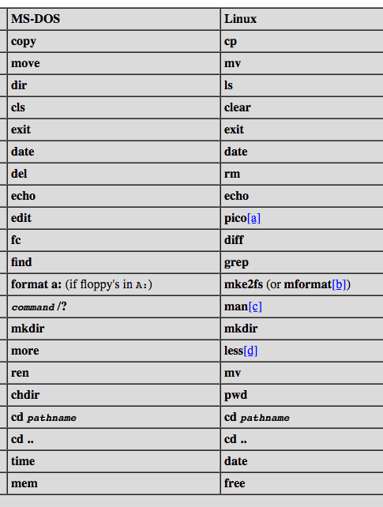
Cheat Sheet
Windows uses the MS-DOS command line system – this cheat sheet will take simple commands from one to the other
https://ftp.kh.edu.tw/Linux/Redhat/en_6.2/doc/gsg/ch-doslinux.htm
There are a wealth of references for using a command line

Slide 5
echo: Print Statements
Prints a message to the console
Example:
$ echo Hello world!
Hello world!
$ echo $x
$ x=3
$ echo $x
3
Notes:
No spaces in the item assignment for x!

Slide 6
pwd: Print Working Directory [chdir]
Prints the name of the directory you’re currently in
Example:
$ pwd
/Users/BrutusBuckeye/Desktop/SURP/bootcamp/
Note: Windows users should be careful not to confuse this with Python’s os.chdir function, whose function is to change directories

Slide 7
cd: Change Directory
Change the directory you’re currently in
Example:
$ pwd
/Users/BrutusBuckeye
$ cd Desktop/SURP/bootcamp
$ pwd
/Users/BrutusBuckeye/Desktop/SURP/bootcamp
$ cd .. (/Users/BrutusBuckeye/Desktop/SURP)
$ cd ~ (/Users/BrutusBuckeye)

Slide 8
ls: List [dir]
List all files in a given directory
Example:
$ pwd
/Users/BrutusBuckeye/Desktop/SURP/bootcamp
$ ls
exercises notes slides somecode.py
$ cd ..
$ ls
bootcamp plots papers notebook.ipynb textfilecode.py

Slide 9
mv: Move [move]
Move (i.e. rename) a file or directory
Usage: mv [old file name] [new file name]
Example:
$ pwd
/Users/BrutusBuckeye/Desktop/SURP/bootcamp
$ mv oldname.py newname.py
$ ls
exercises newname.py notes slides

Slide 10
cp: Copy [copy]
Copy a file to a new name/location
Usage: cp [existing file name] [new file name]
Example:
$ ls
data.dat result.out somecode1.py
$ cp result.out copy.out
$ ls
copy.out data.dat result.out somecode1.py

Slide 11
mkdir: Make Directory
Create a new directory (same as clicking “New Folder” in a Finder window)
Usage: mkdir [directory name]
Example:
$ pwd
/Users/BrutusBuckeye/Desktop/SURP/bootcamp
$ mkdir example
$ ls
example exercises notes slides somecode.py

Slide 12
rm: Remove [del]
Remove a file from system memory (careful – this doesn’t move a file to trash)
Usage: rm [filename]
Example:
$ ls
goodcode1.py goodcode2.py badcode.py
$ rm badcode.py
$ ls
goodcode1.py goodcode2.py

Slide 13
man: Manual [<command>/?]
Pulls up the manual entry (i.e. documentation) for a given terminal command
Can be used as a reference on what “flags” each command takes
Press Q to exit a man page
Example:
$ man ls [ls/?]
$ man mv [mv/?]
$ man pwd [pwd/?]

Slide 14
*: All Files
An asterisk (*) refers to all files in a given directory, and can be modified to refer to only those with a specific prefix or suffix
Known as wildcards or globs
Example:
$ ls
somedata.dat somecode.py someoutput.out
$ ls *.py
somecode.py
$ ls some*
somedata.dat somecode.py someoutput.out

Slide 15
The Bash Profile
A particular file located at ~/.bash_profile (can also use ~/.bashrc)
Typically contains…
Environment variables
Aliases
Modifications to your PATH or PYTHONPATH
Some gibberish used by conda
… if there’s even anything there yet
Modifications require running source ~/.bash_profile or simply restarting the terminal to take effect

Slide 16
The Bash Profile: Windows Equivalent
No standard name, but files can be set to autorun upon terminal start, achieving the same effect
cmd.exe /k "%HOMEDRIVE%\%HOMEPATH%\cmd-startup.bat”
/k causes the cmd-startup.bat file to run on launching command line
https://superuser.com/questions/144347/is-there-windows-equivalent-to-the-bashrc-file-in-linux
Disclaimer: If you’re an astronomer, bash is a better choice than PowerShell. This will vary in other fields, but astronomy uses Unix-based operating systems.

Slide 17
Aliases
A way of creating a terminal command out of other terminal commands
Can create one in your terminal independent of your bash profile, but putting them there makes them permanent
Example:
alias makeplot=“python plotting_script.py”
alias lc=“ls –lha”
alias surp=“cd ~/Desktop/SURP/”
Notes:
For those who may not have seen it before, “python filename.py” is how you would run a text file containing python code.

Slide 18
Environment Variables
Variables global to the current shell
Can be created outside the bash profile, but are permanent when put there. Use export when adding one to the bash profile
Example:
export SURP_DIRECTORY=“~/Desktop/SURP/”
Can be accessed in Python via os.environ (a dictionary)

Slide 19
PATH and PYTHONPATH
PATH: directories where your computer looks for executables and (more importantly) python code (separated by colons)
PYTHONPATH: additional directories where your computer looks for python code, also separated by colons
Example:
export PYTHONPATH=$HOME/path/to/my/python/code:$PYTHONPATH
1 million brownie points to whoever knows why $PYTHONPATH appears on the right here
Notes:
$HOME here is a better way of referring to your home directory, where in previous slides ‘~’ has been used

Slide 20
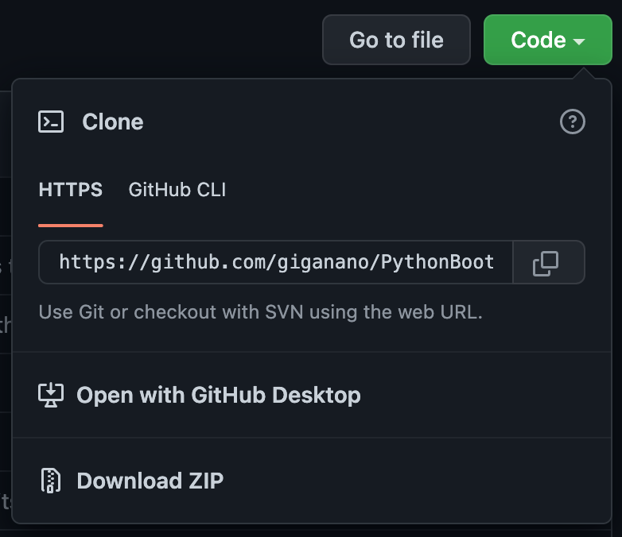
Getting the Bootcamp Material
Online: https://jamesjohnson.space/bootcamp
Navigate to the folder you’d like to store it in
Run git clone https://github.com/giganano/PythonBootcamp.git
Or: Download the zip-drive from the same URL
Whenever there are updates: git pull from within the bootcamp folder

