Slide 1
Multi-File Python Programs
SURP 2022 Python Bootcamp
Ohio State Astronomy
Slides by: James W. Johnson

Slide 2
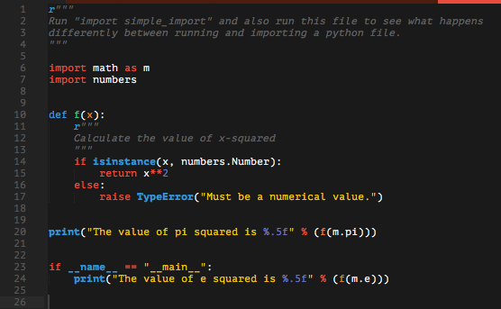
Import Statements: The Basics
Used to load python objects from a separate file or set of files
Analogous to #include and using in C/C++
Consider a simple example file to import:
Notes:
This is in the git repository under examples/simple_import.py

Slide 3

Import Statements: The Basics
Consider a simple example file to import:
This is what happens when we run it:

Slide 4

Import Statements: The Basics
Consider a simple example file to import:
This is what happens when we import it:
if __name__ == “__main__” won’t run if the file is imported

Slide 5
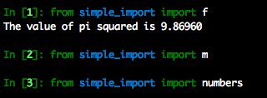
Import Statements: The Basics
Other import formats:
The file runs only once

Slide 6
The __init__.py file
Allows you to import an entire directory
This is how you create python packages
There is no file in your computer named numpy.py, but there is a file named numpy/__init__.py. The same goes for scipy, matplotlib, pandas, etc.
Notes:
Important to note that those are two leading and trailing underscores

Slide 7

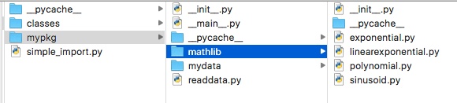
An Example Package
Located in the git repository at examples/mypkg
The __init__.py file:
What this looks like in a Finder window:
Notes:
The variable __all__ will be described in a few of slides, but by convention (PEP 8) it goes at the very top of any Python file

Slide 8


An Example Package
The mathlib/__init__.py file:
The mydata/__init__.py file:
Notes:
You should add an __init__.py file even if it’s blank to any directory that should be included in the installation/distribution process. Many algorithms for finding the sub-directories containing relevant code are based on the presence of an __init__.py file; even if one of these isn’t being used, it’s a useful indication that the given directory is a part of the package.

Slide 9
Relative Imports
Special syntax telling python exactly where to look within your package
from .somefile import something
from ..somedirectory import something_else
The number of dots specifies the directory: one for same directory, two for parent directory, three for parent directory’s parent directory, etc.
Blank __init__.py files are often included to note that the contents of a directory are still an important part of the package. These directories often contain, e.g., data files.
Notes:
If you try to use relative imports outside of a python package, it’ll raise an error.

Slide 10

Other Contents of the __init__.py File
__all__: The names of the objects to import when you run from ___ import *
Note: from ____ import * is considered bad practice anywhere other than inside of an __init__.py file. This is because it is possible to override function names and makes it difficult to keep track of your namespace.
Example: If I call log10, do I get math.log10 or numpy.log10? What if I swap the order?

Slide 11
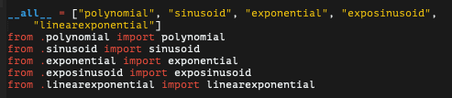
An Example Package
mypkg/__init__.py:
mypkg/mathlib/__init__.py:
mypkg/mydata/__init__.py:
mypkg.__all__ = [“readdata”, “polynomial”, “sinusoid”, “exponential”, …]
Notes:
The extend function is like running multiple append functions at once (same as += with two lists)

Slide 12
To Save You Time
If you are spreading code out across multiple files, and get an ImportError stating that a given package or module cannot be imported, you may have two files both importing one another in the preamble.
To solve this, move the import statement in one of the files to the functions which require it – there is no rule that says import statements need to be at the top; this is just convention.

Slide 13


The __main__.py File
The file that gets ran when you run a directory (i.e. python mypkg)
mypkg/__main__.py:
Important: You cannot relative import in a __main__.py file

Slide 14
The Usefulness of your PYTHONPATH
Put useful code in a given directory or set of directories, put those directories on your PYTHONPATH, and import that code from anywhere in your computer.
You never have to write that code again! Take a guess how a software engineer would describe repeatedly writing similar code, even taking just a few seconds to copy and paste

Slide 15
The Usefulness of your PYTHONPATH
Put useful code in a given directory or set of directories, put those directories on your PYTHONPATH, and import that code from anywhere in your computer.
You never have to write that code again! Take a guess how a software engineer would describe repeatedly writing similar code, even taking just a few seconds to copy and paste
A waste of time

