Slide 1
Documentation in Python
SURP 2022 Python Bootcamp
Ohio State Astronomy
Slides by: James W. Johnson

Slide 2
Why You Should Care
Because you need to know how to read it! Answering your own questions about python is considerably easier if you simply know where to look.
Python Enhancement Proposal (PEP) 287 established reStructuredText (RST) as the standard markup language for python documentation
Whether or not you ever write documentation, you will encounter RST using python
Bonus: What does *args and **kwargs mean?

Slide 3
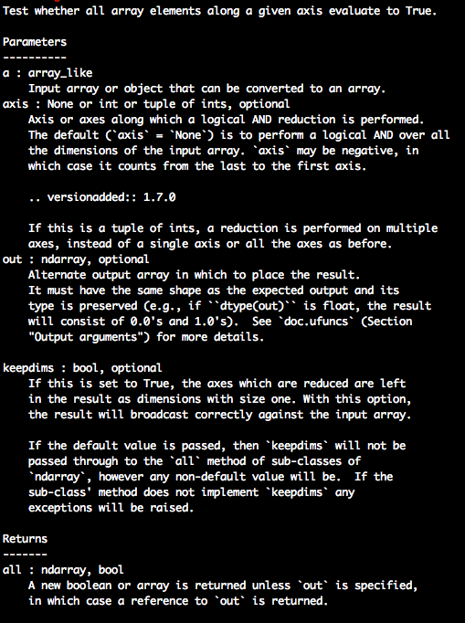
reStructuredText (RST)
The standard format of python documentation
Easily ported into HTML and PDF formats, among others
Relatively easy to read
Online documentation is generally this content ported to HTML, while docstrings viewed in python show the raw RST.
Example: numpy.all docstring

Slide 4
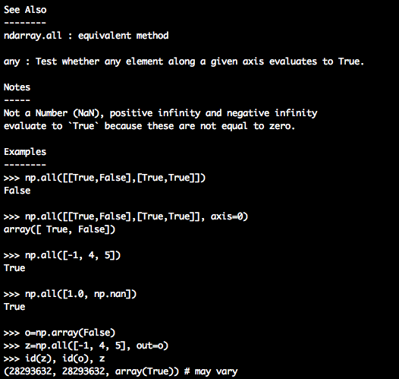
reStructuredText (RST)
The standard format of python documentation
Easily ported into HTML and PDF formats, among others
Relatively easy to read
Online documentation is generally this content ported to HTML, while docstrings viewed in python show the raw RST.
Example: numpy.all docstring

Slide 5
Example RST
This is the all function from NumPy.
Most of the documentation astronomers will see looks very similar to this.

Slide 6
Example RST
Short description
Parameters (in the order they should be passed) and subsequent keyword arguments. Their data type is noted along with a description of what it represents.
What it returns, if anything, and a data type and description for that too

Slide 7
Example RST
See Also for other relevant parts of the documentation
Notes – any caveats or relevant pieces of information on the function’s implementation.
Example code
Math is written with :math: followed by LaTeX style escape sequences within `` (e.g. :math:`\eta`)

Slide 8
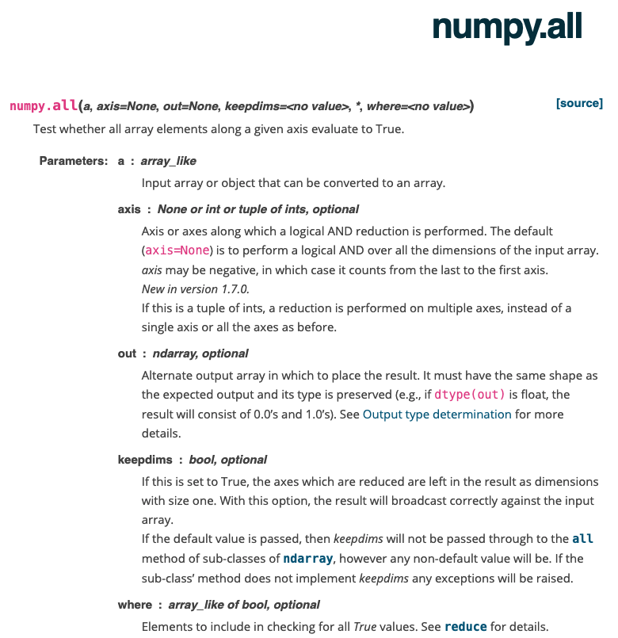
What This Example Looks Like in HTML
Same information as the RST, but formatted nicely.

Slide 9
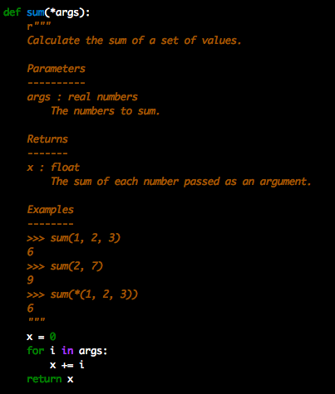
*args
Indicates that the function accepts an arbitrary number of positional arguments (i.e. non-keyword arguments)
The data type and description that follows applies to all of them
args in this case is a tuple
Example: calculate sum of an unknown number of numbers.
Notes:
Note that you can also do sum(*x) with a pre-defined tuple x and the same functionality runs.

Slide 10
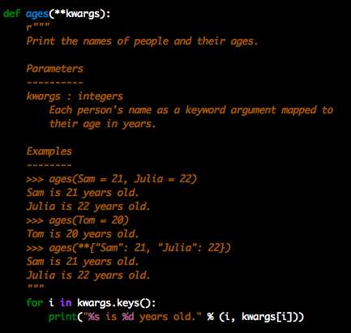
**kwargs
Indicates that the function accepts an arbitrary number of keyword arguments.
Sometimes these are keyword arguments which will be passed to another function. This will be made clear in the Parameters section of a docstring.
kwargs in this case is a dict
Example: print names and ages for an unknown number of people.
Notes:
Note that you can also do ages(**x) with a pre-defined dictionary x and the same functionality runs. Matplotlib’s API is particularly full of these **kwargs constructions, which can get confusing, but to get the keyword arguments your after, simply follow the trail of additional functions that it references.

Slide 11
Documentation: Other Aspects
Parameters, returns, raises, etc. for all components of a software is often referred to as the “Comprehensive API Reference”
Additional pieces of documentation include, though not limited to:
Installation instructions
Tutorials and example code
Where to submit bug reports
Developer’s documentation – how to contribute to an open-source project
Notes:
API: Application Programming Interface

Slide 12
Markdown
Another markup/type-setting language (RST and HTML are also markup languages)
Can be written directly within jupyter notebooks via Cell > Cell Type > Markdown
Files with extension .md (e.g. README.md)
Some useful capabilities:
Embed hyperlinks to specific locations within your notebook or to external webpages
Include LaTeX math-type and raw HTML
By using markdown cells in jupyter notebooks and then exporting to a PDF via File > Download as > PDF via LaTeX (.pdf), you can easily make nicely formatted notes for collaborators

Slide 13
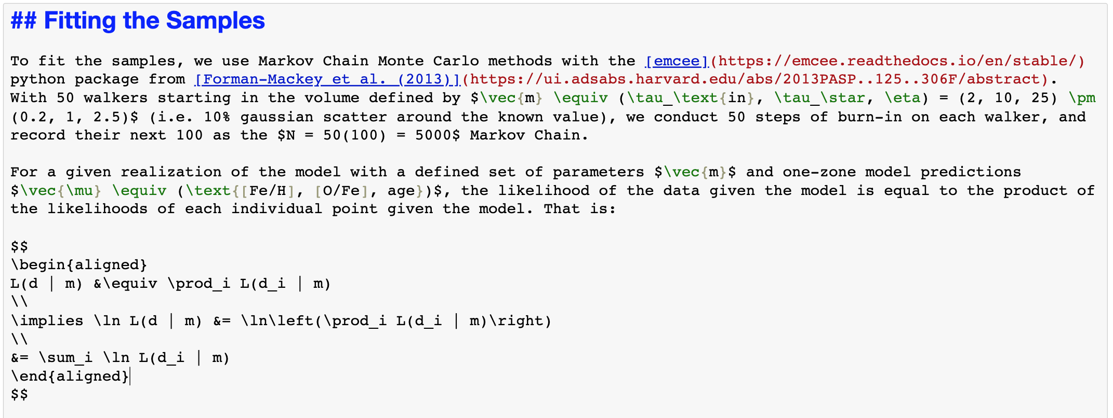
Markdown

Slide 14
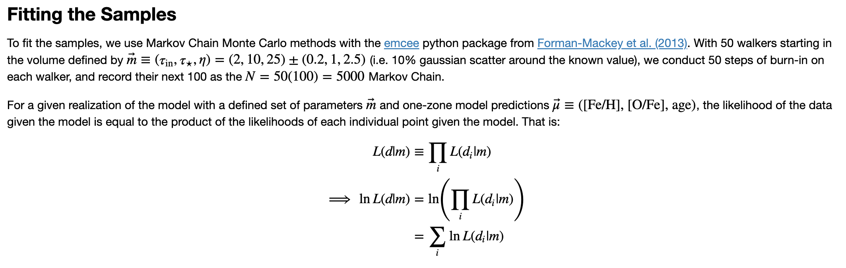
Markdown
Markdown can also include images and tables. Reference: https://www.markdownguide.org/basic-syntax/
Notes:
Remind them that you can pipe this to a PDF and send it to your collaborators.

Slide 15
Markdown: Stepping-Stone to Web Development
You can build websites in markdown using GitHub Pages
Having a nice professional website is proving to be increasingly important for getting a foothold in many industries, academia included
Because you can include raw HTML directly within markdown, it’s a stone’s throw from CSS and JavaScript, the more “bare bones” tools of web development
We’ll talk a little bit about GitHub in the last session!

