Slide 1
GitHub
SURP 2023 Python Bootcamp
Ohio State Astronomy
Slides by: James W. Johnson

Slide 2

What is GitHub?
A website for hosting files in the cloud
More fundamentally: version control
Tracks changes to your files over time
Can host multiple versions of the same file(s)
Free to use, with some features enabled with a premium account
Notes:
Premium accounts are something like $8 per month.

Slide 3
What is GitHub?
For researchers:
Share files with collaborators
Manage copies between multiple computers
For software developers:
Track changes to code over time
Collaborate with other developers seamlessly
Notes:
These two categories are definitely not mutually exclusive.

Slide 4
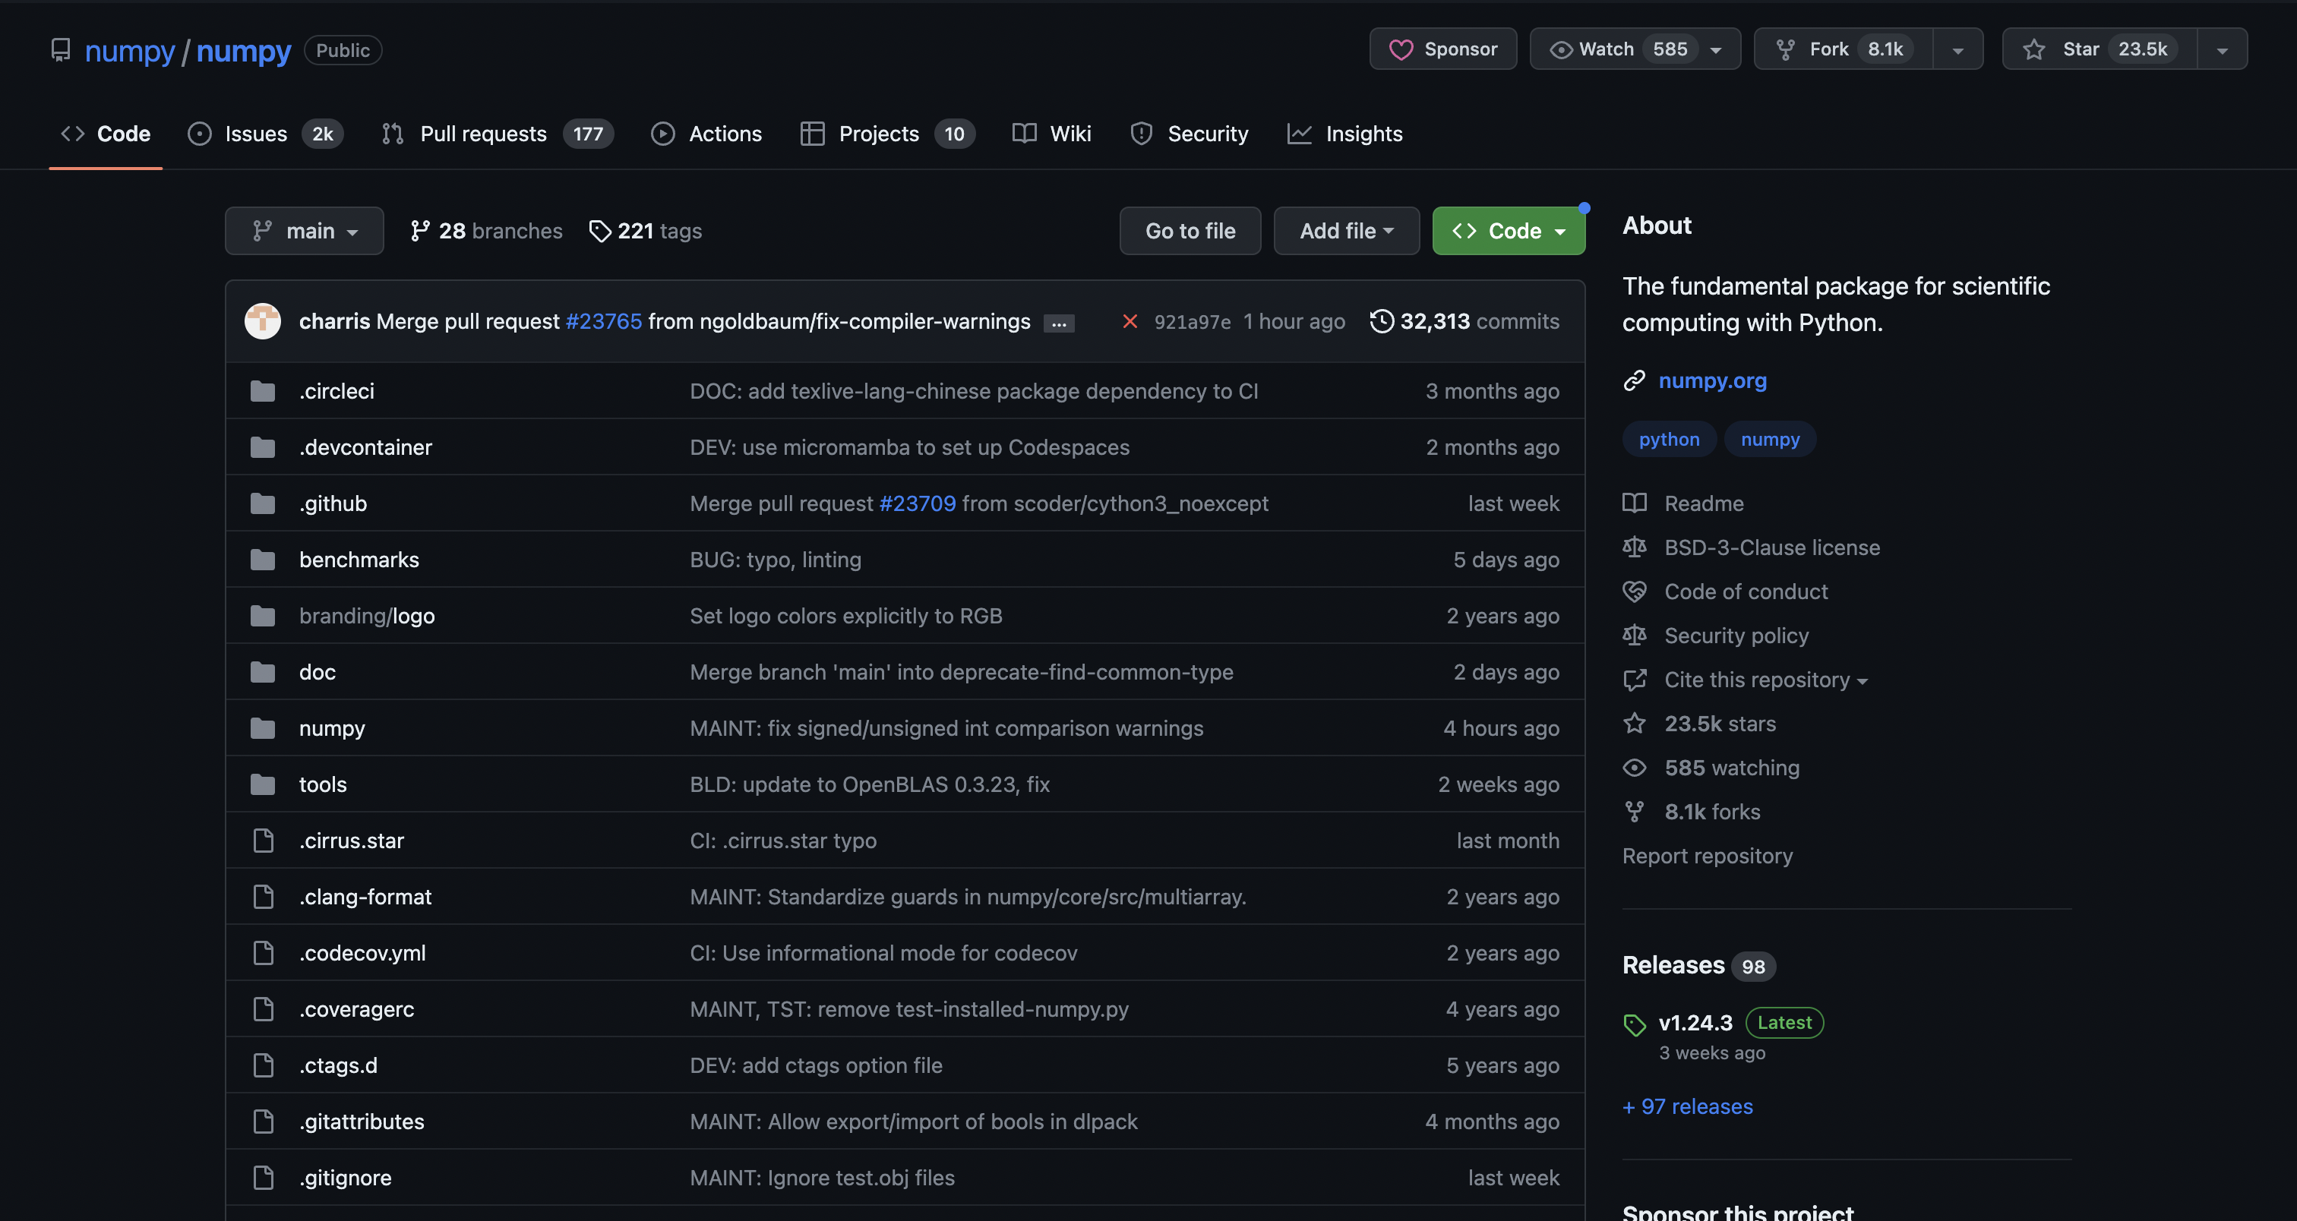
Repositories
A directory containing files and other directories that is stored on GitHub
Example: The NumPy source code is hosted on GitHub
Files can be anything
Code (including jupyter notebooks)
Documents
Images
Notes:
SciPy and matplotlib also host their source code on GitHub. The code that you put in your repository can be in any language.

Slide 5
Repositories: Local vs. Remote
Local: this file system on your computer
Remote: this file system on GitHub’s website
Notes:
Local versus remote really just differentiates between your copy and GitHub’s copy.

Slide 6
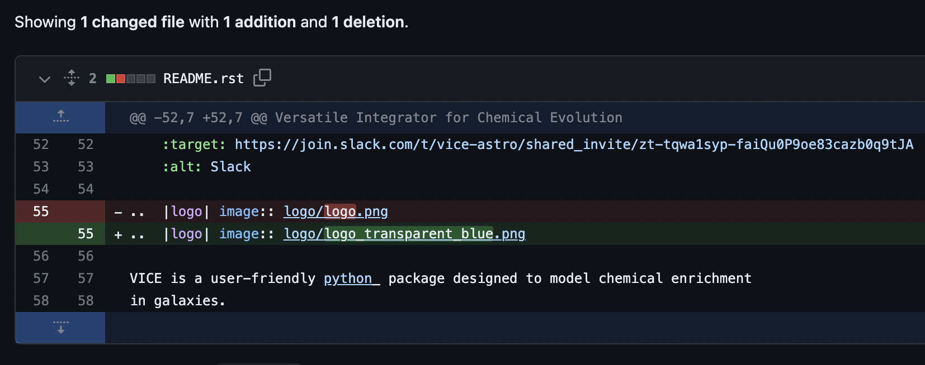
Commits
Bread and butter for making changes to a repository
A series of +’s and –’s within files
Current state of repository = sum of all commits across all files
Notes:
The example is taken from VICE, where the change is a simple modification of the logo displayed on the README. Even though the lines overlap significantly, GitHub’s algorithm is simple – it’s just a subtraction of the previous line and an addition of the new line.

Slide 7
git: How to Interact with Repositories in the Cloud
git: terminal application for managing a repository from your computer
Generally pre-installed
Uploading: git add, git commit, git push
Downloading: git pull
Other websites that implement similar features using git:
GitLab
Bitbucket
Notes:
GitHub is more widely used than GitLab and Bitbucket, at least within astronomy. There are many additional commands not listed on the slide, some of which would fall under the categories of uploading and downloading, but these are the ones that are used the most, and the ones that are the most relevant to researchers and folks getting started with GitHub.

Slide 8



git gud: for when coding is as hard as Dark Souls
Notes:
Joke slide: the reference is to the game Dark Souls and other titles from FromSoftware, known for their difficulty that cannot be adjusted to accommodate noobz.

