Slide 1
Basic Software Engineering
SURP 2022 Python Bootcamp
Ohio State Astronomy
Slides by: James W. Johnson

Slide 2
Software Engineering
The application of the principles of engineering to software development.
All of the usual principles apply
Making efficient use of resources
Extensions of existing features
Testing of individual components
Maintenance
Why care if you’re an astronomer? If you build anything substantially large, these principles can save you not just headaches but migraines.
Notes:
Note here that engineering code and organizing code are more or less the same thing. Substantially large will generally apply to research project code bases as well, not just production-level code.

Slide 3
DRY: Don’t Repeat Yourself
You should never write the same code twice within the same application.
Always assume that every software component you write (no matter how well it performs) is wrong or bugged in some subtle, nuanced way
When you find a bug, you want to be able to fix it once and have that change propagate through the entire code base
Caveat: Some choose to break this rule for software written in a modular manner – that is, if each component of your software is implemented independently of the other components. In this case DRY applies within the individual modules.
Notes:
Specifically address the “oh just copy and paste it!” that seemingly every astronomer says about writing code. Give them the example that in the entire ~76,000 line code base of VICE, the 1-dimensional linear interpolation function is written *once*.

Slide 4
No Ifs, Ands, or Buts
When describing the function fulfilled by a method, object, file, etc. you should be able to state it in a simple, declarative manner with no ifs, ands, or buts.
If you can’t state it without an if, and, or but, then you need to split up that function/object/file/whatever it is into more than one component.
This is a mnemonic for “every component should do exactly one thing.”
Notes:
This is a rule of thumb, and can be broken if the phrase can be re-stated without an if, and, or but. For example “fitting a line” and “determining the slope and intercept” are really the same thing and ideally wouldn’t be separated even though the second version has an “and.”

Slide 5
Version Control
Cataloging of previous copies of a software’s source code
Popular tools: GitHub, Bitbucket
Command line: git
Keeps track of all previous changes to your code base for you
The standard for public codes is to use the 3-digit system (e.g. 1.2.1, 2.3.0)
First is for back-compatibility, second is for new features, third is for bug-fixes
You don’t need to use GitHub/Bitbucket for version control – you can also store your code, plots, etc. there to manage copies between multiple systems.
I also use it to share my research notes and plots with collaborators.
Notes:
Address files and codes with the names “v2”/”v3”/”v4” etc appended on the end of their names. When you see codes with names like that, it’s like a giant banner broadcasting that whoever wrote it has no knowledge of version control.

Slide 6

GitHub
First and foremost: file-sharing system
Keeps a catalog of the changes to your code over time, making it a great tool for version control for developers
For astronomers:
Share with collaborators
Manage files between multiple computers
Terminal: git [add, commit, pull, push, …]
Their website will show you how to set up a repository
Notes:
Same principles apply for BitBucket. Those who cloned the source material for this bootcamp can change into the directory they have it stored at, run git pull, and it should automatically download all of the updates since they first cloned it.

Slide 7
Minimization of Dependencies
If the code base for your software uses another, external software (e.g. NumPy), that is called a dependency (your code depends on NumPy).
It’s quite common to have a ~few dependencies, but too many is problematic.
As of now my own python package (VICE) is ~90k lines of code. If one of its dependencies releases a new version with changes that affect my code, I have to go look at every file to ensure this doesn’t break anything.
Advice: Don’t be afraid to write the small but challenging stuff yourself.
Notes:
This applies much more to people releasing code publicly, but can be a source of errors if you share code with close colleagues too.

Slide 8
Testing
Well-written software implements unit tests
A means of assigning Success/Failure/Skipped messages to the smallest possible components of a code base
When you make a future change to your code base, this gives you an automated means of finding out if your change broke anything you weren’t expecting to break.
This is as simple as actually saving the code you write to test a new component of your software, and the same for when you resolve an issue.
Notes:
If you’re going to release code publicly, unit tests should be viewed as a requirement, although no one enforces this.

Slide 9
Think Before You Write
Many scientists just start writing functions when posed with a problem
This has its place and its usefulness within research
If you’re going to use some function >few times, I advise more thought
If you’re going to be spending even as much as five minutes writing a given file, stop and ask yourself: What objects might be useful? What functions might be useful?
There are many ways to write the same program, so don’t always settle for the first idea that comes into your head. You can usually improve upon the first thing that comes to mind.
Notes:
Professional software engineers don’t start in the text editor/IDE – they know how they’re going to solve the problem and test their implementation before they even write a single line.

Slide 10
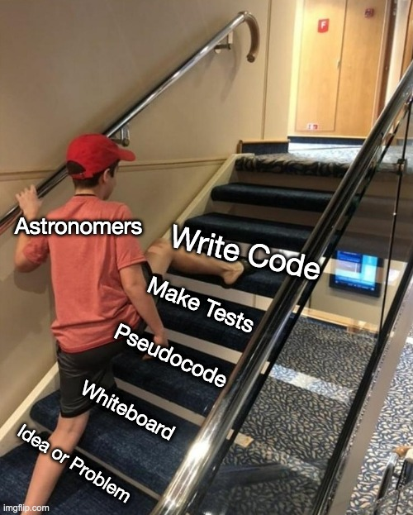
Think Before You Write
This is how professional developers and software engineers view scientist-written code
Notes:
Professional software engineers don’t start in the text editor/IDE – they know how they’re going to solve the problem and test their implementation before they even write a single line.

Slide 11
Rule Number One
Code is read much more often than it is written.
Advice: Assume this applies to all of the code you will ever write
Emphasize readability above all else. It’s okay to break any of these rules if the result is a much more readable solution.
Bottom line: Well-written code is clear, verbose, and does not cut corners.
Viewing code as a mere means to an end solves zero problems while causing many. That line is usually crossed long before a public release, and the solution is knowing how to engineer your code.
Notes:
If you don’t know about their coding background, you should always take code advice from a research scientist with a grain of salt. Being early career researchers, most of the participants of this bootcamp are in the perfect position to make the decision about what kind of code they’re going to write now, but if they choose to be the one who writes good clean code, that’s a decision they have to actively pursue. We live and breathe through our code, so it can only help you to just be organized and clear with your workflow.

Slide 12
Thank you!

