Slide 1
Multiple Inheritance
SURP 2022 Python Bootcamp
Ohio State Astronomy
Slides by: James W. Johnson

Slide 2
What is it?
When an object inherits functionality from more than one base class
Objectives
The basic syntax
The method resolution order
A simple example: A piece-wise function

Slide 3
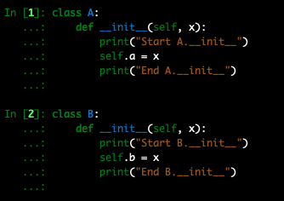
The Basic Syntax
By definition, at least 2 classes to inherit from are required

Slide 4
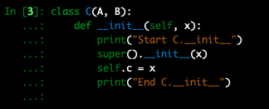
The Basic Syntax
By definition, at least 2 classes to inherit from are required
Where you already specify the class to inherit from with single inheritance, add any additional classes! Simple, right? …right?

Slide 5
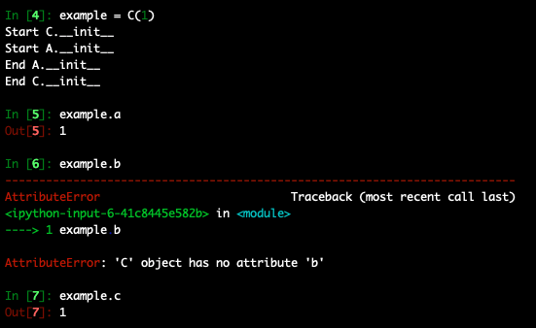
The Basic Syntax
By definition, at least 2 classes to inherit from are required
Where you already specify the class to inherit from with single inheritance, add any additional classes! Simple, right? …right?
Unfortunately, multiple inheritance sort of breaks super

Slide 6

The Method Resolution Order
When you call a function within a class, it looks first within that class, then the first parent class, then the second parent class, and so on
Any call to super is a call to classes further down the MRO
This has been true all along for single inheritance too!
With multiple inheritance, super may not always do what you want

Slide 7
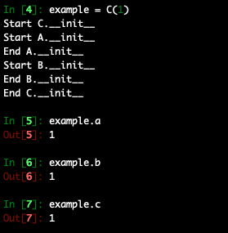
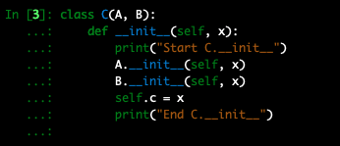
The Basic Syntax
Instead, invoke the inherited class directly and pass self as the first argument
This takes advantage of the fact that x.function(y) is equivalent to classname.function(x, y)

Slide 8
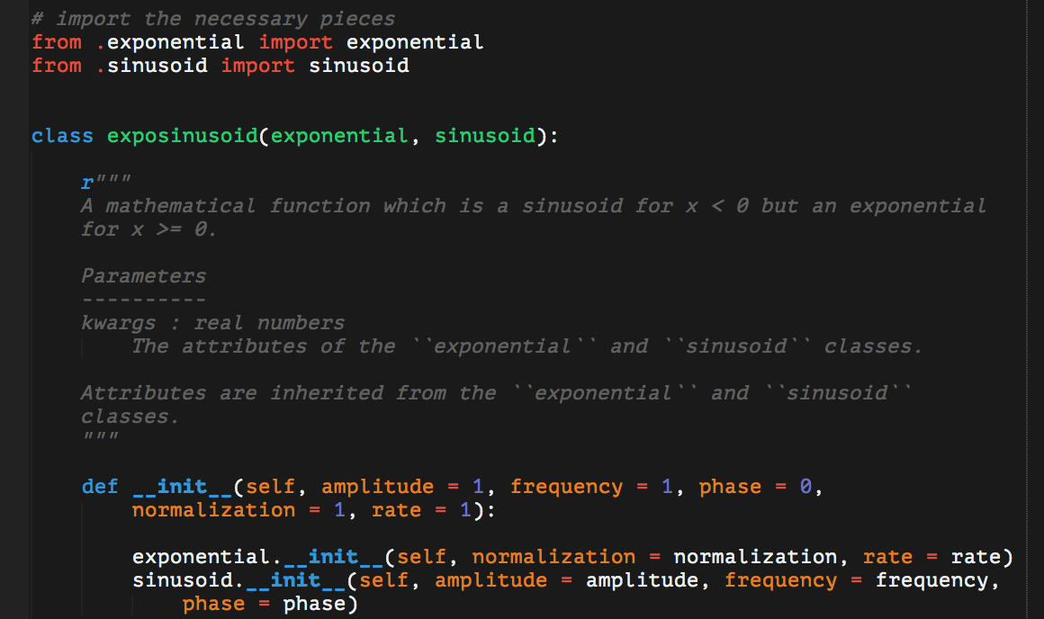
Example: A Piece-Wise Function
The two base classes
exponential describes a classic e-folding function
sinusoid describes a sine or cosine function
Notes:
This is in the example codes under examples/mypkg/mathlib/exposinusoid.py

Slide 9
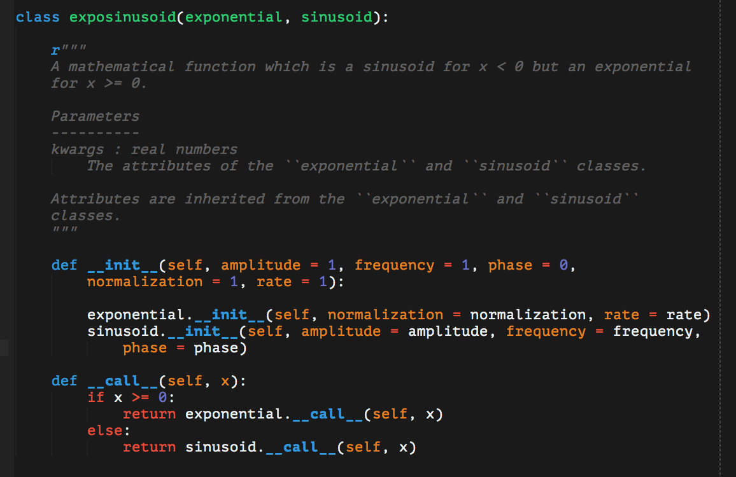
Example: A Piece-Wise Function
The two base classes
exponential describes a classic e-folding function
sinusoid describes a sine or cosine function
Invoking the inherited class directly can also be used to write the __call__ function (or any function for that matter)
Notes:
Other such examples include adding the values from the __call__ functions, multiplying them, subtracting, dividing, whatever you need!

Slide 10
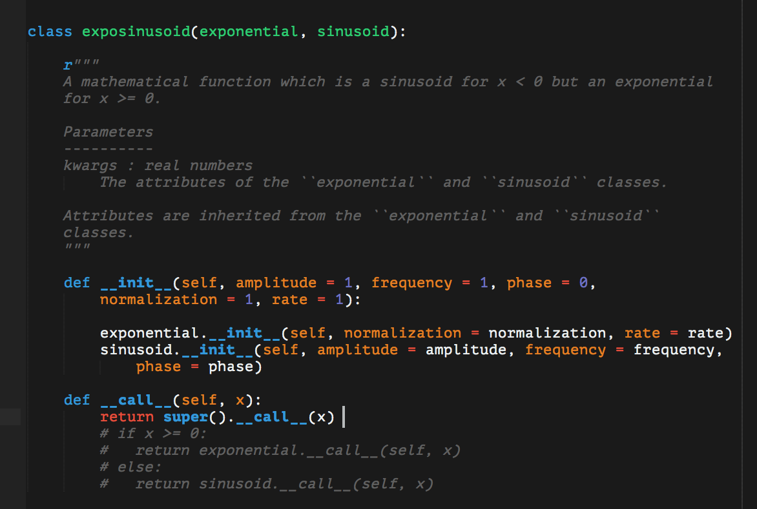
The Method Resolution Order in Action
Replaced the body of the __call__ function with a simple call to super

Slide 11
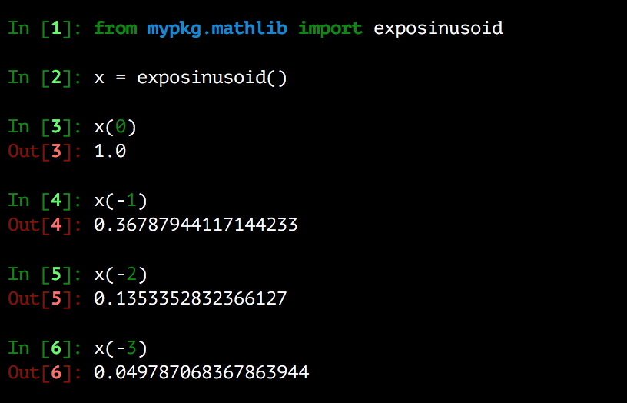
The Method Resolution Order in Action
Replaced the body of the __call__ function with a simple call to super
Now it’s only calling exponential.__call__
If exposinusoid inherited from sinusoid first, this would find sinusoid.__call__ instead

Slide 12
Footnotes
In some specific instances, super is smart enough to make sure all inherited classes’ __init__ functions get called
Example: “diamond inheritance” (B and C inherit from A, D inherits from B and C)
“Mixin” classes – designed for multiple inheritance
Generally implement only one function each, then “mix” them by inheriting from multiple
Conventionally have names ending in -Mixin

Slide 13
Footnotes
Developers often argue that multiple inheritance is bad practice
This really only means it should be used sparingly, when no other options are available
Advice: Don’t be afraid to use it when it offers a concise, readable solution
…but only if the single inheritance version is noticeably less so
Avoid super – it sacrifices readability. “Explicit is better than implicit.”
With this approach, changing functionality requires changing the lines that implement that functionality, which means it’s good code.

