Slide 1
Introduction
SURP 2021 Python Bootcamp
Ohio State Astronomy
Slides by: James W. Johnson

Slide 2
Hello!
Fifth/Sixth year PhD student in the Astronomy Department
Research Interests
Galactic chemical evolution (David Weinberg, Jennifer Johnson)
[Type Ia] Supernovae (Chris Kochanek, Kris Stanek)
Previously: dark matter halos and their environments
Versatile Integrator for Chemical Evolution (VICE: https://pypi.org/project/vice)
~89,200 lines (Python & C) in latest release (1.3.0) supporting Python >= 3.6.
We’ll do a mix of slides and exercises – I won’t be collecting and grading anything. This isn’t a course. What you get out of this will reflect what you put into it.

Slide 3
Survey Responses
Q1: 4C, 13D, 1E
Most of you have written code from scratch for class/research
Q2: 4A, 7B, 6C, 1D
Most of you are comfortable with if/else, for/while, def, etc.
Q3: 5A, 10B, 2C, 1D
About half of you have written a class, the rest have not
Q4: 10A, 8B
About half of you have used “import _____” to use code from another file
Q5: 11A, 4B, 1C, 1D, 1E
Most of you code entirely in notebooks, others have some preference for text files
Q6: 5A, 4B, 5C, 2D, 2E
A number of you haven’t used a terminal before, the rest are fairly comfortable with it

Slide 4
Survey Responses
New material:
For many of you: the terminal
How to import your own code from elsewhere in your computer
Object oriented programming (OOP): classes and inheritance
Some of the material is either impossible or quite difficult when coding in a notebook. I advise all of you to use this bootcamp as practice for working in text files.

Slide 5
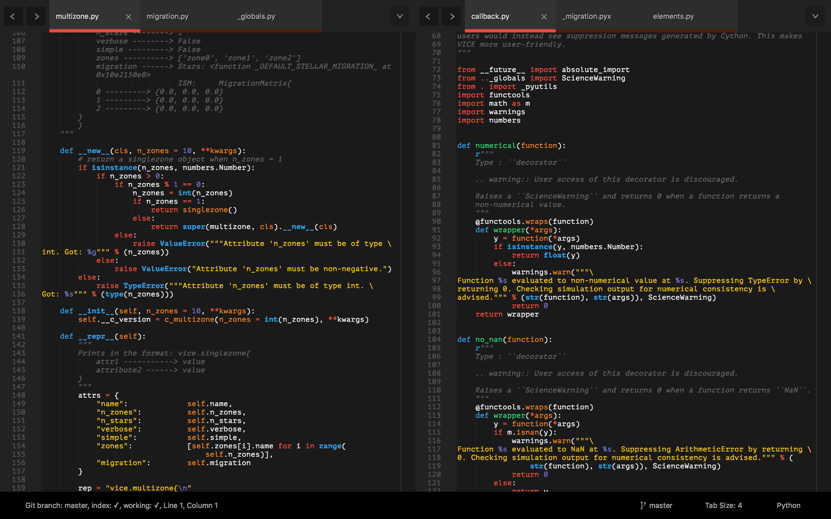
Tools: A Text Editor
Differs from an Integrated Development Environment (IDE) in that IDEs will run the code – all they do is open, create, edit, etc. plain text files
pycharm, spyder
I recommend Sublime Text
https://www.sublimetext.com/

Slide 6
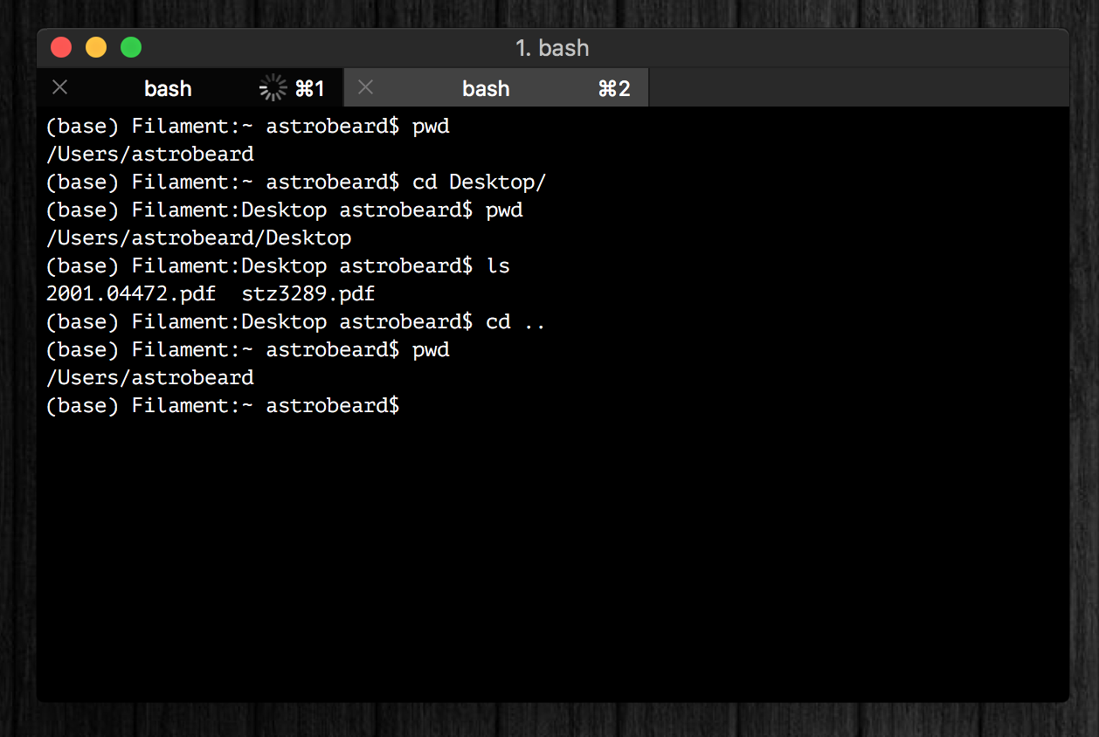
Tools: A Terminal
I recommand iTerm2
Terminal replacement
https://www.iterm2.com/
You should think of a terminal as just a different interface on a Finder window with some extra programs built-in
Tip: you can run python line-by-line in a terminal (python or ipython)

Slide 7
Tools: A Terminal
If you’re running Windows, your terminal will be different than some of the notes and exercises here, unless you take some extra steps at the beginning to set up a bash interpreter.
Talk to me if you need help with this!

Slide 8
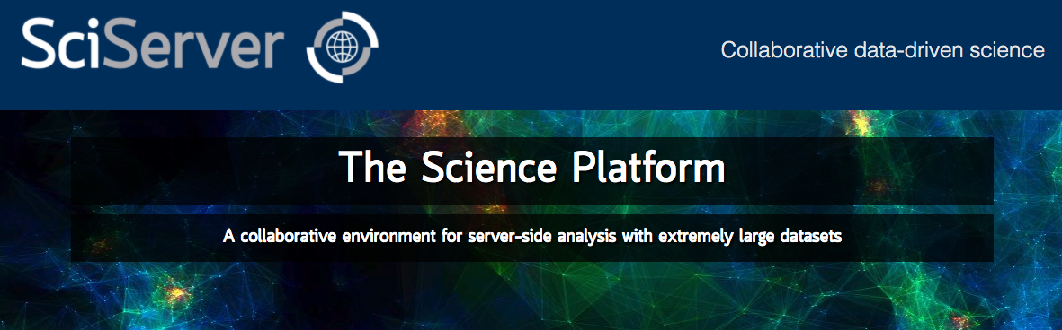
Tools: Cloud Computing
Allows you to run python on a remote server
SciServer is a popular platform across many STEM fields:
https://www.sciserver.org/
In the long run you should choose the tools that you’re most comfortable with

Slide 9
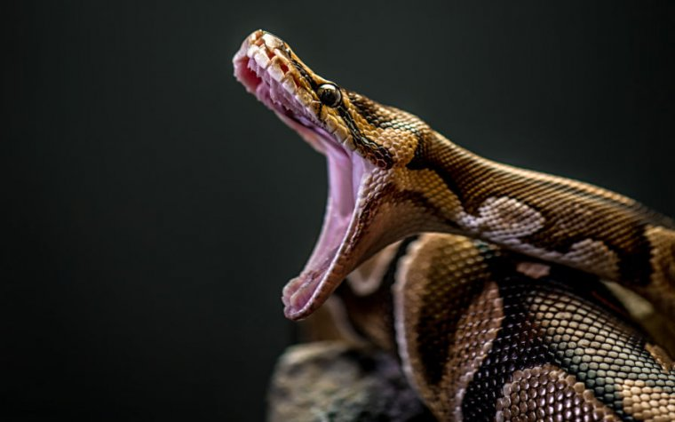
If You Haven’t Already
https://www.anaconda.com/products/individual
This will install Python, Anaconda, and Jupyter Notebooks
Latest version of python: 3.10.4
Most libraries now require >= 3.7
NumPy’s latest version requires >= 3.8
Python 2.7 is deprecated

Slide 10
Other Resources
Python Foundation’s Beginner’s Guide: https://www.python.org/about/gettingstarted/
https://www.learnpython.org/ - There is also an iOS app for this
Codecademy: https://www.codecademy.com/learn/learn-python-3

Slide 11
Goals
What we’ll aim to cover:
How to use a terminal
Review of the basics: control structures, data types, functions, import, etc.
How to read documentation
How to import your own code, and how to set up a directory tree to organize it
Classes: how to make new objects
Inheritance and Composition
Some basic software engineering principles (i.e. good habits)

Slide 12
Monday Motivation
Every expert coder was once a novice.
You can’t improve your coding practices without first criticizing what you once thought was great code.
Since we’re not professional developers, scientists have to actively create and foster good coding habits if they want them. Being early career researchers, you have the option to make this decision now. It will only become more difficult to do this.

