Slide 1
Review
SURP 2022 Python Bootcamp
Ohio State Astronomy
Slides by: James W. Johnson

Slide 2
Objectives
Built-in Data Types: int, float, list, tuple, dict, array, etc.
Conditionals: if/else statements
Loops: for and while
Functions: def statements
Catching Exceptions: try/except/finally
Notes:
We will be reviewing some of the basic data types, functions, conditionals etc in python . We expect that most of you are already familiar with the topics today so we will be going through all of the content briefly.

Slide 3
Numeric Types
Built-in numeric types are int (integers) and float (real numbers)
Some packages implement their own numeric types (e.g. NumPy: numpy.int64)
Numeric operations
=, ==, +, -, *, /, //, %, +=, -=, *=, /=, //=, %=
Recall: x += y is the same as x = x + y
/ vs. //: true division vs. floor division (i.e. integer quotient)
3 / 2 returns 1.5, but 3 // 2 returns 1
%: modulo (calculates remainder)
5 % 2 returns 1; 5 % 3 returns 2; 5 % 1 returns 0
Notes:
In Python, the "=" operator is used for assignment, it is used to assign a value to a variable. On the other hand, the "==" operator is used to compare two values for equality. the "//" and "%" operators are used for integer division and modulo operations, respectively.
The "//" operator performs integer division, which returns the integer quotient of the division operation. For example, 7 // 3 would return 2, The "%" operator performs modulo operation, which returns the remainder of the division operation. For example, 7 % 3 would return 1.

Slide 4
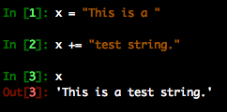
Strings
Text - declared with either single ‘’ or double “” quotes
Triple quotes declare a multi-line string (This will come up again later)
Are compatible with the += operator
In Python 3, strings are unicode by default, meaning you can use special characters without changing anything
Notes:
There’s also the str.join function, but if all you’re looking for a simple string concatenation, I find that the += operator is simply more straight-forward and more readable.
Unicode means that each character in the string is represented by a unique number, called a Unicode code point.
Unicode is a character encoding standard that provides a unique number for every character, no matter what the platform, device, or program is. This ensures that text in different languages and scripts can be represented correctly and consistently across different systems.

Slide 5
The Print Function
In C/C++ print statements are done with printf in stdio.h, and cout in iostream
Python: print(<things to print>)
Can pass multiple parameters separated by commas, and they’ll print with spaces between them
Parentheses are required in Python 3, but not Python 2 (which is deprecated so you shouldn’t be using it anyway)

Slide 6
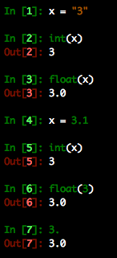
Type Casting
Python objects can be converted between compatible types
Strings containing numbers can be converted to numeric types
Integers can be converted to floats and vice versa
Notes:
Type casting, also known as type conversion, is the process of converting a value from one data type to another in Python. Conversion is very simple we just call the data type we want to convert as a function. When we apply the int() function to a floating-point number, it will return the integer part of that number by rounding down towards zero.

Slide 7
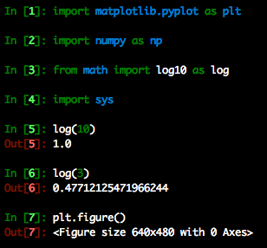
Import Statements
Used to load a python library into your current code
Analogous to #include and using in C/C++
Can assign imported modules new names upon import with from and as
from ___ import * imports all contents
Notes:
The “from ___ import *” construction is considered bad practice as it is often difficult to control the namespace. Think about “from numpy import *” followed by “from math import *” versus the opposite order. We’ll come back to this in the next session.
from numpy import *: This imports all the functions and objects from the numpy module into the current namespace. This means that you can use all the functions and objects from numpy without having to prefix them with the module name. For example, you can use the sin() function directly: sin(3.14).
However, this can lead to naming conflicts if the same name is used in different modules, and can make it harder to trace where a particular function or object came from.

Slide 8
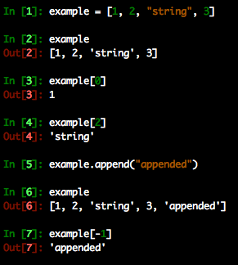
List
A sequence of objects
Created with square brackets [ ]
Can be any mix of types
Access an element of the sequence by its position
Negative indices start at the end of the list and count backwards
Modification proceeds in the same manner
Append function adds an element to the end
Can also use ‘+’ to combine lists
Notes:
lists are a versatile data structure in Python that can be used for a variety of tasks., sort list, append to add more objects, remove objects

Slide 9
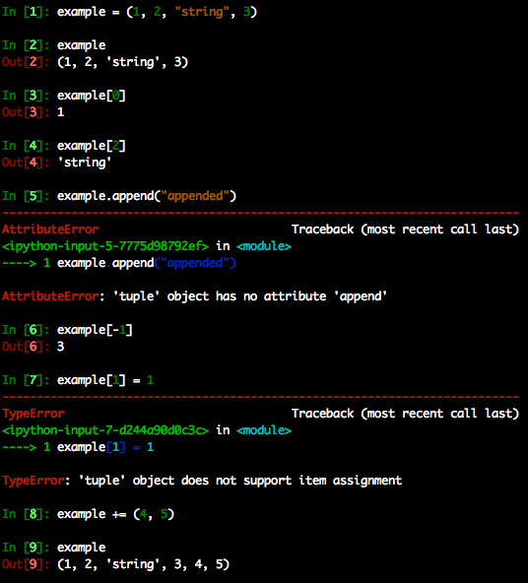
Tuple
An immutable sequence of objects
Created with parentheses ( )
Can be any mix of types
Access an element of the sequence by its position
Negative indices start at the end of the tuple and count backwards
Modification not allowed (immutability)
Can still use ‘+’ to add elements to the end
Notes:
Overall, tuples are a useful data structure in Python when you need to store a collection of related values that should not be changed

Slide 10
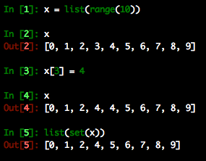
Set
Ensure uniqueness
list(set(some_list)) will remove duplicate elements
Created with the set() function or with {} enclosing elements (be careful w/this, see next slide)
Don’t allow indexing, so aren’t as commonly used as lists, tuples, and dictionaries
Have some other useful function such as union and intersection (‘|’ and ‘&’)
Notes:
a set is a built-in data structure that allows you to store a collection of unique and unordered elements in a single variable. Sets support a variety of set operations such as union, intersection, and difference. These operations can be useful in tasks such as finding common elements between two sets, finding elements unique to one set, or combining two sets.

Slide 11
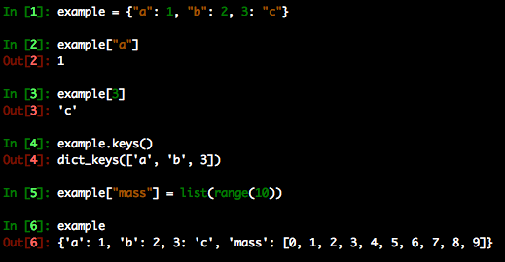
Dictionary
Python’s version of a hash table.
Can be used to map objects to other objects
Created with {}
Stored values can be accessed via their key
keys() function returns each key
Popular method of storing data b/c keys can be strings which describe the data, allowing very readable code
Notes:
a dictionary is a built-in data structure that allows you to store a collection of key-value pairs in a single variable. Each key in a dictionary must be unique and immutable, and each key is associated with a value

Slide 12
Which Data Type Should I Use?
Do you need a logical key-value connection?
If yes: use a dictionary
Do you need to ensure uniqueness of each element, or perhaps union or intersection operations?
If yes: use a set
Do you need to ensure that the contents will never change?
If yes: use a tuple
If you answered no to all of these, a list should suffice.

Slide 13
Arrays
In practice the same as a list, but has some special implementation of tracking data types under the hood, and allow some calculations to be automatically “vectorized”
Can often speed up code
There is a built-in array object, but in practice, most people use the NumPy array
The single most important thing to remember about arrays:
LISTS AND ARRAYS ARE NOT THE SAME THING
Notes:
Have the students parrot this statement back to you
arrays are a type of container that can hold a fixed number of elements of the same data type

Slide 14
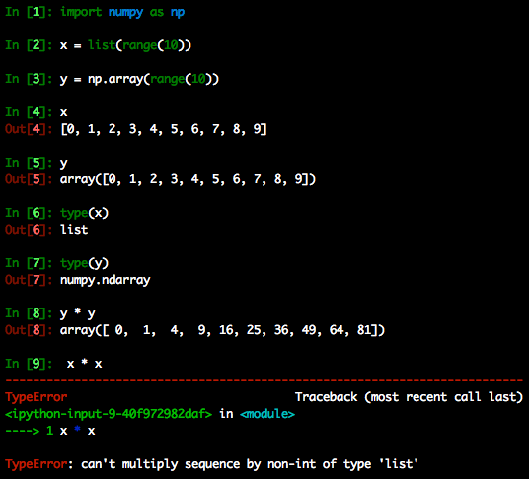
Lists vs. Arrays
They are different objects meant to store similar data
Example: NumPy arrays allow multiplication with another array. A list does not.
Advice: Pick one of either lists or arrays for a given program and stick to it
Notes:
NumPy is a library for working with arrays and numerical operations. ndarray is the primary data structure in NumPy that represents a multidimensional, homogeneous array of fixed-size items.
Range creates a sequence of integers from 0 up to, but not including, 10. stop number will not be counted

Slide 15
Lists vs. Arrays
They are different objects meant to store similar data
It’s probably safe to say that a large portion of all modern scientific code is written using NumPy arrays

Slide 16
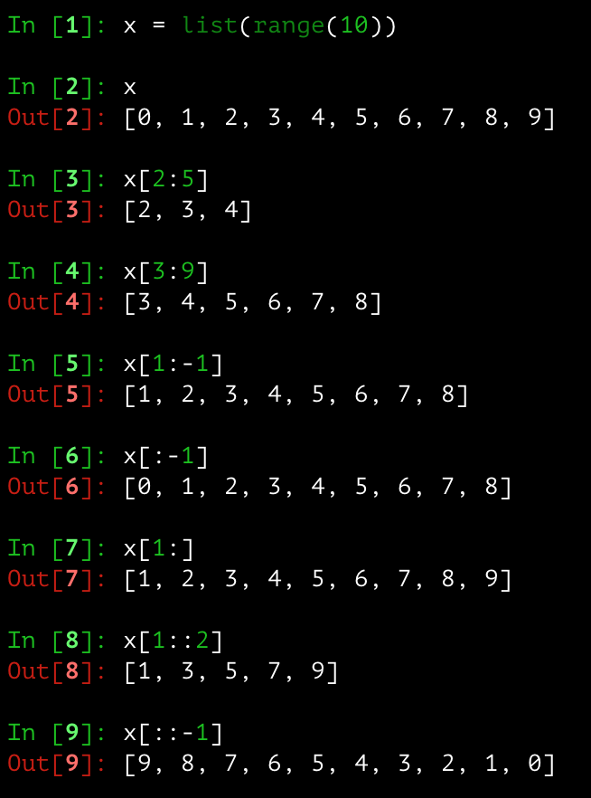
Slicing
A technique used to pull multiple items from array-like objects
General rule: start:stop:stepsize
Start, stop, and stepsize can be omitted, and Python defaults to the beginning or end with a step size of 1, depending on what’s omitted
Achieved by separating indices with a colon
Negative step sizes go through the array in reverse order
Notes:
Slicing arrays, please pay attention to this slide because this is a frequently occurring concept, and I still have google the syntax sometimes to figure how to do it. So first of all why do we need it. For this I will give an example since there are many astronomers in the room, suppose I am doing a time series analysis of a star for 100 days, I have recorded the luminosity of the star on eah day, so I have an array of 100 data points. Now if I only want to see how it varies from day 1 to 20 , or day 50 to 100 , how do I extract only those data points

Slide 17
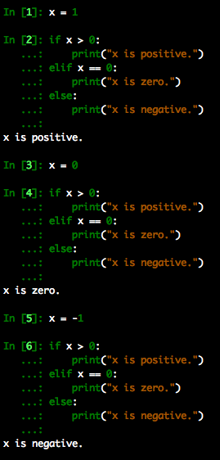
Conditions
Conduct different operations based on whether or not a given condition is satisfied
Uses boolean logic: True and False
Note: Numbers can be used as well – anything nonzero evaluates to True.
Tip: Don’t compare to True and False
if x == True and if x == False are simply if x and if not x
Notes:
For input [3] we have x= 0, the if statement checks if x>=0 and since that condition is satisfied it printed x is positive, it did not move to the second condition of elif x==0, so this means we can get the results from only one out these conditions. It goes in the order of if-elif---else

Slide 18
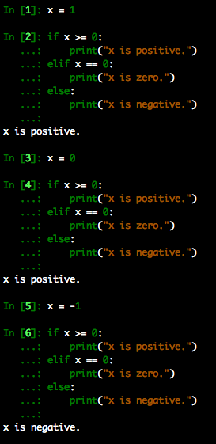
Conditions
Conduct different operations based on whether or not a given condition is satisfied
Uses boolean logic: True and False
Note: Numbers can be used as well – anything nonzero evaluates to True.
Note: if/elif/else blocks executed in order.
Notes:
For input [3] we have x= 0, the if statement checks if x>=0 and since that condition is satisfied it printed x is positive, it did not move to the second condition of elif x==0, so this means we can get the results from only one out these conditions. It goes in the order of if-elif---else

Slide 19
Loops
Two types
For- and while-loops
Both execute the same block of code some number of times
Both types of loops can be forced to terminate with the command “break”, and to start the next iteration with “continue”

Slide 20
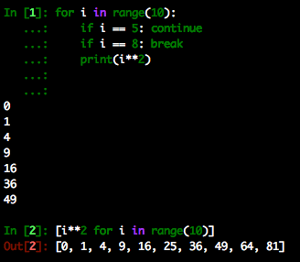
For-loops
Should be used when you know exactly how many times the block should repeat
Come in two flavors:
Explicit for loop: “for i in <some iterable>” followed by an indented block (example: top)
Implicit for loop: occurs within a list comprehension (example: bottom)
Note that list comprehensions return a list, so you must type-cast to an array if you want to write your program using arrays

Slide 21
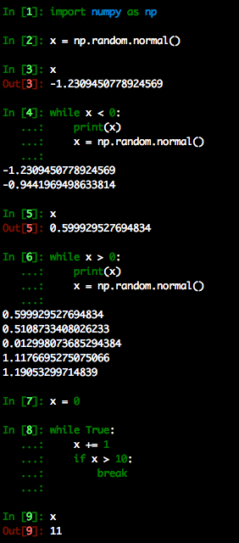
While-loops
Should be used when you don’t know how many times the block should repeat
You should break this rule when the alternate version is significantly more readable (this is quite universal advice)
while True: <…> break is not uncommon, but considered bad practice by some
Advantage: The loop will always execute at least once. Other languages achieve this with what is called a do-while loop.
Notes:
Code is read much more often than it is written – this will come up again in the final session. 50 lines of code that are clear and explicit about their functionality are much better than 10 opaque and convoluted lines doing the same operation.

Slide 22
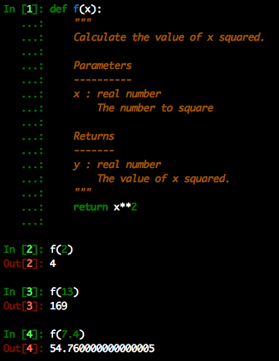
Functions
Often referred to as “methods” in other languages
Created with the def keyword followed by an indented block. Between the def statement and the body of the function is where you should put a docstring.
Astronomers (and scientists in general) are notorious for thin documentation if they document at all.
Notes:
As scientists at the very beginning of their computational careers, students can make the decision of what kind of code they’re going to write *now*.

Slide 23
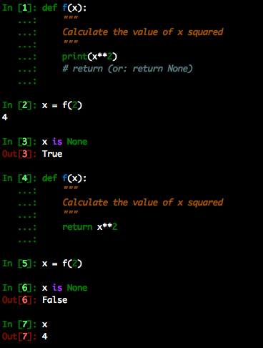
Functions: The Implicit Return
Unless otherwise specified, a function will return None.
In order to obtain an object from a function, you have to override this with a return statement
A note about variable scope: variables declared inside a function cannot be accessed outside the function.

Slide 24
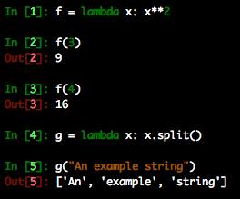
Functions: An Alternative for One-Liners
One line function: lambda
By nature don’t have any error-handling or documentation attached to them, so should only be used when this isn’t necessary – a lambda worth documenting is better replaced by a def with a one-line return and a docstring

Slide 25
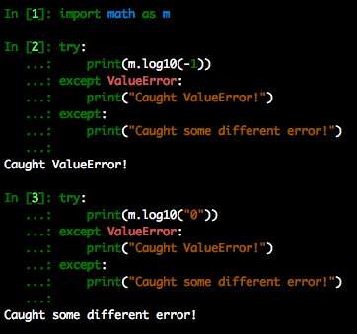
Catching Exceptions: try-except
Catch exceptions before their raised and handle them.
Different types of exceptions can be treated differently by specifying them in the except statement.
The exception can be raised “as is” with the python keyword raise
Notes:
The bare raise statement works only in an except block where there is an active exception.

Slide 26
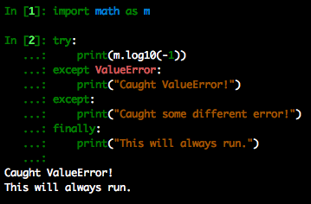
Catching Exceptions: try-except-finally
Use a finally block when you need something to always run regardless of the errors that may or may not be raised.
Example: freeing up memory
Disclaimer – return statements in a finally block will always override previous return statements in the try-except block

Slide 27
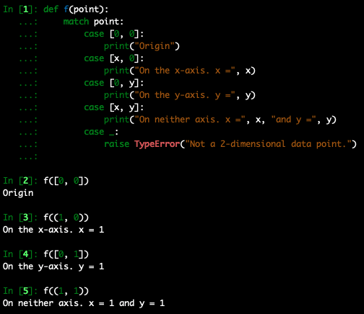
Pattern-Matching: Python 3.10
Python 3.10 (released October 4, 2021) introduced the new match-case syntax
Similar to the switch-case construction in C/C++
Usually implicitly includes some form of type-checking and length-matching for short arrays
Case statements can introduce new local variables
_ represents some default scenario
Notes:
Another difference folks might notice between python’s match-case and C/C++’s switch-case is that the C/C++ switch-case requires a break statement at the end of each case, otherwise it will start to run the subsequent case statement. The break statement is implicitly included in python.

Slide 28
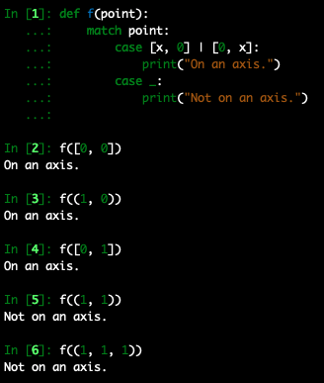
Pattern-Matching: Python 3.10
Python 3.10 (released October 4, 2021) introduced the new match-case syntax
Similar to the switch-case construction in C/C++
Usually implicitly includes some form of type-checking and length-matching for short arrays
Logical “or” function can be used with | character…

Slide 29
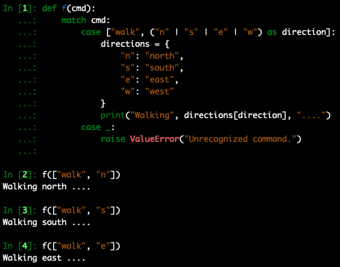
Pattern-Matching: Python 3.10
Python 3.10 (released October 4, 2021) introduced the new match-case syntax
Similar to the switch-case construction in C/C++
Usually implicitly includes some form of type-checking and length-matching for short arrays
Logical “or” function can be used with | character…
… and can be used with as to capture the value as a local variable

Slide 30
Pattern-Matching: Python 3.10
Python 3.10 (released October 4, 2021) introduced the new match-case syntax
Similar to the switch-case construction in C/C++
Usually implicitly includes some form of type-checking and length-matching for short arrays
PEP 636 presents a comprehensive tutorial
https://peps.python.org or google “pep 636”
PEP: Python Enhancement Proposal

Slide 31
Useful Built-In Functions
any: Iterates over a list/array and determines if at least one element is True
all: Iterates over a list/array and determines if all elements are True
zip: Combine lists/arrays into a 2-D list/array component-wise
map: Iterate a function over an array(s) of values
filter: Remove elements from a list/array which don’t meet specific criteria
min: Calculate minimum value of some set of numbers
max: Calculate maximum value of some set of numbers
In python 3, zip, map, and filter return a special type of object which needs to be cast to a list, tuple, etc.
Notes:
Worth noting here that filter and map were almost removed from Python 3 in favor of list comprehensions, but they’re still part of Python.

