Slide 1
Review
SURP 2022 Python Bootcamp
Ohio State Astronomy
Slides by: James W. Johnson

Slide 2
Objectives
Built-in Data Types: int, float, list, tuple, dict, array, etc.
Conditionals: if/else statements
Loops: for and while
Functions: def statements
Catching Exceptions: try/except/finally

Slide 3
Numeric Types
Built-in numeric types are int (integers) and float (real numbers)
Some packages implement their own numeric types (e.g. NumPy: numpy.int64)
Numeric operations
=, ==, +, -, *, /, //, %, +=, -=, *=, /=, //=, %=
Recall: x += y is the same as x = x + y
/ vs. //: true division vs. floor division (i.e. integer quotient)
3 / 2 returns 1.5, but 3 // 2 returns 1
%: modulo (calculates remainder)
5 % 2 returns 1; 5 % 3 returns 2; 5 % 1 returns 0

Slide 4
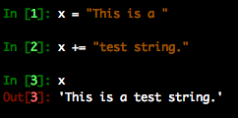
Strings
Text - declared with either single ‘’ or double “” quotes
Triple quotes declare a multi-line string (This will come up again later)
Are compatible with the += operator
In Python 3, strings are unicode by default, meaning you can use special characters without changing anything
Notes:
There’s also the str.join function, but if all you’re looking for a simple string concatenation, I find that the += operator is simply more straight-forward and more readable.

Slide 5
The Print Function
In C/C++ print statements are done with printf in stdio.h, and cout in iostream
Python: print(<things to print>)
Can pass multiple parameters separated by commas, and they’ll print with spaces between them
Parentheses are required in Python 3, but not Python 2 (which is deprecated so you shouldn’t be using it anyway)

Slide 6
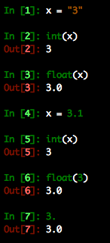
Type Casting
Python objects can be converted between compatible types
Strings containing numbers can be converted to numeric types
Integers can be converted to floats and vice versa

Slide 7
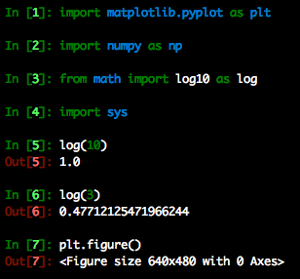
Import Statements
Used to load a python library into your current code
Analogous to #include and using in C/C++
Can assign imported modules new names upon import with from and as
from ___ import * imports all contents
Notes:
The “from ___ import *” construction is considered bad practice as it is often difficult to control the namespace. Think about “from numpy import *” followed by “from math import *” versus the opposite order. We’ll come back to this in the next session.

Slide 8
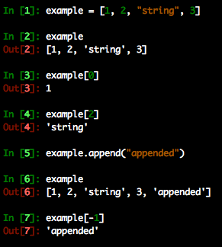
List
A sequence of objects
Created with square brackets [ ]
Can be any mix of types
Access an element of the sequence by its position
Negative indices start at the end of the list and count backwards
Modification proceeds in the same manner
Append function adds an element to the end
Can also use ‘+’ to combine lists

Slide 9
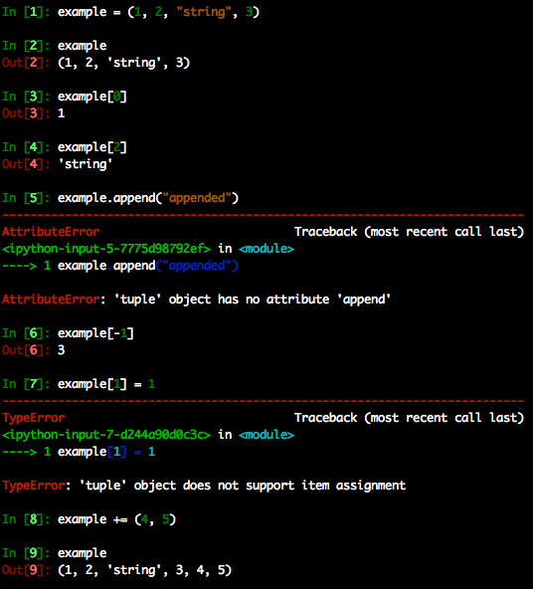
Tuple
An immutable sequence of objects
Created with parentheses ( )
Can be any mix of types
Access an element of the sequence by its position
Negative indices start at the end of the tuple and count backwards
Modification not allowed (immutability)
Can still use ‘+’ to add elements to the end

Slide 10
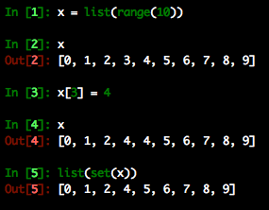
Set
Ensure uniqueness
list(set(some_list)) will remove duplicate elements
Created with the set() function or with {} enclosing elements (be careful w/this, see next slide)
Don’t allow indexing, so aren’t as commonly used as lists, tuples, and dictionaries
Have some other useful function such as union and intersection (‘|’ and ‘&’)

Slide 11
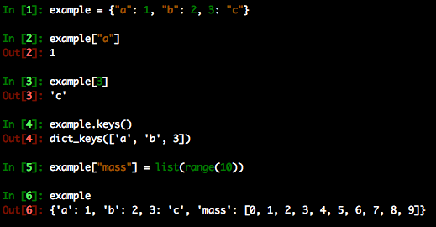
Dictionary
Python’s version of a hash table.
Can be used to map objects to other objects
Created with {}
Stored values can be accessed via their key
keys() function returns each key
Popular method of storing data b/c keys can be strings which describe the data, allowing very readable code

Slide 12
Which Data Type Should I Use?
Do you need a logical key-value connection?
If yes: use a dictionary
Do you need to ensure uniqueness of each element, or perhaps union or intersection operations?
If yes: use a set
Do you need to ensure that the contents will never change?
If yes: use a tuple
If you answered no to all of these, a list should suffice.

Slide 13
Arrays
In practice the same as a list, but has some special implementation of tracking data types under the hood, and allow some calculations to be automatically “vectorized”
Can often speed up code
There is a built-in array object, but in practice, most people use the NumPy array
The single most important thing to remember about arrays:
LISTS AND ARRAYS ARE NOT THE SAME THING
Notes:
Have the students parrot this statement back to you

Slide 14
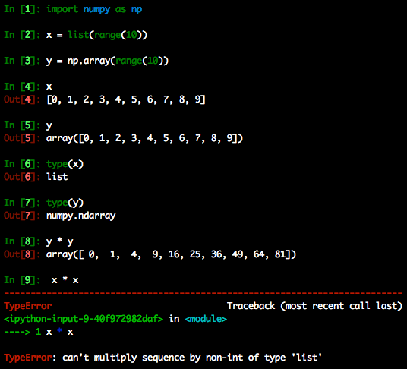
Lists vs. Arrays
They are different objects meant to store similar data
Example: NumPy arrays allow multiplication with another array. A list does not.
Advice: Pick one of either lists or arrays for a given program and stick to it

Slide 15
Lists vs. Arrays
They are different objects meant to store similar data
It’s probably safe to say that a large portion of all modern scientific code is written using NumPy arrays

Slide 16
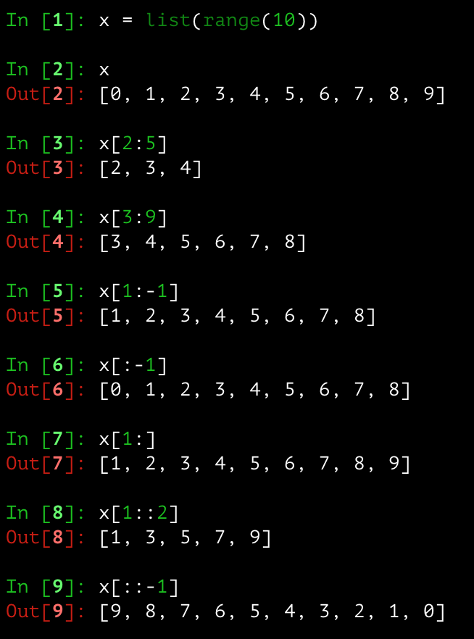
Slicing
A technique used to pull multiple items from array-like objects
General rule: start:stop:stepsize
Start, stop, and stepsize can be omitted, and Python defaults to the beginning or end with a step size of 1, depending on what’s omitted
Achieved by separating indices with a colon
Negative step sizes go through the array in reverse order

Slide 17
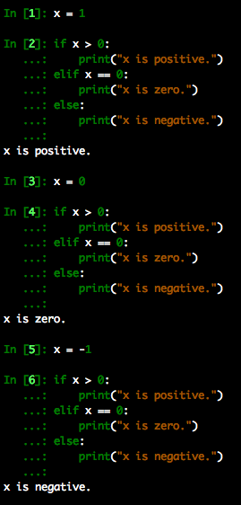
Conditions
Conduct different operations based on whether or not a given condition is satisfied
Uses boolean logic: True and False
Note: Numbers can be used as well – anything nonzero evaluates to True.
Tip: Don’t compare to True and False
if x == True and if x == False are simply if x and if not x

Slide 18
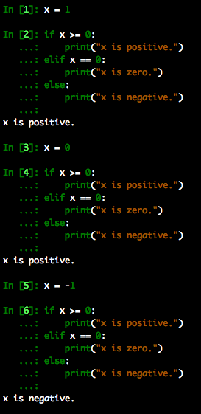
Conditions
Conduct different operations based on whether or not a given condition is satisfied
Uses boolean logic: True and False
Note: Numbers can be used as well – anything nonzero evaluates to True.
Note: if/elif/else blocks executed in order.

Slide 19
Loops
Two types
For- and while-loops
Both execute the same block of code some number of times
Both types of loops can be forced to terminate with the command “break”, and to start the next iteration with “continue”

Slide 20
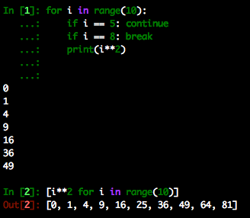
For-loops
Should be used when you know exactly how many times the block should repeat
Come in two flavors:
Explicit for loop: “for i in <some iterable>” followed by an indented block (example: top)
Implicit for loop: occurs within a list comprehension (example: bottom)
Note that list comprehensions return a list, so you must type-cast to an array if you want to write your program using arrays

Slide 21
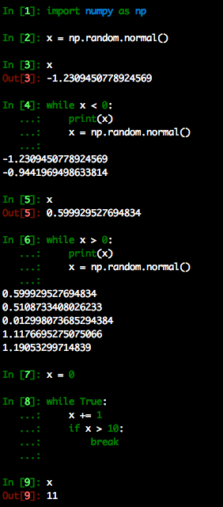
While-loops
Should be used when you don’t know how many times the block should repeat
You should break this rule when the alternate version is significantly more readable (this is quite universal advice)
while True: <…> break is not uncommon, but considered bad practice by some
Advantage: The loop will always execute at least once. Other languages achieve this with what is called a do-while loop.
Notes:
Code is read much more often than it is written – this will come up again in the final session. 50 lines of code that are clear and explicit about their functionality are much better than 10 opaque and convoluted lines doing the same operation.

Slide 22
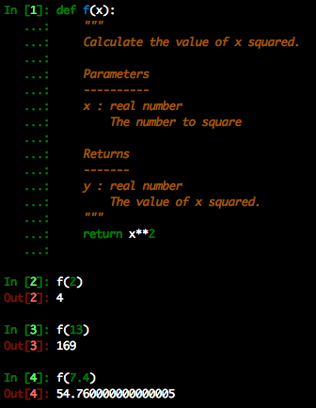
Functions
Often referred to as “methods” in other languages
Created with the def keyword followed by an indented block. Between the def statement and the body of the function is where you should put a docstring.
Astronomers (and scientists in general) are notorious for thin documentation if they document at all.
Notes:
As scientists at the very beginning of their computational careers, students can make the decision of what kind of code they’re going to write *now*.

Slide 23
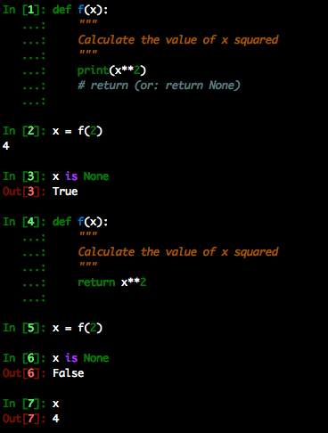
Functions: The Implicit Return
Unless otherwise specified, a function will return None.
In order to obtain an object from a function, you have to override this with a return statement
A note about variable scope: variables declared inside a function cannot be accessed outside the function.

Slide 24
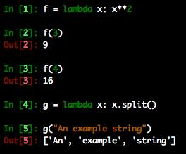
Functions: An Alternative for One-Liners
One line function: lambda
By nature don’t have any error-handling or documentation attached to them, so should only be used when this isn’t necessary – a lambda worth documenting is better replaced by a def with a one-line return and a docstring

Slide 25
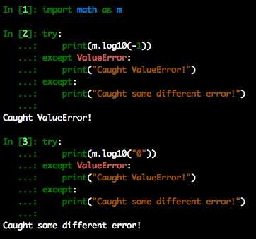
Catching Exceptions: try-except
Catch exceptions before their raised and handle them.
Different types of exceptions can be treated differently by specifying them in the except statement.
The exception can be raised “as is” with the python keyword raise
Notes:
The bare raise statement works only in an except block where there is an active exception.

Slide 26
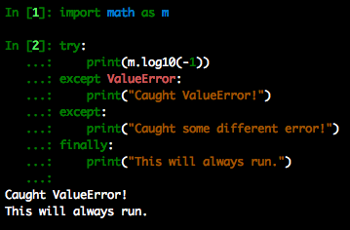
Catching Exceptions: try-except-finally
Use a finally block when you need something to always run regardless of the errors that may or may not be raised.
Example: freeing up memory
Disclaimer – return statements in a finally block will always override previous return statements in the try-except block

Slide 27
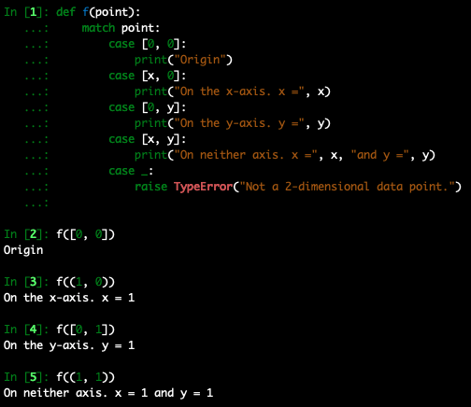
Pattern-Matching: Python 3.10
Python 3.10 (released October 4, 2021) introduced the new match-case syntax
Similar to the switch-case construction in C/C++
Usually implicitly includes some form of type-checking and length-matching for short arrays
Case statements can introduce new local variables
_ represents some default scenario
Notes:
Another difference folks might notice between python’s match-case and C/C++’s switch-case is that the C/C++ switch-case requires a break statement at the end of each case, otherwise it will start to run the subsequent case statement. The break statement is implicitly included in python.

Slide 28
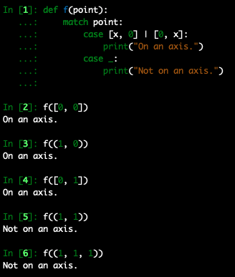
Pattern-Matching: Python 3.10
Python 3.10 (released October 4, 2021) introduced the new match-case syntax
Similar to the switch-case construction in C/C++
Usually implicitly includes some form of type-checking and length-matching for short arrays
Logical “or” function can be used with | character…

Slide 29
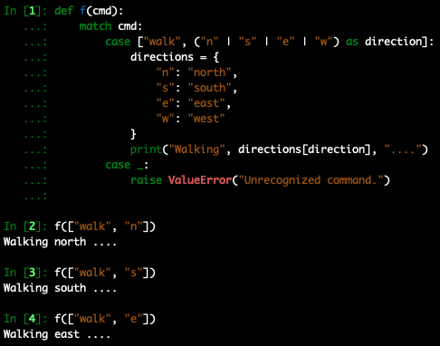
Pattern-Matching: Python 3.10
Python 3.10 (released October 4, 2021) introduced the new match-case syntax
Similar to the switch-case construction in C/C++
Usually implicitly includes some form of type-checking and length-matching for short arrays
Logical “or” function can be used with | character…
… and can be used with as to capture the value as a local variable

Slide 30
Pattern-Matching: Python 3.10
Python 3.10 (released October 4, 2021) introduced the new match-case syntax
Similar to the switch-case construction in C/C++
Usually implicitly includes some form of type-checking and length-matching for short arrays
PEP 636 presents a comprehensive tutorial
https://peps.python.org or google “pep 636”
PEP: Python Enhancement Proposal

Slide 31
Useful Built-In Functions
any: Iterates over a list/array and determines if at least one element is True
all: Iterates over a list/array and determines if all elements are True
zip: Combine lists/arrays into a 2-D list/array component-wise
map: Iterate a function over an array(s) of values
filter: Remove elements from a list/array which don’t meet specific criteria
min: Calculate minimum value of some set of numbers
max: Calculate maximum value of some set of numbers
In python 3, zip, map, and filter return a special type of object which needs to be cast to a list, tuple, etc.
Notes:
Worth noting here that filter and map were almost removed from Python 3 in favor of list comprehensions, but they’re still part of Python.

