Slide 1
Classes
SURP 2022 Python Bootcamp
Ohio State Astronomy
Slides by: James W. Johnson

Slide 2
What are they? Why should I care?
A class is how you implement a new object.
Python is an object-oriented programming language - if you’re a python programmer and you’ve never written a class, you’re missing out on the single most powerful aspect of the language by far.

Slide 3
Recall: The Python Model
Everything is an object in Python, whether you knew it or not.
Objects have …
Attributes
Functions
Data
… which are unique to the object; also interactions with other objects.

Slide 4
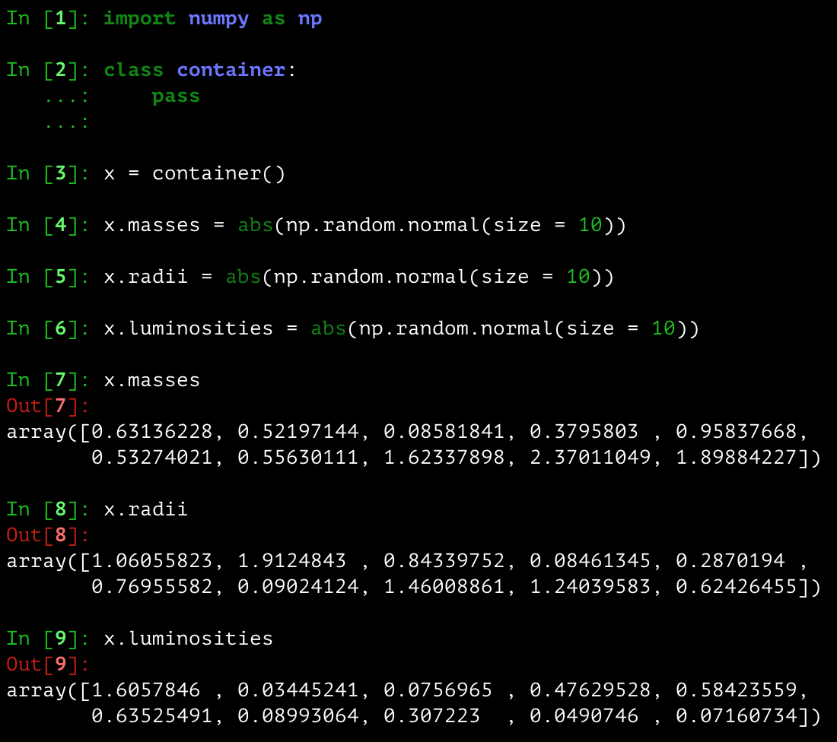
Data Container
The simplest object – all it does is hold on to the attributes that you give it
class container: pass is all you need
Doesn’t need to be called container
The argument pass here means “do nothing.” Objects with more specialization instead have def statements within them.
Notes:
This “dot syntax” is going to keep arising – it’s how you access attributes and functions associated with specific objects.

Slide 5

An Example Object: A Dog
Attributes: color, breed, name, gender
Functions: bark, roll over, shake, eat, drink, chase their tail
Data: date of birth, veterinary records, previous owners
Interactions with other objects: play with other dogs/owner, chase cats

Slide 6
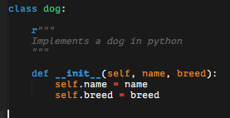
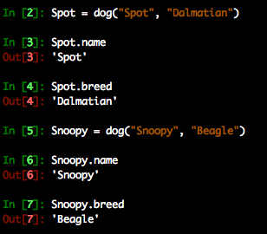
Dogs in Python
How you create instances of the class (i.e. objects) is determined by the __init__ function.
The first argument to __init__ should always be self – this is true of most functions in a class, and refers to the object itself being passed
Notes:
We’ll see another example focusing on the meaning of self in a few slides.

Slide 7
Dogs in Python
How you create instances of the class (i.e. objects) is determined by the __init__ function.
The first argument to __init__ should always be self – this is true of most functions in a class, and refers to the object itself being passed
This gets the job done, but…
Notes:
We’ll see another example focusing on the meaning of self in a few slides.

Slide 8
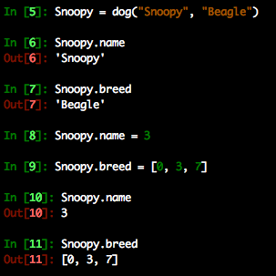
Dogs in Python
How you create instances of the class (i.e. objects) is determined by the __init__ function.
The first argument to __init__ should always be self – this is true of most functions in a class, and refers to the object itself being passed
This gets the job done, but it’s easily broken

Slide 9
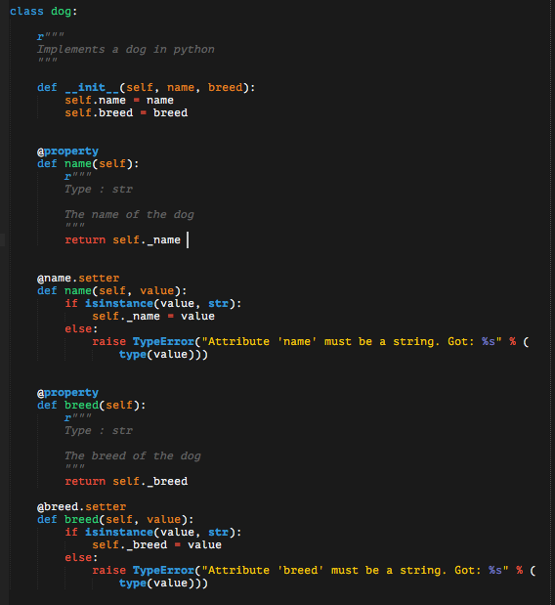
Dogs in Python
Error-handling of attributes requires property and setter functions
self._property is a conventional way of storing self.property under the hood, protected by error-handling
This throws a TypeError whenever the user tries to set name or breed to something other than a str
Notes:
Note verbally here that @property, @name.setter, and @breed.setter are called decorators, and that we’ll see some more of them in a second. You can make your own decorators but that’s a bit outside the scope of the bootcamp.

Slide 10
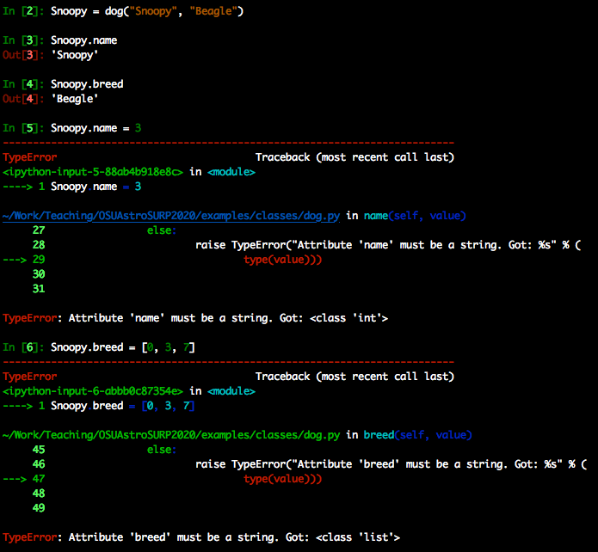
Dogs in Python
Error-handling of attributes requires property and setter functions
self._property is a conventional way of storing self.property under the hood, protected by error-handling
This throws a TypeError whenever the user tries to set name or breed to something other than a str

Slide 11
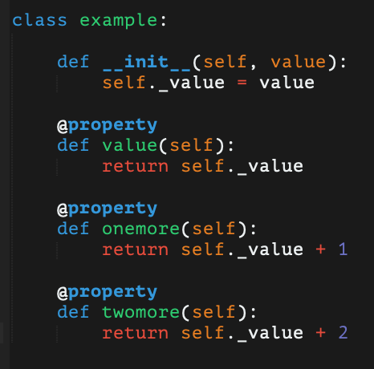
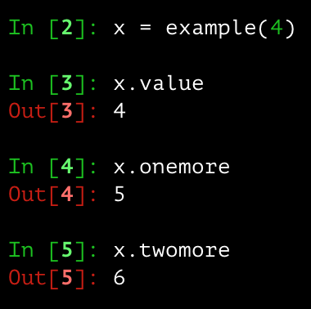
A Quick Note: Property vs. Stored Data
Important: the name of a property is NOT related to the variables stored as data by a class
The connection between obj.x and obj._x is purely for readability – if a value stored under the hood may be of use to the user, it is simply convention to use x and _x
In this example, the values of certain properties are calculated “on the fly” based only one value actually stored as internal data
The @property decorator removes the need for parentheses
Notes:
We’ll get back to doggos in just a second.

Slide 12
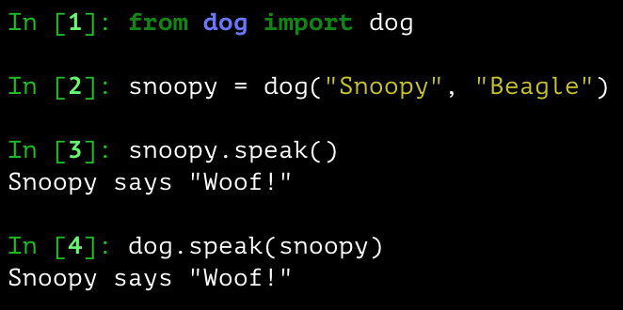

Dogs in Python
Classes can have functions too. These functions can have any number of subroutines, just like other functions, and can access properties and other functions via self
The interpretation of self: refers to the instance of the class (x.func() is the same as classname.func(x)). On line 4 here, I’ve passed snoopy to dog.speak as self.
Notes:
Note: self is not a python keyword. It is standard convention to use self to refer to the instance of the class (i.e. the object), but it must be the first argument.
The nomenclature here is enlightening – the keyword class is used because a class implements a “class of objects.” class dog doesn’t represent a single dog, but dogs in the abstract sense, and snoopy is an instance of dog because he is only one dog.

Slide 13
Static Methods
Functions which are bound to the class and not the object of the class
Can’t access or modify the class
Implemented as part of a class because it makes sense to do so
Created with the @staticmethod decorator

Slide 14
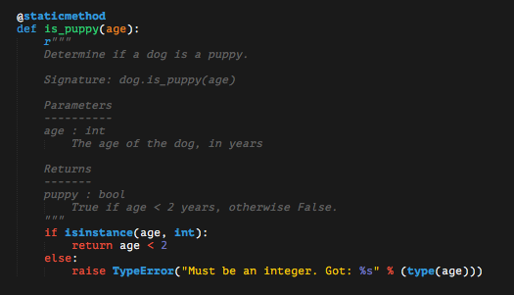
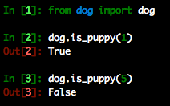
Dogs in Python
An example static method: is_puppy to determine if a dog is a puppy or not.
Do not take self as an argument, and are called with the name of the class
Notes:
The key difference between static methods and class methods is that static methods don’t interact with a single instance (i.e. they don’t take self as an argument).

Slide 15
Class Methods
Like static methods, are bound to the class rather than objects of the class
Can access and modify class state, unlike static methods
Return an instance of the class (i.e. an object)
Created with the @classmethod decorator

Slide 16
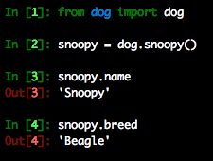
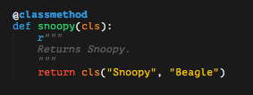
Dogs in Python
An example class method: create Snoopy
They take the class as the first argument (cls)
Notes:
The key difference between static methods and class methods is that static methods don’t interact with a single instance.

Slide 17
Syntactic Sugar
A line of code which is interpreted the same as another, but is more readable
You’ve been using it all along, you just didn’t know it
To implement syntactic sugar, you as the programmer write functions with specific names often referred to as “magic methods”

Slide 18
Syntactic Sugar
Can be used to emulate array-like indexing, item assignment, calling, and more
There are many other forms of syntactic sugar – here is a reference on many of the magic methods you can implement: https://www.tutorialsteacher.com/python/magic-methods-in-python
With Syntactic Sugar | Without Syntactic Sugar
x[0] | x.__getitem__(0)
x(0) | x.__call__(0)
x[0] = 1 | x.__setitem__(0, 1)
str(x) | x.__str__() and x.__repr__()
Notes:
Note verbally that there are TWO trailing and leading underscores, four in total

Slide 19
Example Usage of Syntactic Sugar: Polynomials
Goals:
Properties: coefficients and the order of the polynomial
Indexing – index i should return the i’th coefficient
Calling – f(x) should evaluate the polynomial at the value of x
Item Assignment – f[i] = a should assign the i’th coefficient to the value of a
A string representation
Note: This object is scripted at examples/mypkg/mathlib/polynomial.py in the git repository

Slide 20
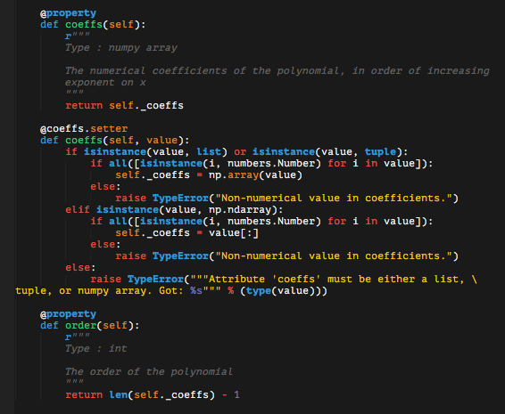
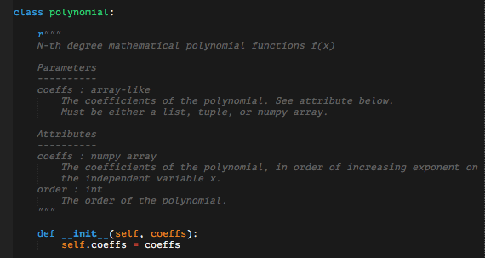
A Polynomial Object
The first pieces of the implementation: the __init__ function and the properties
Notes:
Note verbally that the coeffs.setter function is a good example of production-level code

Slide 21
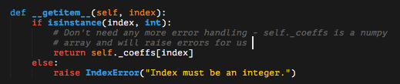

A Polynomial Object
Indexing – requires __getitem__ function, which takes the index as a parameter
Calling – requires __call__ function, which takes any number of parameters
Here it should be a value x to evaluate the polynomial at
Notes:
Note verbally here that when developers speak of ”callable objects” they’re not just referring to functions. This also includes classes with a __call__ function.

Slide 22
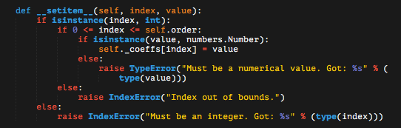
A Polynomial Object
Item assignment – requires __setitem__ function, which takes the index and the value to assign, in that order.

Slide 23
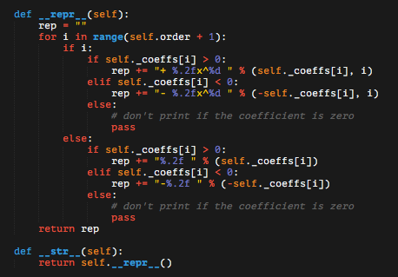
A Polynomial Object
A string representation – requires __str__ and __repr__ functions, which do slightly different things.
__str__ is called when you type-cast to a string
__repr__ is called when you run a line with just the object in ipython or a notebook
Notes:
Note verbally that this definition of __str__ is actually not necessary – by default it returns self.__repr__(), but included here as an example

Slide 24
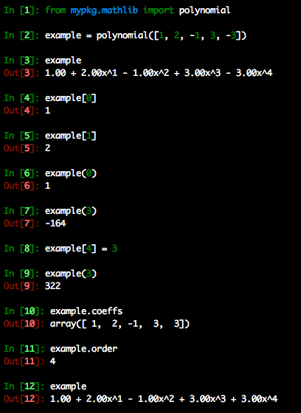
A Polynomial Object
In action – the example has all of these features because of the magic methods implemented in the polynomial class
This is essentially a reimplementation of NumPy’s poly1d object

Slide 25
Emulating Numeric Types
Another application of syntactic sugar
There is also __rsub__ for -=,
__rmul__ for *=, __rdiv__ for /=, etc., but unless otherwise specified these lines will call the corresponding function without the r in the name.
With Syntactic Sugar | Without Syntactic Sugar
x + y | x.__add__(y)
x += y | x.__radd__(y)
x - y | x.__sub__(y)
x * y | x.__mul__(y)
x / y | x.__div__(y)
x // y | x.__floordiv__(y)
x % y | x.__mod__(y)

Slide 26
Emulating Numeric Types: A Polynomial
Extend the polynomial object to allow addition, subtraction, and equivalence comparison with other polynomials
Some extra useful syntactic sugar elements in doing so:
With Syntactic Sugar | Without Syntactic Sugar
+x | x.__pos__()
-x | x.__neg__()
x == y | x.__eq__(y)
x != y | x.__ne__(y)

Slide 27

Emulating Numeric Types: A Polynomial
Unary +: The same as the original polynomial
Unary -: Each coefficient is the negative of the original
Magic methods can return anything, hence the need to specifically create a polynomial object. They don’t call __init__ automatically, so in theory you can have them do whatever you want. Why isn’t this required for __pos__?

Slide 28
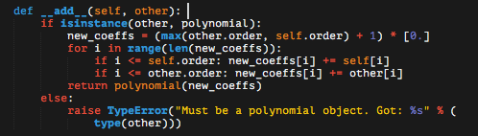
Emulating Numeric Types: A Polynomial
Adding polynomials: The coefficients of each power on x add

Slide 29
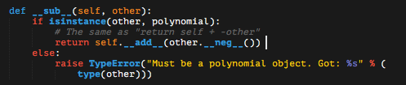
Emulating Numeric Types: A Polynomial
Subtracting polynomials: Use what we’ve already written to add the negative

Slide 30
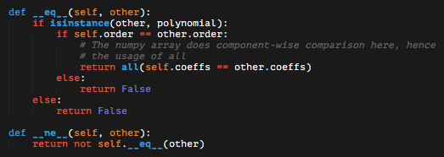
Emulating Numeric Types: A Polynomial
Equivalence comparison: If two polynomials have the same coefficients, say that they are equal to one another
Note: This __ne__ method actually isn’t necessary. If you write an __eq__ method, the __ne__ method takes on this default form. Advice: If you ever override that, you should have a good reason for doing so.

Slide 31
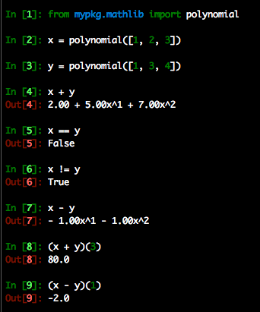
Emulating Numeric Types: A Polynomial
In action – x and y have all of these features because of the magic methods we implemented
Features like this are also included in NumPy’s poly1d object

Slide 32
Recall: Lists vs. Arrays
If it wasn’t already, it should now be fairly clear what we mean when we say lists and arrays are different objects.
They are instances of different classes with different source code.

