Slide 1
Inheritance & Composition
SURP 2022 Python Bootcamp
Ohio State Astronomy
Slides by: James W. Johnson

Slide 2
What Are They?
Inheritance
An object is based on another object, is a special type of that object, or is some kind of extension of it
Subclasses “inherit” functionality from their parent class, which may have its own parent class
Composition
An object contains other objects, is made of them, and may not have meaning without them

Slide 3
Inheritance
A classic example: Pets (the implementation of this is left for an exercise)
Features shared by all pets should be implemented in the pet base class. Those shared by all cats but not dogs in the cat class. These features will be automatically included in all subclasses (a.k.a. derived classes).
pet
cat
dog
bengal
siamese
spaniel
shepherd

Slide 4
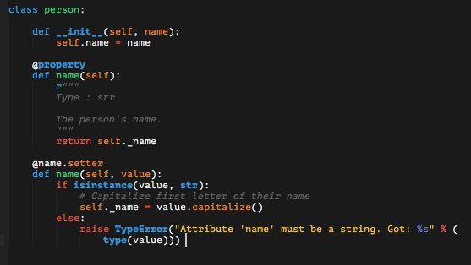
Inheritance: Students and Professors
First: A base class
You need something to inherit from
Both can inherit from a base class person storing the data any person would have (e.g. their name).
So far this is all material from last session.

Slide 5
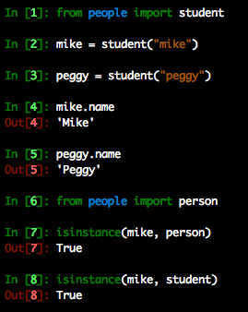

Inheritance: Students and Professors
Next: A derived class
The derived class needs to call its parent class’s __init__ function, and inheritance is accomplished.
Here student objects have a property name which is inherited from the person object.
Notes:
These classes are included in the bootcamp material under examples/classes/people.py. Note verbally that these import statements will only work if you’re running python from within that directory (the ins and outs of import statements were covered in session 3).

Slide 6
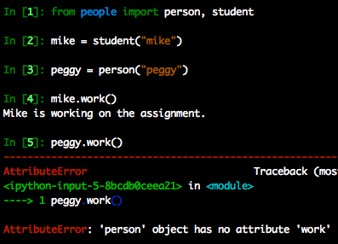
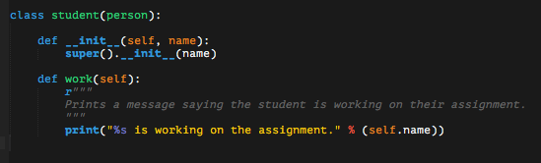
Inheritance: Students and Professors
Next: A derived class
The derived class can have properties, functions, etc. that is unique to that derived class.

Slide 7
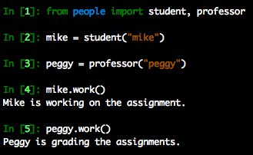
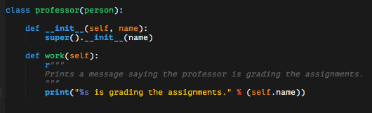
Inheritance: Students and Professors
Next: Another derived class
A different derived class can have a function with the same name executing a different task.

Slide 8
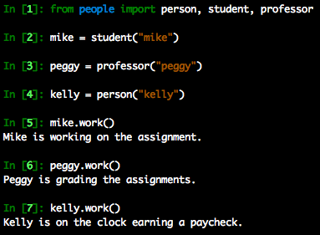
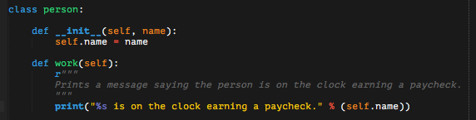
Inheritance: Students and Professors
The derived classes can also override inherited functions or properties.
This can be used to create objects which share data and do different things when you call the same function.

Slide 9
Inheritance: Subclassing Built-Ins
Built-in data types can be subclassed too!
The __init__ functions of built-in types usually accept *args and **kwargs as parameters
Immutable types will require overriding __new__ as opposed to __init__
This includes int, float, bool, string, tuple, and range
In practice you’ll only override __new__ in rare, specific instances
We’ll see an example of this in a few slides
Sometimes inheriting built-in features can be very powerful

Slide 10
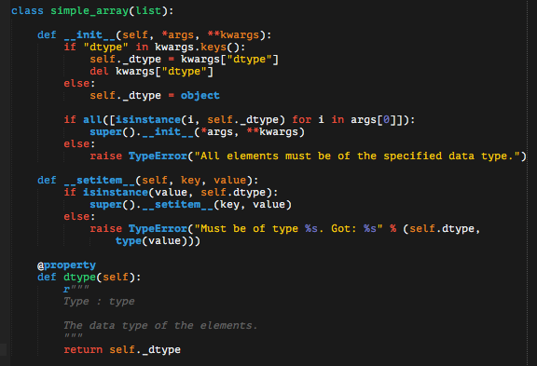
Inheritance: Subclassing Built-Ins
Example: subclass list to make a simple array
Arrays differ from lists in that all elements must be of the same type.

Slide 11
Inheritance: Subclassing Built-Ins
In the example, a TypeError is raised by __init__ if not all elements are of the specified dtype.
Then override the inherited __setitem__ to only accept the specified dtype.
Note the reappearance of super – it can be used anywhere to refer to an inherited class or function.
Notes:
In case anyone hasn’t seen it yet, del is a keyword which means delete.

Slide 12
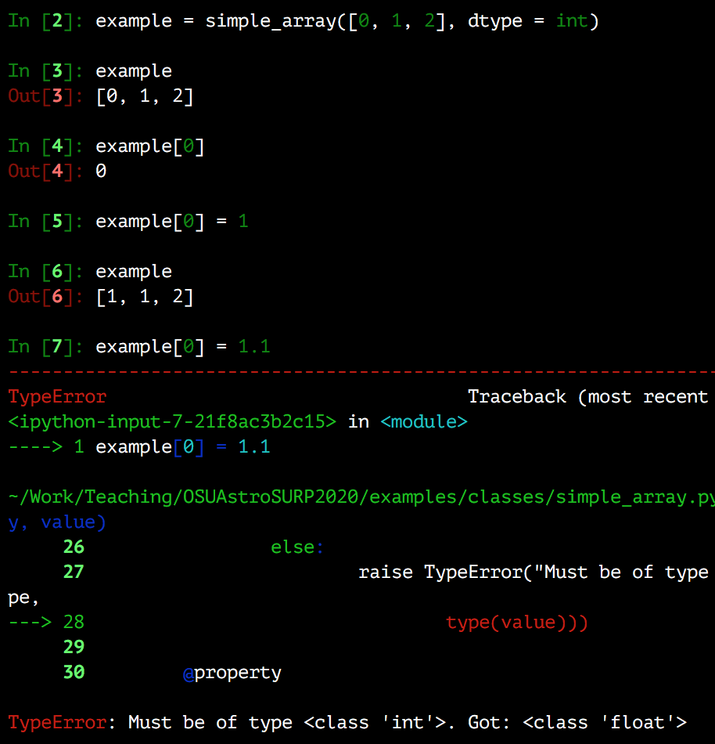
Inheritance: Subclassing Built-Ins
All of the features and behavior of the list are inherited, with the modification that this only allows integers

Slide 13
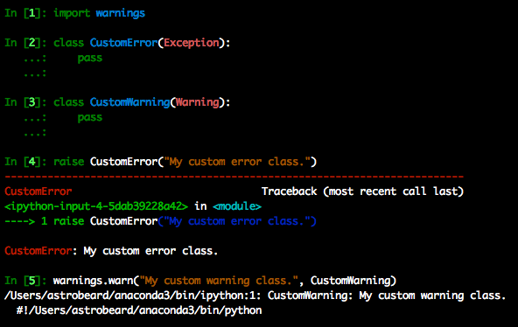
This Includes Exceptions and Warnings
You can create your own Exception and Warning classes by subclassing these built-in types
Unless you want to do something special, this only requires two lines
Notes:
Say verbally that you can do this simply because even the __init__ function can be inherited. If you’re just going to “def __init__(self): super().__init__()” then you don’t even need to write that.

Slide 14
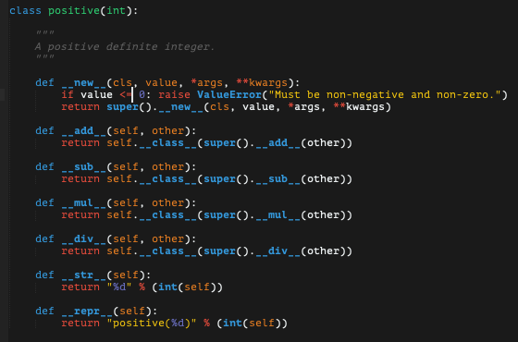
Inheritance: Subclassing Built-Ins
Sub-classing immutable types requires over-riding __new__ rather than __init__ (example: positive int)
__new__ vs. __init__:
__init__ must return None ; __new__ must return the object
cls versus self as first parameter
__new__ handles creation of the class ; __init__ handles initialization
__new__ can be used to return instances of entirely different classes if need be
Notes:
Note verbally here that “self.__class__” is the same as saying “positive(…)” – it’s a way of invoking the class without having to type its actual name (what if the name changed?). This class is in the git repository under examples/classes/positive.py. Note verbally also that cls is the parameter taken by a classmethod. __new__ is like a classmethod in that it also returns an instance of the class.

Slide 15
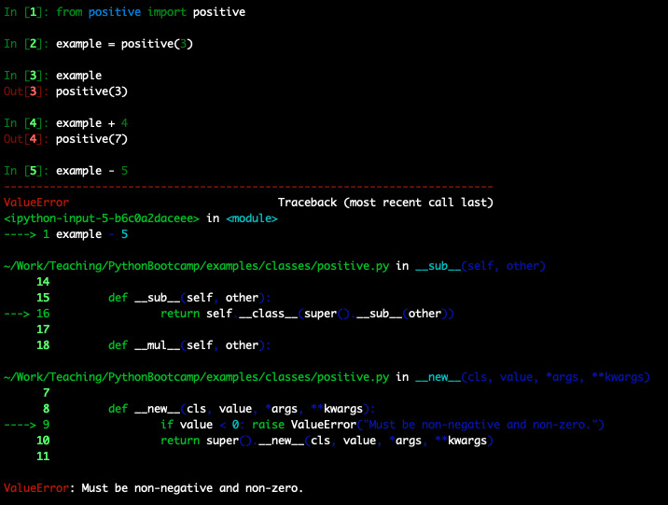
Inheritance: Subclassing Built-Ins
Sub-classing immutable types requires over-riding __new__ rather than __init__ (example: positive int)
__new__ vs. __init__:
__init__ must return None ; __new__ must return the object
cls versus self as first parameter
__new__ handles creation of the class ; __init__ handles initialization
__new__ can be used to return instances of entirely different classes if need be
Notes:
Note verbally here that “self.__class__” is the same as saying “positive(…)” – it’s a way of invoking the class without having to type its actual name (what if the name changed?). This class is in the git repository under examples/classes/positive.py.
A good example of __new__ returning a different class is the multizone object in VICE returning a singlezone object when the number of zones is equal to one.

Slide 16
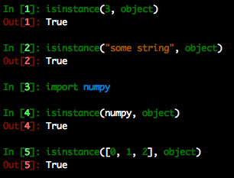
Recall: The Python Model
Everything is an object
At the end of the day, everything inherits from object
isinstance(x, object) will always return True

Slide 17
Composition
An astronomical example: A solar system
Components: star, planets, moons, asteroids, comets

Slide 18
Composition
An astronomical example: A solar system
Components: star, planets, moons, asteroids, comets
Solar System
Body
Satellite
Star
Planet
Moon
Asteroid
Comet
Planetary System

Slide 19
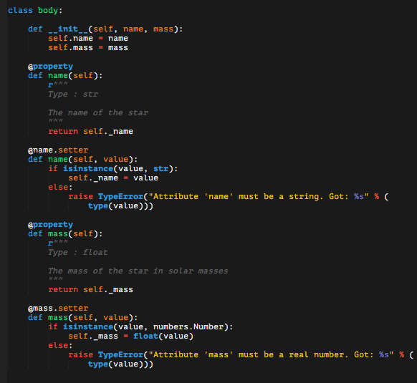
Composition: A Solar System
First pieces: the inheritance structure of the solar system bodies. All solar system bodies have a name and a mass, so we put those in the base class.

Slide 20

Composition: A Solar System
First pieces: the inheritance structure of the solar system bodies. All solar system bodies have a name and a mass, so we put those in the base class.
The star doesn’t need any more than this, so we can let it inherit everything – even the __init__ function.
Notes:
Recall that pass is a keyword which just means “do nothing.” The examples at the beginning of this set of slides didn’t actually need to do def __init__(self, name): super().__init__(name) - that was included just for demonstration purposes to introduce super.

Slide 21
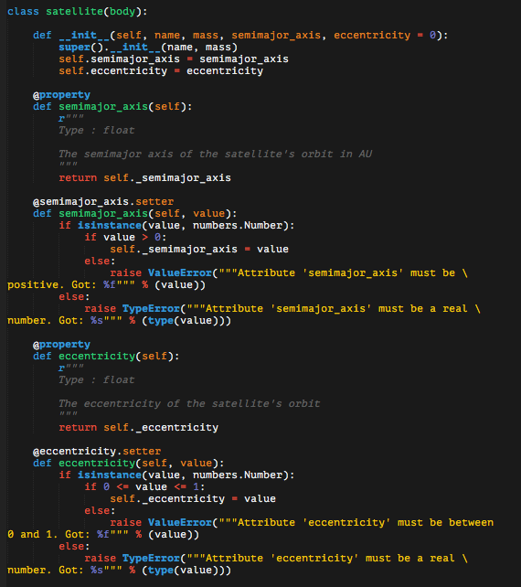
Composition: A Solar System
First pieces: the inheritance structure of the solar system bodies. All solar system bodies have a name and a mass, so we put those in the base class.
A satellite object also has a semi-major axis and an eccentricity.
Notes:
In case anyone hadn’t seen it up to this point, pass is a python keyword that just means “do nothing”

Slide 22
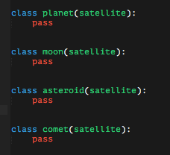
Composition: A Solar System
First pieces: the inheritance structure of the solar system bodies. All solar system bodies have a name and a mass, so we put those in the base class.
A satellite object also has a semi-major axis and an eccentricity.
Planets, moons, asteroids, and comets don’t need any data beyond that.
Notes:
In case anyone hadn’t seen it up to this point, pass is a python keyword that just means “do nothing”

Slide 23
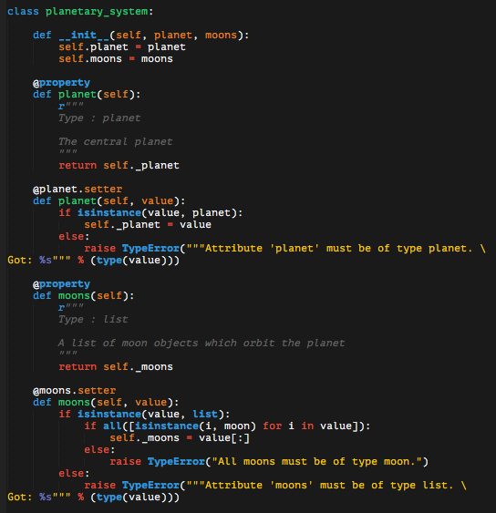
Composition: A Solar System
Next: A planetary system composed of a planet object and moons. This requires no new syntax – these can be properties of a new class.
Here the planet attribute is just the planet object, and the moons is a list of moon objects. Composition introduces no new syntax - it just refers to properties of a specific type.

Slide 24
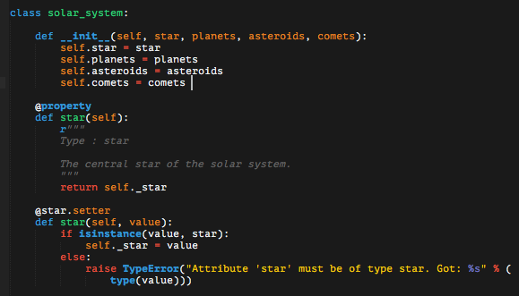
Composition: A Solar System
Next: A solar system object composed of a star, planetary system objects, asteroids, and comets.
Note: the __init__ function is calling setter functions not pictured here.

Slide 25
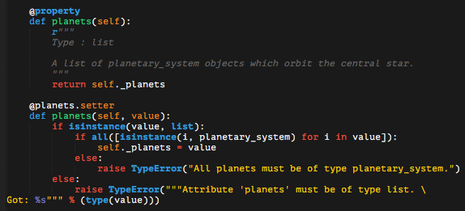
Composition: A Solar System
Next: A solar system object composed of a star, planetary system objects, asteroids, and comets.
The planets attribute is a list of planetary_system objects. The asteroids and comets properties proceed similarly.

Slide 26
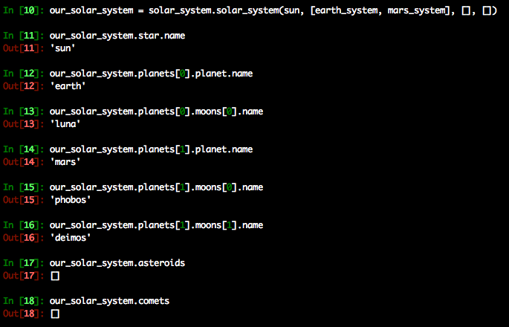
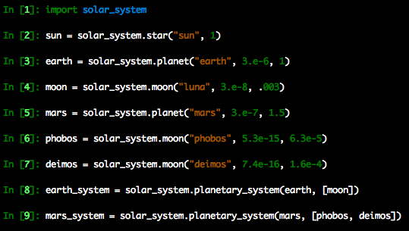
Composition: A Solar System
The planetary_system and the solar_system objects in action:
Notes:
Could give the sun the name “Sol,” but this is fine for a demonstration.

Slide 27
Composition vs. Aggregation
Composition differs in detail from aggregation – composition implies ownership whereas aggregation implies usage.
Consider a program with two objects: A and B
Composition: A “owns” B, and B is destroyed when A is destroyed
Aggregation: A “uses” B, and B is not destroyed when A is destroyed
Like composition, aggregation requires no syntax we haven’t already covered - the two are often confused. A real-world example would be ammunition in a first-person shooter video game – in some games it’s dropped when you have to re-spawn and another player can pick it up
Notes:
This is worth noting because folks who engineer their code will likely run across this caveat.

