Slide 1
File I/O
SURP 2022 Python Bootcamp
Ohio State Astronomy
Slides by: James W. Johnson

Slide 2
Objectives
An example of how to write to a text file with standard library
An example of reading that same text file with standard library
How NumPy simplifies things

Slide 3
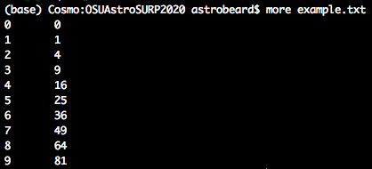
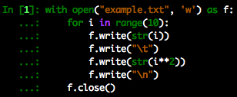
An Example Output File
Write the integers 0 through 9 and their squares separated by tabs, with each integer-square pair on separate lines
Note: file I/O is typically done with a with statement – this functionally is the same as using f = open(“example.txt”, ‘w’)

Slide 4

An Example Output File: A Better Code
Makes use of string formatting: %d allows integers to be substituted in their place
There are many ways to format string in python: The %-style notation will look familiar if you have experience with C/C++
https://docs.python.org/3.10/library/string.html

Slide 5
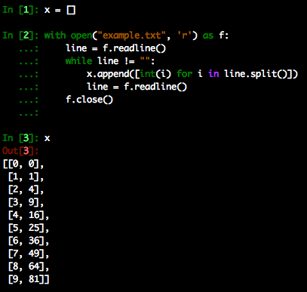
An Example Input File
Read in the same file and store it in a 2D-list
Note: Some argue that append is a bad idea when lists are large, but others argue that the performance issues that arose are largely resolved

Slide 6
A Much Simpler Approach
File I/O is made easy with NumPy’s genfromtxt, savetxt, etc. functions
These functions read and write 1-D and 2-D data to files.
Caveat: The data must be square. Chances are you’ll get non-square data at some point
In the previous example, the entire with block can be replaced by:
import numpy as np
x = np.genfromtxt(“example.txt”)
(Note however this returns a NumPy array, not a list)
Notes:
We will cover more on NumPy and Anaconda in the next session!

