Slide 1
Basic Software Engineering
SURP 2022 Python Bootcamp
Ohio State Astronomy
Slides by: James W. Johnson

Slide 2
Software Engineering
The application of the principles of engineering to software development.
All of the usual principles apply
Making efficient use of resources
Extensions of existing features
Testing of individual components
Maintenance
Why care if you’re an astronomer? If you build anything substantially large, these principles can save you not just headaches but migraines.
Notes:
Software engineering is defined as: The application of the principles of engineering to software development. These principles include: making efficient use of resources, extensions of existing features, testing the individual components and maintenance of the code you write. So, why care if you’re an astronomer? Well, what we do is complicated so the code we write is complicated. Applying these principles to the code you write will save you headaches and migraines later on. Engineering code based upon these principles will create good habits in the long run. Also, as a side note when we say engineering code, we also mean organizing it, they mean essentially the same thing. Additionally, when we talk about ‘substantially large’ codes, we don’t just mean production-level ones like who Python packages. Any code that you look at and think ‘huh maybe I should organize this a little’ is substantially large code, whether it’s for a research project or class or an entire Python package.
Note here that engineering code and organizing code are more or less the same thing. Substantially large will generally apply to research project code bases as well, not just production-level code.

Slide 3
DRY: Don’t Repeat Yourself
You should never write the same code twice within the same application.
Always assume that every software component you write (no matter how well it performs) is wrong or bugged in some subtle, nuanced way
When you find a bug, you want to be able to fix it once and have that change propagate through the entire code base
Caveat: Some choose to break this rule for software written in a modular manner – that is, if each component of your software is implemented independently of the other components. In this case DRY applies within the individual modules.
Notes:
The first principle that you should familiarize yourself with in terms of organizing or engineering code is DRY: Don’t Repeat Yourself. The basic idea in this is that you should never write the same code twice within the independent software. And in any piece of code you write, whether it’s a function, file, or an entire application, you should always assume that it is bugged in some subtle, nuanced way that’s not necessarily apparent to you at that moment. We don’t know the bugs we’re going to find in the future within our code. Therefore, the idea behind don’t repeat yourself is that you want to make the correction in one piece of code and then have that correction propagate throughout your entire code. That way, you’re not spending time correcting the same mistake several different times within one piece of code. The caveat to this is that some python packages are written in a modular manner, meaning that every component is implemented independently of the other components. Some people will break this rule across modules, meaning they won’t use the same line of code within one module but might repeat it in other modules. A lot of research scientists, including astronomers, will just tell you to copy and paste code often times and make small changes to it. Don’t do that!!! It breaks the DRY rule.
Specifically address the “oh just copy and paste it!” that seemingly every astronomer says about writing code. Give them the example that in the entire ~76,000 line code base of VICE, the 1-dimensional linear interpolation function is written *once*.

Slide 4
No Ifs, Ands, or Buts
When describing the function fulfilled by a method, object, file, etc. you should be able to state it in a simple, declarative manner with no ifs, ands, or buts.
If you can’t state it without an if, and, or but, then you need to split up that function/object/file/whatever it is into more than one component.
This is a mnemonic for “every component should do exactly one thing.”
Notes:
Another good rule of thumb is the pneumonic: No Ifs, Ands or Buts. This basically means that each line of code that you write should do exactly one thing, no ifs, ands or buts. If you can’t describe what a file, function, class or just piece of code in general in one simple, declarative statement without an if and or but, you should split it into more than one component. You should be able to say “this file does BLANK”, “this class does BLANK”, etc. It helps to know simply what each piece of code’s purpose is and greatly helps with organization. If everything you write has one simple purpose, it becomes easier to move things around to where they need to go. This rule of thumb can be broken if the phrase can be re-stated without an if, and, or but. For example “fitting a line” and “determining the slope and intercept” are really the same thing and ideally wouldn’t be separated even though the second version has an “and.”

Slide 5
Version Control
Cataloging of previous copies of a software’s source code
Popular tools: GitHub, Bitbucket
Command line: git
Keeps track of all previous changes to your code base for you
The standard for public codes is to use the 3-digit system (e.g. 1.2.1, 2.3.0)
First is for back-compatibility, second is for new features, third is for bug-fixes
You don’t need to use GitHub/Bitbucket for version control – you can also store your code, plots, etc. there to manage copies between multiple systems.
I also use it to share my research notes and plots with collaborators.
Notes:
If you need it, version control is great for managing large code bases. Version control is basically cataloging previous versions of a software’s source code. Tools like Github and Bitbucket were made for this kind of thing. You can access these repositories of code, from platforms like Github, with the command line git. And these tools allow you to keep track of all the previous changes in your code in one easily-accessible place. The standard for identifying versions of code is by using the 3-digit system, for example the latest version of Python is: 3.10.4. The first number is for back-compatibility, basically meaning any version with the same first number can be used together while if one version has a different first number (like Python 2), then it will be incompatible with any code running on Python 3. The second number just indicates new features were added to this version of the code and the third number is for bug-fixes between versions. Sometimes, you may run into files and codes with the names “v2”/”v3”/”v4” etc appended on the end of their names. When you see codes with names like that, it’s like a giant banner broadcasting that whoever wrote it has no knowledge of version control. Version control is not the only thing you can do with Github and you certainly don’t have to use it for just that. It’s also a great collaborative tool to share your research code and plots with other scientists or team members.

Slide 6

GitHub
First and foremost: file-sharing system
Keeps a catalog of the changes to your code over time, making it a great tool for version control for developers
For astronomers:
Share with collaborators
Manage files between multiple computers
Terminal: git [add, commit, pull, push, …]
Their website will show you how to set up a repository
Notes:
It is first and foremost a file-sharing system, but as mentioned previously a great version control tool for developers. For astronomers: Github is not only a good way to share code and plots between collaborators but also to manage files from multiple different computers. As graduate students, we have AT MINIMUM a desktop computer in our office and then our own laptops as well. Using Github, you can access your code from either of those computers whether you’re at home or school. Using the git command lines, you can upload changes that you’ve made to code from one computer onto Github and then pull these changes directly onto another computer to work from there as well. It acts almost like a Google drive, except for your codes and provides a much needed back-up when your computer crashes and you lose all of the code you worked so hard on. Their website will also show you how to set up a repository where you can upload and change your code using the git command lines. BitBucket works on the same principle and for those of you who cloned the source material for this bootcamp, you can run git pull and it will automatically download all of the updates we’ve made since you first cloned it. Overall, Github is a really useful and life-saving tool and astronomers use it on a daily basis for almost all of their code.
Same principles apply for BitBucket. Those who cloned the source material for this bootcamp can change into the directory they have it stored at, run git pull, and it should automatically download all of the updates since they first cloned it.

Slide 7
Minimization of Dependencies
If the code base for your software uses another, external software (e.g. NumPy), that is called a dependency (your code depends on NumPy).
It’s quite common to have a ~few dependencies, but too many is problematic.
As of now my own python package (VICE) is ~90k lines of code. If one of its dependencies releases a new version with changes that affect my code, I have to go look at every file to ensure this doesn’t break anything.
Advice: Don’t be afraid to write the small but challenging stuff yourself.
Notes:
This applies much more to people releasing code publicly, but can be a source of errors if you share code with close colleagues too.

Slide 8
Testing
Well-written software implements unit tests
A means of assigning Success/Failure/Skipped messages to the smallest possible components of a code base
When you make a future change to your code base, this gives you an automated means of finding out if your change broke anything you weren’t expecting to break.
This is as simple as actually saving the code you write to test a new component of your software, and the same for when you resolve an issue.
Notes:
If you’re going to release code publicly, unit tests should be viewed as a requirement, although no one enforces this.

Slide 9
Think Before You Write
Many scientists just start writing functions when posed with a problem
This has its place and its usefulness within research
If you’re going to use some function >few times, I advise more thought
If you’re going to be spending even as much as five minutes writing a given file, stop and ask yourself: What objects might be useful? What functions might be useful?
There are many ways to write the same program, so don’t always settle for the first idea that comes into your head. You can usually improve upon the first thing that comes to mind.
Notes:
Professional software engineers don’t start in the text editor/IDE – they know how they’re going to solve the problem and test their implementation before they even write a single line.

Slide 10
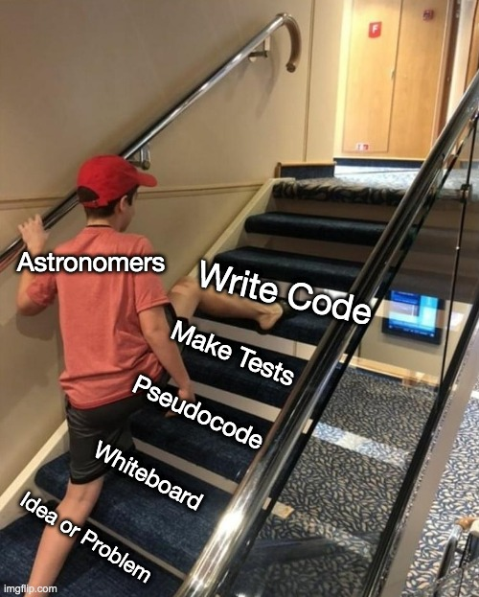
Think Before You Write
This is how professional developers and software engineers view scientist-written code
Notes:
Professional software engineers don’t start in the text editor/IDE – they know how they’re going to solve the problem and test their implementation before they even write a single line.

Slide 11
Rule Number One
Code is read much more often than it is written.
Advice: Assume this applies to all of the code you will ever write
Emphasize readability above all else. It’s okay to break any of these rules if the result is a much more readable solution.
Bottom line: Well-written code is clear, verbose, and does not cut corners.
Viewing code as a mere means to an end solves zero problems while causing many. That line is usually crossed long before a public release, and the solution is knowing how to engineer your code.
Notes:
If you don’t know about their coding background, you should always take code advice from a research scientist with a grain of salt. Being early career researchers, most of the participants of this bootcamp are in the perfect position to make the decision about what kind of code they’re going to write now, but if they choose to be the one who writes good clean code, that’s a decision they have to actively pursue. We live and breathe through our code, so it can only help you to just be organized and clear with your workflow.

