Slide 1
Multiple Inheritance
SURP 2021 Python Bootcamp
Ohio State Astronomy
Slides by: James W. Johnson

Slide 2
What is it?
When an object inherits functionality from more than one base class
Examples
Making a piece-wise callable object out of other callable objects
“gradstudent” object out of the “student” and “professor” classes from last session

Slide 3
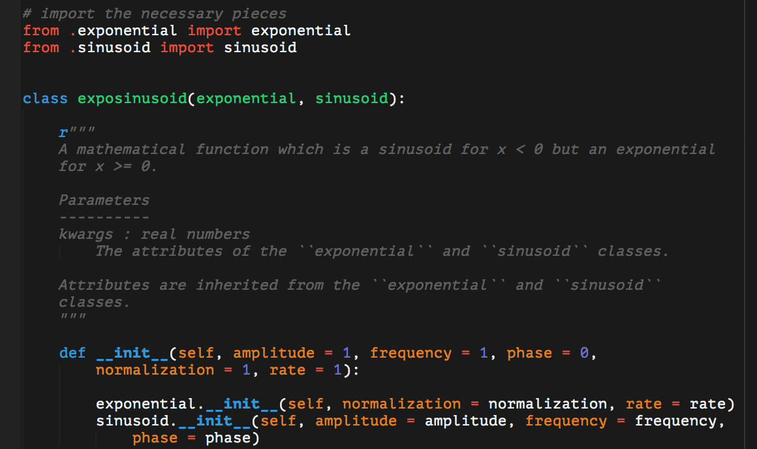
The Basic Syntax
Where previously you’d put the name of the one base class you want to inherit from, add all additional base classes.
The primary difference is that this usually breaks super().__init__(…)

Slide 4
The Basic Syntax
The primary difference is that this usually breaks super().__init__(…)
We’ll come back to this
x.function(y) is the same as classname.function(x, y), so use this construction to call the __init__ function passing self as an argument.

Slide 5
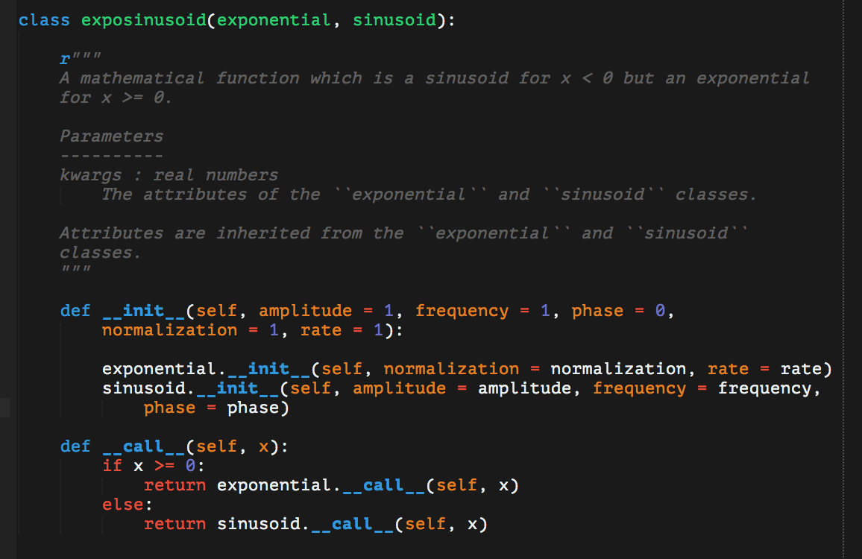
The Basic Syntax
x.function(y) is the same as classname.function(x, y), so use this construction to call the __init__ function passing self as an argument.
The same construction can be used to write the __call__ function!
Notes:
Other such examples include adding the values from the __call__ functions, multiplying them, subtracting, dividing, whatever you need!

Slide 6
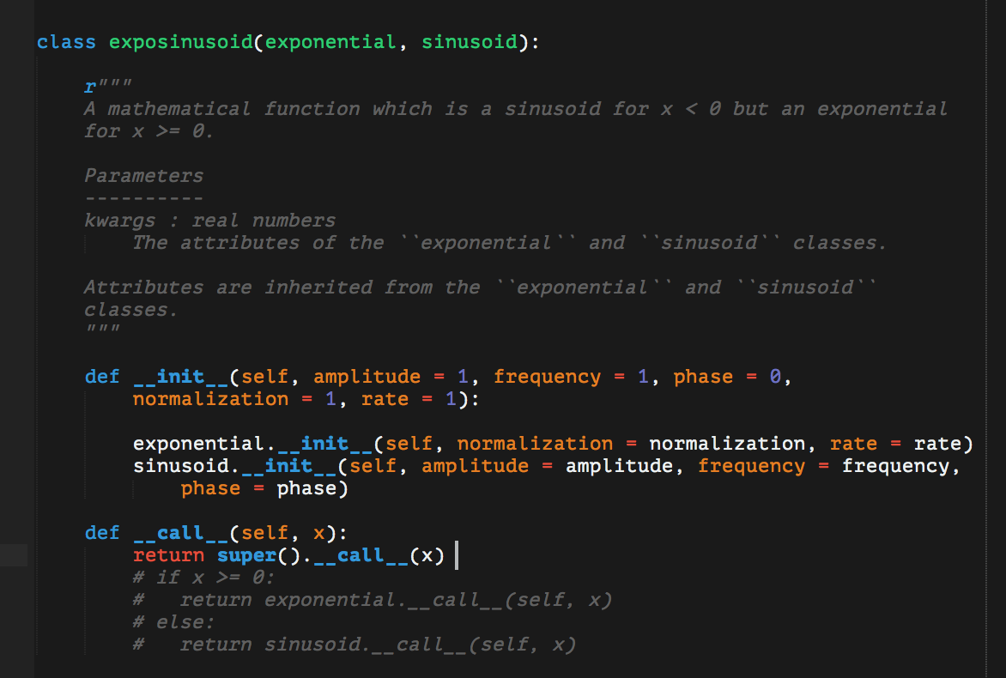
The Method Resolution Order
The MRO is the reason super() may not always do what you want when using multiple inheritance
To see this in action, let’s deliberately bug the code and insert super() to see what happens

Slide 7
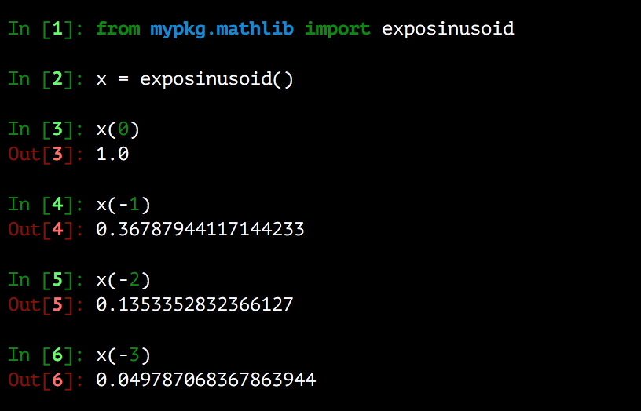
The Method Resolution Order
The MRO is the reason super() may not always do what you want when using multiple inheritance
To see this in action, let’s deliberately bug the code and insert super() to see what happens
It’s just calling exponential for values of x where it should be calling sinusoid

Slide 8
The Method Resolution Order
The MRO is the reason super() may not always do what you want when using multiple inheritance
When you call super(), Python looks at the first base class, then the second, then the third, etc. until it finds the function with the specified name.

Slide 9
The Method Resolution Order
When you call super(), Python looks at the first base class, then the second, then the third, etc. until it finds the function with the specified name.
By reversing the order of exponential and sinusoid in the class declaration, the code would find sinusoid.__call__ instead of exponential.__call__.

Slide 10
The Method Resolution Order
By reversing the order of exponential and sinusoid in the class declaration, the code would find sinusoid.__call__ instead of exponential.__call__.
Advice: super() sacrifices readability when using multiple inheritance, so it’s best to specify which base class you want to pull from.

