Slide 1


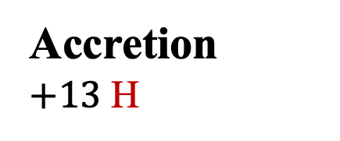

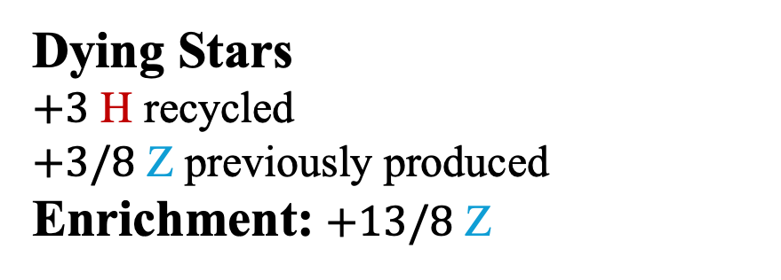
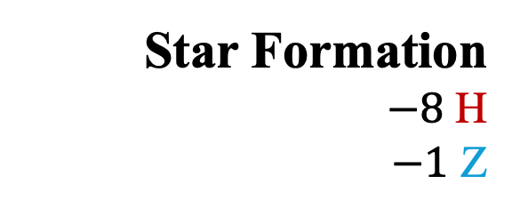
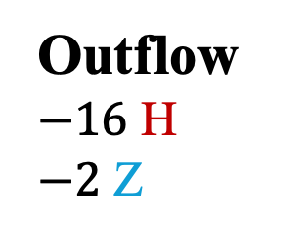
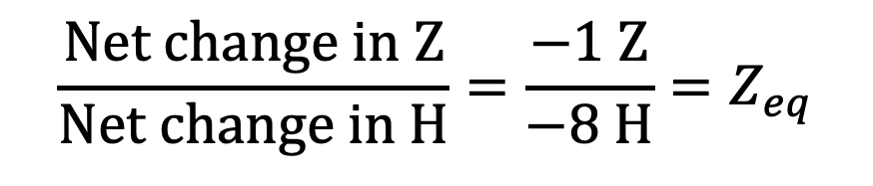
$$\frac{Net change in Z}{Net change in H}=\frac{−1 Z}{−8 H}=Z_{eq}$$
Outflow
$−16$ H
$−2$ Z
Accretion
$+13$ H
Z_{ISM} = 1:8
Z_{ISM} = 1:8
$$t→t+Δt$$
Star Formation
$−8$ H
$−1$ Z
Dying Stars
$+3$ H recycled
$+3/8$ Z previously produced
Enrichment: $+13/8$ Z

Slide 2
H
H
H
Z
H
H
H
H
H

Slide 3
H

Slide 4
H
H
H
Z
H
H
H
H
H

