Slide 1
Contract Testing

Slide 2
Contract tests assert that inter-applications messages conform to a shared understanding that is documented in a contract
Notes:
Contract testing ensures that a pair of applications will work correctly together to ensure the messages each application sends or receives conform to a shared understanding that is documented in a "contract".
In Contract testing we check each application in isolation

Slide 3
Consumer
Provider
What endpoints can be used?
What input do the endpoints take?
What does the output look like?
Notes:
There are two main types of actors in contract testing, Providers and Consumers. The Provider is an application responsible for publishing an API; a Consumer of the Provider is another application consuming the API.
For example, a consumer can be a client that wants to receive some data and a provider an API that provides the data the client needs.

Slide 4
Why Contract Testing?
Helps Providers make changes without fearing accidentally breaking their Consumers
Lets Consumers know that the APIs they consume won’t suddenly break
Allows Consumers to develop against API definitions before the Provider API has been developed
Makes integrating and testing a service in a microservice landscape easier
Serves as an efficient communication tool between Provider and Consumer teams
Notes:
One approach when testing communication with external services is to use TestDoubles. This is to circumvent issues with unreliable networks, slowness of the tests
But testing against a double always raises the question of whether the double is indeed an accurate representation of the external service, and what happens if the external service changes its contract?
A good way to deal with this is to run your own tests against the double, but to periodically run a separate set of contract tests that checks all the calls against your test doubles return the same results as a call to the external service would. A failure in any of these contract tests implies you need to update your test doubles, and probably your code to take into account the service contract change.
These tests need not be run as part of your regular deployment pipeline. Your regular pipeline is based on the rhythm of changes to your code, but these tests need to be based on the rhythm of changes to the external service. Often running just once a day is plenty.
A failure in a contract test shouldn't necessarily break the build in the same way that a normal test failure would. It should, however, trigger a task to get things consistent again. This may involve updating the tests and code to bring them back into consistency with the external service. Just as likely it will trigger a conversation with the keepers of the external service to talk about the change and alert them to how their changes are affecting other applications.

Slide 5
Consumer Driven
Provider Driven
Notes:
If it’s consumer-driven, then the Consumers define their expectations and the Provider checks that they’re fulfilled; if it’s provider-driven, then the Provider defines the contract, and Consumers check that they’re compatible with it.

Slide 6
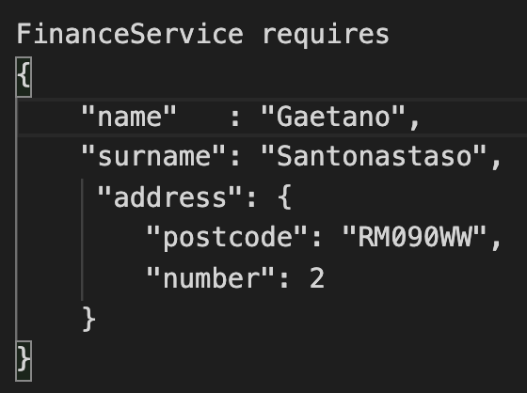
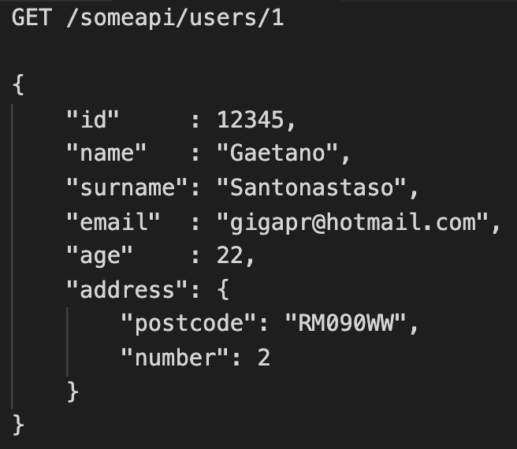
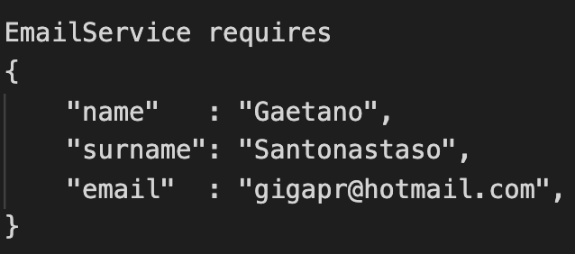

Slide 7
Consumer Driven Contracts
In Consumer-Driven Contracts, each consumer captures their expectations of the provider in a separate contract
Notes:
Consumer-driven contract testing is a way to formalize these expectations into a contract between each Consumer-Provider pair. Once this contract is established, contract testing ensures, automatically, that the contract doesn’t break unexpectedly.
To reduce the chances of unexpected breaks in contracts, it's useful to move to a Consumer Driven Contracts
In Consumer-Driven Contracts, each consumer captures their expectations of the provider in a separate contract. All of these contracts are shared with the provider so they gain insight into the obligations they must fulfill for each individual client. The provider can create a test suite to validate these obligations. This lets them stay agile and make changes that do not affect any consumer, and pinpoint consumers that will be affected by a required change for deeper planning and discussion.
Contract testing can be thought of as testing (and therefore guaranteeing) the communication layer between services.
Contract testing tests that any pair of dependent services can properly send and decode messages between each other, but doesn’t test the services’ internal logic. As such, contract testing exists somewhere on the boundary between integration testing and end-to-end testing.

Slide 8
Pact
https://github.com/pact-foundation
pact-ruby
pact-php
pact-net
pact-js
pact-go
pact-jvm
…….
Notes:
It is possible to use CDCs without having a framework however there are some great ones available which help you get up and running quickly.

Slide 9
Consumer Perspective
Notes:
From a consumer perspective Pact acts as a mock HTTP server. The team that owns the consumer write a set of tests which exercise their code against the mock server and set up expected results from the provider.
Pact records these request/response pairs and uses them to generate a contract. The contract consists of the requests sent by the consumer and the required responses from the provider.

Slide 10
Provider Perspective

Slide 11
Demo

