Slide 1
Availability ----------------- Data
Notes:
We want to investigate the impact that software design decisions have on availability and data.
For this we’re going to try to analyse an application that allows to display posts from friends, similar to what facebook does
For simplicity when we talk about service we consider it as unit (service + DB)

Slide 2
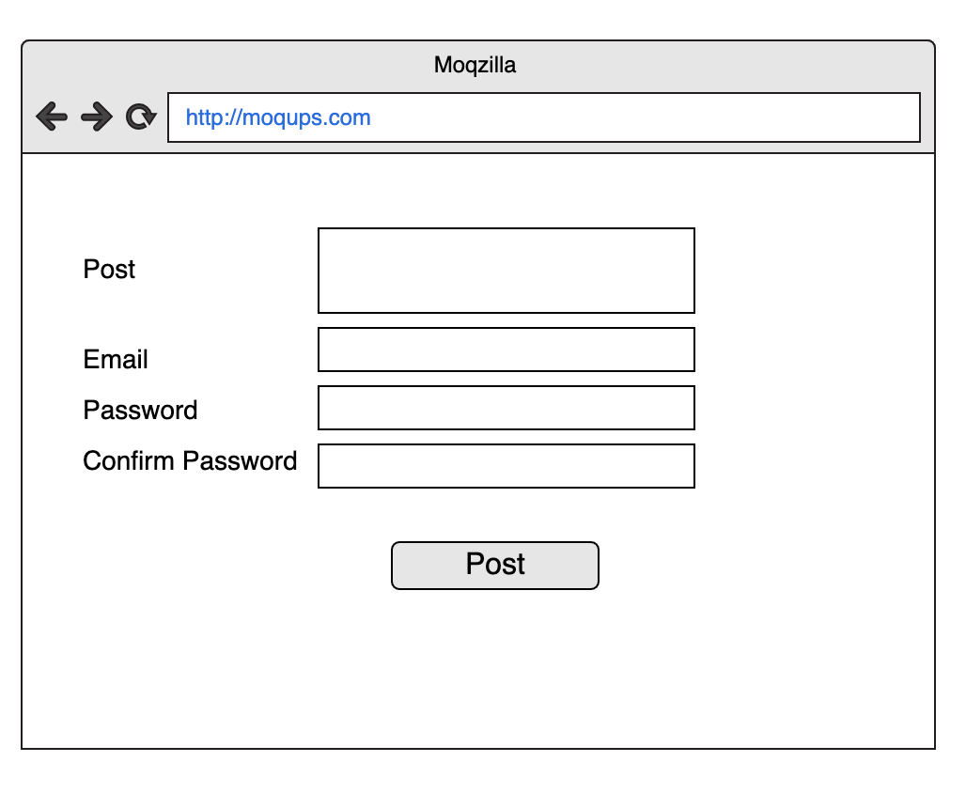
THE PROBLEM
….something like Facebook

Slide 3
Data

Slide 4
Availability
Availability means the probability that a system is operational at a given time, i.e. the amount of time a device is actually operating as the percentage of total time it should be operating
……
Availability features allow the system to stay operational even when faults do occur.
…..
Availability is typically given as a percentage of the time a system is expected to be available, e.g., 99.999 percent ("five nines").
From Wikipedia https://en.wikipedia.org/wiki/Reliability,_availability_and_serviceability
Notes:
A highly available system would disable the malfunctioning portion and continue operating at a reduced capacity. In contrast, a less capable system
might crash and become totally nonoperational.
99.999% ("five nines")5.26 downtime per year

Slide 5
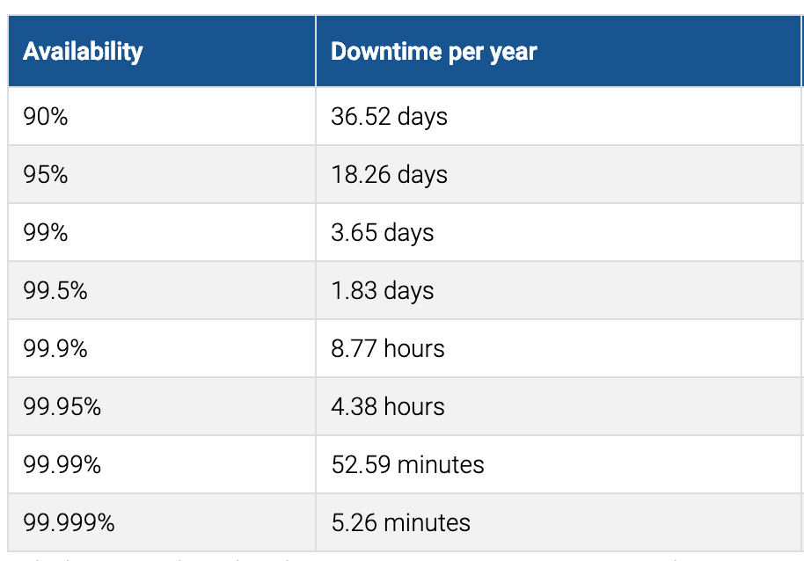
availability

Slide 6



Once upon a time
Notes:
Big ball of mud
Scaling
single development stack
It’s difficult to achieve operational agility in the repeated deployment of monolithic application artifacts
Availability – the system is either up or down

Slide 7
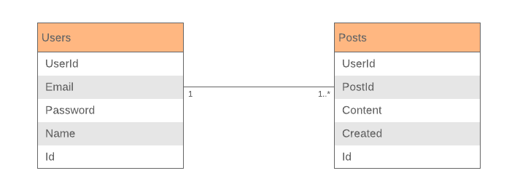
Monolith Data

Slide 8
Monolith Data
ACID Transactions
Atomicity – Changes are made atomically
Consistency – The state of the database is always consistent
Isolation – Even though transactions are executed concurrently it appears they are executed serially
Durability – Once a transaction has committed it is not undone
Notes:
A monolithic application typically has a single relational database. A key benefit of using a relational database is that your application can use ACID transactions, which provide some important guarantees:
.
Atomicity
Transactions are often composed of multiple statements. Atomicityguarantees that each transaction is treated as a single "unit", which either succeeds completely, or fails completely: if any of the statements constituting a transaction fails to complete, the entire transaction fails and the database is left unchanged. An atomic system must guarantee atomicity in each and every situation, including power failures, errors and crashes.
Consistency[edit]
Consistency ensures that a transaction can only bring the database from one valid state to another, maintaining database invariants: any data written to the database must be valid according to all defined rules, including constraints, cascades, triggers, and any combination thereof. This prevents database corruption by an illegal transaction, but does not guarantee that a transaction is correct.
Isolation
Transactions are often executed concurrently (e.g., reading and writing to multiple tables at the same time). Isolation ensures that concurrent execution of transactions leaves the database in the same state that would have been obtained if the transactions were executed sequentially. Isolation is the main goal of concurrency control; depending on the method used, the effects of an incomplete transaction might not even be visible to other transactions.
Durability
Durability guarantees that once a transaction has been committed, it will remain committed even in the case of a system failure (e.g., power outage or crash). This usually means that completed transactions (or their effects) are recorded in non-volatile memory.

Slide 9
Monolith Availability
Up
Down

Slide 10
microservices
POST
POST
Users Service
UI
Write Service
POST
Posts Service
Notes:
https://www.nginx.com/blog/event-driven-data-management-microservices/
A monolithic application typically has a single relational database. A key benefit of using a relational database is that your application can use ACID transactions, which provide some important guarantees:
Atomicity – Changes are made atomically
Consistency – The state of the database is always consistent
Isolation – Even though transactions are executed concurrently it appears they are executed serially
Durability – Once a transaction has committed it is not undone
As a result, your application can simply begin a transaction, change (insert, update, and delete) multiple rows, and commit the transaction.
Besides You can easily write a query that combines data from multiple tables.
A partitioned, polyglot‑persistent architecture for data storage has many benefits, including loosely coupled services and better performance and scalability. However, it does introduce some distributed data management challenges.
The first challenge is how to implement business transactions that maintain consistency across multiple services. To see why this is a problem, let’s take a look at an example of an online B2B store. The Customer Service maintains information about customers, including their credit lines. The Order Service manages orders and must verify that a new order doesn’t exceed the customer’s credit limit. In the monolithic version of this application, the Order Service can simply use an ACID transaction to check the available credit and create the order.
Database vendors long ago recognized the need for partitioning databases and introduced a technique known as 2PC (two-phase commit) for providing ACID guarantees across multiple database instances. The protocol is broken into two phases:
First, the transaction coordinator asks each database involved to precommit the operation and indicate whether commit is possible. If all databases agree the commit can proceed, then phase 2 begins.
The transaction coordinator asks each database to commit the data.

Slide 11
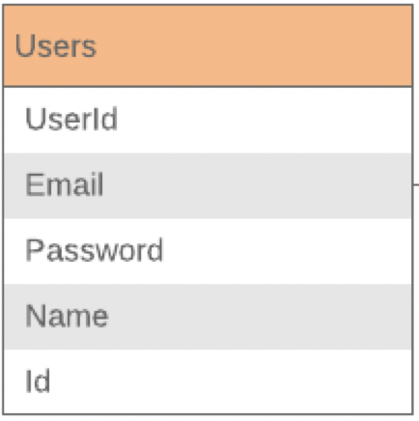
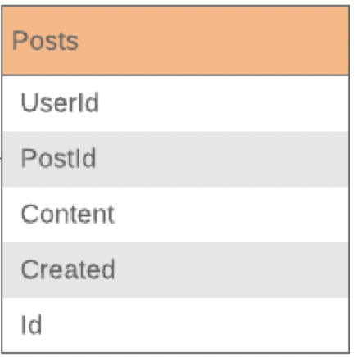
What about availability?
GET
GET
Users Service
UI
Read Service
GET
Posts Service

Slide 12
Availability
UI
Read Service
Users
Service
Posts
Service

Slide 13
System availability
System Availability is calculated by modelling the system as an interconnection of parts in series and parallel. The following rules are used to decide if components should be placed in series or parallel:
If failure of a part leads to the combination becoming inoperable, the two parts are considered to be operating in series
If failure of a part leads to the other part taking over the operations of the failed part, the two parts are considered to be operating in parallel.
https://www.eventhelix.com/RealtimeMantra/FaultHandling/system_reliability_availability.htm

Slide 14
Availability
99.99%
98.99%
Users Service
UI
Read Service
99%
Posts Service

Slide 15
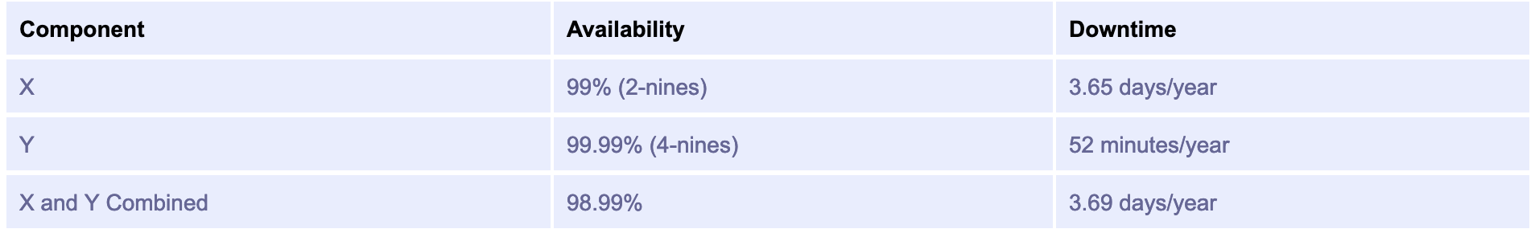
availability
How…..(99X99.99) : 100

Slide 16
Stale data
GET
GET
Users Service
UI
Read Service
GET
Posts Service

Slide 17
The Naïve approach
POST/ Event
GET
Users Service
UI
Read Service
POST/ Event
Posts Service

Slide 18
Requests
UI
Read Service
Users
Service
Posts
Service

Slide 19
A better approach
BUS
Publish
GET
Users Service
Subscribe
UI
Read Service
Publish
Posts Service
Notes:
An event‑driven architecture has several benefits and drawbacks. It enables the implementation of transactions that span multiple services and provide eventual consistency. Another benefit is that it also enables an application to maintain materialized views. One drawback is that the programming model is more complex than when using ACID transactions. Often you must implement compensating transactions to recover from application‑level failures; for example, you must cancel an order if the credit check fails. Also, applications must deal with inconsistent data. That is because changes made by in‑flight transactions are visible. The application can also see inconsistencies if it reads from a materialized view that is not yet updated. Another drawback is that subscribers must detect and ignore duplicate events.

Slide 20
Requests
UI
Read Service
Bus
Users
Service
Posts
Service

Slide 21
Distributed Data Management
BUS
Subscribe
POST
Users Service
Publish
UI
Write Service
Subscribe
Posts Service
Notes:
https://www.nginx.com/blog/event-driven-data-management-microservices/
A monolithic application typically has a single relational database. A key benefit of using a relational database is that your application can use ACID transactions, which provide some important guarantees:
Atomicity – Changes are made atomically
Consistency – The state of the database is always consistent
Isolation – Even though transactions are executed concurrently it appears they are executed serially
Durability – Once a transaction has committed it is not undone
As a result, your application can simply begin a transaction, change (insert, update, and delete) multiple rows, and commit the transaction.
Besides You can easily write a query that combines data from multiple tables.
A partitioned, polyglot‑persistent architecture for data storage has many benefits, including loosely coupled services and better performance and scalability. However, it does introduce some distributed data management challenges.
The first challenge is how to implement business transactions that maintain consistency across multiple services. To see why this is a problem, let’s take a look at an example of an online B2B store. The Customer Service maintains information about customers, including their credit lines. The Order Service manages orders and must verify that a new order doesn’t exceed the customer’s credit limit. In the monolithic version of this application, the Order Service can simply use an ACID transaction to check the available credit and create the order.
An event‑driven architecture has several benefits and drawbacks. It enables the implementation of transactions that span multiple services and provide eventual consistency. Another benefit is that it also enables an application to maintain materialized views. One drawback is that the programming model is more complex than when using ACID transactions. Often you must implement compensating transactions to recover from application‑level failures; for example, you must cancel an order if the credit check fails. Also, applications must deal with inconsistent data. That is because changes made by in‑flight transactions are visible. The application can also see inconsistencies if it reads from a materialized view that is not yet updated. Another drawback is that subscribers must detect and ignore duplicate events.
Database vendors long ago recognized the need for partitioning databases and introduced a technique known as 2PC (two-phase commit) for providing ACID guarantees across multiple database instances. The protocol is broken into two phases:
First, the transaction coordinator asks each database involved to precommit the operation and indicate whether commit is possible. If all databases agree the commit can proceed, then phase 2 begins.
The transaction coordinator asks each database to commit the data.

Slide 22
Another approach
Events Store
Subscribe
Subscribe
Publish
GET
UI
Read Service
Users Service
Subscribe
Publish
Posts Service

Slide 23

To conclude
Fallacies of distributed computing
The network is reliable
Latency is zero
Bandwidth is infinite
The network is secure
Topology doesn't change
There is one administrator
Transport cost is zero
The network is homogeneous
Notes:
Is monolith what we need to do? Certainly not but when designing distributed systems failure has to be our first classs citizen

Slide 24
Feedback please

