Slide 1
Remote Controllers for the Raspberry Pi

Slide 2


8BitDo Controllers
Both 8BitDo controllers work with the C++ and python libraries
Pastel Green controller is USB-dongle controller
Gray SN30 is Bluetooth controlled
Can get joystick floating point values from them but the values can be chaotic

Slide 3
Code that works with 8BitDo controllers
In \embedded\RaspberryPi\PiControllerBeagleBone there is a linux_controller.cpp file w/EightBitDoDualStickController class
Has callback functions such as on_up_cb, on_left_cb, on_left_stick_press_cb, etc that you can subscribe to
Uses on_left_stick and on_right_stick for analog floating point X,Y values
This will auto-SSH into the BeagleBone (assuming its connected to BB Wifi)
It then outputs to \tmp\robot.txt to control the BB (joes_robot_control needs to run)
In \embedded\RaspberryPi\GameControllerRobot\ there are various python methods of getting controller info

Slide 4
Setting up 8BitDo remote control
Power on Pi & BeagleBone blue
On Pi connect to BeagleBone’s WiFi
SSH into the BeagleBone and run joes_robot_control
ssh debian@192.168.8.1 (password blick77)
cd /embedded/librobotcontrol_arm/joes_robot_control/
sudo ./joes_robot_control
In another Pi terminal:
cd /embedded/RaspberryPi/PiControllerBeagleBone/
./pi_control_bb
8BitDo controls:
Left stick for movement
X & B to move turret
Y & A for camera servo

Slide 5
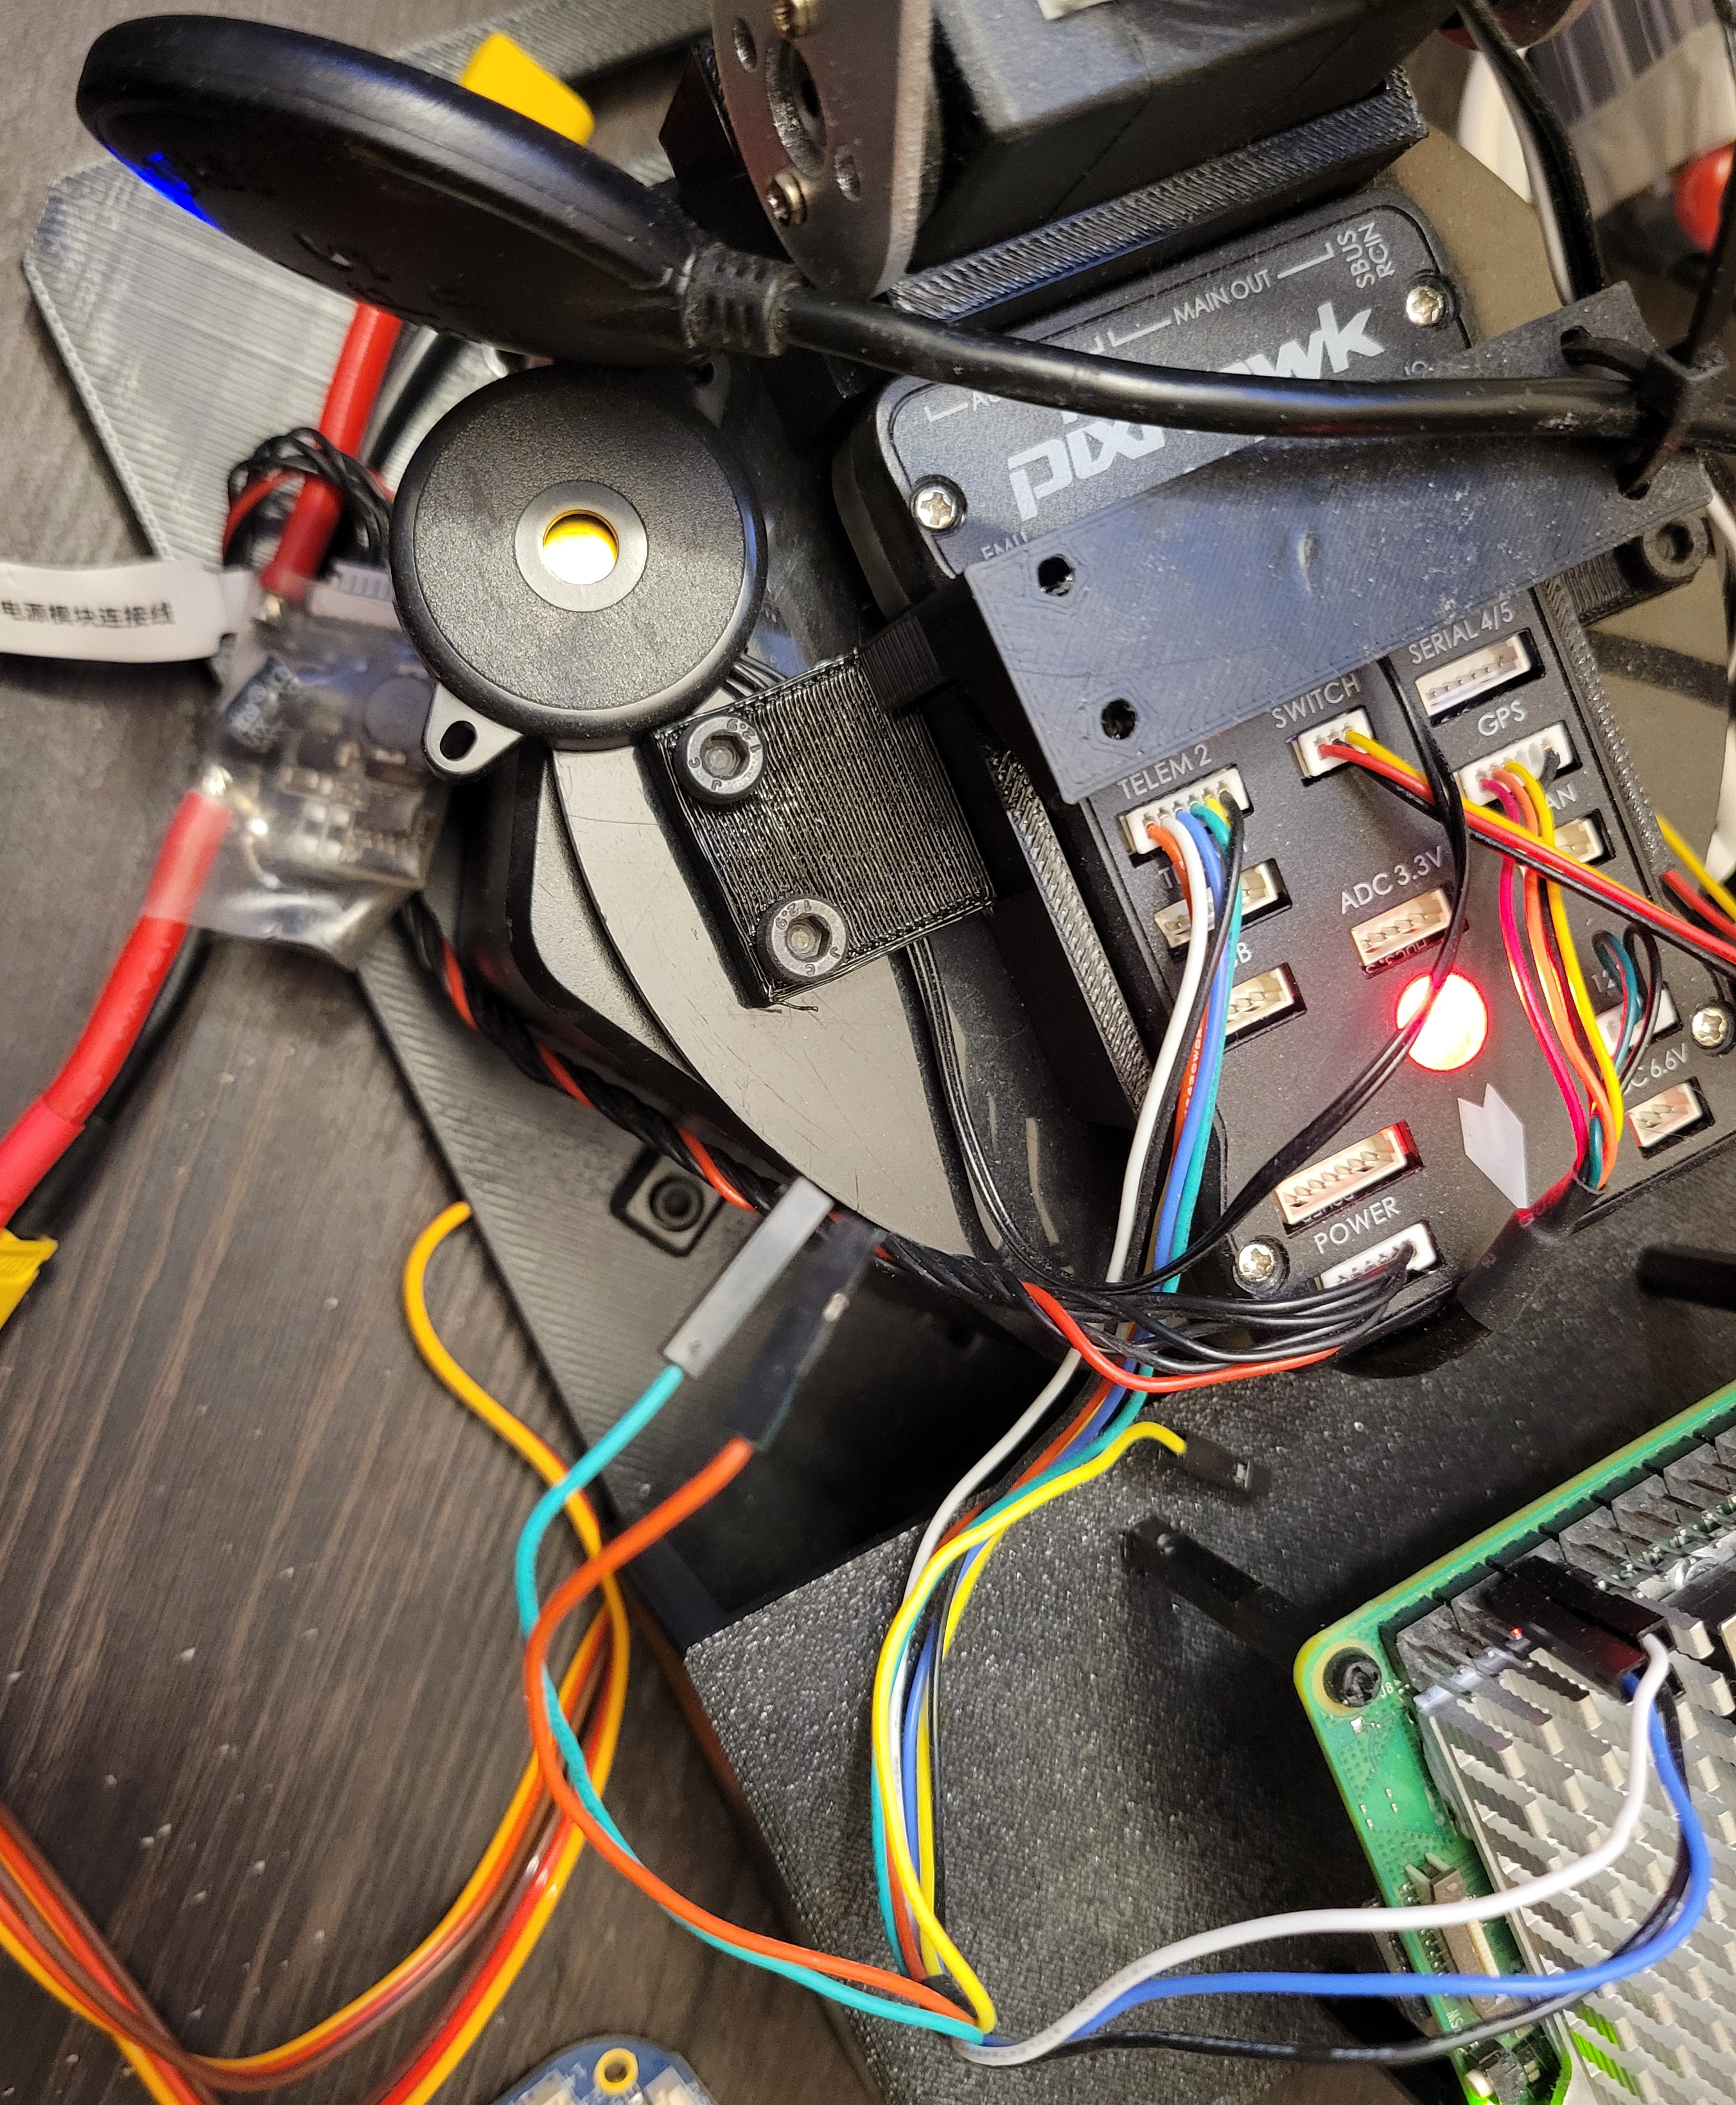
Connect to PixHawk the long-range option & more accurate control
Power is split off
from LiPo battery
with adapter
TELEM2 connection
to Pi pins

Slide 6
PixHawk Remote Controller
*Does the dronekit library give you the controller/slider position data??

Slide 7
Getting info from the PixHawk
DroneKit has code to get telemetry data from the PixHawk
\embedded\RaspberryPi\PixHawk\dronekit_joes\
*note the readme.txt that has some manual fixes that need to be applied to the library files! Library code is dated and needs small fixes.
Also can do it through mavproxy:
pip3 install mavproxy
mavproxy.py --master=/dev/ttyAMA0 --baudrate 57600
There is the MAVSDK-Python git repo that has some examples to run (after the mavproxy server is running)
*gives error, not sure this is working

