Slide 1
Raspberry Pi controlling devices

Slide 2
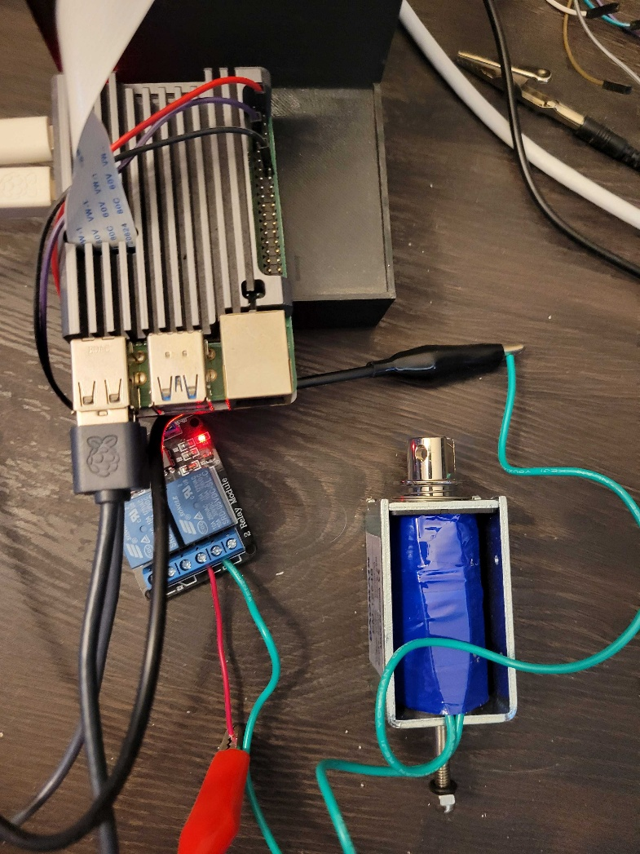
Solenoid
Only needs GPIO pin
and 5V power from Pi.
Power goes through solenoid
and out to 12V ground.
12V power comes from
power supply / battery.
LED only goes on when
solenoid is activated.
LED does NOT go on
just when it has power (either
the 5V power from the Pi or
the 12V power from battery/supply.

Slide 3
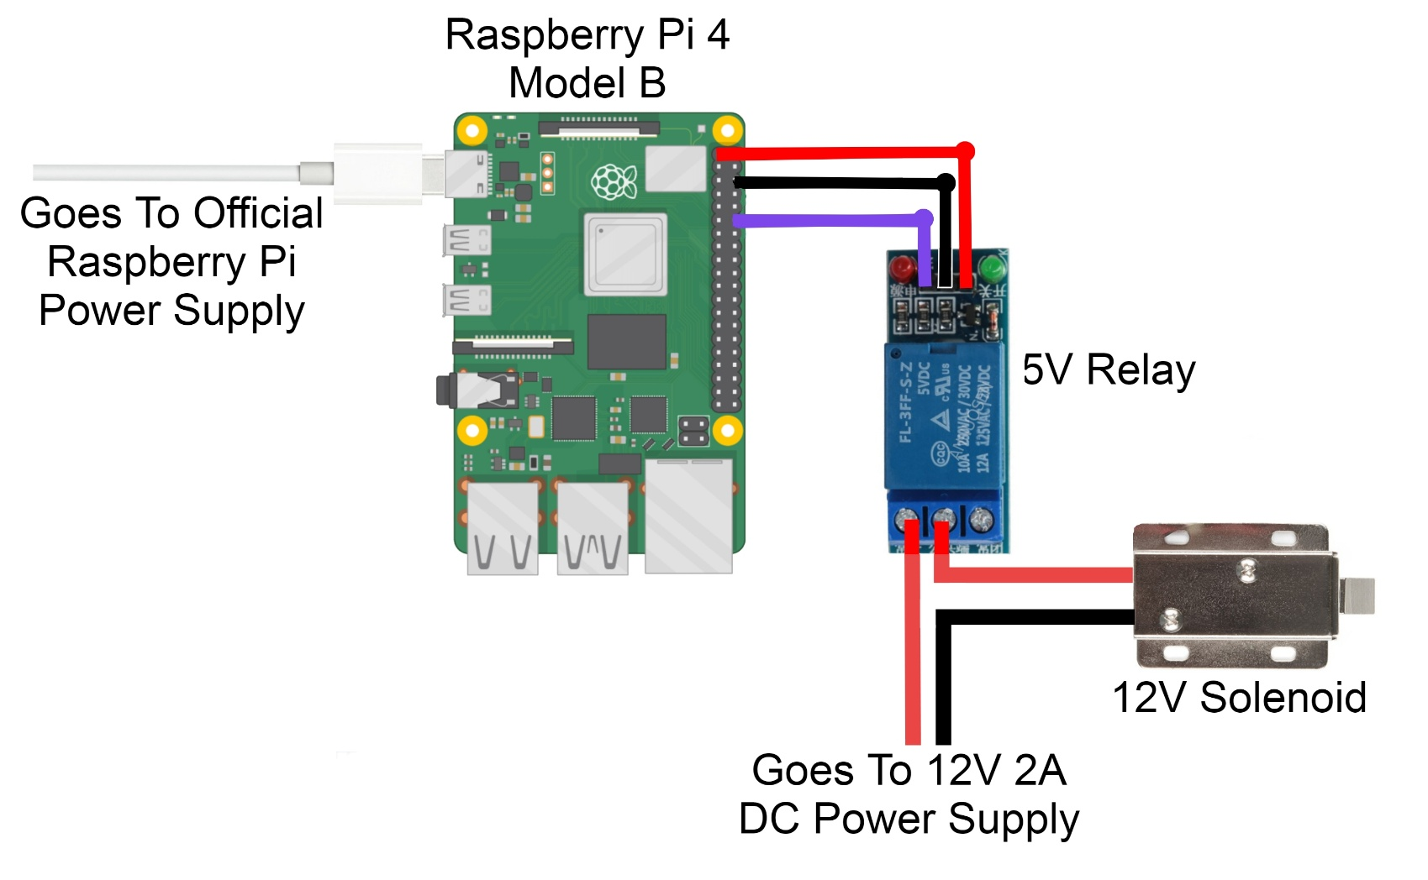
Solenoid – input pins may be regular or terminal blocks. The high power to the Solenoid are terminal blocks.
This end may have terminal blocks as well.
Pins determine whether it triggers on high 5V.

Slide 4
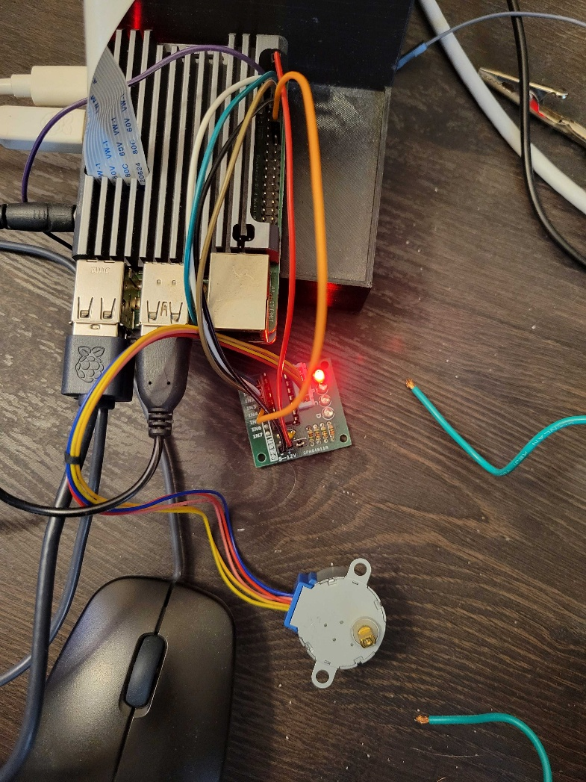
Cheap stepper motors can be controlled with ULN2003 driver boards
GPIOs 14,15,18,23 → IN1-4
Also needs 5V power
LEDs will alternate back-and-
forth when stepper
motor is moving.
LEDs off otherwise (even when powered).

Slide 5
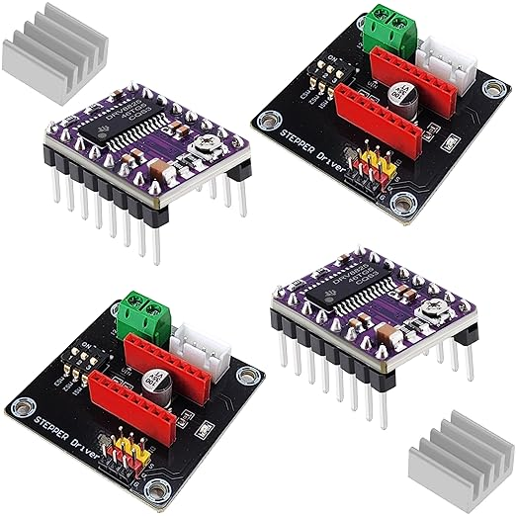
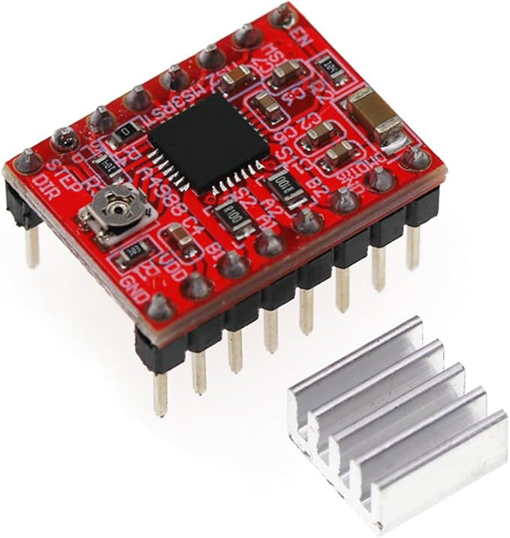
Bigger NEMA17 stepper motors must be controlled with A4988 or DRV8825 boards

